Slide 1

MINOR PROJECT:
COGNITIVE MUSIC RECOMMENDATION SYSTEM
UNDER THE GUIDENCE OF:
Mr. G Anil Kumar
(Associate Professor)
COMPUTER SCIENCE AND ENGINEERING
PRESENTED BY: (BATCH-6)
T. Chandradeep (21p61a0545)
B. Lakshmi Pranuthi (21p61a0526)
B. Sai Rushikesh Reddy(21p61a0538)

Slide 2
ABSTRACT:
Natural Language Processing: Utilizes NLP to understand user input and preferences.
Personalized Suggestions: Analyzes user preferences, moods, and listening behavior for tailored music recommendations.
Dynamic Adaptation: The system adjusts its recommendations in real time based on changing user inputs.
Sentiment Analysis: Uses sentiment analysis to gauge user emotions and improve recommendation relevance.
Keyword Recognition: Identifies keywords to better understand user preferences and context.

Slide 3
INTRODUCTION:
Web-Based Application
Personalized Recommendations (Based On Emotions)
Backend with Flask
Sentiment Analysis with BERT
Emotional States
Song Matching
Sentiment Scores and Keywords
Dynamic and Adaptive
Tailored Listening Experience

Slide 4
LITERATURE SURVEY :
TITLE | AUTHOR | SUMMARY | PROS | CONS | CONCLUSION
Music recommendation systems in music information retrieval: Leveraging machine learning and data mining techniques. | Yan Chen | The paper discusses how machine learning and data mining, especially collaborative filtering and hybrid methods, enhance music recommendation systems for personalized experiences on platforms like Spotify, etc. | Music recommendation systems enhance user satisfaction through highly personalized suggestions and facilitate the discovery of diverse tracks, including new and less popular songs. | Music recommendation systems can be resource-intensive, requiring significant computational power and extensive training data, which can increase costs and complexity. | The paper concludes that integrating machine learning and data mining techniques significantly enhances music recommendation systems, particularly through collaborative filtering and hybrid approaches.
The Contribution of Music Information Retrieval System Optimization to Music Analysis in the Context of Big Data | Yuefeng Du Junbo Yin | The system enables users to search for music within large datasets by analyzing specific features like rhythm and melody. | The system enhances music discovery by providing accurate recommendations based on detailed analysis of song features in large libraries. | The system may require significant computational resources for processing large datasets, its effectiveness depends on the quality of the music features extracted. | The music information retrieval system offers a powerful tool for discovering and organizing music in vast collections by leveraging feature analysis.
Comparative Analysis of Pretrained Audio Representations in Music Recommender Systems | Yan-Martin Tamm Anna Aljanaki | The model with the highest performance among the six pretrained music models will be used to recommend music effectively. | Using the highest-performing model for music recommendations can lead to more accurate and relevant song suggestions for listeners. | Focusing solely on the highest-performing model might miss out on valuable insights from other models that could work better in specific situations. | while the highest-performing pretrained model shows promise for music recommendations, it's important to consider the strengths of other models for diverse and effective suggestions.

Slide 5
Music Player Box | Akshay Kumar Maurya Vandana Abishek Kumar Abhinav Kumar | It aims to develop a versatile music player app that offers seamless playback, efficient organization, and a personalized experience for modern music enthusiasts. | The app will enhance user experience by providing seamless playback and efficient organization of music libraries. | Handling large music libraries may strain performance and require optimized algorithms. | The development of a comprehensive music player app offers significant benefits in enhancing user experience.
A Study of Sentiment Analysis: Concepts, Techniques, and Challenges | Dr Manjula Bairam R Lakshman Naik | This study examines sentiment analysis (SA), which analyzes online text to determine opinions as positive, negative, or neutral, and highlights its importance in various fields. | Sentiment analysis provides valuable insights into public opinions and trends, helping businesses and organizations make informed decisions. | Sentiment analysis can struggle with accurately interpreting nuances in language, such as sarcasm or cultural context, leading to misclassification of sentiments. | sentiment analysis offers valuable insights into public opinion and decision-making, yet it encounters limitations in accurately capturing language nuances.
Natural Language Processing: State of The Art, Current Trends and Challenges | Diksha Khurana Aditya Koli Kiran Khatter | Natural Language Processing (NLP) enables computers to understand and generate human language, with applications in areas like machine translation and information extraction. | NLP enhances user interaction with technology by allowing natural language communication, making complex tasks more accessible. | NLP often struggles with ambiguity and context, leading to misinterpretations and errors in understanding human language. | Natural Language Processing has made significant strides in enabling human-computer interaction, challenges like ambiguity and bias remain.
Mood Based Music Recommendation System | Alex Johnson David Kumar | This research presents a mood-based music recommendation system that utilizes VADER sentiment analysis to interpret user emotions from text inputs. | VADER sentiment analysis enables precise mood detection, allowing for highly personalized music recommendations. | The system primarily relies on sentiment scores, which may overlook contextual keywords and nuanced emotional expressions. | This study demonstrates that a mood-based music recommendation system using VADER can enhance personalization by aligning music choices with emotions.

Slide 6
RESEARCH GAP & CHALLENGES:
Contextual Understanding: VADER provides sentiment scores but lacks deeper contextual understanding.
Sentiment Ambiguity: Natural language can be ambiguous. Accurately determining mood from mixed or nuanced sentiments poses a significant challenge.
Data Quality and Preprocessing: Text data can be noisy and requires extensive preprocessing. Ensuring high-quality input for VADER analysis is crucial for accurate mood detection.
Real-Time Processing: Implementing mood-based recommendations in real time demands efficient algorithms that can process and analyze text quickly.
Integration with Existing Systems: Developing a mood-based recommendation system that seamlessly integrates with existing platforms (e.g., streaming services) presents technical challenges.

Slide 7
PROBLEM STATEMENT:
The Cognitive Music Recommendation System aims to address the user mood, emotional states, and cognitive patterns to recommend music that is both relavant and emotionally resonant.
The System will analyze user input, such as text(through sentimental analysis), pschycological data to generate personalized music recommendations that align with the user’s current cognitive state.

Slide 8
OBJECTIVES:
Implement Sentiment Analysis and Categorize Emotional States
Generate Music Recommendations Based on User Input
Ensure Dynamic Adaptation and Continuous Improvement

Slide 9
EXISTING SYSTEM:
Mood-Based Music Player
VADER Sentiment Analysis
User-Generated Text Analysis
Emotional State Categorization
Tailored Playlists

Slide 10

PROPOSED SYSTEM:
Web-Based Application
Sentiment Analysis Integration
BERT for Emotion Evaluation
Identified Emotional States
Curated Song Suggestions
User-Friendly Interface
Dynamic Music Discovery

Slide 11
SOFTWARE & HARDWARE REQUIREMENTS:
RAM: 4GB
Hard Disk: 1GB of free Hard Disk space
Operating System: Compatible with Windows, macOS, and Linux operating systems.
Coding Language: Python
IDE: Visual Studio Code, Google Colab.

Slide 12
MODULES :
User Input
Natural Language Processing, Sentimental Analysis & Mood Detection
Song Recommendation
Display Of Results

Slide 13
Implementations Done :
Requirements Gathering
Project Flow Understanding
Algorithm Selection
Frontend Development

Slide 14
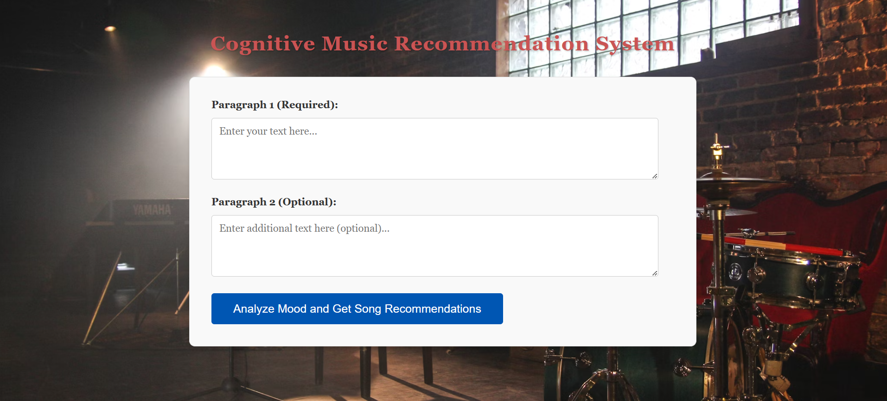
RESULTS:

Slide 15
REFERENCES:
https://www.researchgate.net/publication/383128398_Music_recommendation_systems_in_music_information_retrieval_Leveraging_machine_learning_and_data_mining_techniques
https://www.researchgate.net/publication/383406590_The_Contribution_of_Music_Information_Retrieval_System_Optimization_to_Music_Analysis_in_the_Context_of_Big_Data
https://www.researchgate.net/publication/376152792_Music_Player_Box
https://www.researchgate.net/publication/383406590_The_Contribution_of_Music_Information_Retrieval_System_Optimization_to_Music_Analysis_in_the_Context_of_Big_Data
https://www.researchgate.net/publication/332451019_A_Study_of_Sentiment_Analysis_Concepts_Techniques_and_Challenges
https://www.researchgate.net/publication/319164243_Natural_Language_Processing_State_of_The_Art_Current_Trends_and_Challenges

