Slide 1

DEPARTMENT OF COMPUTER SCIENCE AND ENGINEERING
SOCIAL MEDIA ANALYTICS FOR USER BEHAVIOR PREDICTION
Project Guide: Batch No:17 Team members:
Mrs. L. Bhargavi Year/Sem: IV/I A. Chaithan(21P61A0501)
Assistant Professor Section: CSE-A A . Florence(21P61A0512)
B. Supraja(22P65A0502)

Slide 2
Abstract:
The Internet has witnessed a rapid growth since last decade, Along with that we have also witnessed the tremendous growth in the internet users, and that leads to an exceptional growth in the data generated by the users. The main reason behind this rapid growth in the internet users is social networking sites.
Users spend hours of their time every day on social networking sites like- Facebook, YouTube, Twitter and so on. There, every action performed by the user on those websites is being recorded to provide them the better user experience.
Apart from making the user experience better, we can use such data to provide certain services on time if we are able to predict the user intention well ahead. Hence, this paper addresses the problem of finding the user's deeper intention based on their past behaviour.
In this we introduced two additional parameters, time and location in addition to the existing parameters used in the intention serialization algorithm. The proposed approach enriches the Intention Serialization algorithm.
Key Words:Social Media Analytics, Machine Learning Data , Collection Data, Preprocessing, Data Analysis, Business Intelligence, Public Health , Politics and Governance, Crisis Management , Data Privacy, Ethical Issues, Big Data, Real-Time Analytics, AI, Sentiment Analysis.

Slide 3
Introduction:
Social media platforms such as Facebook, Twitter, Google+, and Instagram has gained popularity due to ease access throughout the world and user-friendly interfaces to start communicating with others within a short period of time.
Each user in these social networking sites (SNSs) is considered as an entity, and each entity is connected with other entities as friends, connections, or followers . While using these SNS’s, users are facilitated by many activities, such as posting statuses/tweets, sharing others’ posts/re-tweets, liking others’ posts, commenting on others’ posts, chatting directly with the friends, and playing online games with the friends.
Understanding users’ behavior may help to identify personality traits. Predicting users’ personalities from digital footprints of social media is a challenging task as the context of identifying personality traits in social media is not trivial.
Users behave differently in social media and real life. Therefore, the user generated content, such as status updates in social media, may provide enough evidential reflection of personality as SNS user posts statuses based on his/her current situation , a recent political or popular event, hyped topics, and so on.
For example, during an election of his/her country, he/she may posts positive or negative reviews/opinions about a political party.

Slide 4
Literature Review:
 | Year | Pros | Cons
1. Machine Learning ,Deep Learning | 2021 | Handling high-dimensional data, Identifying complex patterns | Limited handling of sequential data, Requires large datasets
2. . Random Forest | 2020 | Handles high-dimensional data, Easy to interpret | Overfitting, Computational expensive
3. . Sentiment Analysis | 2019 | Detects emotions(positive ,negative) in user-generated content | Accuracy issues due to ambiguity and context. Difficulty in handling nuanced emotions
4. Graph-Based Methods | 2018 | Models complex relationships between users, Captures structural properties of social networks | Computational complexity. Scalability issues with large graphs

Slide 5
 | Year | Pros | Cons
5.Gradient Boosting | 2019 | Handles Large Datasets | Slow training ,Prone to Overfitting
6.Decision Tree | 2019 | Easy to interpret, Fast training | Prone to Overfitting, Handles Limited features
7. GNN | 2018 | Handling Complex , Relationships Flexibility | Require Careful Node Ordering, Computational Complexity
8. Text Classification | 2019 | Handles Large datasets | Difficulty in handling imbalanced data

Slide 6
Problem Statement:
How can we effectively utilize the vast and unstructured data generated on social media platforms to accurately predict user behavior, while addressing challenges related to data noise, privacy concerns, and the dynamic nature of social media environments? Additionally, how can predictive models account for complex external factors such as trends, social influence, and emotional states, to provide actionable insights.

Slide 7
Objectives:
Customer Segmentation and Targeting:
To segment users into distinct groups based on their behavior, interests, demographics, and engagement patterns .Marketers can personalize content or advertisements to specific audience segments, improving engagement and conversion rates.
Content Engagement PredictionObjective:
To predict which types of content (posts, videos, images) are most likely to engage users. Helps in creating more targeted content strategies that are more likely to go viral or attract higher interaction rates (likes, shares, comments).
Sentiment Analysis and Brand PerceptionObjective:
To analyze user sentiment (positive, negative, neutral) towards a brand, product, or topic over time. Businesses can track how users feel about their brand and adjust marketing strategies, public relations efforts, or product offerings accordingly.
Ad Performance OptimizationObjective:
To predict which ads will perform well based on past user interactions and engagement metrics.Usage: Marketers can optimize their ad spend by focusing on campaigns that are likely to yield the highest return on investment (ROI).

Slide 8
Software Requirements:
Operating System: Window 11 Home single Language
Coding Language: Python.
Data Base: CSV/text
Hardware Requirements:
RAM: 8.00 GB
Hard Disk: 476 GB
Processor: 12th Gen Intel® Core™ i5-1240P 1.70GHz

Slide 9
Proposed Methodology:
Constructing Social Media Graphs:
The first step involves collecting raw data from social media platforms, including user profiles, interaction data (e.g., likes, shares, comments), and content (e.g., posts, tweets, images). Once the data is collected, it is transformed into a graph representation where nodes represent users, content items, or interactions, and edges represent relationships or interactions between them. For example, users can be represented as nodes, and edges can denote connections such as friendships or follower relationships.
Preprocessing and Feature Engineering:
Raw social media data often contains noise, missing values, and relevant information. Preprocessing techniques such as text cleaning, noise removal, and handling missing data are applied to clean the data and ensure its quality. Relevant features are extracted from the social media graph and user-generated content to represent nodes and edges. These features may include user demographics, content attributes (e.g., text features, image features), and interaction patterns.
Training and Evaluation of GNN Models:
Model Training: GNN models are trained on the constructed social media graph using labelled data (e.g., user engagement labels and user preferences). The GNN architecture (e.g., GCNs, GATs) is instantiated and trained using backpropagation and optimization algorithms such as stochastic gradient descent (SGD) or Adam. The trained GNN models are evaluated using appropriate evaluation metrics for the specific task.

Slide 10
Hyperparameter Tuning:
Hyperparameters of the GNN model, such as learning rate, number of layers, hidden units, and regularization parameters, are tuned using techniques such as grid search or random search to optimize model performance.
Deployment and Monitoring:
Once trained and evaluated, the GNN model can be deployed for real-world applications, such as user engagement prediction or content recommendation on social media platforms. Continuous monitoring and performance evaluation are essential to ensure the model's effectiveness and adaptability to evolving user behavior and preferences.

Slide 11
MODULES:
Data Collection Module:
This module is responsible for gathering data from social media platforms, such as Facebook, Twitter platforms. The data collected typically includes user interactions (likes, comments, shares), content details (post text, images, videos), metadata (timestamps, location), and user demographics (age, gender, location).
2. Data Preprocessing Module
Once data is collected, it must be cleaned, transformed, and structured for analysis. This module deals with the cleaning, normalization, and transformation of raw data into a usable format.
3. Exploratory Data Analysis (EDA) Module
This module helps identify patterns, trends, and relationships in the data by visually and statistically analyzing it. EDA is crucial for understanding the data before building predictive models.
4. Feature Engineering Module
The purpose of this module is to extract meaningful features from raw data, which will then be used to build predictive models. Feature engineering is essential to improve model accuracy and performance.

Slide 12
5.Model Building and Training Module
This module is responsible for developing the predictive models that will forecast user behaviors based on the engineered features. Machine learning algorithms such as decision trees, logistic regression, random forests, gradient boosting, or neural networks (LSTM for sequential data) are used.
6. Prediction Module
This module generates predictions of user behavior based on the trained model. The predictions may include whether a user will engage with a specific type of content, the likelihood of churn, or which products a user is most likely to purchase.
7.Evaluation and Testing Module
This module evaluates the performance of the prediction models using various metrics to assess their accuracy and reliability.
8. Visualization and Reporting Module
This module generates visualizations, reports, and dashboards that present the findings and predictions in an understandable way. The goal is to communicate insights to stakeholders (e.g., marketers, product managers).
10. Privacy and Ethics Module
Given the sensitivity of social media data, this module ensures that data is handled responsibly, in compliance with privacy laws such as GDPR, and that user privacy is protected.

Slide 13
IMPLEMENTATION:
# Logistic regression
scaler = StandardScaler()
x_train_scaled = scaler.fit_transform(x_train)
model_logreg = LogisticRegression(max_iter=1000)
rfe = RFE(estimator=model_logreg, n_features_to_select=9)
rfe.fit(x_train_scaled, y_train)
print("Selected Features:", rfe.support_)
print("Feature Ranking:", rfe.ranking_)

Slide 14
# RANDOM FOREST:
model_rf = RandomForestClassifier()
model_rf.fit(x_train, y_train)
y_pred_rf = model_rf.predict(x_test)
print("Training accuracy (RF):", model_rf.score(x_train, y_train))
print("Testing accuracy (RF):", model_rf.score(x_test, y_test))
# Feature importance
feature_importances = pd.DataFrame(model_rf.feature_importances_, index=x_train.columns, columns=['importance']).sort_values('importance', ascending=False)
print(feature_importances)

Slide 15
#KNN:
model_knn = KNeighborsClassifier(n_neighbors=5, metric='euclidean')
model_knn.fit(x_train, y_train)
y_pred_knn = model_knn.predict(x_test)
print("Training accuracy (KNN):", model_knn.score(x_train, y_train))
print("Testing accuracy (KNN):", model_knn.score(x_test, y_test))
#XG-BOOST
model_xgb = XGBClassifier(max_depth=2, objective='binary:logistic', eta=0.3)
model_xgb.fit(x_train, y_train)
y_pred_xgb = model_xgb.predict(x_test)
print("Training accuracy (XGB):", model_xgb.score(x_train, y_train))
print("Testing accuracy (XGB):", model_xgb.score(x_test, y_test))
plot_importance(model_xgb, max_num_features=9).

Slide 16
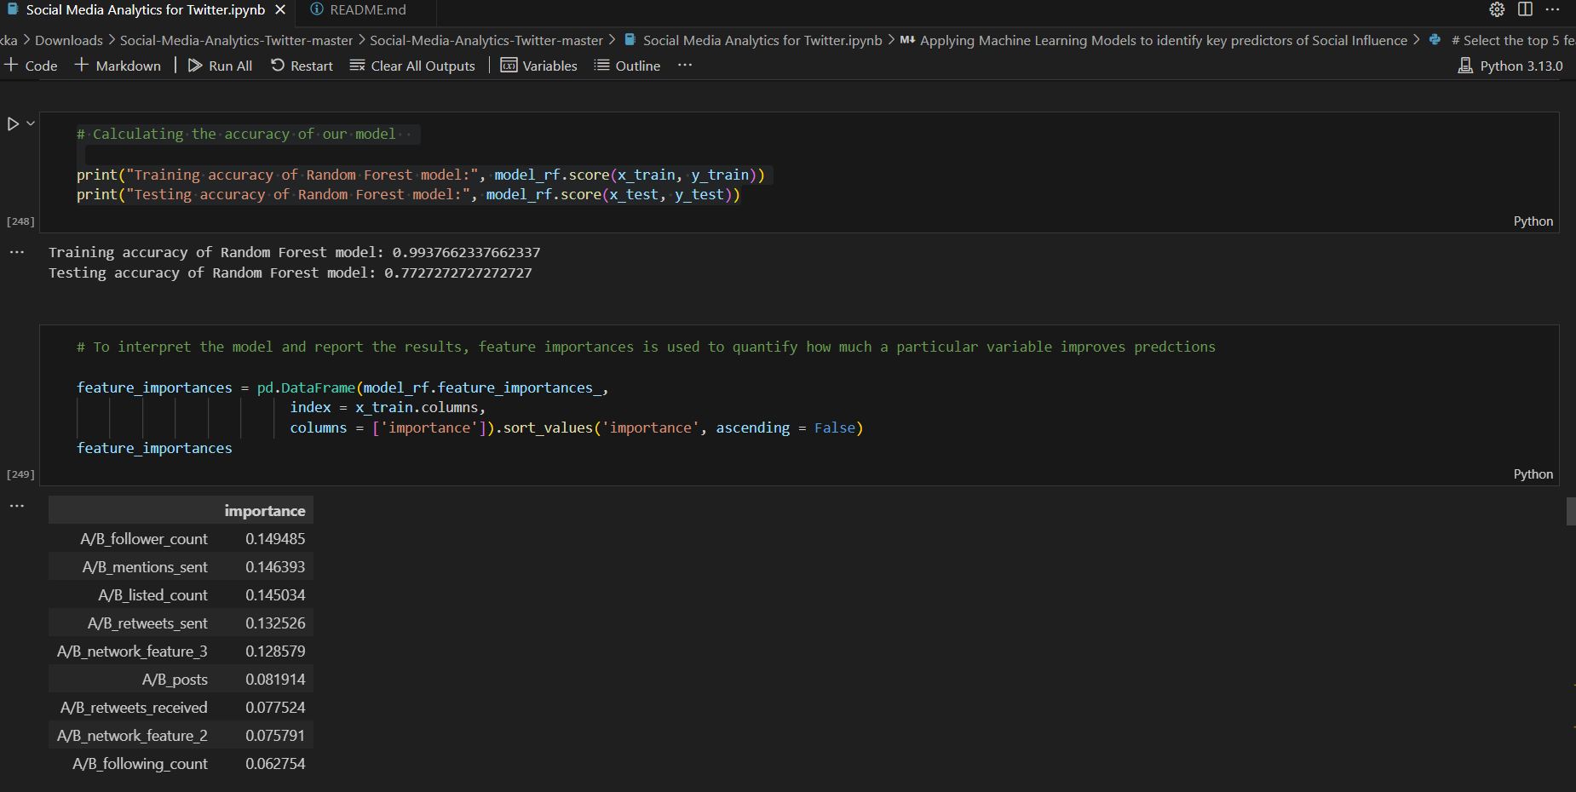
RESULT:

Slide 17
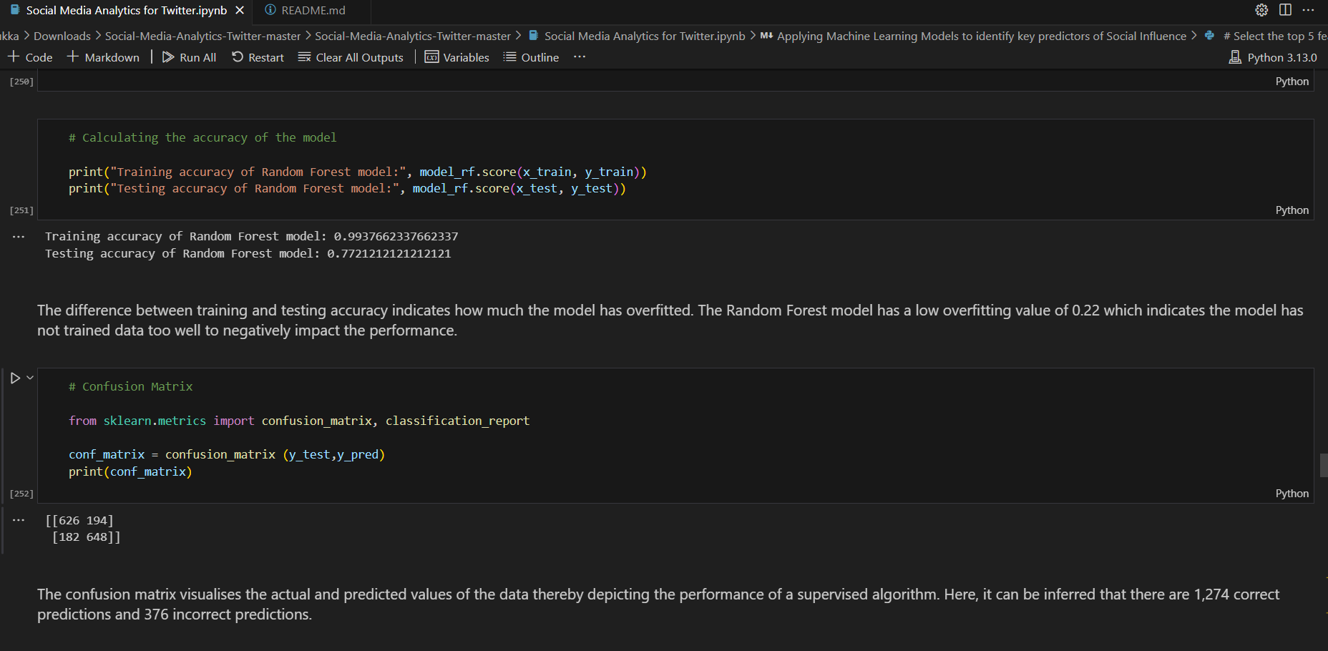

Slide 18


Slide 19
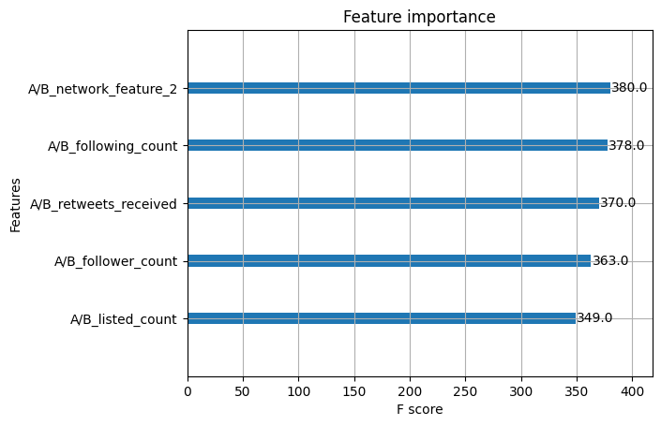

Slide 20
References:
1."Predicting User Behavior in Social Media" by A. Majumder et al. (2019) - IEEE Transactions on Knowledge and Data Engineering.
2. "Deep Learning for Social Media Analysis" by Y. Zhang et al. (2020) - ACM Computing Surveys.
3. "Social Media User Behavior Prediction using Machine Learning" by S. K. Singh et al. (2019) - Journal of Intelligent Information Systems.
4. "Sentiment Analysis for User Behavior Prediction in Social Media" by J. Liu et al. (2018) - IEEE Transactions on Affective Computing.
5. "Graph Neural Networks for Social Media User Behavior Prediction" by W. Liu et al. (2020) - IEEE Transactions on Neural Networks and Learning Systems.
6."Social Media Analysis for User Behavior Prediction" by A. A. Abbasi et al. (2020) - Springer.
7. "Predicting User Behavior in Social Media" by D. M. Blei et al. (2019) - Cambridge University Press.
8. "Social Media Data Mining and Analytics" by C. C. Aggarwal et al. (2019) - Springer.

Slide 21
THANK YOU

