Slide 1


Slide 2


How to be (more) productive in IntelliJ IDEA
Miloš Garunović
milos.garunovic@gmail.com

Slide 3

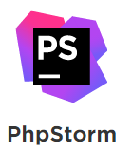






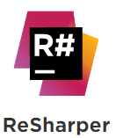
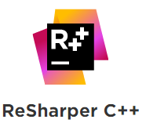


Slide 4
C#
C/C++
Groovy
Java
JavaScript, TypeScript
Kotlin
Objective-C
PHP
Python
Ruby
Scala
SQL
Swift
Java SE
J2EE, Spring
.NET
ASP.NET
VB.NET
Android
iOS
Django
Ruby on Rails
Node.js
Angular JS
JRuby

Slide 5
Database support
Microsoft SQL Server
Oracle Database
MySQL
PostgreSQL
SQLite
HyperSQL
Sybase
IBM DB2
H2

Slide 6
Content
IntelliJ tools: editing, search and navigation, refactoring, VCS, Live templates…
HTML and CSS editing
SQL database manipulation and integration
GitHub and Maven integrations
IntelliJ vs Eclipse (You know that comparing IDEs is going to start a war, don’t you?)

