Slide 1
FUNDAMENTALS OF AUTOMATION ENGINEERING
FSM PROJECT

Slide 2
INTRODUCTION
A finite-state machine (FSM) is an abstract machine that can be in exactly one of a finite number of states at any given time.
The basic idea of an FSM is to store a sequence of different unique states and transition between them takes place depending on the values of the inputs and the current state of the machine.
It is defined by a list of its states, its initial state, and the inputs that trigger each transition.

Slide 3
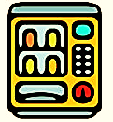
In our project, we have designed an FSM based Vending Machine GUI.
GIVES OPTIONS
SELECT OPTION
It displays all the product option which are available
Customer has to select one option from it
INSERT MONEY
TAKE PRODUCT
Customer has to insert money
Dispenses the product

Slide 4







STATES IN
OUR FSM
INITIATE
PRODUCT
SELECTION
AMOUNT
TO
DEPOSIT
RIGHT
AMOUNT CONFIRMATION
PRODUCT
WITH CHANGE
EXIT

Slide 5
STATE DIAGRAM
Initiate
NO
YES
Exit
Product Selection
OK
CANCEL
PRODUCT CHOSEN
INCORRECT
Product with Changes
Amount to Deposit
Check Amount
OK
CORRECT

Slide 6

IMPLEMENTING IT IN GUI
For creating GUI, we have used:
EASY GUI Library
Spyder (Python 3.0)

Slide 7
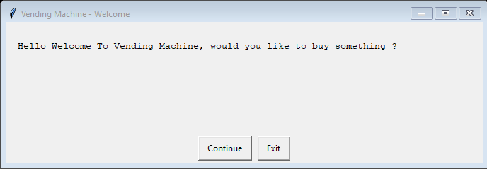
SNAPS OF GUI
INITIAL WINDOW
“Continue” will take you to next state
“EXIT” will take you to Exit state

Slide 8
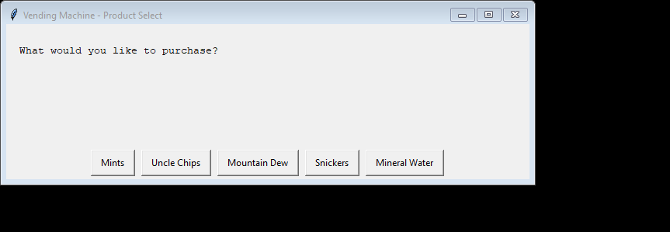
PRODUCT SELECTION STATE
Selecting any one of the button out of given 5 options will take you to the next state displaying the total cost of the item chosen.

Slide 9
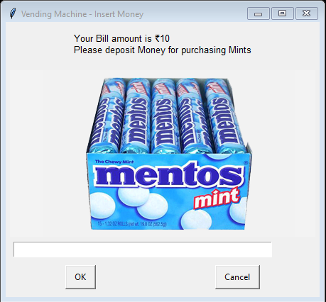
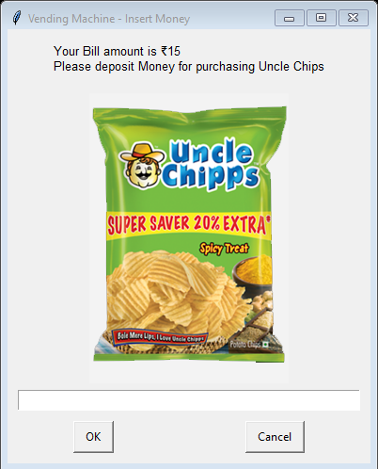
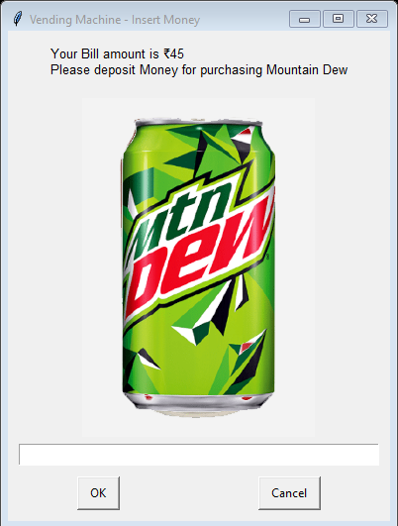
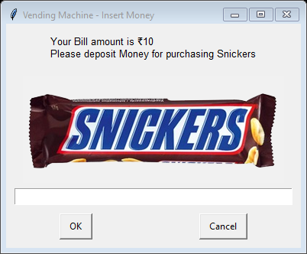
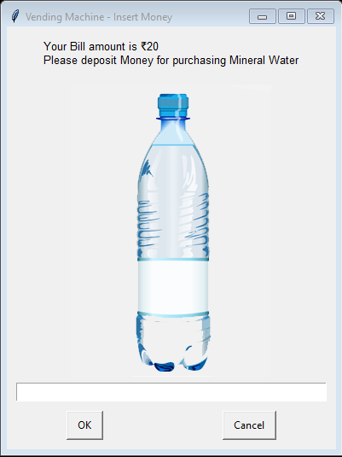

AMOUNT DEPOSIT STATE
“OK” will take you to next state if you entered amount
“CANCEL” will take you to Initial state

Slide 10
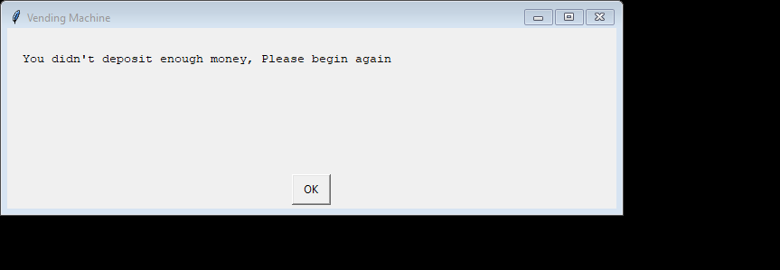
AMOUNT CHECK STATE
If amount will be equal to/greater than Bill amount, it will take you to next state
ELSE “OK” will take you to initial state if deposit amount is less than the bill amount.

Slide 11


PRODUCT WITH CHANGES STATE
EXIT STATE
“OK” will take you to initial state
“OK” will close the GUI

Slide 12
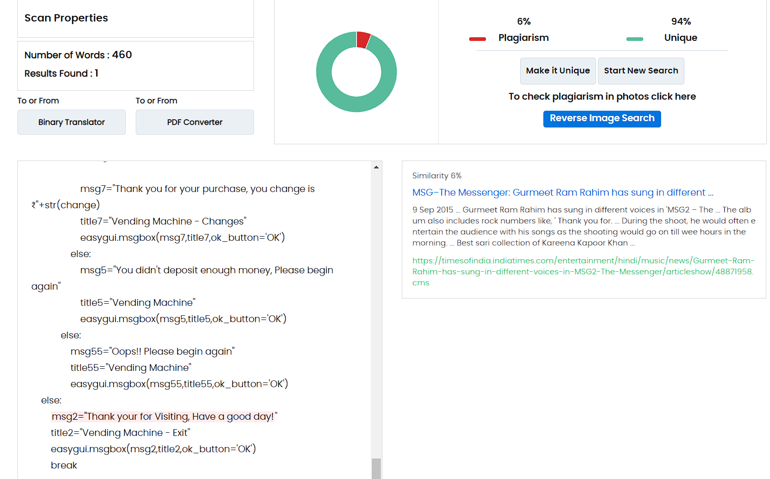
PLAGIARISM REPORT
UNIQUENESS OF CODE

Slide 13
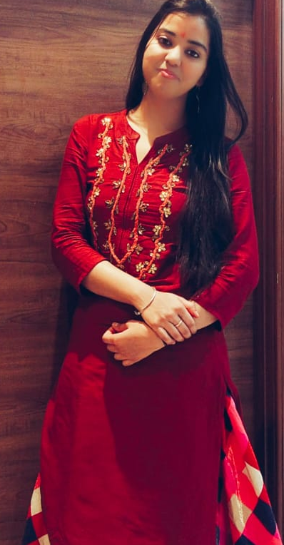

Thank You!
TEAM MEMBERS
Do you have any questions?
Sakshi Kashyap
2020/BTech/CSE/089
Garv Baheti
2020/BTech/CSE/031

