Slide 1
Explainable Plant-Disease Detection
Deep Learning Project - CO3 / CO4 / CO5 | Reg. No. 2430010316 | Batch F | Manipal University Jaipur
Real data: PlantVillage, 38 classes, 54,305 colour images (CPU study subset: 7,552 images, 96x96).
Question: does a leaf classifier look at the leaf, or at the background?
Contribution: background randomisation (+ mask-supervised attention) and a robustness test that measures it.

Slide 2
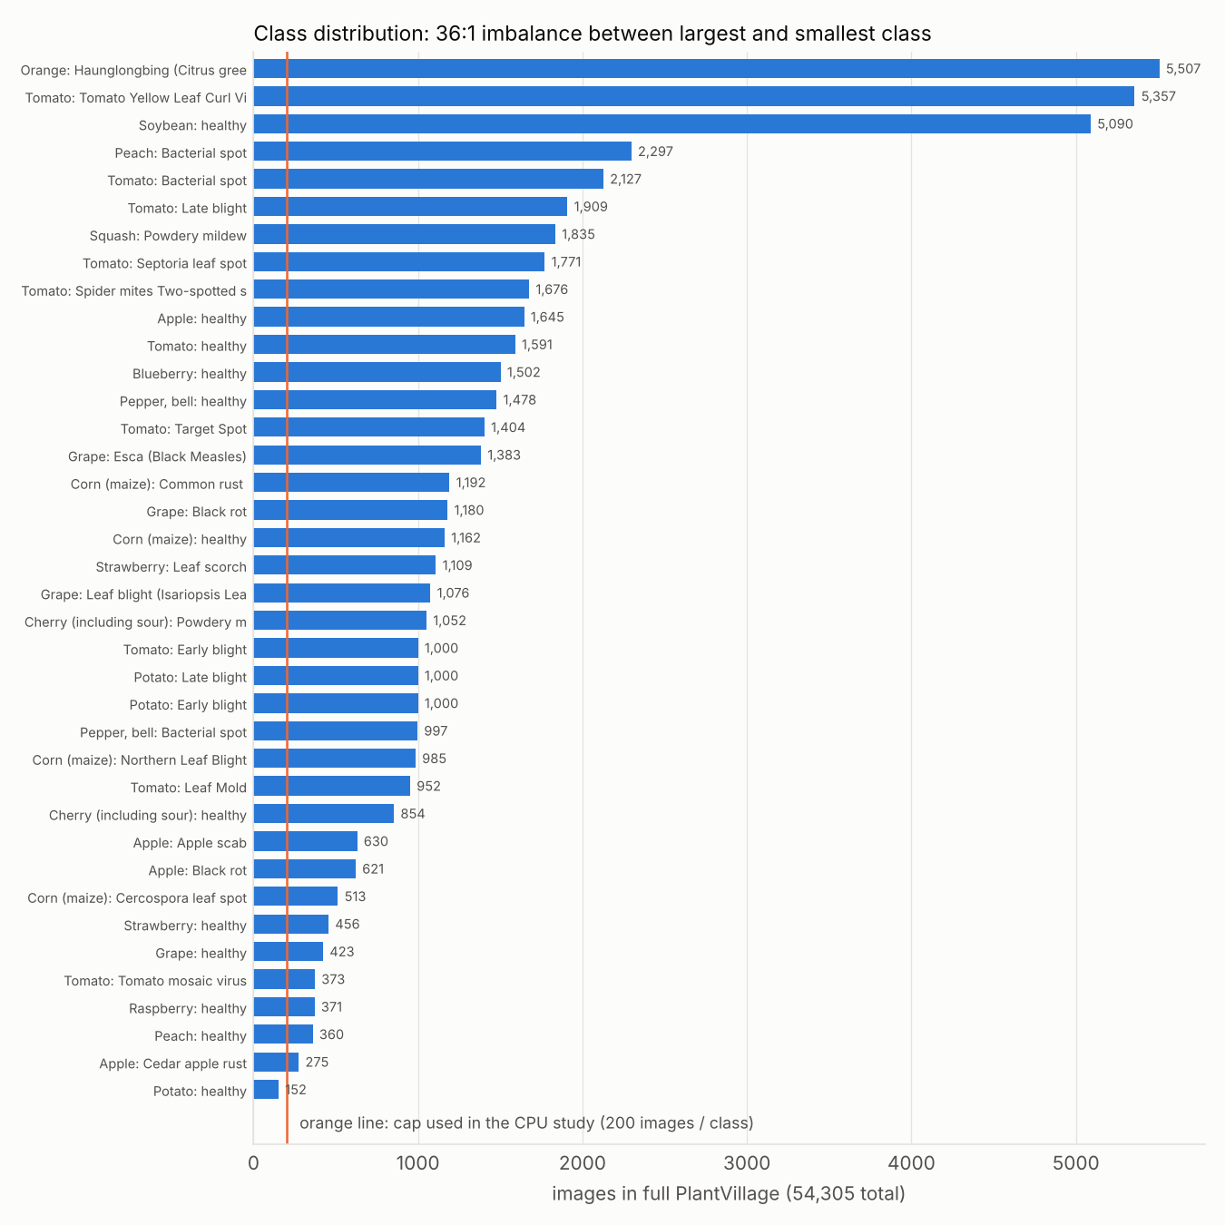
Dataset and preprocessing (CO3)
54,305 images, 38 classes (PlantVillage, pinned commit).
Study subset: max 200/class = 7,552 images.
Stratified split 70/15/15, seed 42 (5286 / 1133 / 1133).
Resize 96x96, normalise, flip / rot90 / brightness augmentation.
Leaf masks from segmented images - used only in training and evaluation, never at inference.

Slide 3
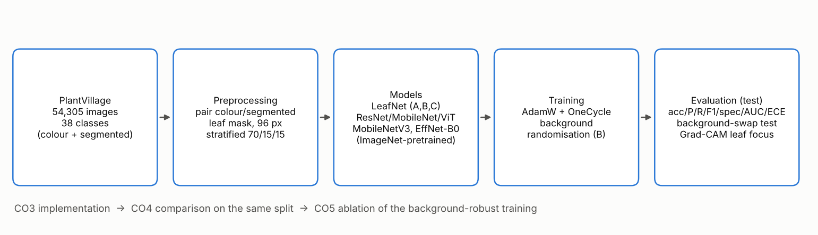
Pipeline and models (CO3)

Slide 4
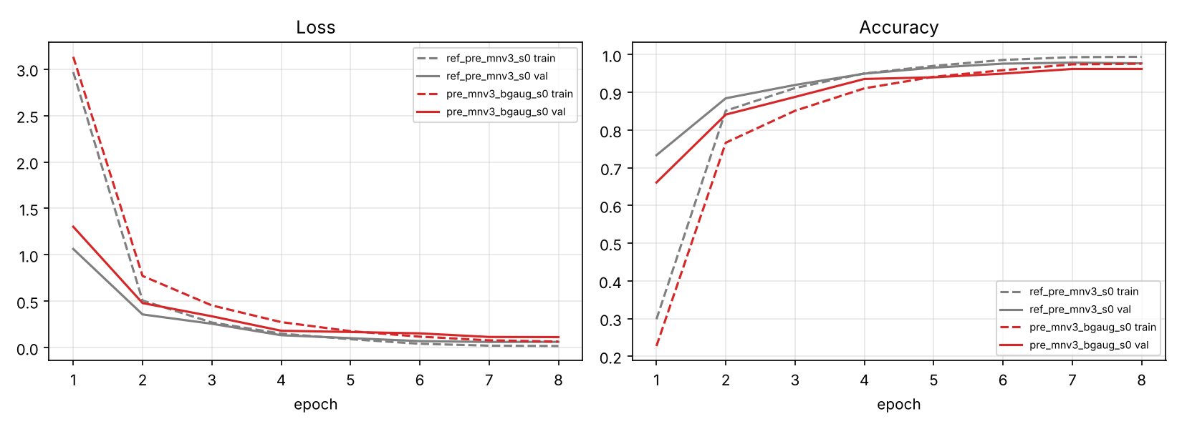
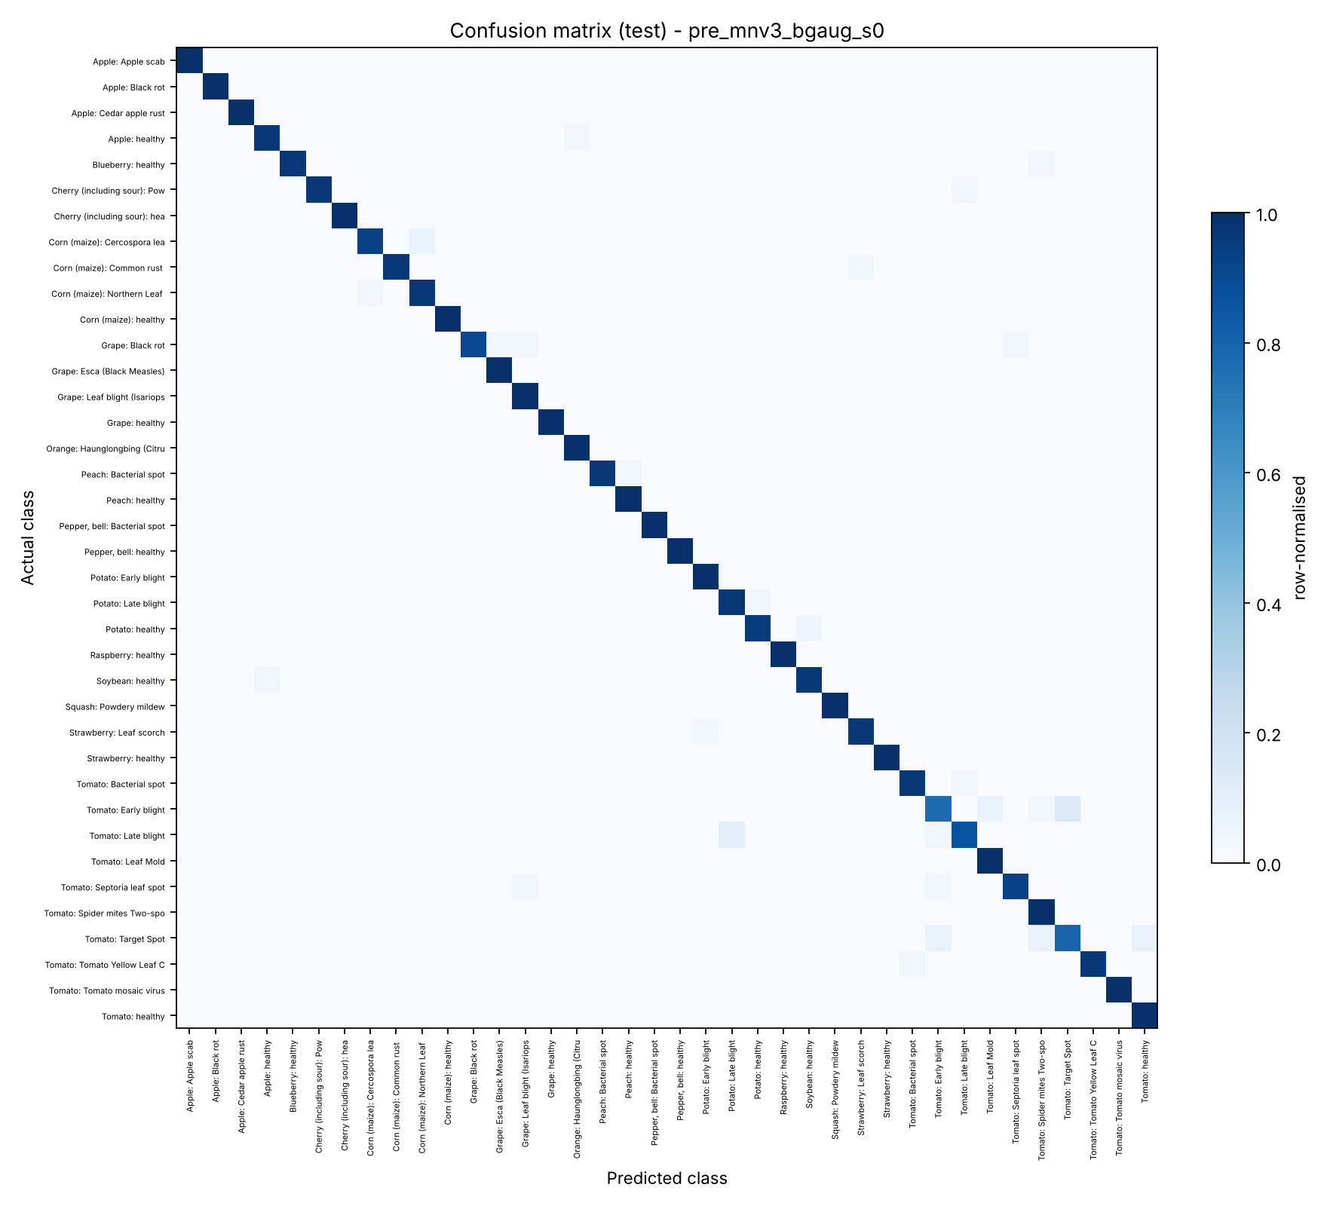
Results: classification metrics (CO3)
Test split, 1133 images. Accuracy, macro P/R/F1, ROC-AUC (OvR), specificity in results.csv
Proposed model (3 seeds): accuracy 0.9653 ± 0.0061, macro-F1 0.9647 ± 0.0063.
Per-class precision / recall / F1 / specificity and ROC-AUC: results/results.csv, results/perclass_*.csv.

Slide 5
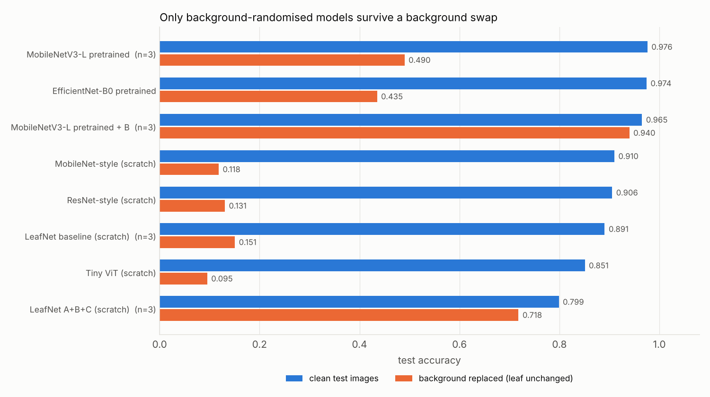
CO4: comparison with state of the art, same data and split
Model | seeds | Accuracy | F1(macro) | BG-swap Acc
ResNet-style (scratch) | 1 | 0.9056 | 0.9041 | 0.1306
MobileNet-style (scratch) | 1 | 0.9100 | 0.9092 | 0.1183
Tiny ViT (scratch) | 1 | 0.8508 | 0.8505 | 0.0953
MobileNetV3-L (pre) | 3 | 0.9762 ± 0.0036 | 0.9760 ± 0.0036 | 0.4901 ± 0.0348
EfficientNet-B0 (pre) | 1 | 0.9744 | 0.9742 | 0.4351
Baseline LeafNet | 3 | 0.8906 ± 0.0148 | 0.8884 ± 0.0147 | 0.1506 ± 0.0069
LeafNet A+B+C | 3 | 0.7988 ± 0.0059 | 0.7939 ± 0.0069 | 0.7182 ± 0.0055
MobileNetV3-L-pre + B = Proposed | 3 | 0.9653 ± 0.0061 | 0.9647 ± 0.0063 | 0.9400 ± 0.0050
Mohanty et al. 2016 (~99.35%) is context only: different protocol, full data, 256 px. Not a like-for-like comparison.

Slide 6
CO5: innovation - background randomisation
Pretrained backbones score high but collapse when the background is swapped
Experiment | seeds | Accuracy | BG-swap Acc | Leaf-focus (clean)
MobileNetV3-L pretrained (plain) | 3 | 0.9762 ± 0.0036 | 0.4901 ± 0.0348 | 0.5985 ± 0.0020
MobileNetV3-L pretrained + background randomisation (B) | 3 | 0.9653 ± 0.0061 | 0.9400 ± 0.0050 | 0.6680 ± 0.0066
Plain pretrained MobileNetV3-L: 0.9762 ± 0.0036 accuracy (mean of 3 seeds) but only 0.4901 ± 0.0348 with a swapped background.
With background randomisation: 0.9653 ± 0.0061 accuracy, 0.9400 ± 0.0050 under swap.
Cost: a small drop in clean accuracy; gain: the model no longer depends on the background.

Slide 7
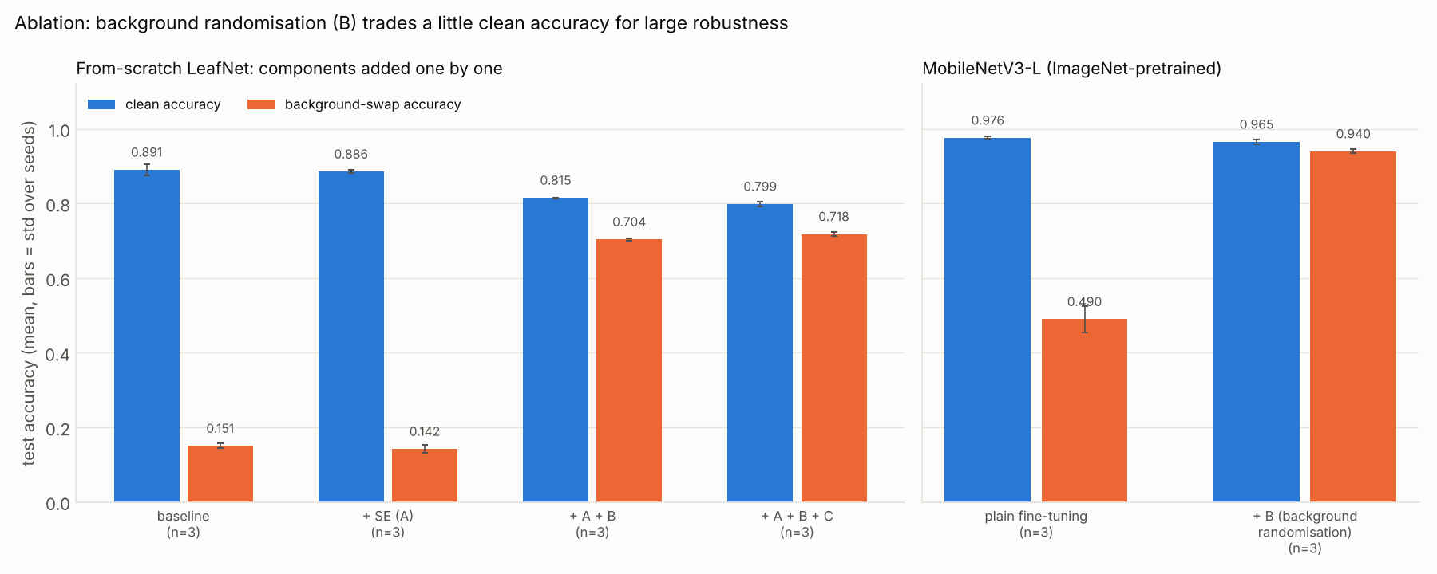
CO5: ablation study (LeafNet, from scratch, 3 seeds)
Experiment | Accuracy | BG-swap Acc
Baseline LeafNet | 0.8906 ± 0.0148 | 0.1506 ± 0.0069
+ SE attention (A) | 0.8856 ± 0.0040 | 0.1424 ± 0.0106
+ background randomisation (A+B) | 0.8152 ± 0.0011 | 0.7040 ± 0.0034
+ mask-supervised spatial attention (A+B+C) = LeafNet A+B+C | 0.7988 ± 0.0059 | 0.7182 ± 0.0055
Squeeze-and-excitation gave no gain; background randomisation is the main effect; mask-supervised attention is a small robustness gain at an accuracy cost.

Slide 8
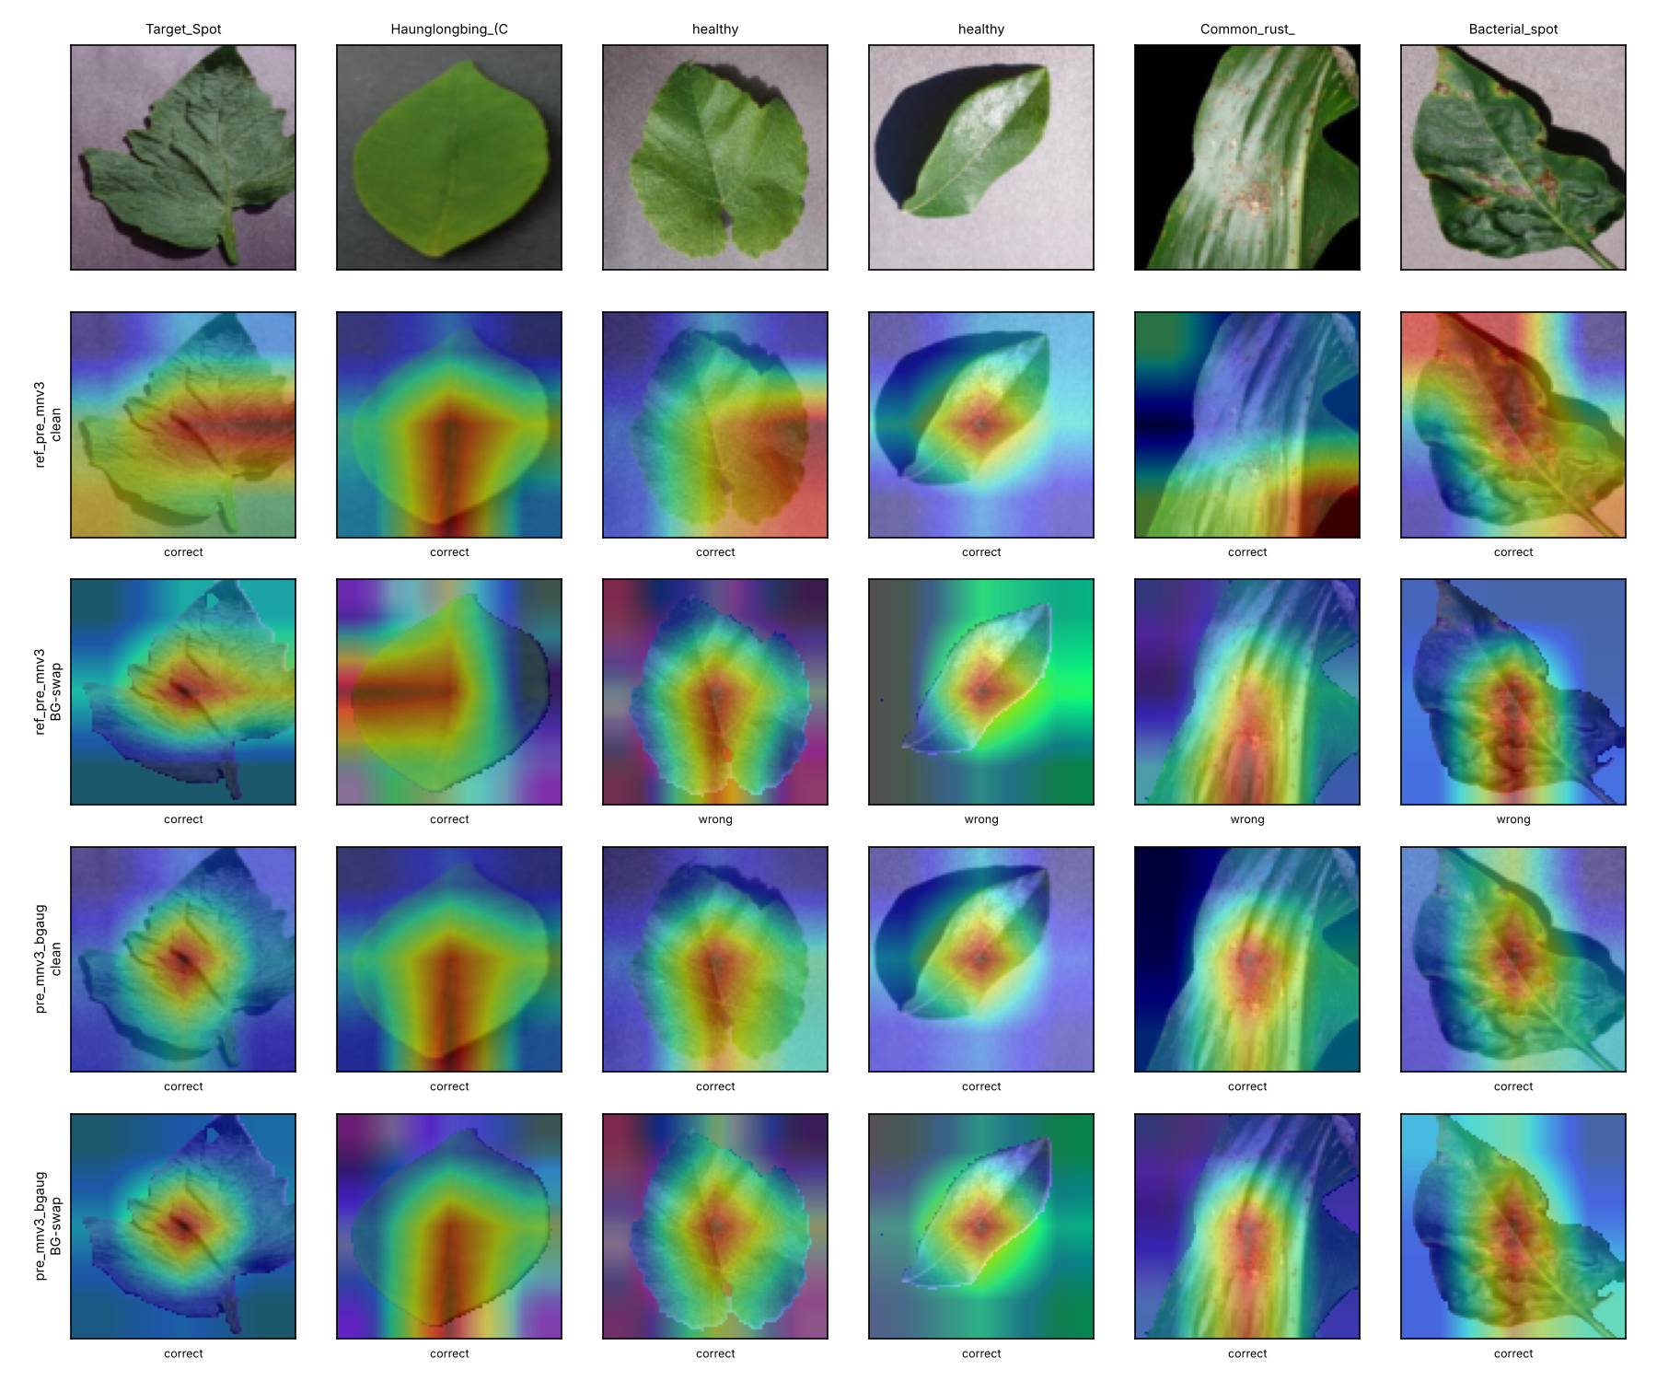
Explainability (Grad-CAM)

Slide 9
Limitations and honest caveats
CPU study: subset (7,552 images) at 96 px. Full-data GPU run is a tracked issue (Colab notebook provided, not yet run on a GPU).
Random per-image split: near-duplicate leaves may leak between train and test, so accuracies may be optimistic.
Background-swap test is synthetic; real field images are not yet evaluated.
Several rows use a single seed; the ablation rows use 3 seeds (mean +/- std).
Hyperparameters were not searched extensively (one learning-rate sensitivity check).

Slide 10
Reproducibility and next steps
Pinned requirements.txt, fixed seeds and split, resumable run scripts, pip install -r requirements.txt.
python code/demo.py --image leaf.jpg -> prediction + Grad-CAM overlay.
Open issues: full-data Colab run, leakage-safe split, field images, hyperparameter search, web demo, CI.

