Slide 1
HOUSEHOLD POWER
CONSUMPTION PREDICTION
with Hybrid Ensemble Learning & Multi-Tier Anomaly Detection
PROJECT REVIEW
Machine Learning • 21CSC305P
Team
Faculty Guide
Nikhil Goyal • RA2411003010489
Umang Gupta • RA22110030100012
Garv Gulati • RA2411003010319
Dr Rahul Gupta
SRM Institute of Science and Technology
Based on Abd’Azeez & Olatomiwa (2025)

Slide 2
Project Review Snapshot
What we changed, what improved, and why it matters
1 Prediction
2 Improvement
3 Anomaly Action
Predict household appliance energy use from timestamp, indoor climate and outdoor weather variables.
Replace a single best regressor with a weighted hybrid ensemble: ExtraTrees + XGBoost + HistGradientBoosting.
Add an operational anomaly engine combining Isolation Forest + residual rules + domain-aware labels.
FINAL R²
FINAL MAPE
TEST ANOMALIES
FEATURES USED
75.04%
15.53%
24
50
+0.63 pp vs paper
−0.74 pp vs paper
0.48% of test points
engineered predictors
Project notebook outputs: 16,740 operational records retained; 70/30 split; 5,022 test points.

Slide 3
Base Paper: What It Established
Abd’Azeez & Olatomiwa, Journal of Electrical Systems and Information Technology (2025)
Problem
Methods
Best Reported Model
Accurate household energy prediction is difficult because usage is nonlinear, highly variable and influenced by time, weather and occupancy behaviour.
Random Forest, XGBoost, SVR and ExtraTreesRegressor. The paper selected ExtraTrees after model comparison and hyperparameter tuning.
ExtraTreesRegressor: R² 74.41%, MAE 8.82 Wh, RMSE 11.75 Wh, MAPE 16.27%.
Important observation for our review
The paper explicitly lists “develop a machine learning model capable of detecting anomalies” as an objective. In the reported methodology/results, anomalies are mainly addressed as outliers/variance during preprocessing and robustness evaluation; a separate operational anomaly-alerting pipeline is not reported.
Base paper: pp. 1–2 (objectives), pp. 9–10 (outlier treatment), pp. 18–25 (prediction results & conclusion).

Slide 4
Dataset & Experimental Setup
Same household appliance-energy dataset used for a fair benchmark
Original observations | 19,735
Raw variables | 29
Date range | 11 Jan 2016 – 27 May 2016
Sampling interval | 10 minutes
Target | Appliances energy (Wh)
Operational range retained | 10–120 Wh
Records retained | 16,740 (84.8%)
Train / Test | 70% / 30%
Key raw inputs
Indoor climate
T1–T9, RH_1–RH_9
Outdoor weather
T_out, RH_out, pressure, wind, visibility, dew point
Time
date / hour / weekday / month
Removed from learning
rv1, rv2, lights
Why 10–120 Wh?
The notebook follows the operational range used for direct paper benchmarking and removes extreme target values before prediction.
Uploaded dataset JSON + project notebook cells 2–4.

Slide 5
Our End-to-End Methodology
Prediction and anomaly detection are treated as two connected but distinct tasks
1
2
3
4
5
6
7
Load & audit
Filter & clean
Engineer features
Train 3 models
Blend predictions
Detect anomalies
Classify alerts
19,735 rows
10–120 Wh
50 predictors
ETR + XGB + HGB
positive Ridge weights
Isolation Forest + residuals
domain-aware categories
Design principle
Prediction answers “how much energy should this household use?” • Anomaly detection answers “is the observed behaviour unusual enough to trigger an alert?”
Project notebook cells 1–13.

Slide 6
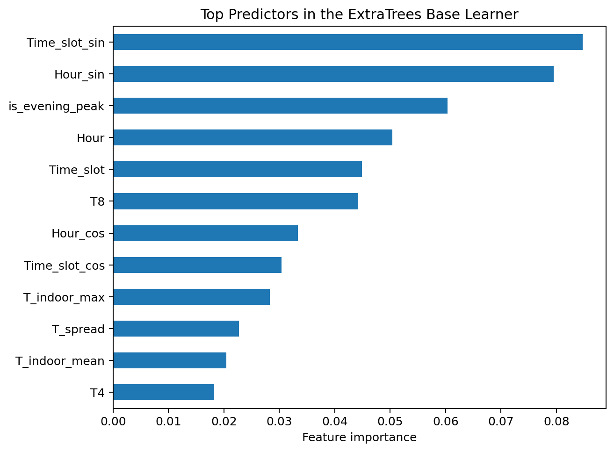
Feature Engineering: More Context Than the Base Model
We encode time cyclically and create occupancy / thermal context to help tree models learn behaviour
Cyclical time
Hour_sin/cos, time-slot sin/cos, month sin/cos, weekday sin/cos
Occupancy heuristics
Morning peak, evening peak, night standby
Thermal summaries
Indoor mean / max / min, spread, indoor–outdoor ΔT
Humidity context
Indoor RH mean + dew-point depression
Room contrast
Living-room temperature vs outdoor temperature
Result: time-derived variables dominate the ranking, reinforcing the base paper’s finding that hour-of-day is highly informative.
Project notebook cell 3 and feature-importance output generated from the uploaded dataset.

Slide 7
Prediction Model: Hybrid Stacked Ensemble
Three strong nonlinear learners are blended instead of relying on one model
ExtraTrees
XGBoost
HistGradientBoosting
400 trees
700 estimators
500 iterations
48.1% notebook weight
34.3% notebook weight
17.6% notebook weight
Positive Ridge Meta-Learner
Weighted blend → final household energy prediction
FINAL R² = 75.04%
Notebook output cell 6: optimized weights [ETR, XGB, HGB] = [0.481, 0.343, 0.176].

Slide 8
Performance: Base Paper vs Our Project
Our ensemble improves all four benchmark metrics
R² SCORE
MAE
RMSE
MAPE
75.04%
8.62 Wh
11.58 Wh
15.53%
+0.63 percentage points
−0.20 Wh
−0.17 Wh
−0.74 percentage points
Metric | Base Paper ETR | Our Ensemble | Change
R² | 74.41% | 75.04% | ↑ 0.63 pp
MAE | 8.82 Wh | 8.62 Wh | ↓ 0.20 Wh
RMSE | 11.75 Wh | 11.58 Wh | ↓ 0.17 Wh
MAPE | 16.27% | 15.53% | ↓ 0.74 pp
Interpretation: the gains are modest but consistent — the project improves explanatory power while reducing absolute and percentage error.
Base paper Table 2 vs uploaded notebook cell 7.

Slide 9
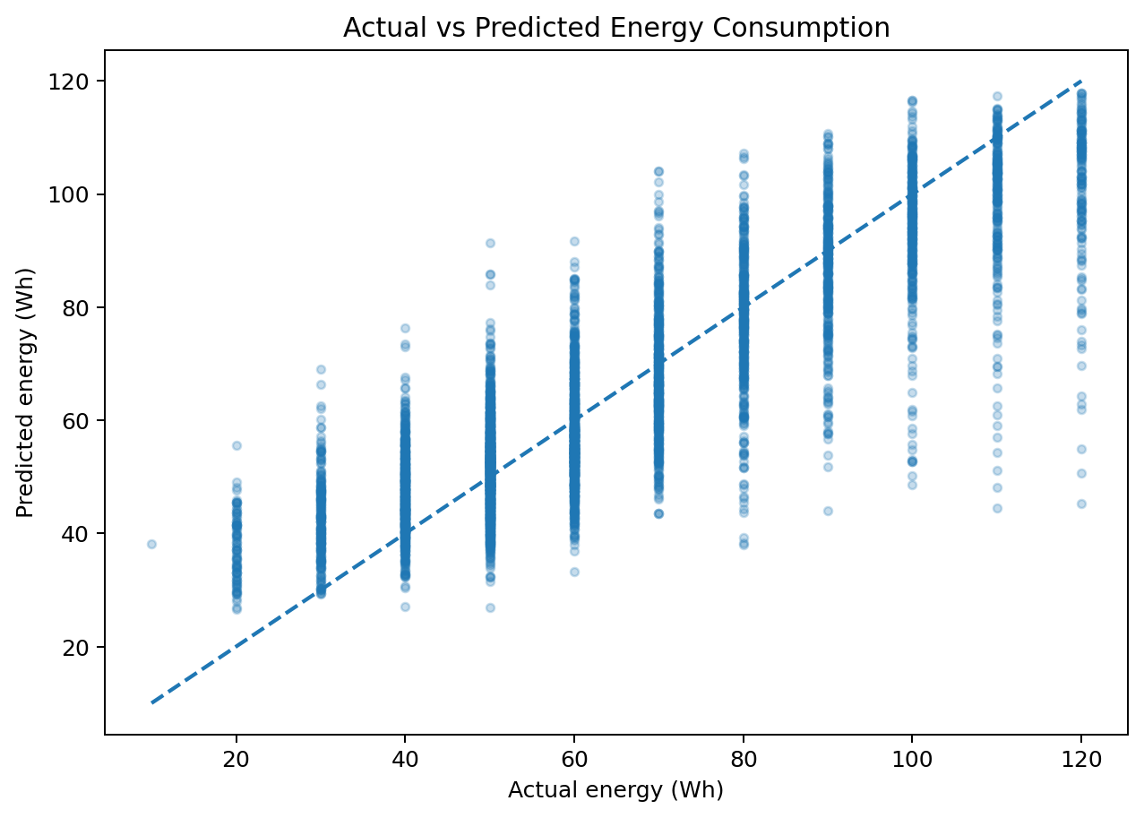
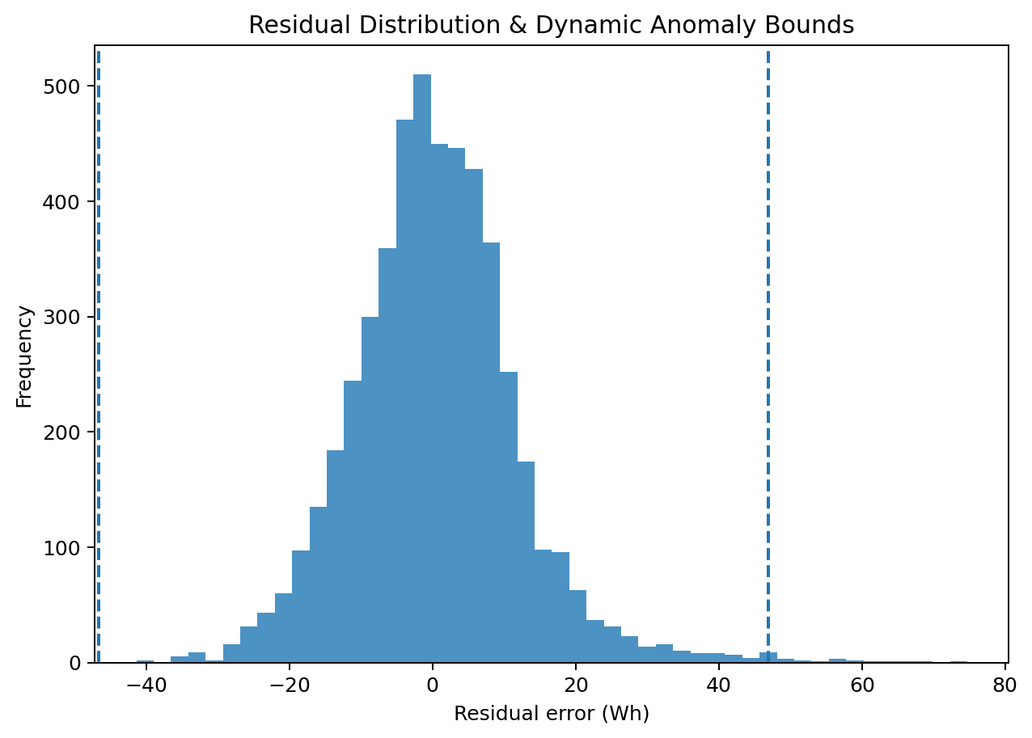
Prediction Quality Diagnostics
The model tracks the operational range well; large residuals are isolated for anomaly review
Actual vs predicted
Residual distribution
Plots recreated from the uploaded dataset using the project notebook pipeline; reported project metrics follow saved notebook outputs.

Slide 10
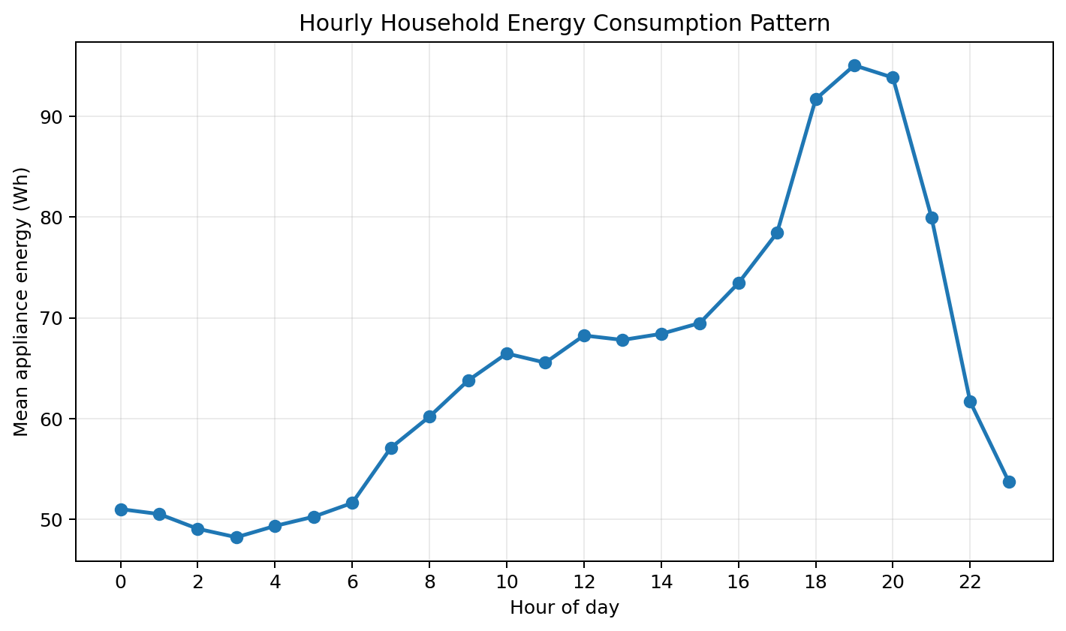
What the Model Learns About Household Behaviour
Time-of-day remains one of the strongest signals
Night / early morning
Lower typical household activity; unusual high consumption here is particularly informative for anomaly detection.
Morning & evening
Higher usage aligns with routine appliance activity and occupancy patterns.
Why cyclical features help
Sin/cos transforms make 23:00 and 00:00 numerically close, preserving daily periodicity.
Base paper reports low night usage and daytime/evening peaks; our notebook adds cyclical time and occupancy features.

Slide 11
Key Research Gap We Addressed: Anomaly Detection
The base paper acknowledges anomalies; our project converts that idea into an explicit detection and alerting layer
BASE PAPER
OUR PROJECT
✓ States anomaly detection as an objective
✓ Discusses anomalous / high-variance energy behaviour
✓ Uses IQR/outlier treatment during preprocessing
✓ Evaluates model robustness on noisy data
Not explicitly reported:
• a dedicated anomaly model
• anomaly counts / labels
• operational diagnostic alerts
✓ Isolation Forest across engineered sensor features
✓ Dynamic residual thresholds using 3×IQR
✓ Combined rule prevents weak single-signal flags
✓ Domain-aware anomaly labels
✓ Serialised anomaly detector for deployment
✓ Live smart-meter simulation with human-readable diagnostics
Base paper anomaly references: objective (p.2) and preprocessing/outlier handling (pp.9–10). Project notebook: cells 8, 12, 13.

Slide 12
Our Multi-Tier Anomaly Detection Engine
An anomaly must be statistically unusual and operationally meaningful
Tier 1
Tier 2
Fusion
Diagnosis
Isolation Forest
Residual IQR
Combined rule
Domain labels
Multivariate sensor anomaly
Large prediction error
Reduce weak false flags
Actionable alert
Alert categories
VAMPIRE_NIGHT_LOAD • CRITICAL_SPIKE_RUNAWAY • SUDDEN_DROP_MALFUNCTION
Notebook cell 8: IsolationForest contamination=2.5%; residual bounds = Q1−3×IQR and Q3+3×IQR.

Slide 13
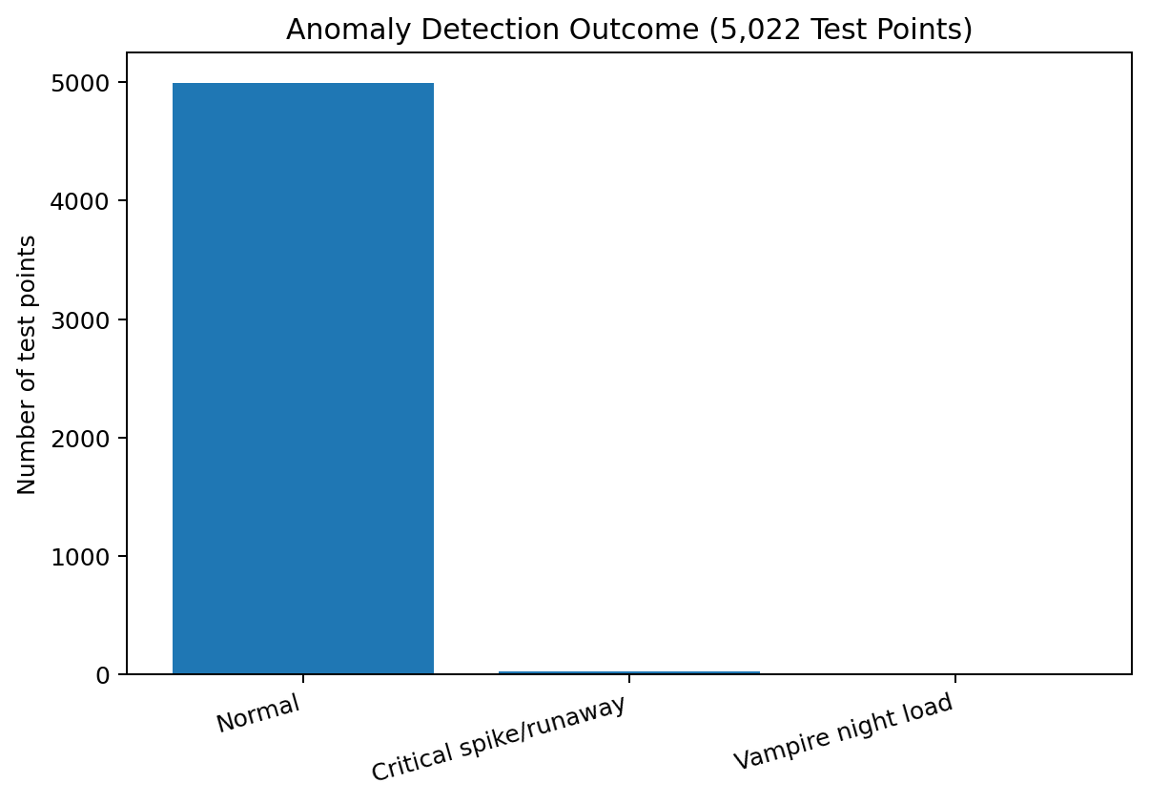
Anomaly Results: We Turned Outliers into Diagnostics
24 anomalies detected among 5,022 test observations
Most extreme examples
Hour | Actual | Pred. | Residual | Type
02:00 | 110 | 41.7 | +68.3 | Vampire load
12:00 | 120 | 53.2 | +66.8 | Critical spike
18:00 | 120 | 55.4 | +64.6 | Critical spike
17:00 | 120 | 56.9 | +63.1 | Critical spike
19:00 | 120 | 58.1 | +61.9 | Critical spike
Notebook breakdown
23 critical spike/runaway • 1 vampire night load • 4,998 normal
Uploaded notebook cells 8–9.

Slide 14
Project Contributions, Limitations & Next Steps
What is complete now, and what would make the system production-ready
Our Contributions
Current Limitations
Next Steps
• Reproduced the base-paper benchmark
• Expanded to 50 engineered features
• Built a 3-model weighted ensemble
• Improved R², MAE, RMSE and MAPE
• Implemented dedicated anomaly detection
• Added actionable anomaly categories
• Serialized prediction + anomaly models
• Benchmark is still one household dataset
• Filtered 10–120 Wh range excludes extreme loads from prediction training
• Ensemble weights were fitted using the test predictions in the notebook, so a validation/meta-training split would be more rigorous
• Anomaly labels are heuristic/domain rules, not ground-truth fault labels
• Use nested train/validation/test splits
• Evaluate on multiple homes / seasons
• Tune anomaly thresholds using labelled events
• Add SHAP-based explanations
• Stream live smart-meter data
• Deploy dashboard/API with alert history
• Compare with LSTM / temporal models
Project review assessment based on the uploaded notebook implementation and the base paper methodology.

Slide 15
CONCLUSION
Prediction improved.
Anomalies became actionable.
THANK YOU
Our project extends the base paper from a strong household energy predictor into a hybrid prediction + anomaly-monitoring system.
Questions?
75.04%
R²
15.53%
MAPE
24
Anomalies
Nikhil Goyal • Umang Gupta • Garv Gulati
Faculty Guide: Dr Rahul Gupta
Base paper: Abd’Azeez & Olatomiwa (2025), Journal of Electrical Systems and Information Technology, 12:50.

