Slide 1














Python Statistical
Library
By Aditi (202318005) and Garvika (202318061)

Slide 2
Overview
The name of the library is dastats.
This project involved the creation of a Python library consisting of 1 package and 8 modules.
Its has three versions 0.0.1, 0.0.2 and 0.0.3.
The packages are uploaded to the central repositry and host PyPI for easier access and use.
Link to the PYPI test site containing the package information and file - https://test.pypi.org/project/dastats/0.0.3/
Link to the project report - https://satin-beech-25b.notion.site/Project_Report_dastats-4f04c31f5c8e4d2d91e44fad3e09b8e3
Link to the official documentation - https://tangible-drop-40a.notion.site/Documentation-for-dastats-91046561f5d04ba1a980ad0086d95fc5

Slide 3
01.
Python library with 1 package and 8 statistical modules
Project Deliverables
Documentation for each module, including descriptions, usage examples, and function/class reference
02.
Test suite for each module, ensuring proper functionality and reliability.
03.

Slide 4
Packages and Modules
There is a single package called published and 8 modules under published package.
01
02
03
04
Read_file
DescriptiveStatistics
Correlation tests
Hypothesistesting
05
06
07
08
Data_Distribution_Test
Non_Parametric_Test
Normality
_Test
Regression_analysis

Slide 5
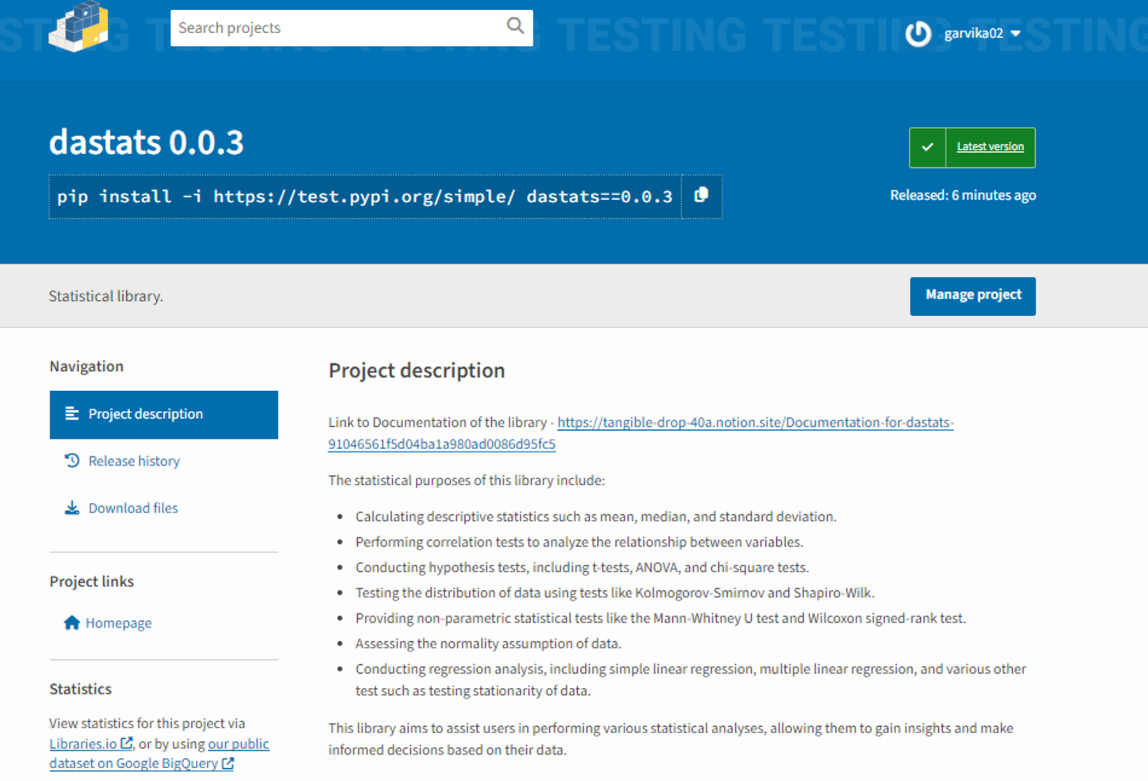

Slide 6
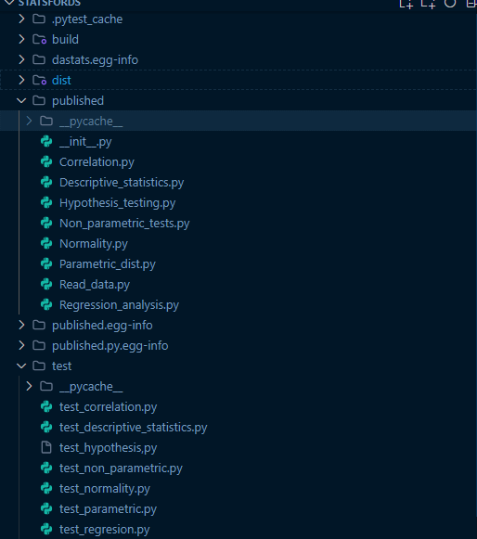
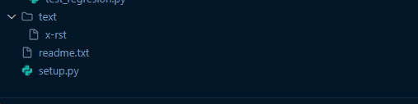
File Structure and Purpose
.pytest_cache: This folder contains cached data from running pytest, a testing framework for Python. It helps improve test execution speed by storing previously computed results.
dist: This folder contains the distribution files of the library. These files are typically in the form of compressed archives (e.g., .tar.gz or .zip) and are used for distributing the library to other users.
build: This folder is generated during the build process and contains temporary files used in the creation of the Python library. It is typically used by build tools like setuptools.
published: This folder contains the published version of the library. It includes the 8 modules that make up the library. These modules provide the core functionality and features of the library.
dastats.egg-info: This folder contains metadata about the installed package, such as its name, version, and dependencies. It is automatically generated when the library is installed using setuptools.
test: This folder contains test files for each module in the library. These test files are used to ensure that the library functions correctly and to catch any potential bugs or issues.
setup.py: This file is used to define the configuration and dependencies required to build and distribute the library. It provides instructions to tools like setuptools on how to package and install the library.
README: This file contains all the long description of the project. How to use the project and necessary link to documentation if any.

Slide 7
Tools/Libraries Used
setuptools
pytest
wheel
This library is used for packaging and distributing Python projects. It provides the necessary setup functions and metadata for building and installing the library.
This is a testing framework for Python. It allows you to write and run tests to ensure the functionality and reliability of your library.
This tool is used for creating a distribution package in the form of an .egg file. It simplifies the process of packaging and distributing Python libraries.
bdist
sdist
twine
This is a command provided by setuptools for creating binary distributions of the library. It packages the library into a format that can be easily installed on different
This is another command provided by setuptools for creating source distributions of the library. It packages the library's source code and resources into a compressed archive that can be distributed and installed on different platforms.
This utility is used for publishing Python packages on PyPI. It simplifies the process of uploading your library to PyPI for others to install and use.

Slide 8
Output and Comparision
We imported the library in google collab and tested it on california housing data set. All tests ran successfully. Then we cross verified the results by importing functions from three main libraries - Scipy, sklern, numpy and statistics.
The link for collab file - https://colab.research.google.com/drive/1fneuT44n40yBFjapHhuj3Y2JOzmwlRqG?usp=sharing

Slide 9
References
https://github.com/python-supply/guide-to-publishing-packages
https://github.com/TezRomacH/python-package-template
https://www.freecodecamp.org/news/build-your-first-python-package/
https://realpython.com/pypi-publish-python-package/#get-to-know-python-packaging
https://machinelearningmastery.com/statistical-hypothesis-tests-in-python-cheat-sheet/
https://www.alchemer.com/resources/blog/how-to-choose-between-parametric-nonparametric-tests/

