Slide 1
Child Mortality Analysis
GROUP 5
202318005 🡪 Aditi Singh
202318032 🡪Kruti Patel
202318044 🡪Hani Soni
202318061 🡪Garvika Singh

Slide 2
Dataset Description
1. Country: Name of the country.
2. Region: Geographic or administrative region.
3. Indicator: Measure related to child mortality or health.
4. Sex: Gender category.
5. Year: Data year.
6. OBS_VALUE: Observed indicator value.
7. Scenario: Policy or projection scenario.
8. SDG.target.2030: 2030 SDG target value.
9. Current.trends.2030: Predicted 2030 value.
10. Status: Progress status toward target.
11. Category: Demographic/socioeconomic factor.
12. Sub-category: Specific group within the category.
13. Current value: Latest indicator data.
14. Target value: Desired value by a set date.
15. Education (% GDP/budget): Portion allocated to education.
16. Health (% GDP/budget): Health expenditure percentage.
17. Social protection (% GDP): GDP share for social protection.
18. Health coverage index: Coverage for reproductive, maternal, and child health interventions.

Slide 3
Aim
01
02
03
04
In-depth Analysis
Trend Assessment
analysis of global child mortality data to identify key factors impacting under-five mortality rates.
Analyze trends to highlight disparities across income levels, regions, and socio-economic categories.
Progress Evaluation
Key Driver Identification:
Evaluate progress towards SDGs related to child health.
Identify key drivers, focusing on maternal education and healthcare spending, that reduce under-five mortality rates.

Slide 4
Hypothesis
Conflict-affected regions experience higher child mortality rates.
Increased government spending on healthcare, education, and social protection can lower mortality rates.
A mother’s socioeconomic status significantly impacts child survival.
Prioritizing immunization for young children and enhancing mental health, education, and economic support for teens can further reduce under five mortality and teen mortality.

Slide 5
What are the under five mortality patterns across different countries?

Slide 6
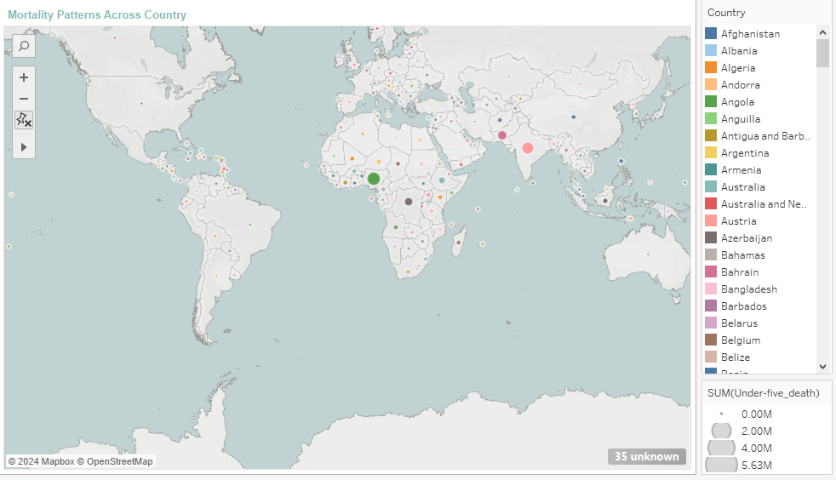

Slide 7
What are the SDG mortality rate targets for different regions?
Will the world be able to meet them with current mortality trends?

Slide 8
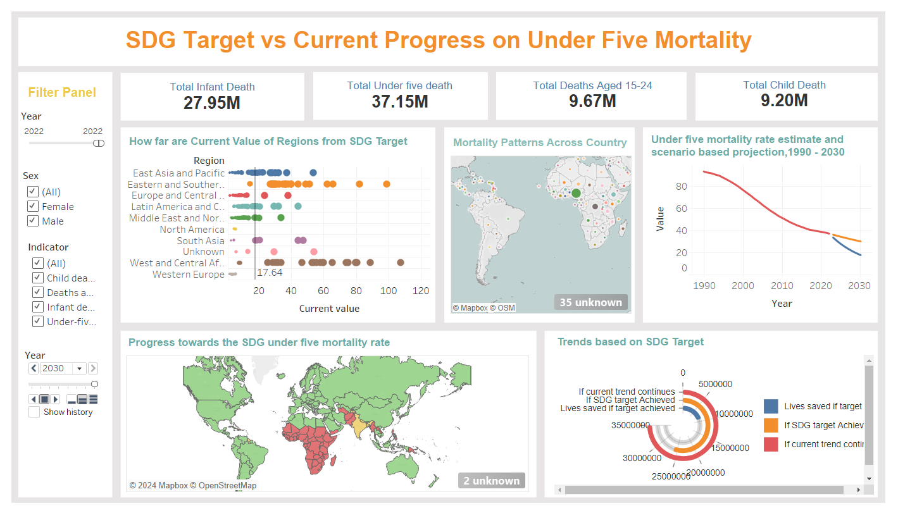
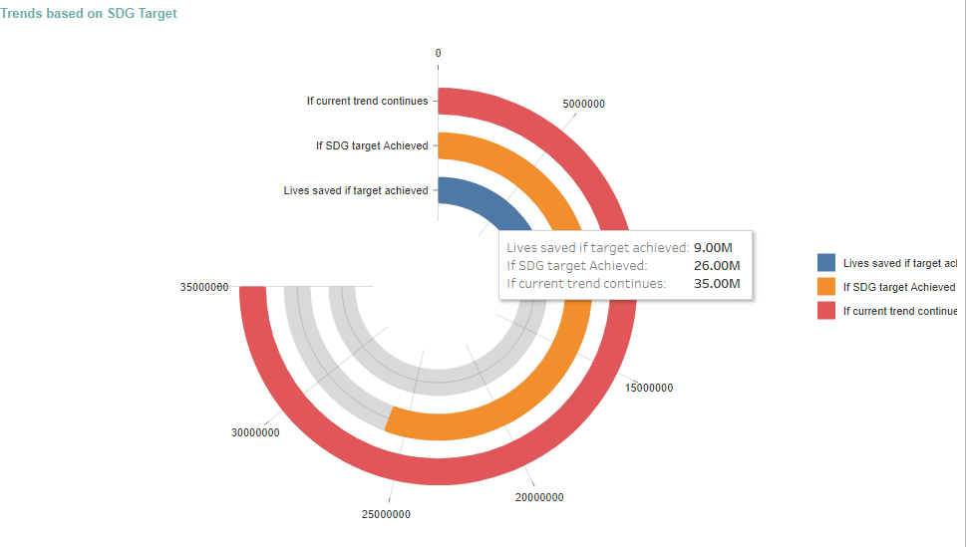

Slide 9
How are different regions moving towards achieving this target over the years?

Slide 10


Slide 11
How can countries speed up the acceleration process to achieve SDG Targets?

Slide 12
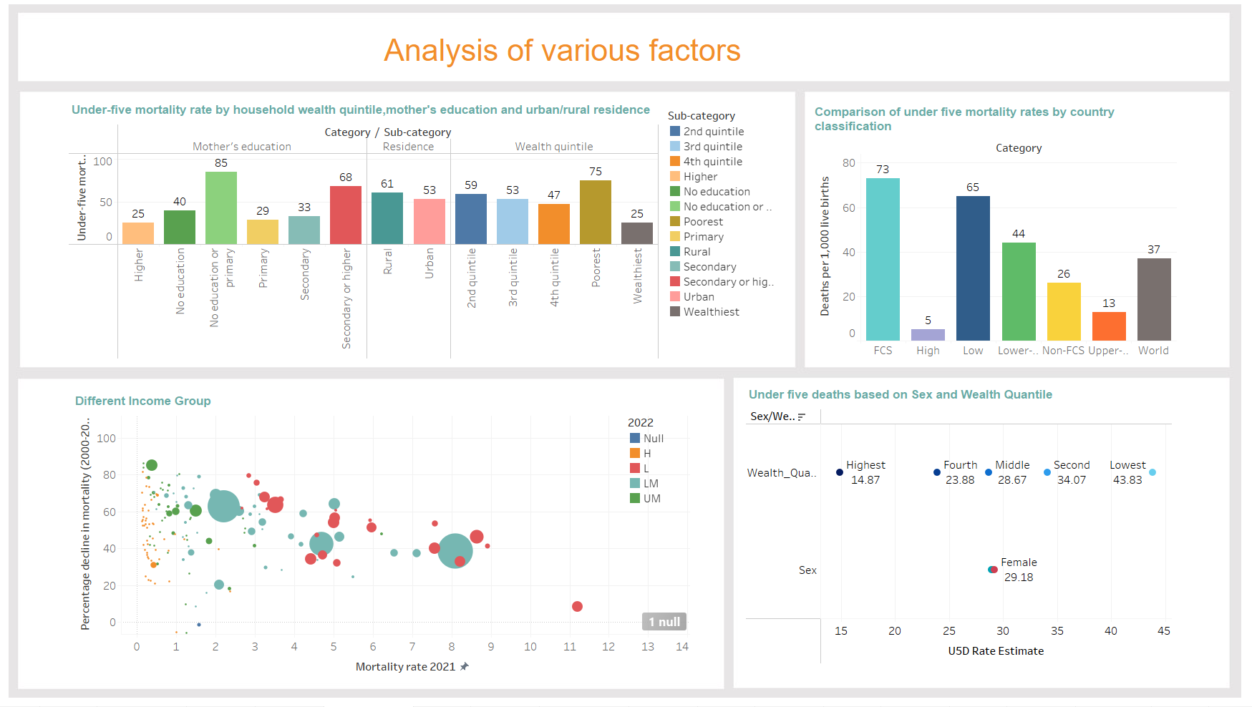

Slide 13
How do the countries even with lower income perform better than their counterparts in some of the upper income groups?

Slide 14
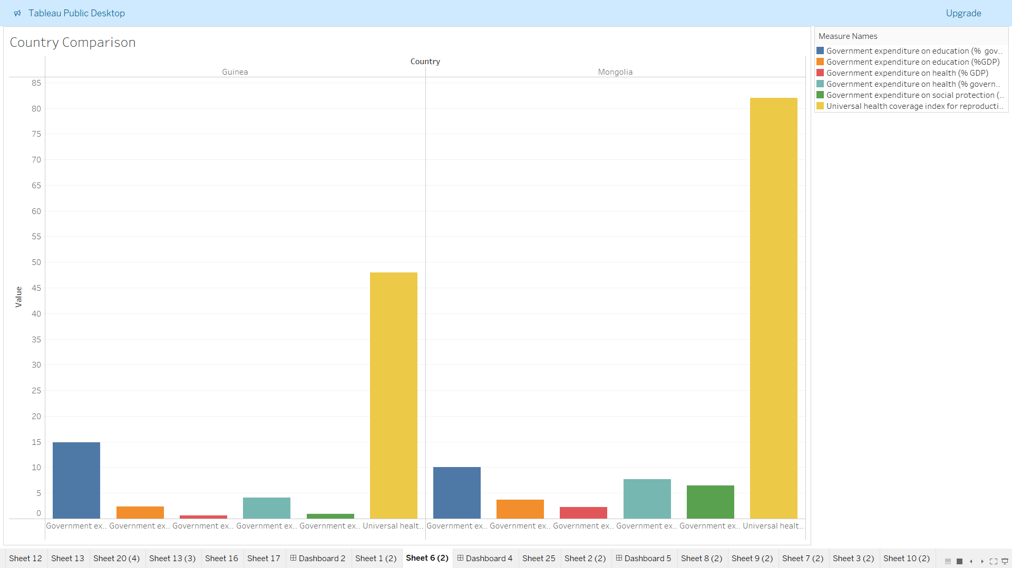

Slide 15
Which Age Group is at High Risk?

Slide 16
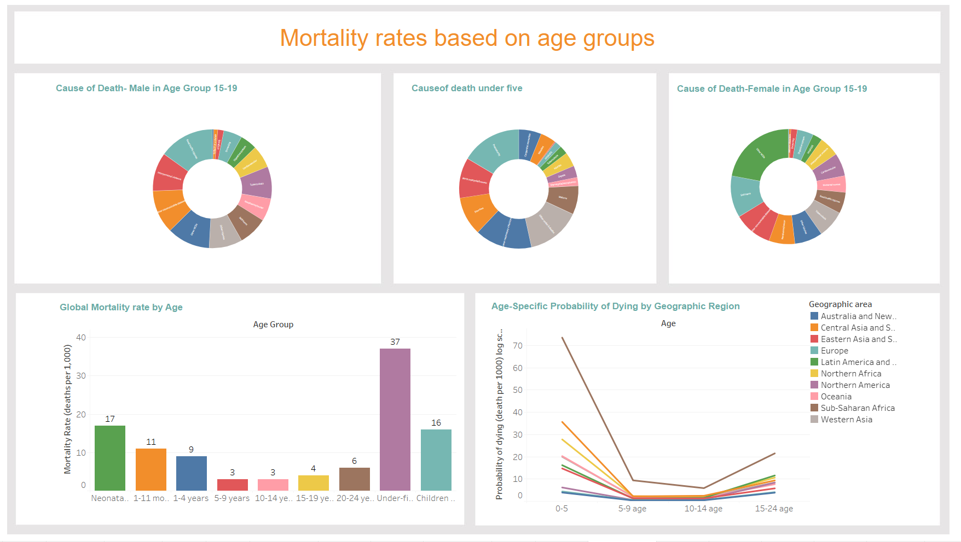

Slide 17
What are the major reasons for deaths in each age group?

Slide 18
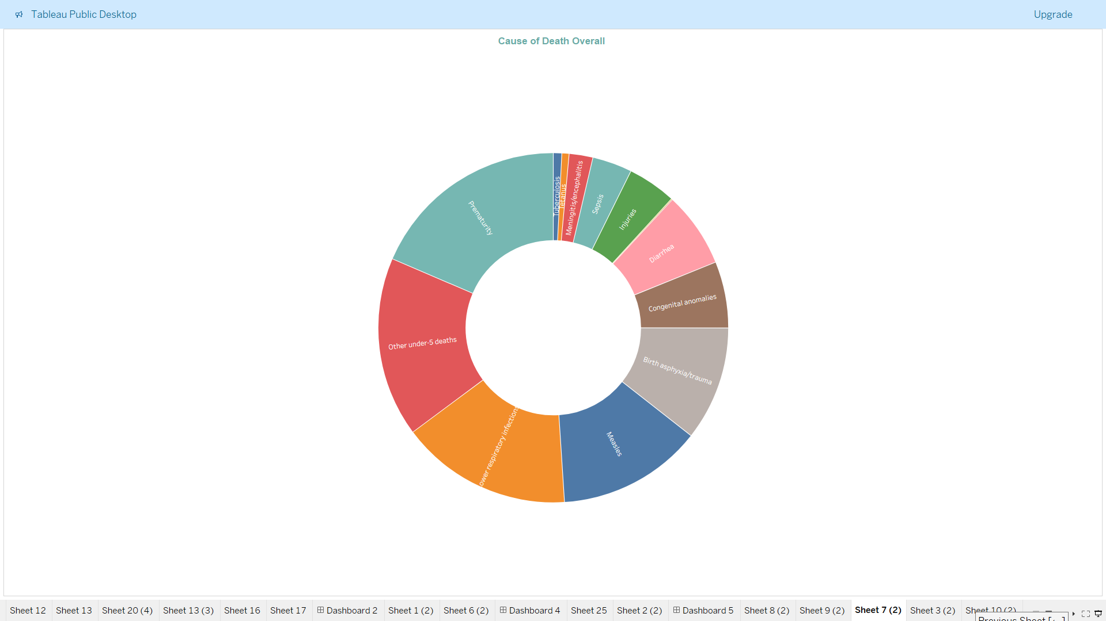
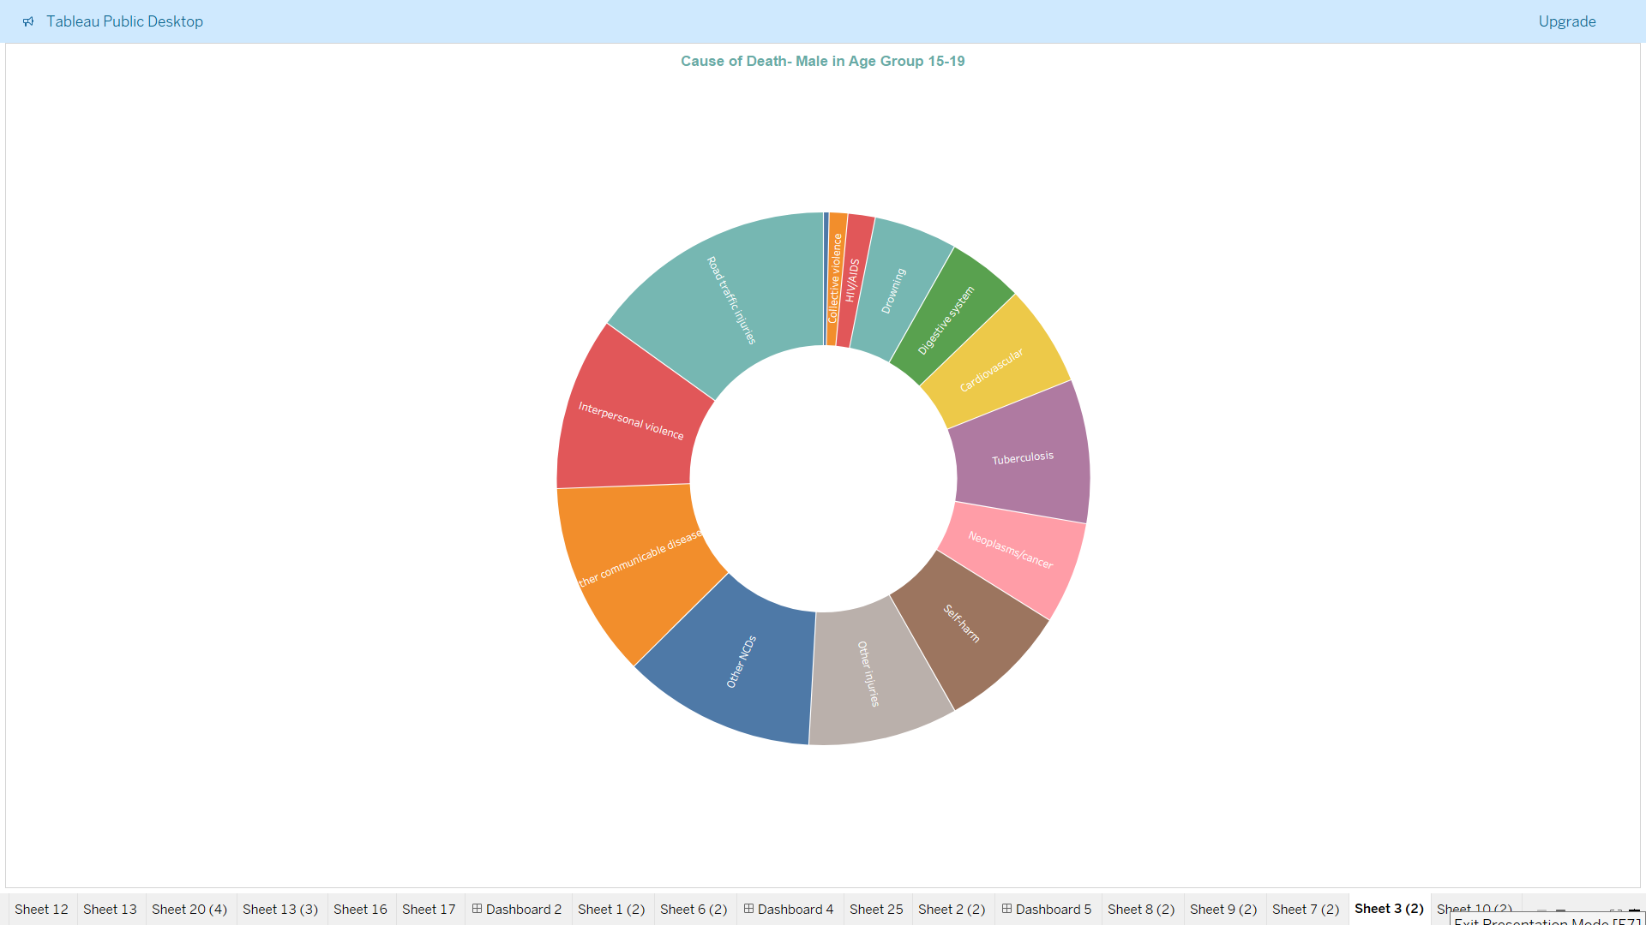
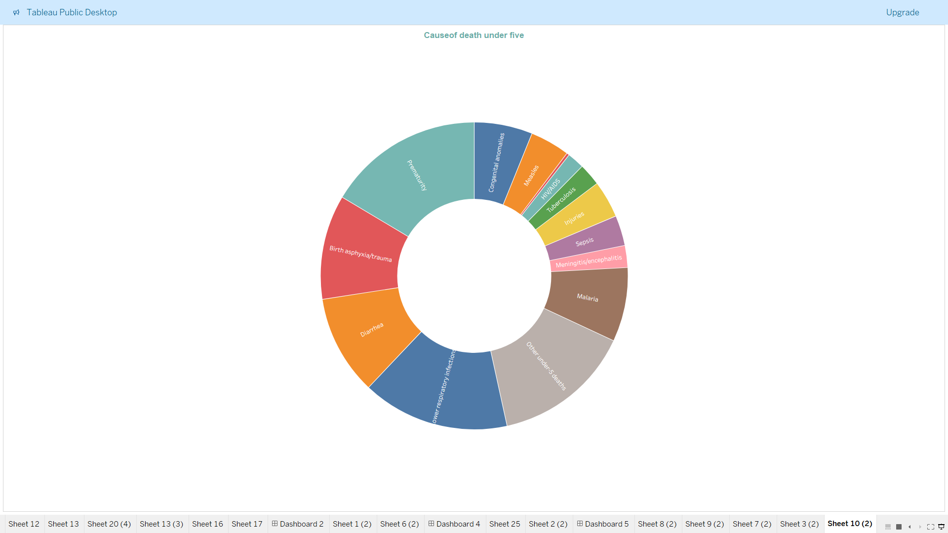

Slide 19
How has the annual rate of reduction in under-five mortality changed over time across regions?

Slide 20
