Slide 1
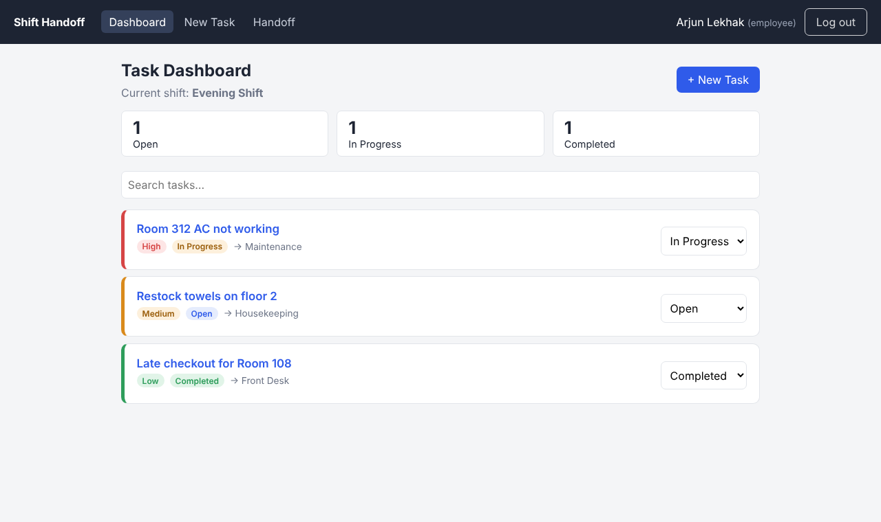
SECTION 3
Live Demonstration
The working frontend: React + TypeScript
Presented by Arjun Lekhak
Notes:
Hand-off line from teammate. "I built the frontend. Instead of describing it, let me show you the app running."

Slide 2
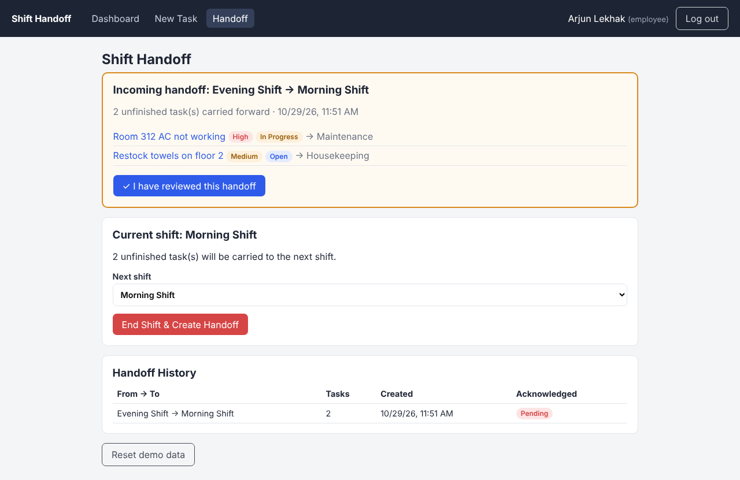
3 · LIVE DEMONSTRATION
Demo path: Room 312, end to end
1
2
3
4
5
6
Log in
Dashboard
Create task
Update status
End shift
Acknowledge
Employee or supervisor account
Open / In Progress / Completed counts
Title, priority, owner
History records every change
Unfinished tasks carry forward
Next shift confirms the handoff
Steps 5–6 are the core of the project. Ending the shift moves every unfinished task into a handoff automatically. Nobody re-types anything, and the incoming shift has to acknowledge it.
Notes:
Switch to the browser now and do the live demo. Log in as arjun / 1234, open Room 312, create "Freezer temperature alarm" (High, Kitchen), go to Handoff, click End Shift, then click acknowledge. Come back to the slides afterwards.

Slide 3
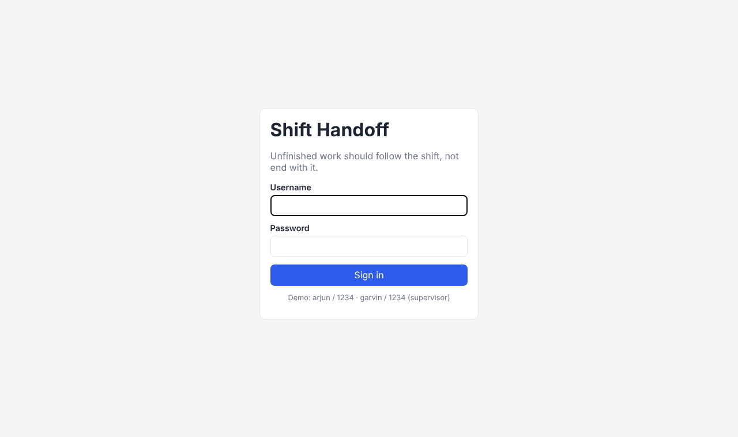
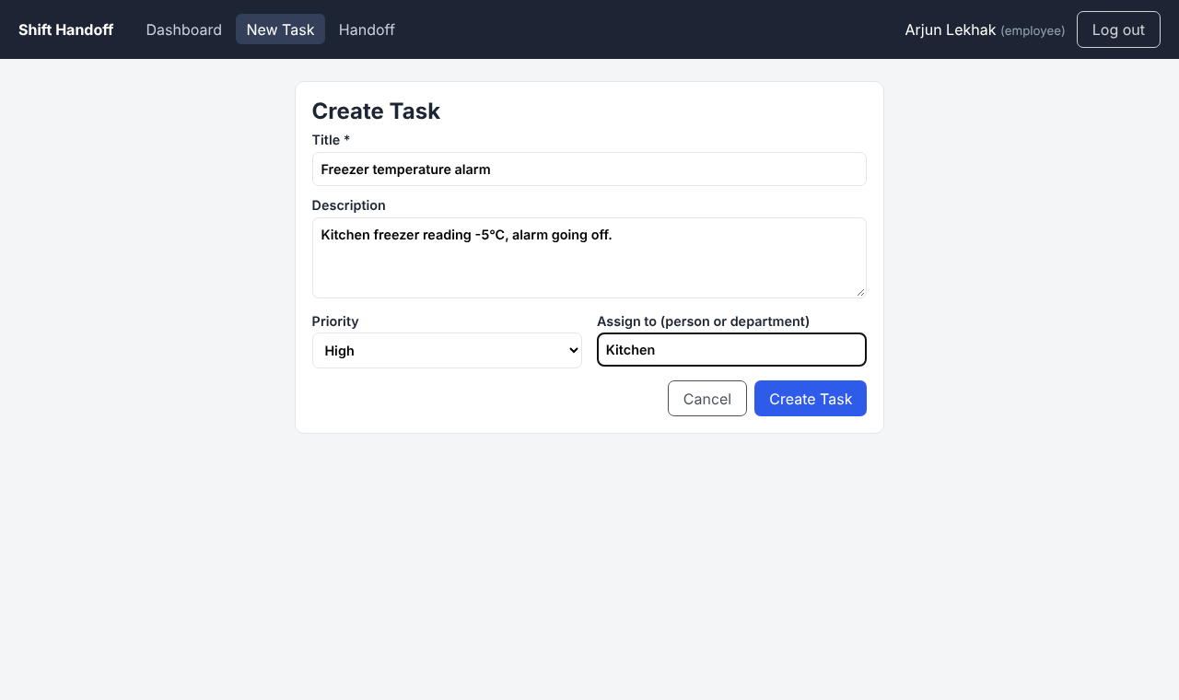
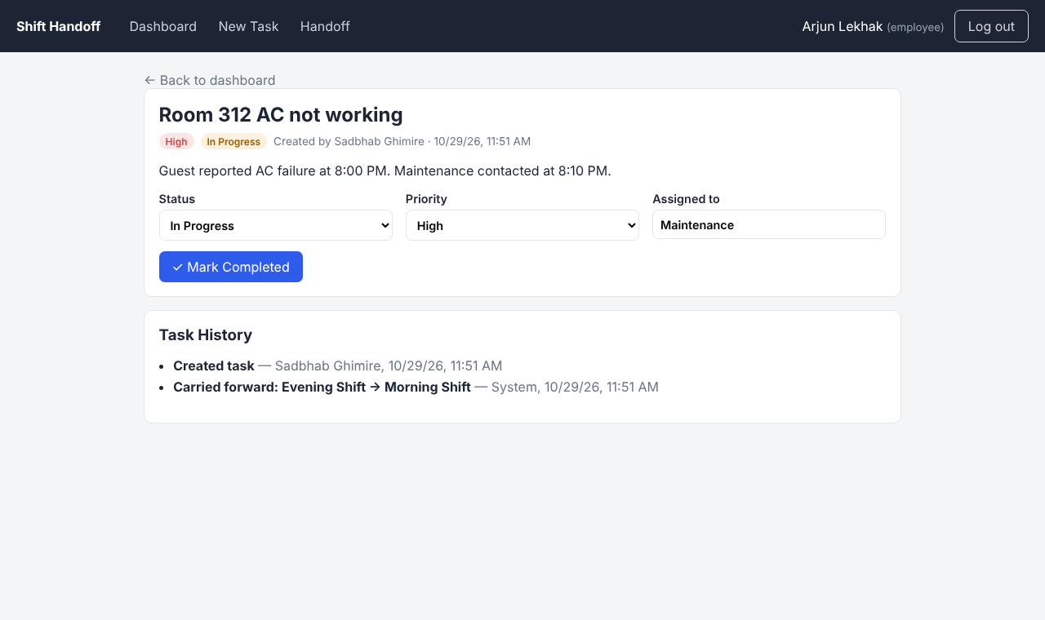
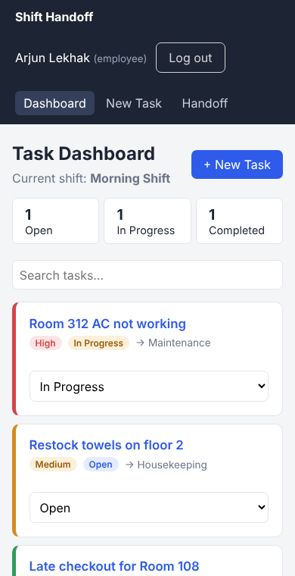
3 · LIVE DEMONSTRATION
Screens built so far
Login
Create task
Task detail + history
Backup if the live demo fails: these are real screenshots of the running app.
Shift handoff
Mobile view
Notes:
Backup slide. If the browser or Wi-Fi fails, walk through these screenshots in the same order as the demo.

Slide 4
3 · LIVE DEMONSTRATION
What works now, and what is not done yet
Working
Partial
Pending
Login screen with error handling
Dashboard: counts, filter, search, priority sort
Create, view and update tasks
Task history (who, what, when)
End shift → carry forward
Acknowledge handoff + history
Desktop and mobile layout
Runs on a mock API in the browser, not the real database yet
Login uses demo accounts, not real authentication
Roles shown but not enforced
Connect to FastAPI endpoints (Sadbhab)
Connect to PostgreSQL + auth (Garvin)
Frontend tests
Cloud deployment
Notes:
Be honest here, since the rubric rewards it. The screens and the workflow are done. The data currently comes from a mock API that follows the same REST contract, so switching to the real backend is one setting (VITE_API_URL). That integration is our Nov 9–15 milestone.

