Slide 1
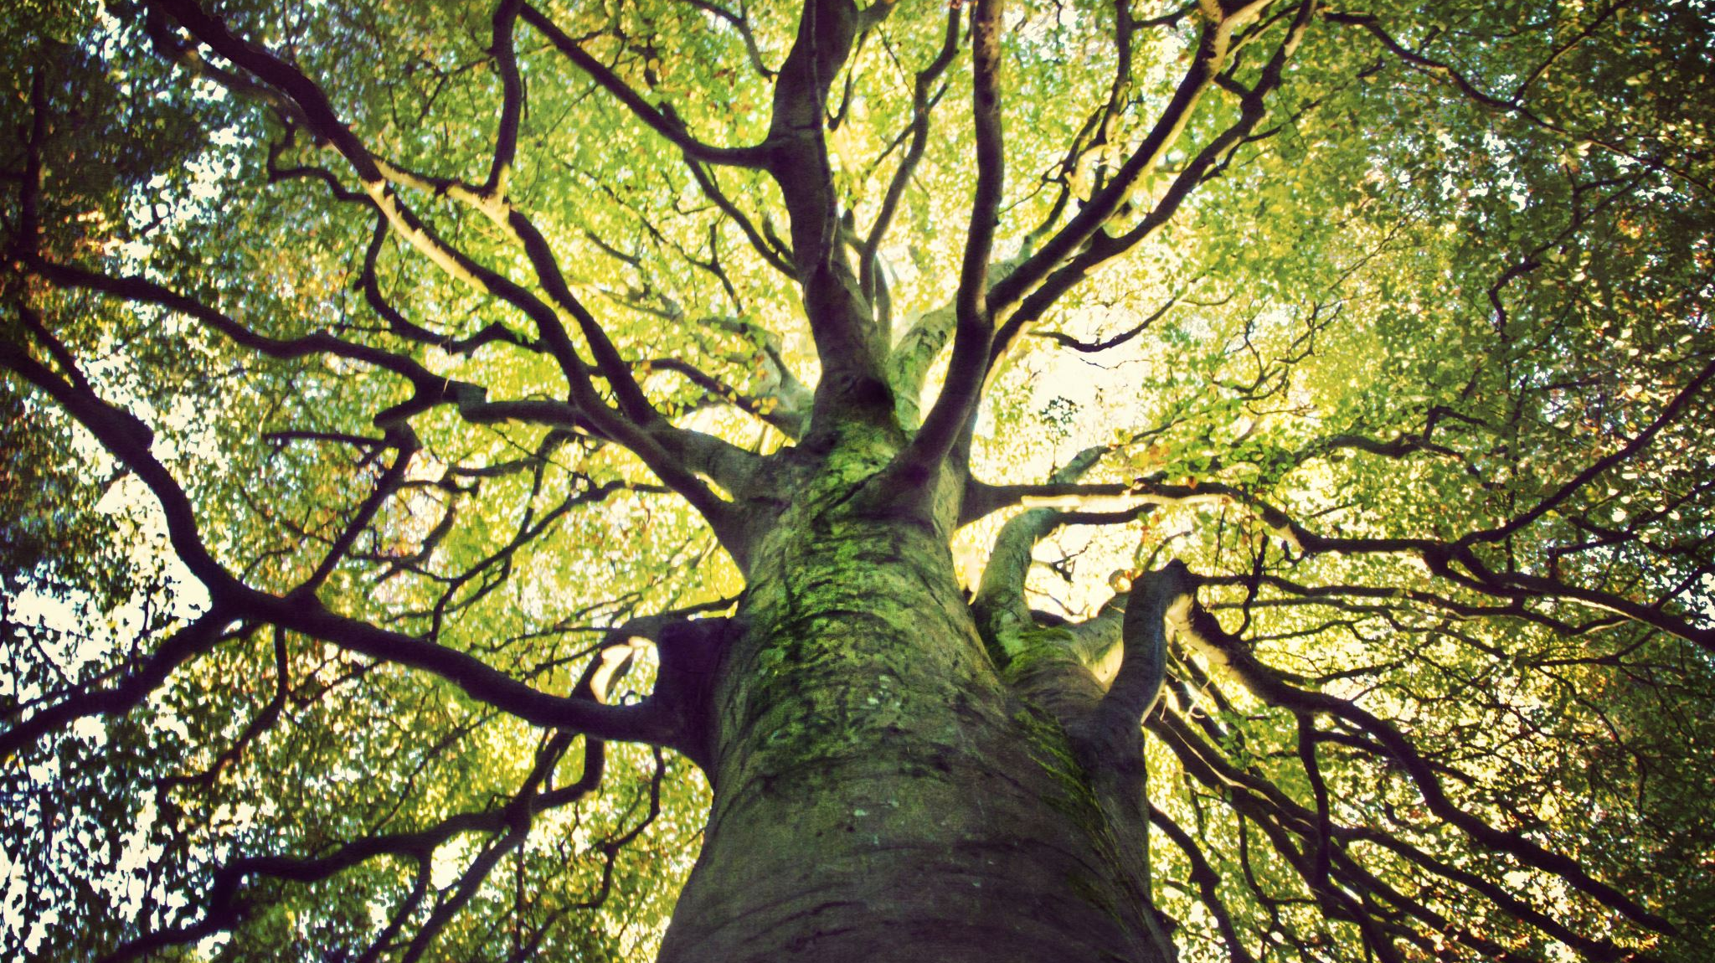
Cs59000-014 Machine Learning Project
GINI COEFFICIENT: Inequality Between Rich AND Poor

Slide 2
Gini Coefficient
The Gini coefficient is a single number aimed at measuring the degree of inequality in a distribution. It is most often used in economics to measure how far a country's wealth or income distribution deviates from a totally equal distribution.
The Gini is the sum, over all income-ordered population-percentiles, of the shortfall, from equal-share, of the cumulative-income up to each population-percentile. ....with that summed shortfall divided by the greatest value that it could have, with complete inequality.

Slide 3
Gini Coefficient
The Gini coefficient is usually defined mathematically based on the Lorenz curve, which plots the proportion of the total income of the population (y axis) that is cumulatively earned by the bottom x of the population (see diagram). The line at 45 degrees thus represents perfect equality of incomes. The Gini coefficient can then be thought of as the ratio of the area that lies between the line of equality and the Lorenz curve (marked A in the diagram) over the total area under the line of equality (marked A and B in the diagram); i.e., G = A/(A + B). It is also equal to 2A and to 1 − 2B due to the fact that A + B = 0.5 (since the axes scale from 0 to 1).

Slide 4
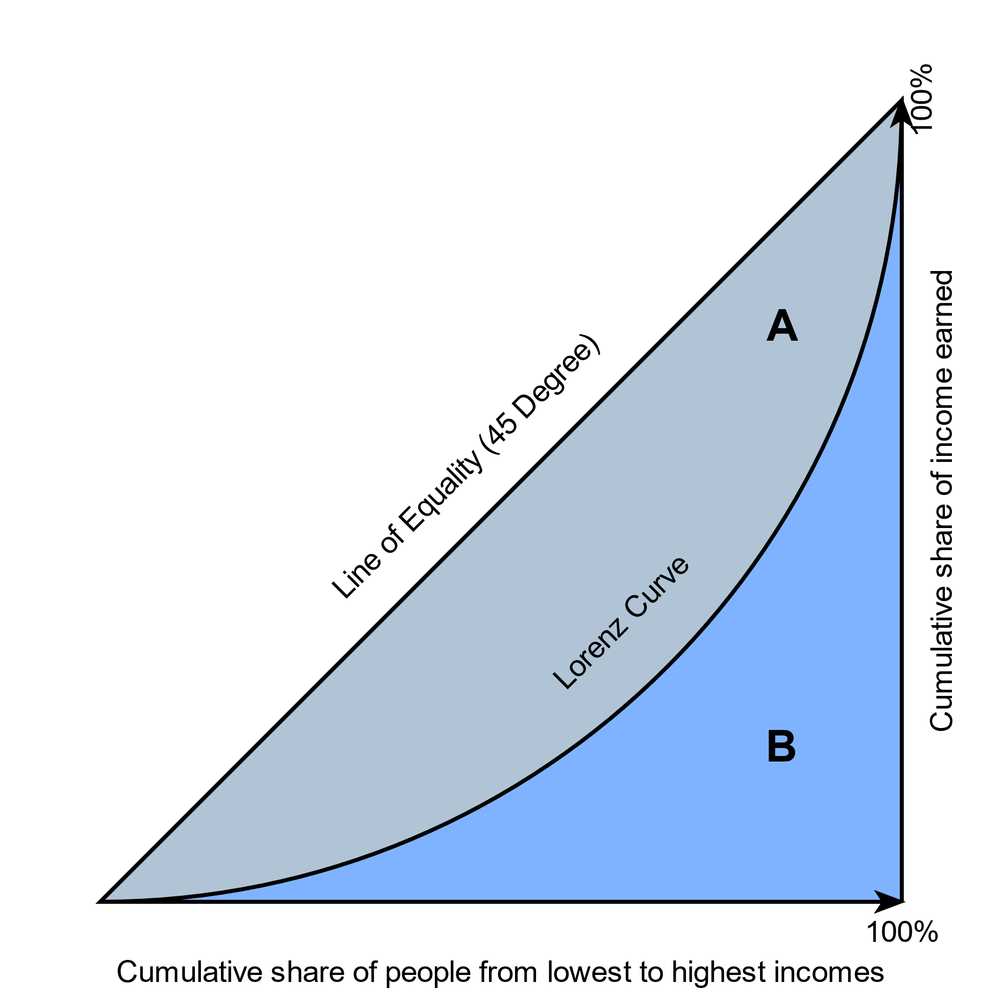
Lorenz curve
Graphical representation of the Gini coefficient The graph shows that the Gini coefficient is equal to the area marked A divided by the sum of the areas marked A and B, that is, Gini = A/(A + B). It is also equal to 2A and to 1 − 2B due to the fact that A + B = 0.5 (since the axes scale from 0 to 1).

Slide 5

Machine Learning

Slide 6
Machine Learning
Machine learning (ML) is the study of computer algorithms that improve automatically through experience. It is seen as a subset of artificial intelligence. Machine learning algorithms build a model based on sample data, known as "training data", in order to make predictions or decisions without being explicitly programmed to do so. Machine learning algorithms are used in a wide variety of applications, such as email filtering and computer vision, where it is difficult or unfeasible to develop conventional algorithms to perform the needed tasks.

Slide 7

Machine Learning approaches
Supervised learning: The computer is presented with example inputs and their desired outputs, given by a "teacher", and the goal is to learn a general rule that maps inputs to outputs.
Unsupervised learning: No labels are given to the learning algorithm, leaving it on its own to find structure in its input. Unsupervised learning can be a goal in itself (discovering hidden patterns in data) or a means towards an end (feature learning).
Reinforcement learning: A computer program interacts with a dynamic environment in which it must perform a certain goal (such as driving a vehicle or playing a game against an opponent). As it navigates its problem space, the program is provided feedback that's analogous to rewards, which it tries to maximize.

Slide 8

Decision Tree
A decision tree is a flowchart-like tree structure where an internal node represents feature(or attribute), the branch represents a decision rule, and each leaf node represents the outcome. The topmost node in a decision tree is known as the root node. It learns to partition on the basis of the attribute value. It partitions the tree in recursively manner call recursive partitioning. This flowchart-like structure helps you in decision making. It's visualization like a flowchart diagram which easily mimics the human level thinking. That is why decision trees are easy to understand and interpret.

Slide 9
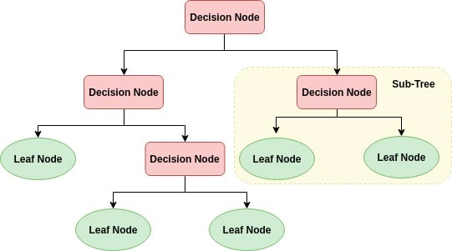
Decision Tree
Decision Tree is a white box type of ML algorithm. It shares internal decision-making logic, which is not available in the black box type of algorithms such as Neural Network. Its training time is faster compared to the neural network algorithm. The time complexity of decision trees is a function of the number of records and number of attributes in the given data. The decision tree is a distribution-free or non-parametric method, which does not depend upon probability distribution assumptions. Decision trees can handle high dimensional data with good accuracy.

Slide 10
How decision tree works?
The basic idea behind any decision tree algorithm is as follows:
Select the best attribute using Attribute Selection Measures(ASM) to split the records.
Make that attribute a decision node and breaks the dataset into smaller subsets.
Starts tree building by repeating this process recursively for each child until one of the condition will match:
All the tuples belong to the same attribute value.
There are no more remaining attributes.
There are no more instances.

Slide 11
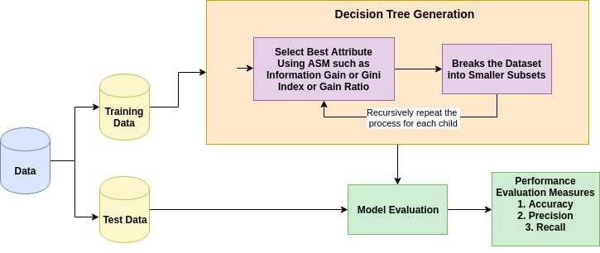
How decision tree works?

Slide 12
Attribute selection measures
Attribute selection measure is a heuristic for selecting the splitting criterion that partition data into the best possible manner. It is also known as splitting rules because it helps us to determine breakpoints for tuples on a given node. ASM provides a rank to each feature(or attribute) by explaining the given dataset. Best score attribute will be selected as a splitting attribute. In the case of a continuous-valued attribute, split points for branches also need to define. Most popular selection measures are Information Gain, Gain Ratio, and Gini Index.

Slide 13
Information gain
Shannon invented the concept of entropy, which measures the impurity of the input set. In physics and mathematics, entropy referred as the randomness or the impurity in the system. In information theory, it refers to the impurity in a group of examples. Information gain is the decrease in entropy. Information gain computes the difference between entropy before split and average entropy after split of the dataset based on given attribute values. ID3 (Iterative Dichotomiser) decision tree algorithm uses information gain.

Slide 14



Information gain
Where, Pi is the probability that an arbitrary tuple in D belongs to class Ci.
Where,
Info(D) is the average amount of information needed to identify the class label of a tuple in D.
|Dj|/|D| acts as the weight of the jth partition.
InfoA(D) is the expected informa-tion required to classify a tuple from D based on the partitioning by A.
The attribute A with the highest information gain, Gain(A), is chosen as the splitting attribute at node N().

Slide 15
Gain Ratio
Information gain is biased for the attribute with many outcomes. It means it prefers the attribute with a large number of distinct values. For instance, consider an attribute with a unique identifier such as customer_ID has zero info(D) because of pure partition. This maximizes the information gain and creates useless partitioning.
C4.5, an improvement of ID3, uses an extension to information gain known as the gain ratio. Gain ratio handles the issue of bias by normalizing the information gain using Split Info. Java implementation of the C4.5 algorithm is known as J48, which is available in WEKA data mining tool.

Slide 16


Gain Ratio
Where,
|Dj|/|D| acts as the weight of the jth partition.
v is the number of discrete values in attribute A.
The gain ratio can be defined as
The attribute with the highest gain ratio is chosen as the splitting attribute.

Slide 17


Gini Index
Another decision tree algorithm CART (Classification and Regression Tree) uses the Gini method to create split points.
Where, pi is the probability that a tuple in D belongs to class Ci.
The Gini Index considers a binary split for each attribute. You can compute a weighted sum of the impurity of each partition. If a binary split on attribute A partitions data D into D1 and D2, the Gini index of D is:

Slide 18

Gini Index
In case of a discrete-valued attribute, the subset that gives the minimum gini index for that chosen is selected as a splitting attribute. In the case of continuous-valued attributes, the strategy is to select each pair of adjacent values as a possible split-point and point with smaller gini index chosen as the splitting point.
The attribute with minimum Gini index is chosen as the splitting attribute.

Slide 19
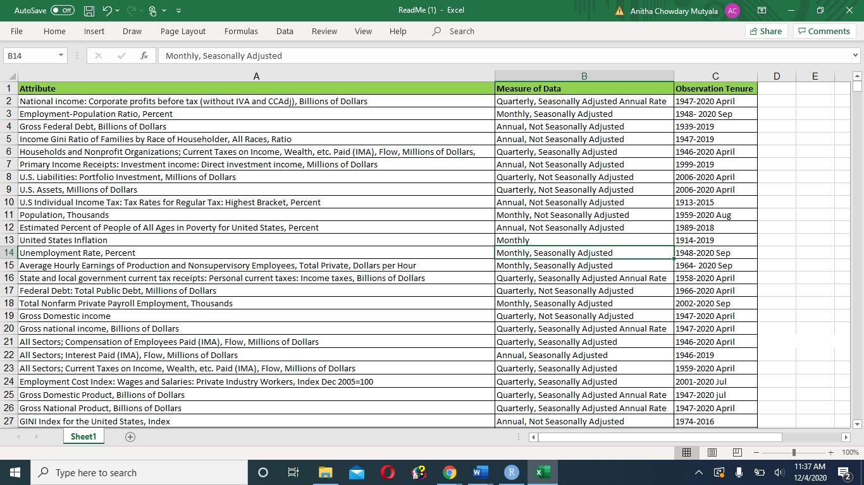
Data collection
Overall, we have collected 30 attributes in the initial stage.
We have decided on the most appropriate attributes amongst the 30 attributes and finalized our data with 19 attributes for the interval (1964-2020) and 225 cases/rows

Slide 20
Data preprocessing
The following steps are used to preprocess the data.
Import packages
Import datasets
Create linear regression function
Create time series function
Predict values for 19 attributes
Concatenate data frames to export the new dataset

Slide 21
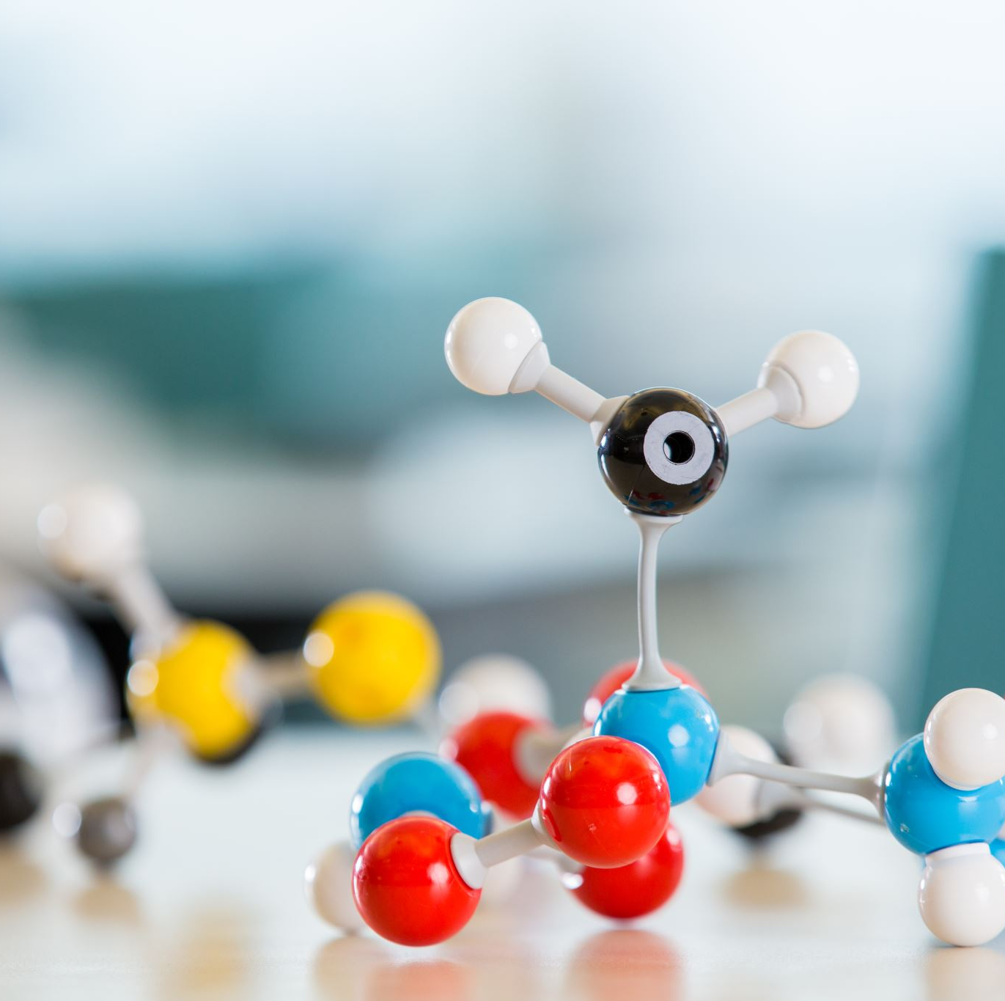
Model training
We used DecisionTreeCassifier from the sklearn library to train our model.
In which we used Gini impurity to decide the node of the decision tree

Slide 22
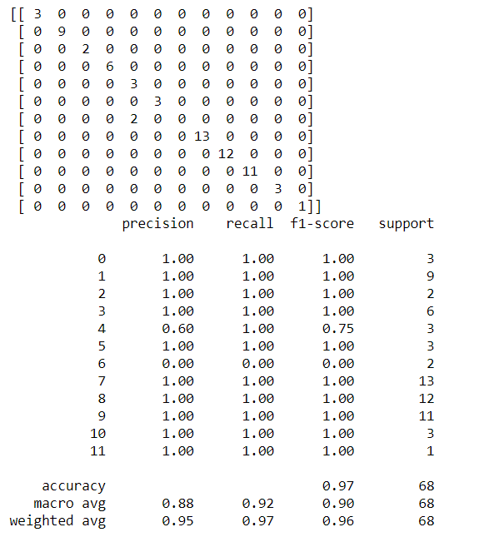
Model Accuracy
We got a classification rate of 97.1%, accuracy.

Slide 23
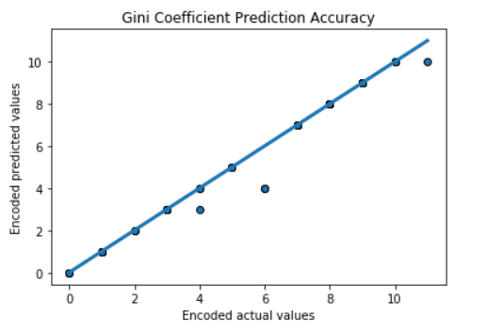
Actual VS Prediacted
This graph represents the accuracy of the model where the x_lable and the y_lable shows the encode value of the GINI coefficients as
Encoded | 0 | 1 | 2 | 3 | 4 | 5 | 6 | 7 | 8 | 9 | 10 | 11
GINI | 0.35 | 0.36 | 0.37 | 0.38 | 0.39 | 0.40 | 0.42 | 0.43 | 0.44 | 0.45 | 0.46 | 0.47
Where the dot shows the error in the model

Slide 24
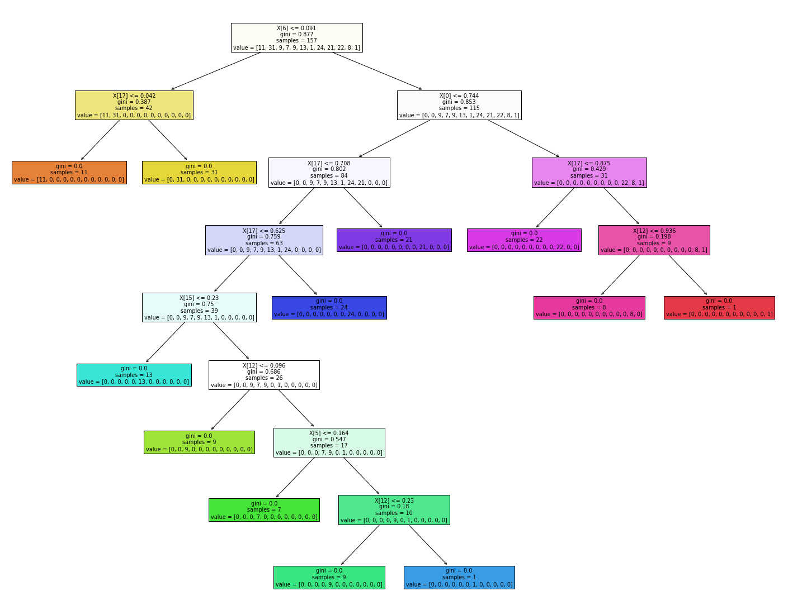
Decision tree
In the decision tree chart, each internal node has a decision rule that splits the data. Gini referred as Gini ratio, which measures the impurity of the node. You can say a node is pure when all its records belong to the same class, such nodes known as the leaf node.

Slide 25
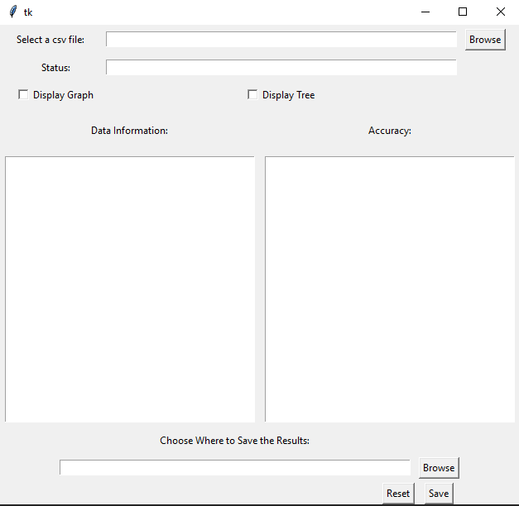
User interface
To be able to work with models in real time, designing a user interface was ideal. The design goals were to produce a simple, easy to understand, and intuitive to use. The figure below shows the structure of the UI. The GUI uses the tkinter library and runs on Python 3.

Slide 26
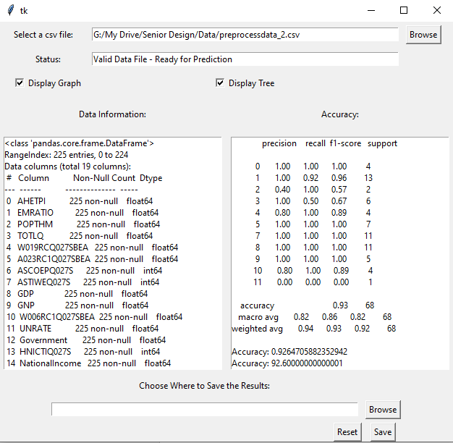
User interface

Slide 27
Future changes
Currently, the model does not have options to insert the dependent and independent variable fields individually by the user. Currently, those values can only be entered within the code itself. Future versions of the model will be able to take input fields from the user dynamically to make it more functionable.

Slide 28

Thank you

