Slide 1

Plasma Donation Bank

Slide 2
Group info:-
Faculty incharge – Pritee Khanna Mam
Group members – Garvit Gupta(2019060)
- Piyush Goel(2019108)
- Ganesh Kalyankar(2019058)

Slide 3
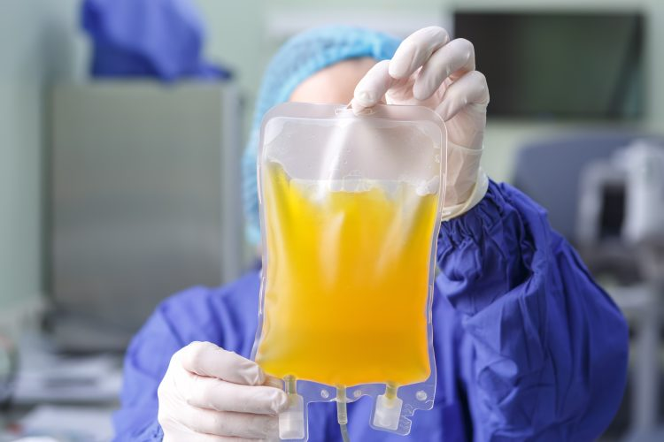
What Is Plasma??
Plasma is the yellow, liquid part of blood that contains. antibodies. Antibodies are proteins made by the body in response to infections. Convalescent plasma from patients who have already recovered from coronavirus disease 2019 (COVID-19) may contain antibodies against COVID-19.

Slide 4
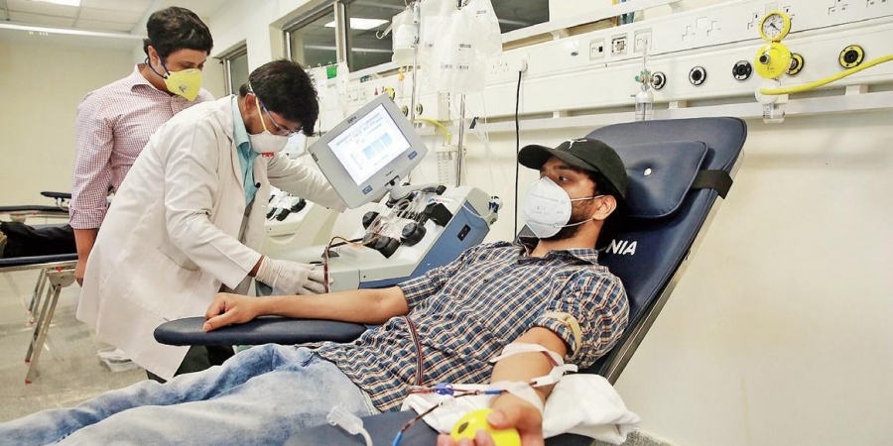
Why Plasma Banks Are Reqired?
Due to covid-19 pandemic the demand for plasma increses rapidly because the plasma of the recovered covid -19 patient contains the antibodies against covid-19.
As we all knew that there is no proper cure for this disease. So plasma of recoverd patient is used for treatment of the other covid-19 patients .

Slide 5

Who had coronavirus or its symptoms. He must be over 17 and have enough
to donate safely
Doctor! What are the criterias to donate plasma

Slide 6

Relational Diagram

Slide 7
Thank you…

