Slide 1
UK BTR / PBSA
BD Intelligence Platform
One live source of BD truth for UK BTR & PBSA — every scheme, every planning application, every operator.
SCHEMES
PLANNING APPS
BD-ACTIONABLE NOW
27,767
1.35M
332
operating BTR / PBSA
305 councils, daily refresh
operators showing distress
Internal — BD Leadership Review
1 / 11

Slide 2
The problem we solve
From fragmented BD intel to one live source of truth
WITHOUT THE TOOL
WITH THE TOOL
✗
Intel scattered across Knight Frank, JLL, BPF, press releases
✓
27,767 operating schemes — operator, owner, units, contract, postcode
✗
BTR pipeline surfaces weeks after planning permission
✓
1.35M planning apps refreshed daily, BTR-eligible flagged automatically
✗
No central view of which operator runs which scheme
✓
Live distress score on every operator — switch opportunities surface first
✗
Distress signals only land after they're already public
✓
Filter, rank, deep-link — built for sales calls and pitch decks
UK BTR/PBSA BD Intelligence Platform
2 / 11

Slide 3
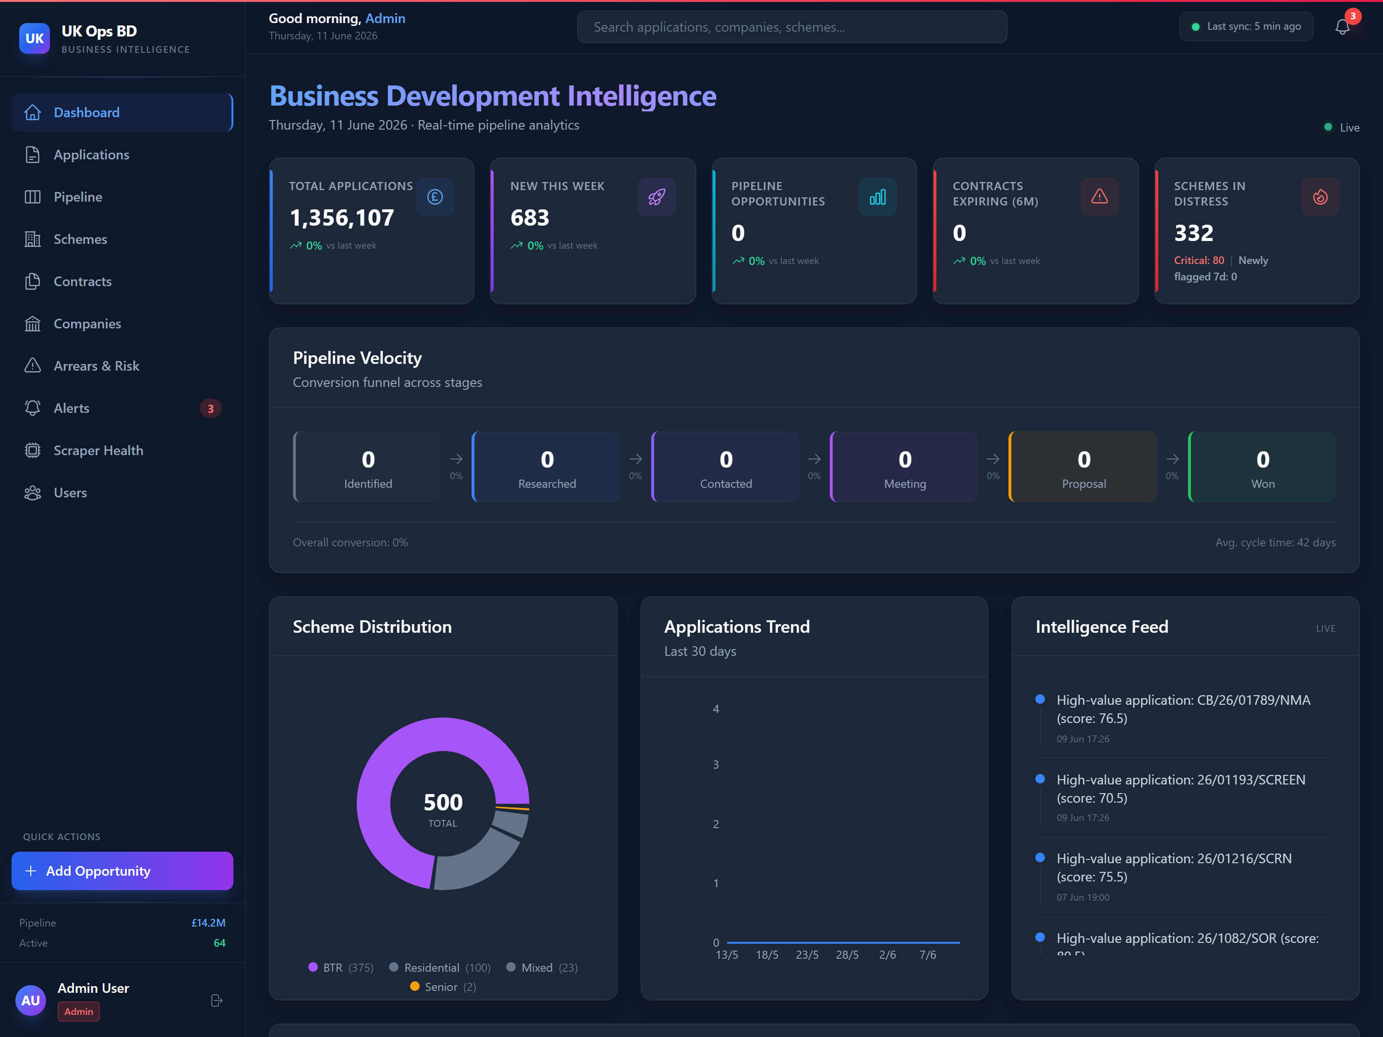
What the team sees on day one
Live dashboard: pipeline, distress, schemes in one view
Headline KPIs
1.35M apps · 332 distress · contracts expiring
Pipeline velocity
6-stage funnel from Identified to Won
Live intelligence feed
New high-value apps surfaced minute-by-minute
Distress alerts
Operators flagged as their CH filings change
Quick actions
Add opportunity, jump to scheme, export list
UK BTR/PBSA BD Intelligence Platform
3 / 11

Slide 4
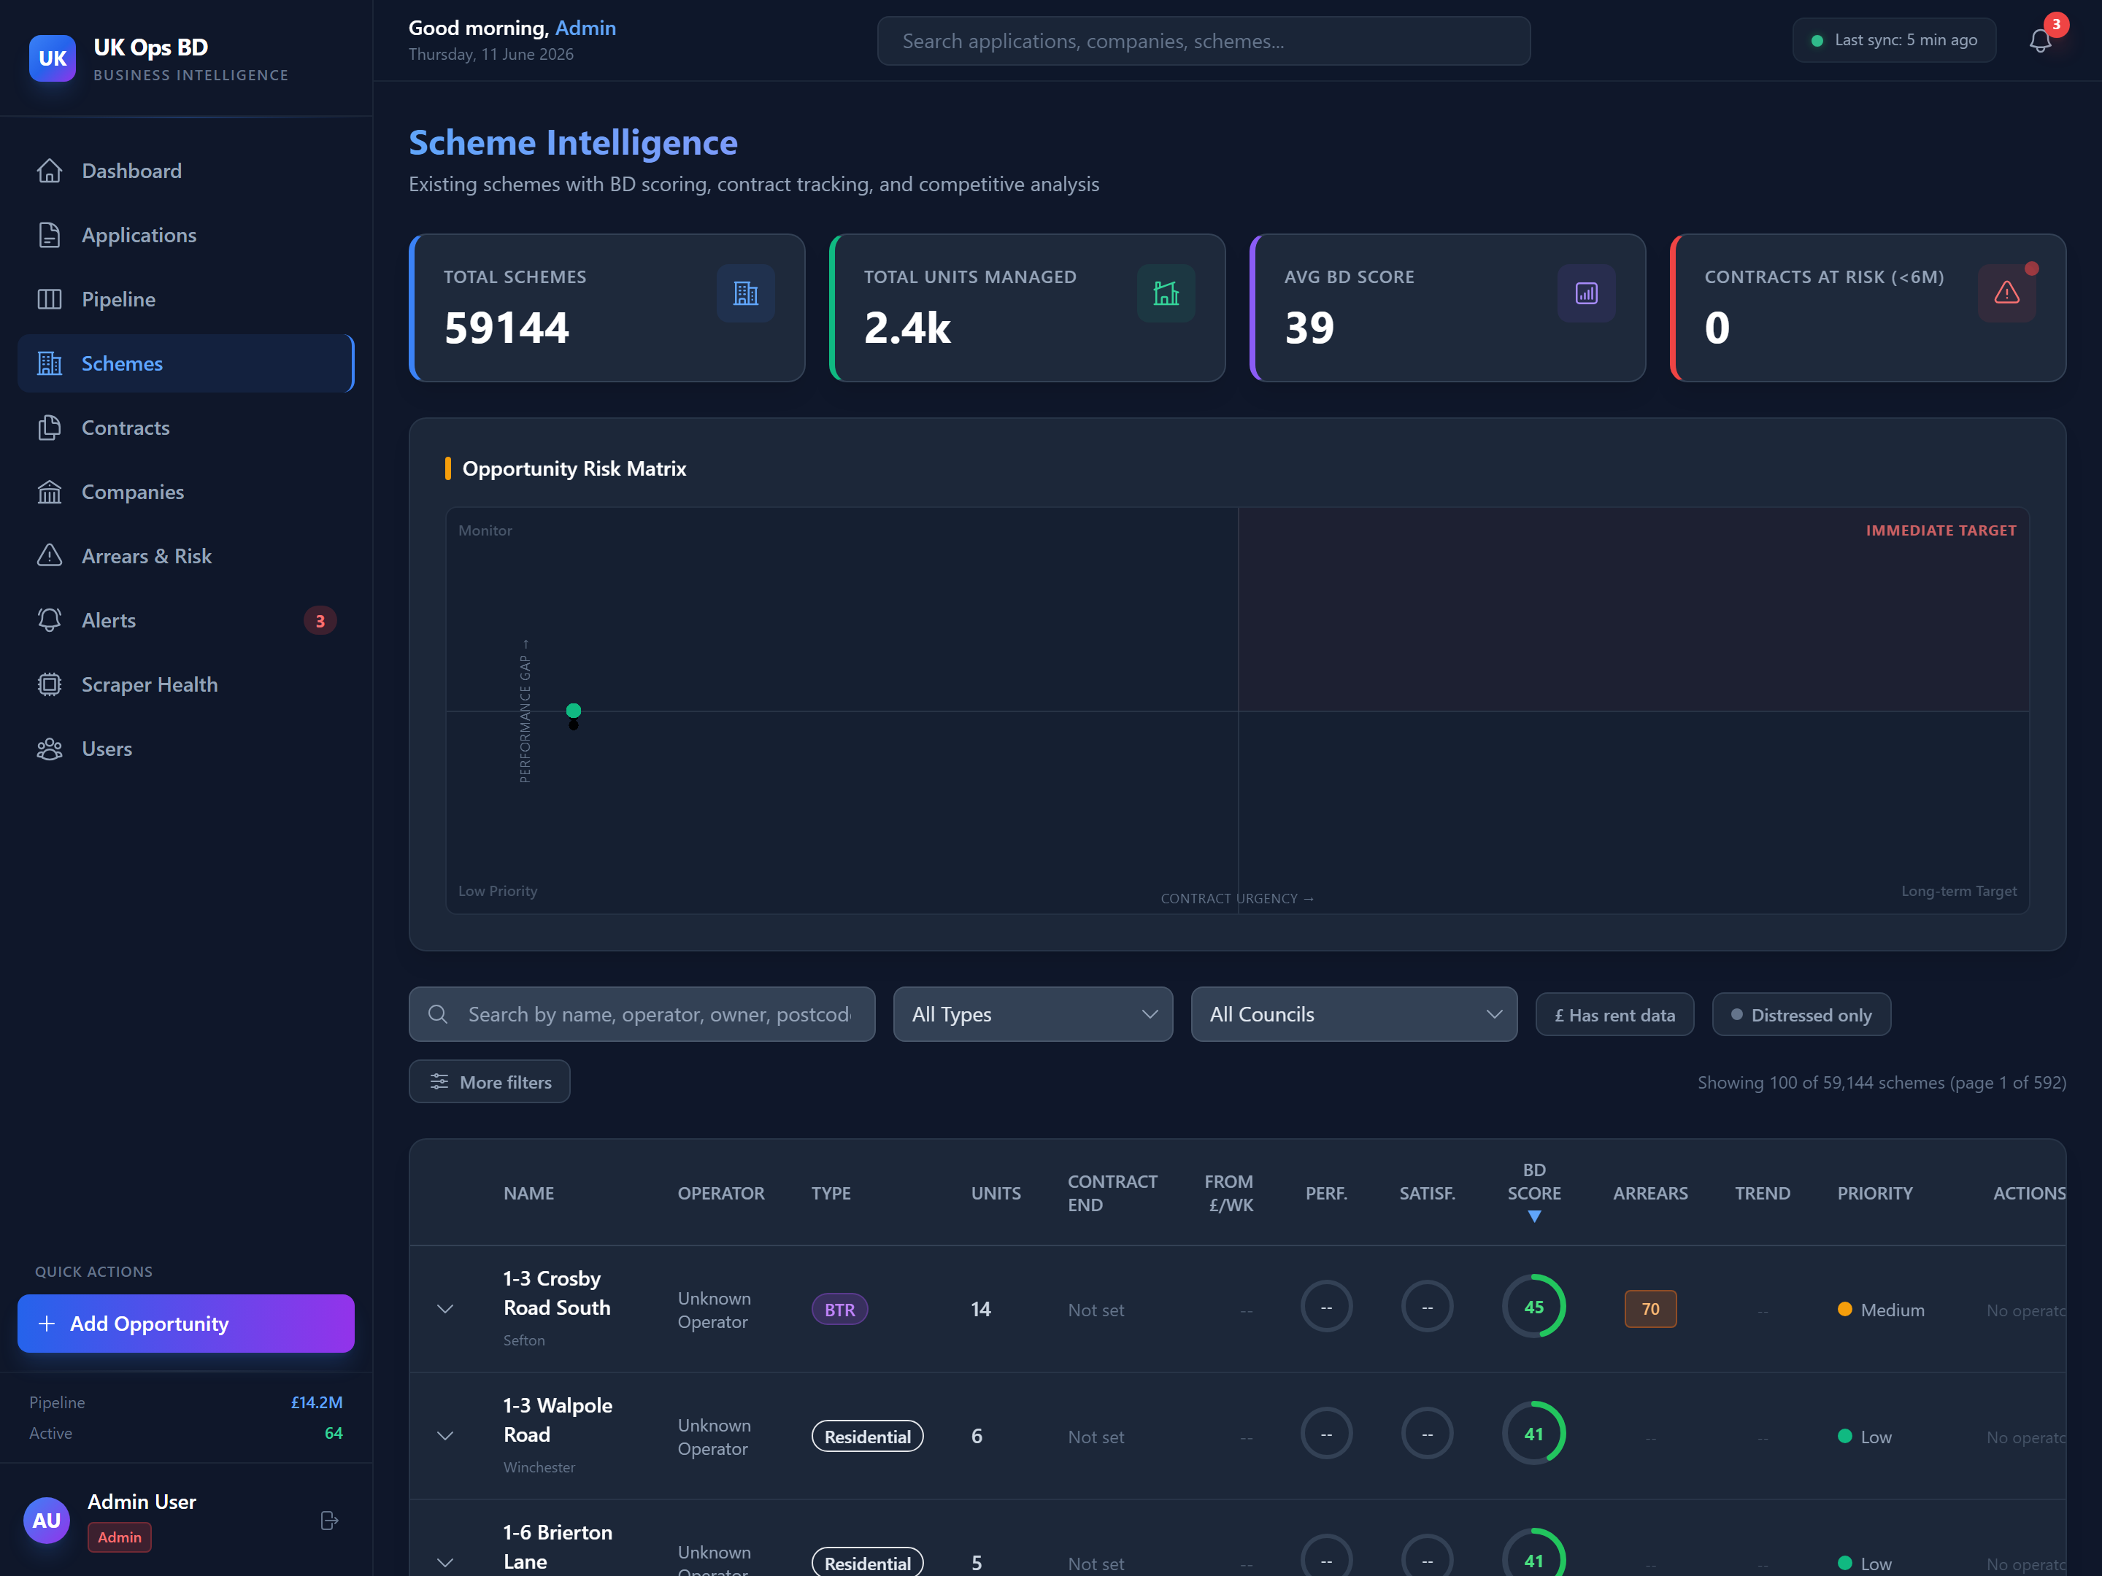
Schemes data — how BD uses it
27,767 BTR / PBSA schemes · operator · owner · units · rent · contract · distress
WHAT BD DOES WITH IT
Rent benchmarking & pricing defence
Operator targeting — find every scheme in their book
Acquisition shortlist — 332 schemes in distress today
Market sizing & white-space discovery by city
Track operator changes & contract expiries
27,767
Schemes
1,182
Rent records
44
Operators linked
332
Operators in distress
59
Acquisition targets
UK BTR/PBSA BD Intelligence Platform
4 / 11

Slide 5
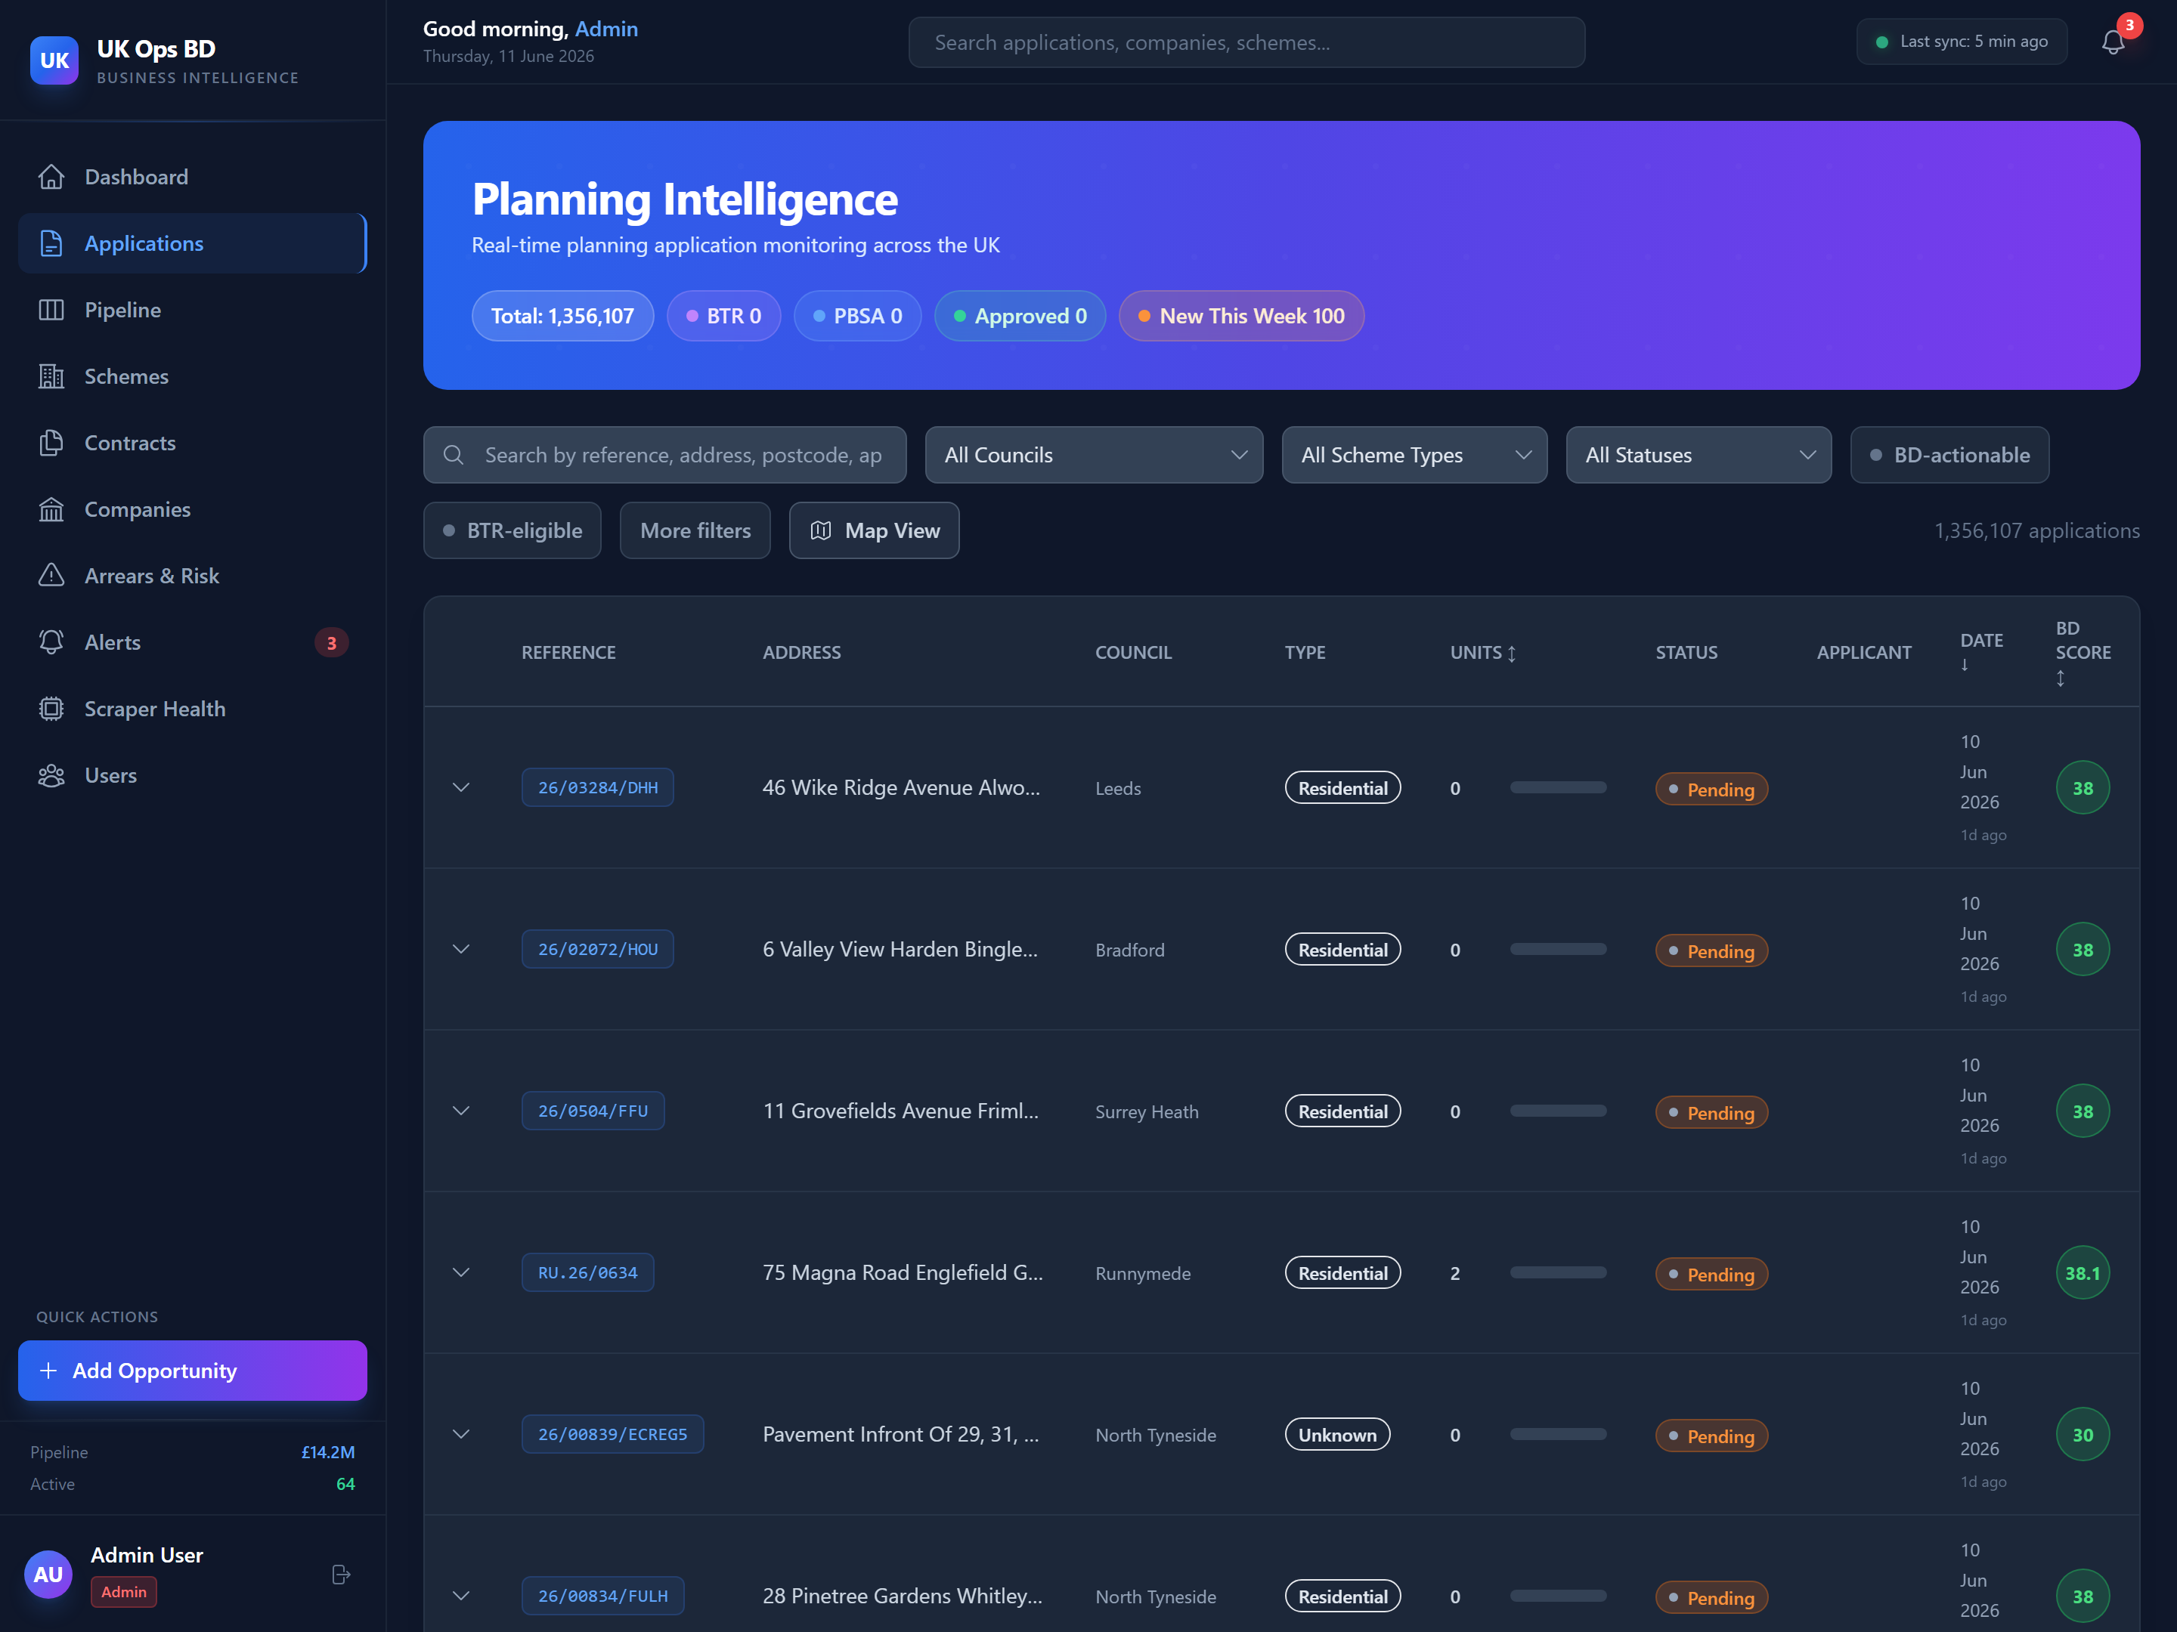
Applications data — how BD uses it
1.35M planning applications · BTR opportunities surfaced before competitors find them
WHAT BD DOES WITH IT
Early-stage BTR pipeline — before competitors notice
Pitch the right developer at the right moment
Track developer pipelines — Berkeley, Quintain, Moda…
Council relationships — see who's planning-friendly
BD-actionable filter — Pending / Pre-App / Submitted
1.35M
Applications
305
Councils tracked
1,373
BTR-eligible
479
Pending BD-actionable
~1,000
New every day
UK BTR/PBSA BD Intelligence Platform
5 / 11

Slide 6
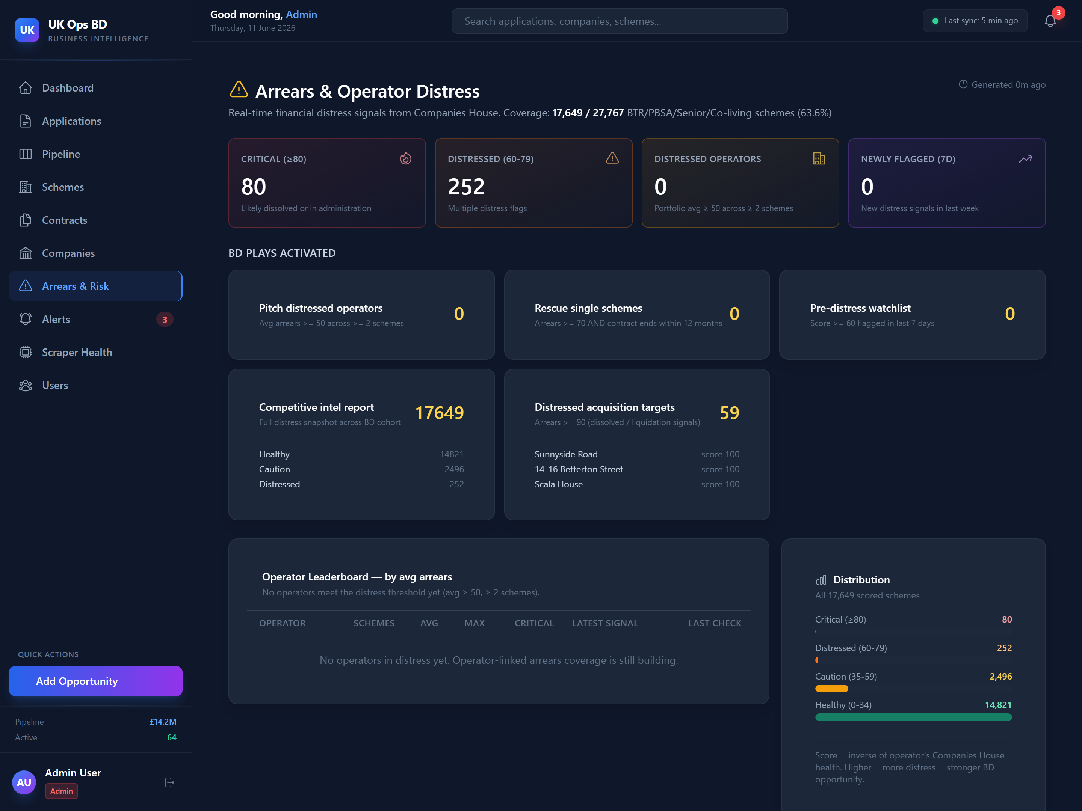
Distress intelligence
Who's wobbling, which schemes are exposed, where the BD play is
OUTPUTS
80
Critical (≥80)
252
Distressed (60-79)
17,649
Scheme cohort scored
59
Acquisition targets
UK BTR/PBSA BD Intelligence Platform
6 / 11

Slide 7
Coverage & honest gaps
What we have today, what's still thin, and the business impact
UK COUNCILS
COUNCIL LINKAGE
SCHEMES SCORED
ARREARS SCORED
339
99.97%
27,503
63.6%
of 417 LPAs (81%)
of scheme records
every BD-cohort row
of BD cohort
HONEST GAPS
01
02
03
Planning data is metadata-thin
Operator linkage incomplete
Live occupancy + CSAT not wired
~99% of council planning records lack unit counts and developer names. Top operators captured reliably; mid-tier weaker.
1,468 schemes have no operator. 8,500 more have an operator named but no Companies House link, so distress can't flow through.
BD score has 4 dimensions — 2 are live (contract urgency, distress); 2 (occupancy, Google Reviews) are baseline-defaulted.
BUSINESS IMPACT
BUSINESS IMPACT
BUSINESS IMPACT
Mid-tier developer pipeline under-represented
Distress leaderboard understated — 5× upside on completion
Activating these doubles operator-switch ranking precision
UK BTR/PBSA BD Intelligence Platform
7 / 11

Slide 8
Ownership intelligence — scheme → SPV → fund
Identify the PE owners, white-label SPVs and asset-management platforms behind every building
HOW WE UNMASK THE WHITE LABEL
THE 23 TARGET CITIES — COVERAGE TODAY
Operating scheme
TIER
SCHEMES
OPERATOR
OWNER
The brand on the building — already in platform: 27,767 schemes
Highest Opportunity
9,309
5%
96%
TODAY
London · Bristol · Edinburgh · Glasgow
▼
Owning SPV
Strong Institutional
1,567
15%
96%
Single-asset company named on the land title
Manchester · Birmingham · Liverpool
HM LAND REGISTRY CCOD / OCOD — £0
Emerging — FOCUS
1,013
9%
95%
▼
Leeds · Cardiff · Exeter · S'oton · M'bro · Colchester
Asset-management platform
Highest Potential — FOCUS
Clusters of SPVs sharing a registered address + officers
576
5%
93%
COMPANIES HOUSE — £0
10 secondary university cities
▼
Ultimate owner / PE fund
DISCOVERY GAP
Only 12 PBSA records exist across the 10 secondary university cities — real stock is 10–30 schemes per city. Find the stock first, then fill every field.
Persons-with-significant-control chain + overseas entity register
COMPANIES HOUSE PSC + ROE — £0
Honest ceiling: offshore fund structures cap ownership resolution at ~80–90% — flagged in the UI, never silently missing.
UK BTR/PBSA BD Intelligence Platform
8 / 11

Slide 9
Build plan — step by step
14 development steps across four phases · ~3 weeks · focus market first
Discover the stock
Fill operators & merge
WEEK 1 · £0 (DEV)
WEEKS 1–2 · £500 AI CREDITS
1
Build StuRents scraper — city → scheme, operator, rents
5
Dedupe + merge new schemes (existing pipeline)
2
Build AccommodationForStudents scraper (cross-check)
6
AI enrichment over every focus-city operator gap
3
Extend operator-site scrapers to ~15 PBSA brands
7
Manual curation residue + lock verified fields
4
Scrape university halls pages in 10 secondary cities
Ownership pipeline
Surface for BD
WEEKS 2–3 · £0 — FREE REGISTERS
WEEK 3+ · INCLUDED
8
Ingest Land Registry CCOD / OCOD monthly files
12
Ownership tab: scheme → SPV → platform → fund
9
Match titles → schemes by postcode + address
13
PE / asset-manager target-list view + export
10
Walk Companies House PSC chains: SPV → ultimate owner
14
Contract-end AI estimation with confidence flags
11
Cluster SPVs by address + officers → platforms
TOTAL INVESTMENT
£500 – £1,000 one-off (AI credits) · ~3 weeks dev · £0 data cost — every ownership source is a free public register
UK BTR/PBSA BD Intelligence Platform
9 / 11

Slide 10
What gets scraped
Five scrape targets to build or extend, plus three free public registers to integrate
NEW SCRAPERS TO BUILD OR EXTEND
StuRents
Every PBSA scheme listed per city — name, address, operator, rooms, rents
BUILD · WK 1
AccommodationForStudents
Second PBSA directory — cross-validates schemes and fills gaps
BUILD · WK 1
Operator websites (~15 brands)
Unite, iQ, Fresh, Vita, Yugo, Homes for Students, CRM, Prestige, Collegiate…
EXTEND · WK 1
University halls pages
Partner halls + nomination stock across the 10 secondary cities
BUILD · WK 1
Rightmove / Zoopla
BTR + co-living listings and rent evidence in the focus cities
EXTEND · WK 2
FREE PUBLIC REGISTERS — API / BULK DOWNLOAD, NO SCRAPING NEEDED
HMLR CCOD + OCOD
Registered owner (SPV) of every UK title — company name + CH number, monthly
INTEGRATE · WK 2
Companies House API
PSC chains, officers, charges — already integrated for distress scoring
LIVE TODAY
Register of Overseas Entities
Beneficial owners behind offshore vehicles holding UK property
INTEGRATE · WK 3
All scraping is rate-limited and respects robots.txt · registers are licensed open data · scheme records dedupe through the existing merge pipeline.
UK BTR/PBSA BD Intelligence Platform
10 / 11

Slide 11
Platform investment & next steps
Five targeted investments, sequenced into three phases
WHAT TO FUND
ROLL-OUT
INVESTMENT
COST
UNLOCKS
Phase 1
Week 1
£500–1k
AI enrichment top-up
£500 → £5k
Operator link on ~10–15k schemes
Quick wins
AI top-up, scrapers re-enabled, top-1k targets enriched
Re-enable scheduled scrapers
£0
~1,000 new planning apps / day
Phase 2
Weeks 2 – 4
+2 wks dev
Deeper council planning crawls
£0 + 1 wk dev
BTR pipeline 290 → 1,500–3,000
Coverage extension
Deeper council crawls, full PBSA rent benchmark
Complete PBSA rent scraping
£50 / month
Full UK Tier-1 rent benchmarks
Phase 3
Month 2 – 3
£250 / mo
Vacancy + CSAT signals
£200 / month
Activates 45% of BD score weight
Premium signals
CSAT + vacancy live → full 100% BD score
UK BTR/PBSA BD Intelligence Platform
11 / 11

