Slide 1
Automated Text Summarization
Submitted By :
Garvit Sharda (500093671)
Devansh Aggarwal (500092974)
Nitika Singh (500094000)
Submitted To :
Dr. Achala Shakya

Slide 2
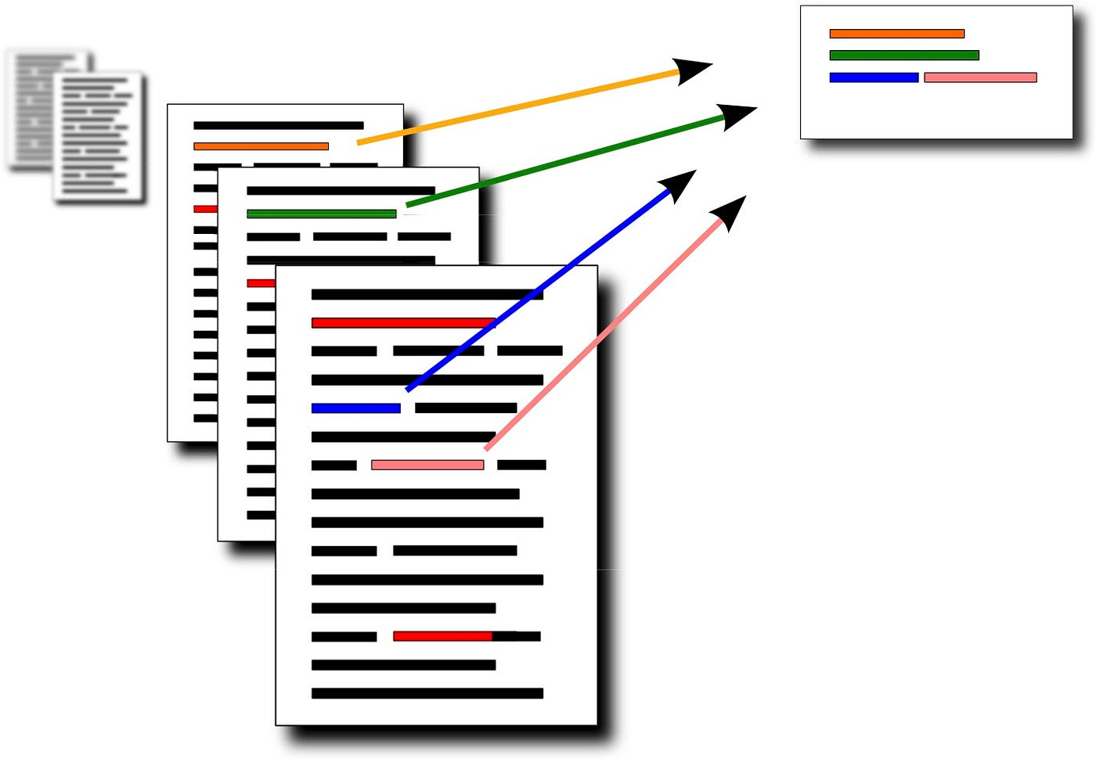
Text Summarization
Definition :
The act of computationally condensing a collection of data to produce a subset that highlights the most crucial or pertinent details from the original material is known as automatic summarization. To do this, artificial intelligence algorithms that are tailored for various data kinds are frequently created and used.

Slide 3
Methodology & Algorithm
Importing Libraries : Open text processing libraries (e.g., pandas, spaCy, etc.).
Tokenization : Divide the text into discrete words or meaningful units.
Frequency Count : Examine the frequency at which words appear to determine their significance.
Stop Words Removal : Get rid of ordinary, meaningless words like "the" and "a".
Ordering Every Sentence : Based on keywords and relevancy, give sentences a score.
Combining Sentences : For conciseness, combine related, highly-scoring sentences.
Summarization : To create the final summary, choose the sentences that rank highest.
Output : Display the streamlined content as the abridged version.

Slide 4
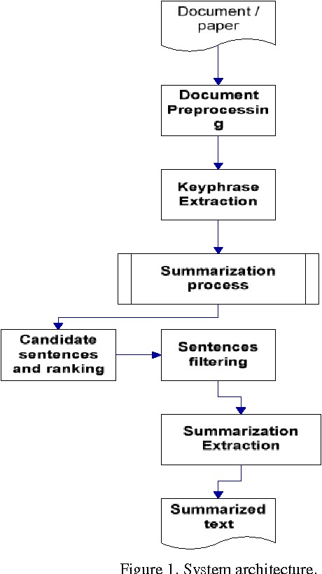
Flowchart

Slide 5
Libraries & Applications
Libraries Used:
SpaCy : A library for natural language processing.
Collections : The built-in library for lists, dictionaries, and sets in Python.
Pandas : Pandas is a data analysis and manipulation library.
heapq : A heap data structure implementation library.
tkinter : A Python standard GUI toolkit.
ttk (a subset of tkinter) : A tkinter themed extension for building GUIs that appear native.
Applications :
News & Research
Education
Business
Content Creation

Slide 6
SWOT Analysis
Strengths:
Efficiency
Reliability
Scalability
Weaknesses:
Accuracy
Language Complexity
Subjectivity
Opportunities:
Technological Developments
Integration
Multilingual Support
Threats:
Competition
Privacy Concerns
Regulatory Difficulties

Slide 7
Thank You !!

