Slide 1

DevOps Journey
Weather-App
Bringing Forecasting to Fingertips: Empowering Users with Real-Time Weather Insights
Anushk Sanghvi 500091334

Slide 2

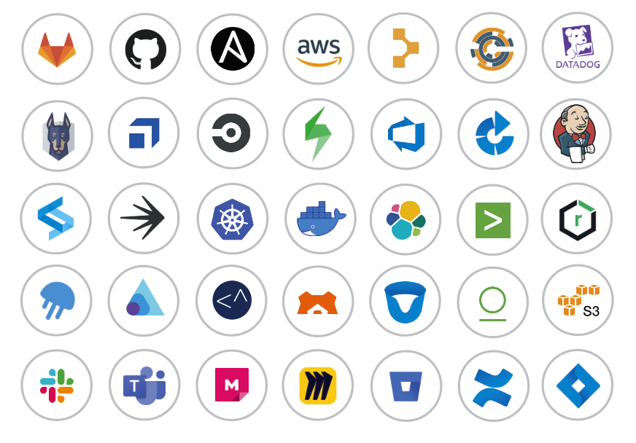
DevOps Tools Used
Tools
Jira
Git
GitHub
Jenkins
Selenium
Docker
Terraform
AWS

Slide 3

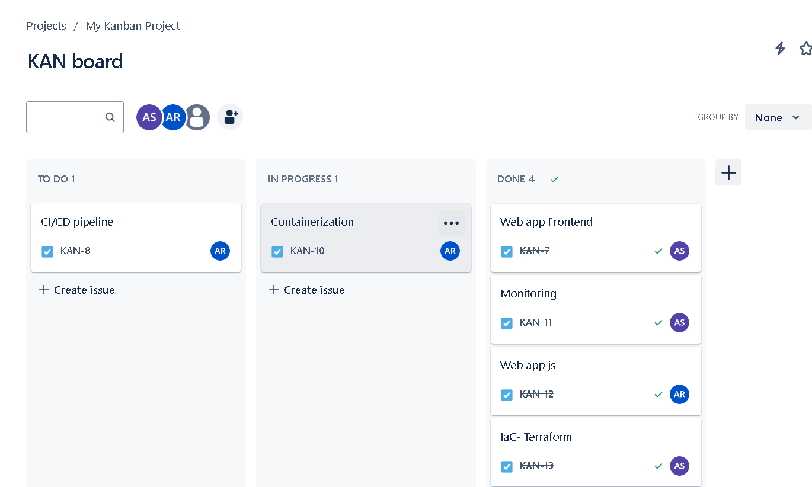
Planning
Planning phase was carried out via the use of
Kanban board using the Jira Software from Atlassian.
Tasks were assigned and progress was notified to all team members via the Kanban board.
Jira Board

Slide 4
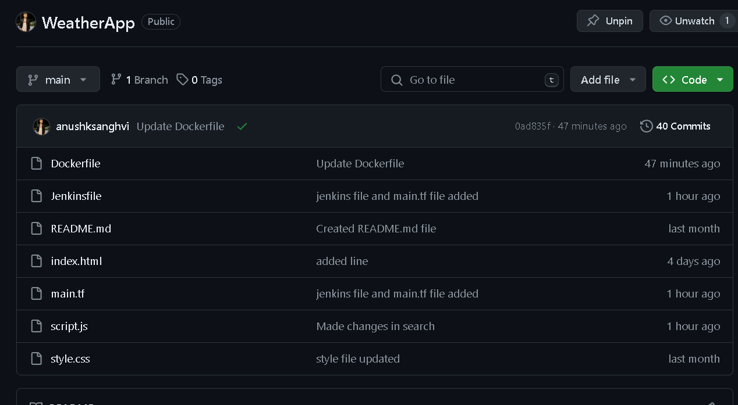
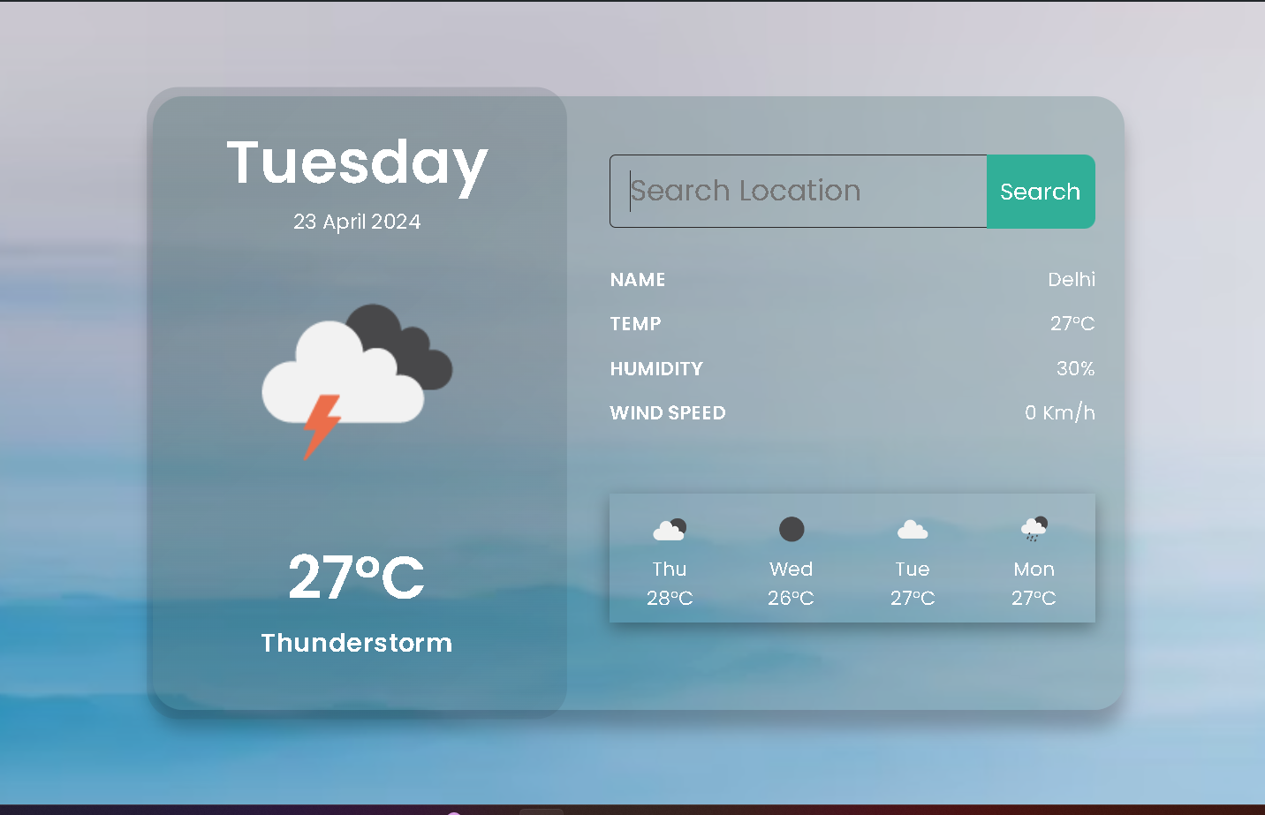
Version Control & Source Code
The source code is written in HTML, CSS, and JavaScript. This source code is managed in the local Repository via Git and was stored in the central Repository using GitHub
GitHub Repository

Slide 5
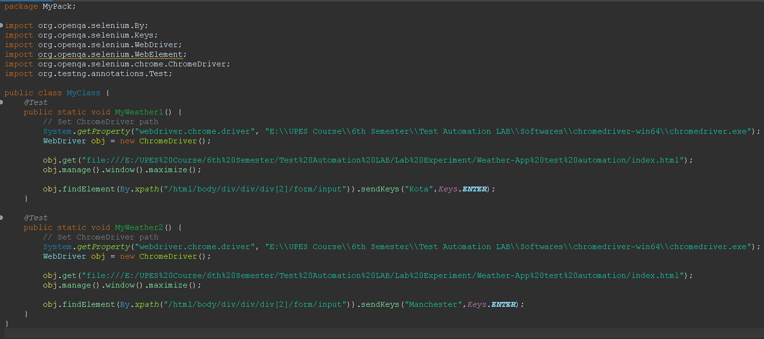
Testing
Using Selenium and TestNG, the web application is systematically tested against a range of input values and scenarios on a Chrome browser. Selenium facilitates automated interaction with the web elements, while TestNG provides a structured framework for organizing and executing tests

Slide 6
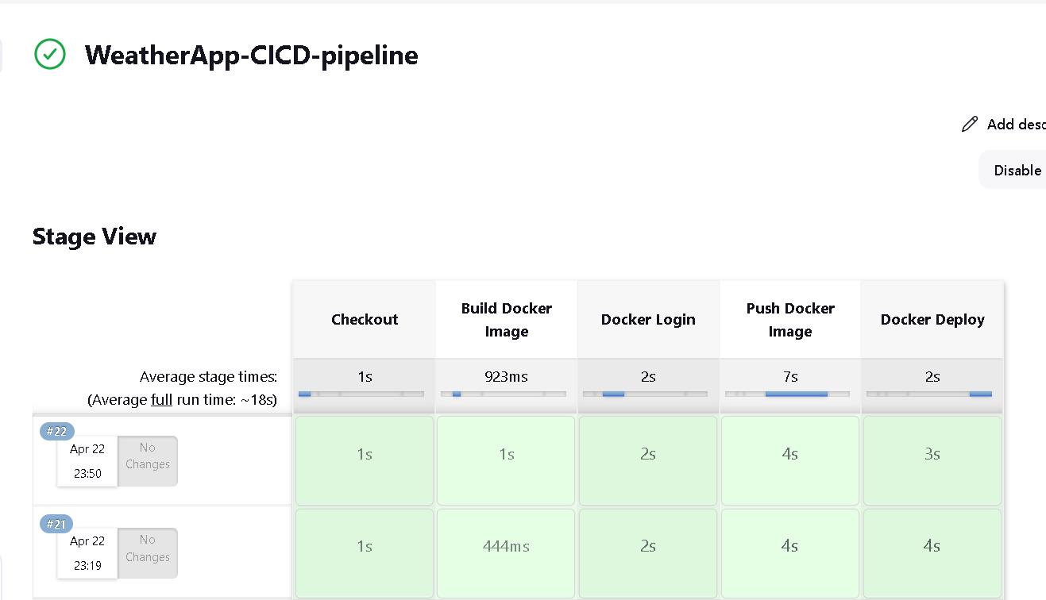
CI/CD Pipeline
Jenkins pipeline is created and it is integrated with Webhooks.
So, an automated workflow is established, whenever any change is done in the Central repository, the pipeline triggers itself and updates the build and creates a new build for deployment.
Jenkins Pipeline

Slide 7
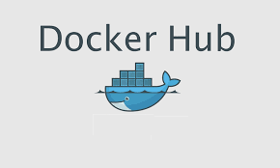
Containerization-
Containerization is a process of packaging your application together with its dependencies into one package (a container). Such a package can then be run pretty much anywhere, no matter if it's an on-premises server, a virtual machine in the cloud, or a developer's laptop.
docker pull
docker push

Slide 8
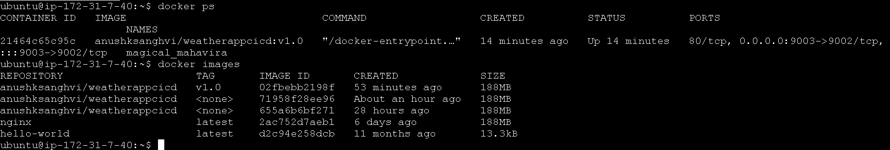
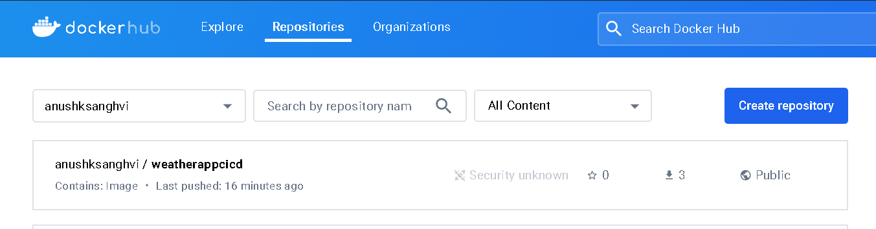
Dockerhub-Registry

Slide 9
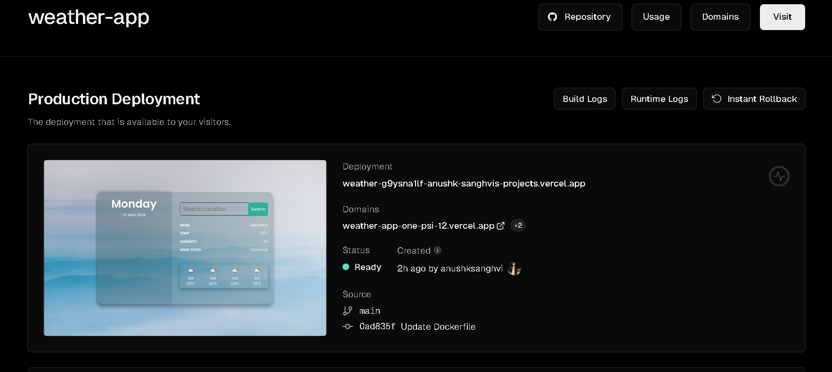
Deployed weather-app to Vercel

Slide 10
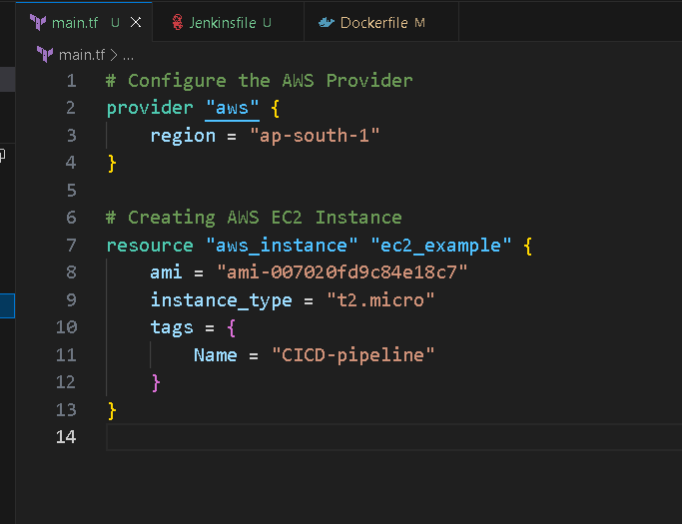
IAC (Infrastructure as code)
Creating AWS EC2 instances by using terraform
Terraform Life Cycle:
terraform init
terraform plan
terraform apply
terraform destroy
Terraform configuration files

Slide 11
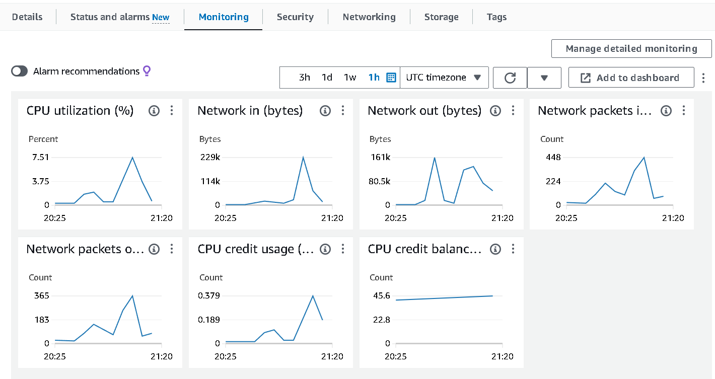
Monitoring
AWS CloudWatch is a comprehensive monitoring service that enables us to track the health and performance of your EC2 instances. It collects and stores metrics on various aspects like CPU utilization, network traffic, and disk I/O, allowing you to gain insights into system behavior.

Slide 12
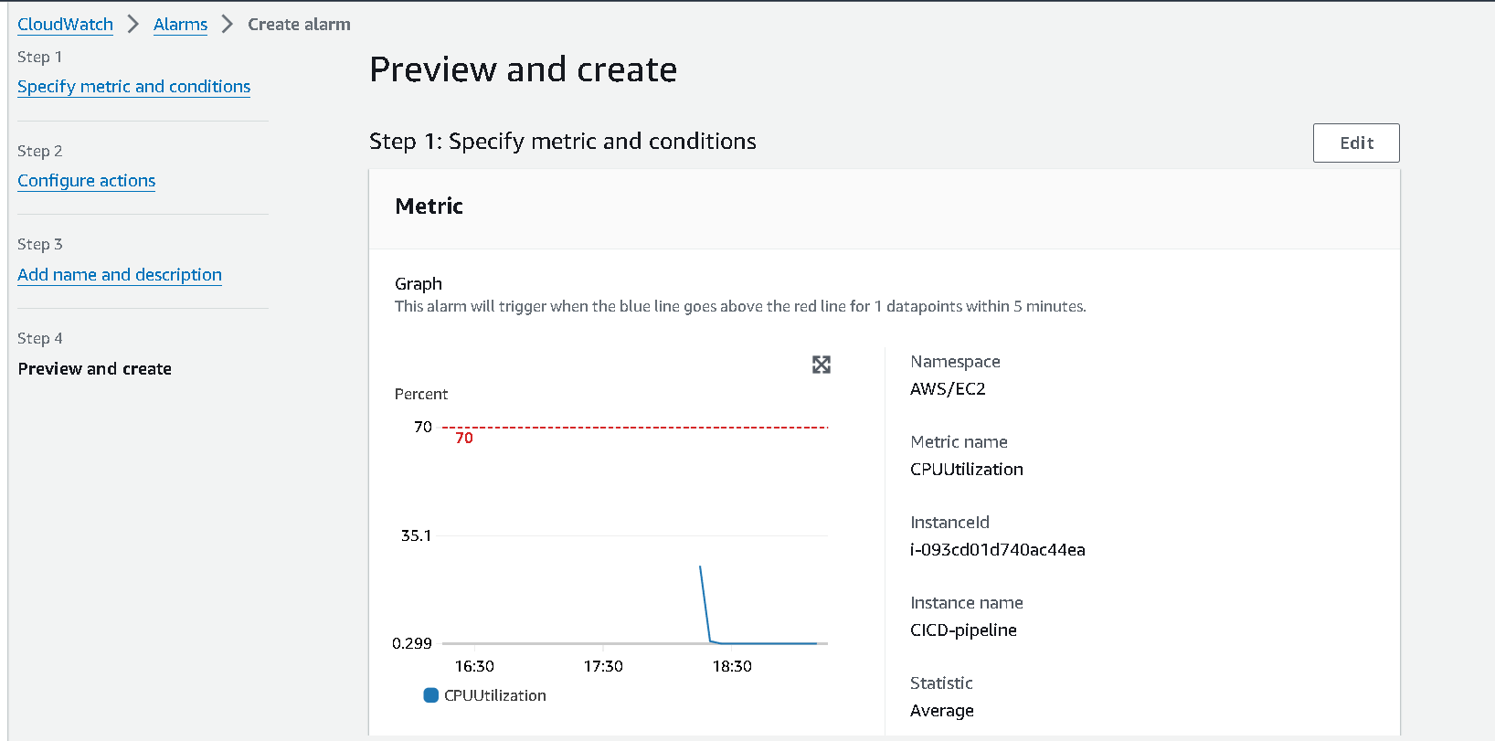
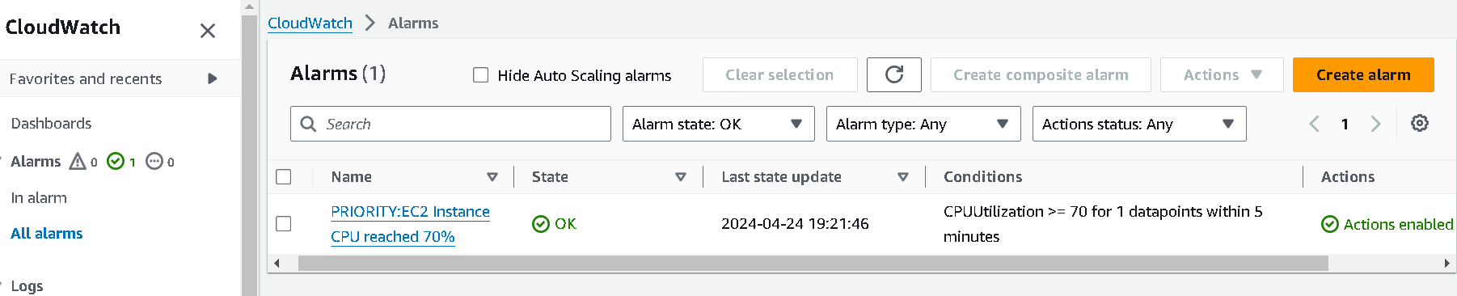
Set up CloudWatch alarms that will notify when CPU utilization exceed 70% thresholds. And send an email when the alarm is triggered in order to take necessary action.

Slide 13
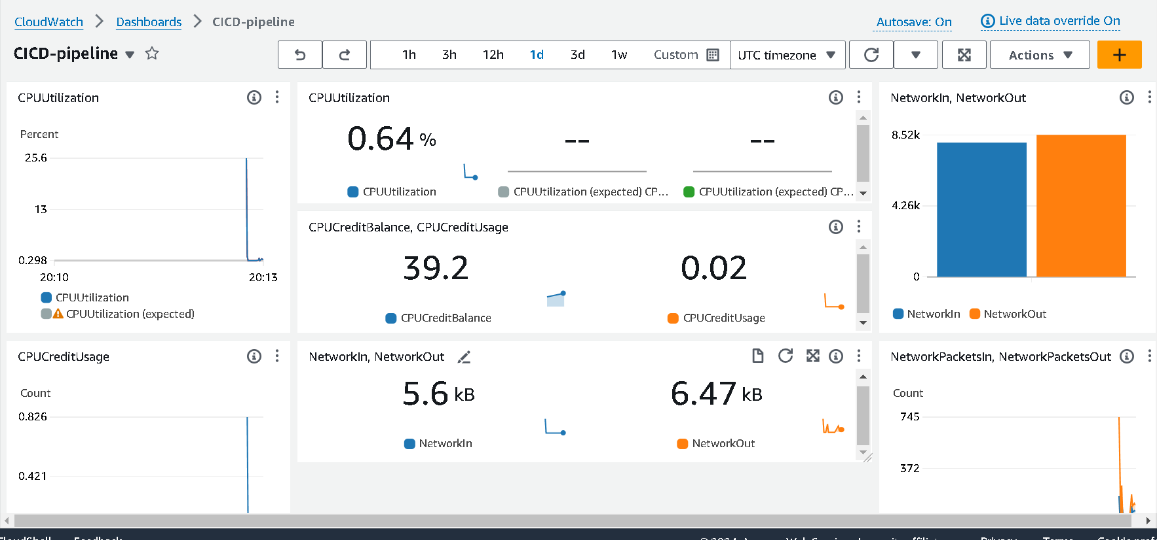
Created custom dashboards in CloudWatch to visualize and monitor the metrics that are most relevant to us.

Slide 14
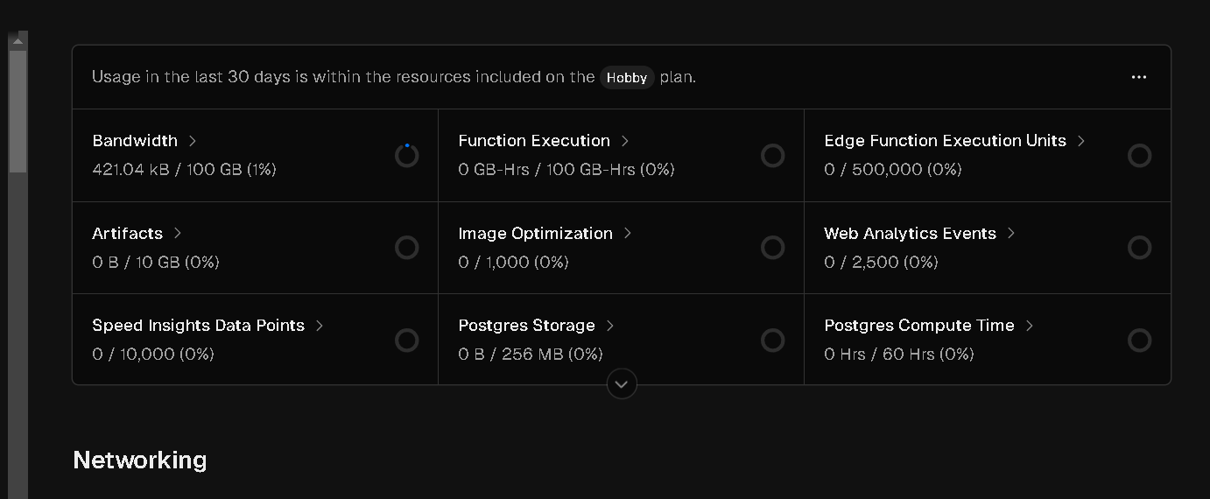
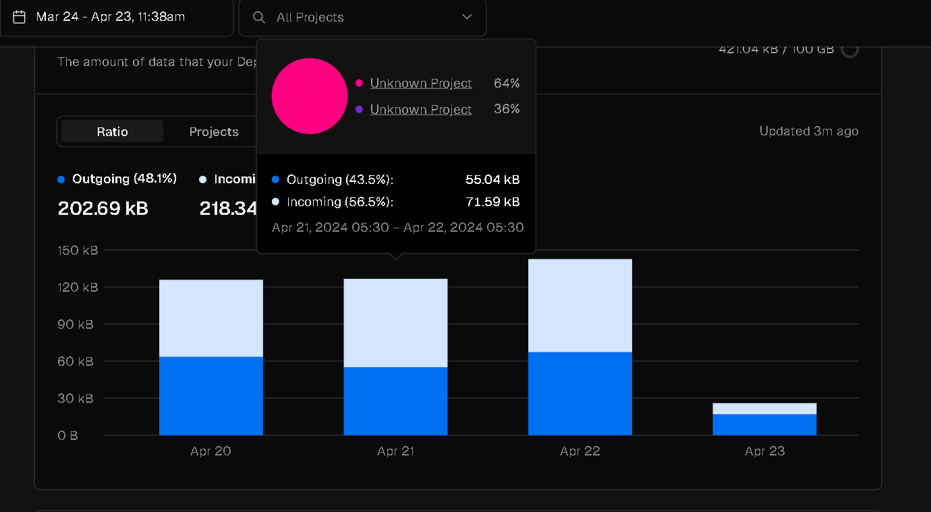
Vercel Monitoring

Slide 15
Collaboration
Google meet
Jira – created a team where we assigned the work and check the progress
GitHub- frequent commit and Pull request

Slide 16

Thank YOU

