Slide 1

AI-Powered Aviation Incident Analysis
and Contributing Factor Discovery
End-to-End NLP/ML Web Application for Unsupervised Safety Analytics
Research Project · B.Tech Computer Science & Engineering
ABES Engineering College, Ghaziabad · Session 2026–27
Garvit Singh (2400320100462) · Divyansh Yadav (2400320100444) · Section CSE-17
Guide: Ms. Shweta Singh

Slide 2
Table of Contents
1
Introduction & Problem Statement
2
Literature Survey Completed
3
System Architecture / Design Finalized
4
Dataset and Tools Identified
5
Methodology and Work Plan Prepared
6
The 14-Stage NLP Pipeline
7
Tech Stack
8
Key Features & Dashboard Views
9
Conclusion & Future Work

Slide 3
Introduction & Problem Statement
The Problem
Our Solution
Aviation safety reports are dense, unstructured prose
Reading reports one at a time hides systemic patterns
Manual analysis is slow and prone to human bias
No scalable way to discover recurring contributing factors
Unsupervised NLP/ML pipeline — no labelled data needed
BERTopic + UMAP + HDBSCAN for topic discovery
KMeans clustering over sentence embeddings
Interactive dashboard with semantic search
Key Questions Answered:
What themes recur?
What are the latent topics?
How do incidents cluster?
7-theme safety taxonomy from discovered topics
BERTopic validated against classical LDA baseline
KMeans over sentence embeddings → 2-D semantic map
Contributing factors?
How are factors trending?
Find similar reports?
Factor ranking + co-occurrence network
Per-theme trajectories with rising/falling signals
Semantic search matching concepts, not keywords

Slide 4
Literature Survey Completed
1
Topic Modelling Approaches
2
Text Embedding Techniques
3
Clustering in NLP
Surveyed LDA (Blei et al. 2003), NMF, and neural topic models. Selected BERTopic (Grootendorst 2022) for leveraging transformer embeddings with UMAP dimensionality reduction and HDBSCAN density-based clustering, producing more coherent topics than bag-of-words methods.
Compared KMeans, DBSCAN, and Agglomerative clustering on embedded text. KMeans selected for interpretability; cluster quality validated via Silhouette Score (intrinsic, label-free metric).
Reviewed Word2Vec, GloVe, ELMo, and sentence-transformers. Chose all-MiniLM-L6-v2 (384-d) for its balance of quality and speed. Also implemented TF-IDF + SVD fallback for lightweight deployment.
4
Aviation Safety Text Mining
5
Unsupervised Factor Discovery
6
Semantic Search in Corpora
Studied NTSB/ASRS report analysis pipelines and prior work on contributing factor extraction from incident narratives using named entity recognition and pattern-based factor identification.
Explored co-occurrence analysis techniques (count, lift, Jaccard) for discovering relationships between contributing factors without supervision, enabling automated safety-pattern detection.
Reviewed keyword (BM25) vs. dense retrieval approaches. Implemented cosine-similarity search over L2-normalised embeddings for concept-level matching (e.g., 'engine fire' finds 'powerplant blaze').

Slide 5
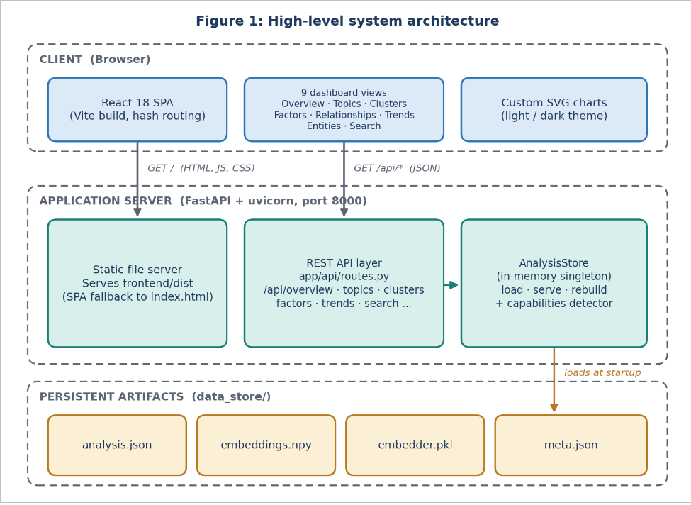
System Architecture / Design Finalized

Slide 6
Dataset and Tools Identified
📊 Dataset
🛠️ Tools & Libraries
Synthetic corpus: ~480 aviation incident narratives
Deterministic generation — fully reproducible
Dataset-agnostic: supports real NTSB / NASA ASRS CSV
Set AV_DATASET_CSV to point at real data
Pipeline rebuilds identical analysis on any corpus
Backend — Python
• FastAPI + uvicorn (web framework & server)
• sentence-transformers — all-MiniLM-L6-v2
• BERTopic (UMAP + HDBSCAN + c-TF-IDF)
• spaCy — en_core_web_sm (NER)
• scikit-learn (KMeans, LDA, TF-IDF+SVD)
• NumPy, pandas
Frontend — JavaScript
• React 18 + Vite
• Custom SVG charts (no charting library)
• Hash routing + React Context
• Colorblind-safe data-viz design system
DevOps
• Docker + docker-compose
• Multi-stage build (Node → Python)

Slide 7
Methodology and Work Plan Prepared
Phase 1
Phase 2
Phase 3
Phase 4
Phase 5
Phase 6
Data Layer
Feature Extraction
Unsupervised Analysis
Relationship Mining
Dashboard & Search
Deploy & Evaluate
Collect / generate corpus
Clean & preprocess
NLP tokenization
→
Sentence embeddings
Named Entity Recognition
TF-IDF features
→
BERTopic + LDA topics
KMeans clustering
Factor extraction
→
Co-occurrence network
Lift & Jaccard metrics
Trend analysis
→
React SPA build
Semantic search
API integration
→
Docker containerisation
19-check evaluation
Documentation
Work Plan Timeline
Week 1–2
Week 3–4
Week 5–7
Week 8–9
Week 10–11
Week 12
Literature survey
& data collection
Architecture design
& NLP preprocessing
Topic modelling,
clustering, factors
Dashboard, semantic
search, relationships
Docker deployment,
testing & evaluation
Documentation
& presentation

Slide 8
The 14-Stage NLP Pipeline
1
2
3
4
5
6
7
Data Collection
Data Preparation
NLP Preprocessing
Named Entity Recognition
Text Embeddings
Topic Modelling
Clustering
generate_dataset.py
data_loader.py
preprocess.py
ner.py (spaCy)
embeddings.py
topics.py (BERTopic+LDA)
clustering.py (KMeans)
8
9
10
11
12
13
14
Factor Analysis
Co-occurrence
Trend Analysis
Dashboard
Semantic Search
Deployment
Testing
factors.py
relationships.py
trends.py
frontend/ (React+Vite)
search.py
Docker / compose
evaluate.py

Slide 9
Tech Stack
Backend
Frontend
DevOps
Language
Python 3.x
Framework
React 18
Containerisation
Docker + docker-compose
Web Framework
FastAPI + uvicorn
Build Tool
Vite
Build
Multi-stage (Node → Python)
Embeddings
sentence-transformers (all-MiniLM-L6-v2, 384-d)
Routing
Hash routing + React Context
Configuration
Environment variables (AV_*)
Topic Modelling
BERTopic (UMAP + HDBSCAN + c-TF-IDF)
Charts
Custom SVG (hand-built, colorblind-safe, light/dark)
NER
spaCy (en_core_web_sm)
Styling
CSS design-system tokens (theme.css)
ML / Math
scikit-learn (KMeans, LDA, TF-IDF+SVD), NumPy, pandas

Slide 10
Key Features & Dashboard Views
Overview
Topics
Clusters
Corpus stats, top factors,
trend signals, topic
model comparison
BERTopic primary topics
+ LDA baseline +
side-by-side comparison
KMeans cluster summaries
+ 2-D semantic scatter
map visualisation
Factors
Relationships
Trends
Ranked contributing
factors + 7-theme
safety taxonomy rollup
Factor co-occurrence
network (count / lift /
Jaccard metrics)
Per-theme yearly series
with rising / falling
signal detection
Entities
Search
Reports
Aggregated named entities:
aircraft, organisations,
airports, locations
Semantic search matching
concepts not keywords —
cosine over embeddings
Filter / paginate reports
by topic, cluster, theme,
severity, year + detail

Slide 11
Progress Summary — Deliverables Completed
✓
Literature Survey Completed
Comprehensive review of topic modelling (LDA, BERTopic), text embeddings (sentence-transformers), clustering (KMeans), aviation text mining, unsupervised factor discovery, and semantic search approaches.
✓
System Architecture / Design Finalized
Single-process FastAPI architecture serving React SPA and REST API. 14-stage pipeline with precomputed analysis cached in data_store/. Graceful degradation from full transformer stack to scikit-learn fallback.
✓
Dataset and Tools Identified
~480 synthetic aviation incident narratives (deterministic, reproducible). Python + FastAPI backend, React + Vite frontend, BERTopic + spaCy + scikit-learn for NLP, Docker for deployment.
✓
Methodology and Work Plan Prepared
6-phase methodology: Data Layer → Feature Extraction → Unsupervised Analysis → Relationship Mining → Dashboard & Search → Deploy & Evaluate. 12-week timeline with clear milestones.

Slide 12
Conclusion & Future Work
Conclusion
Future Work
End-to-end unsupervised NLP pipeline for aviation safety analytics
No labelled data required — fully automated pattern discovery
BERTopic + KMeans + semantic search provide multi-faceted analysis
Interactive React dashboard with 9 specialised views
19/19 evaluation checks passed; 5/5 search queries relevant
Single-container Docker deployment — production ready
Integration with real NTSB / NASA ASRS datasets
Fine-tuned domain-specific embeddings for aviation
Temporal topic evolution tracking (dynamic topics)
Causal factor chain analysis beyond co-occurrence
Multi-language report support
Real-time ingestion pipeline for streaming reports
Key Project Metrics
14
~480
384-d
7
19/19
9
Pipeline
Stages
Incident
Narratives
Embedding
Dimensions
Safety
Themes
Evaluation
Checks Passed
Dashboard
Views

