Slide 1
Efficiency of an air-core induction electromagnetic linear accelerator
By Jim Garvey

Slide 2
Overview
LabView Program
Calibration Methods
Gauss Cannon Methods
Gauss Cannon Results
Conclusion

Slide 3
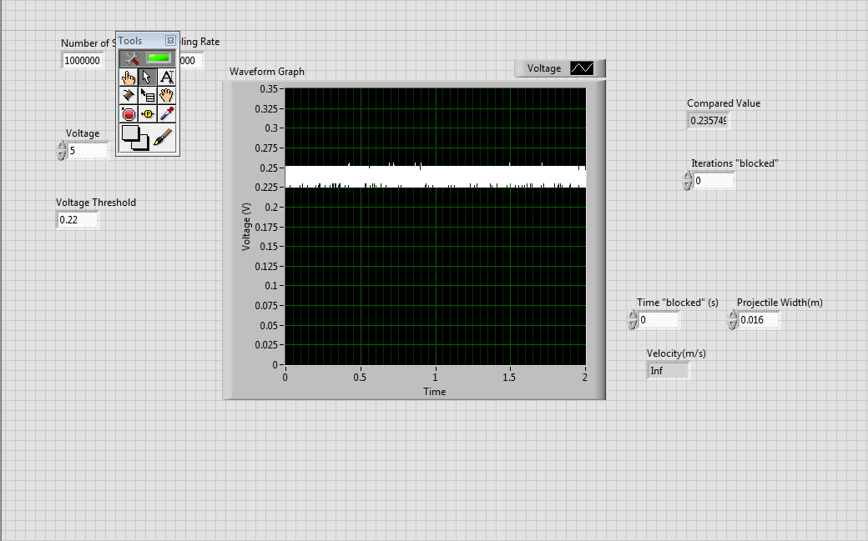
Front View of LabView Program
The Waveform graph displays the voltage reading across a photodiode. This is a
calibration step to determine the appropriate threshold voltage for measurements.

Slide 4
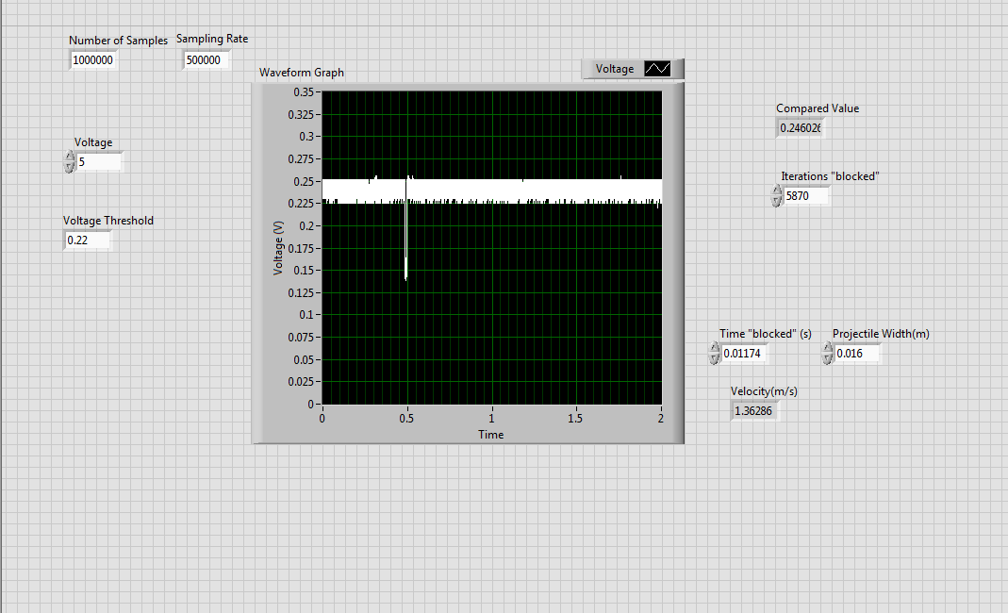
Front View Recording a “Shot”

Slide 5
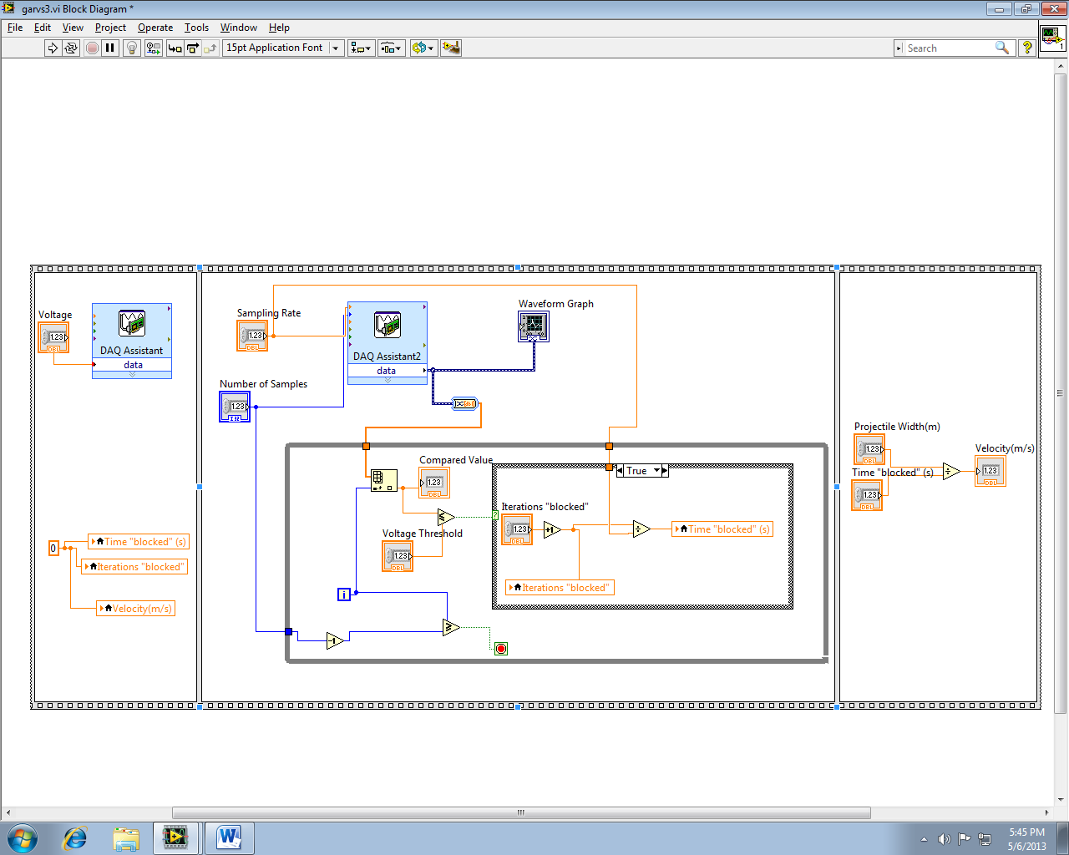
LabView Block Diagram

Slide 6
Photogate Set-up
LabView on Comp
Generate Voltage
V Out
V in
NI9263
NI9201
Acquire Voltage
Projectile Motion
Infrared LED
Infrared Photodiode

Slide 7
Calibration Methods
2 measurements with uncertainty, the ‘width of the projectile’ and the time the projectile was in the gate.
Width of projectile:
0.866R
R
½ R
1.7321R
∆D = +/- 0.268R

Slide 8
Calibration Methods Cont
Uncertainty in Time experiment
Dropped Projectile from set height from my photogate
Used the LabView program I wrote to measure the time in the gate
Compared to the expected value I calculated
Gave me a percentage that I would use as my estimated uncertainty in time

Slide 9
Calibration Methods Cont
Trial | Time in Gate
1 | 0.0117
2 | 0.0118
3 | 0.0119
4 | 0.0116
5 | 0.0121
6 | 0.0120
7 | 0.0121
8 | 0.0118
9 | 0.0119
10 | 0.0120
Equation: x(t) = X₀ + V₀ *t + 0.5*a*t²
drop height: 0.095m
diameter of ball: 0.016m
Want the time that the ball enters the
“beam” and when it leaves. So find
t when x = drop height – r and when
x = drop height + r
Expected time is 0.012s
Average is 0.0119
Therefore the error is ~ 1%

Slide 10
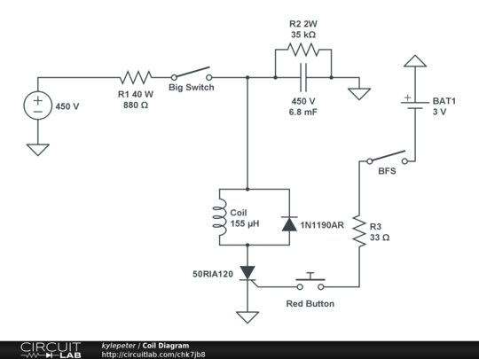
Gauss Cannon Circuit Diagram

Slide 11
Gauss Cannon Data Collection Methods
Positioned photogate within one centimeter from the end of the barrel of the Gauss Cannon
Charged the Capacitor to a voltage around 5V above the test voltage (DMM to measure)
Ran the LabView program when the voltage dropped to within one volt of the test voltage
Fired the cannon when the voltage reached the test voltage
Recorded the time in gate and velocity

Slide 12
Key Equations
E = ½ C V²
C is capacitance and V is voltage
E = ½ m v²
M is mass and v is velocity
Error propagation is simplified because the error in the velocity is dominated by the standard deviation and I assume that the uncertainty in the voltage measured by the DMM is negligible compared to the +/- 20% Capacitance of the Capacitor
Error propagation equations: quotient rule and power rule

Slide 13
Gauss Cannon Raw Data Example
Input Voltage(V) | Time in Gate (s) | δt (s) | Width (m) | δw (m)
150 | 0.00117 | 1E-05 | 0.026 | 0.003
150 | 0.00112 | 1E-05 | 0.026 | 0.003
150 | 0.00108 | 1E-05 | 0.026 | 0.003
150 | 0.00110 | 1E-05 | 0.026 | 0.003
150 | 0.00109 | 1E-05 | 0.026 | 0.003

Slide 14
Gauss Cannon Results
Input V (V) | Input E (J) | δE_{in} (J) | Velocity (m/s) | δV (m/s) | Output E (J) | δE_{out} (J) | %Eff | δE_{ff}
100 | 34 | 6.8 | 16.41 | 1.17 | 1.948 | 0.010 | 5.7 | 1.14
150 | 76.5 | 15.3 | 23.39 | 0.70 | 3.958 | 0.004 | 5.2 | 1.04
200 | 136 | 27.2 | 26.10 | 0.82 | 4.926 | 0.005 | 3.6 | 0.72
300 | 306 | 61.2 | 29.73 | 1.11 | 6.393 | 0.009 | 2.1 | 0.42
430 | 628.7 | 125.7 | 34.29 | 4.77 | 8.5 | 0.2 | 1.4 | 0.28
Mass of the Projectile was 14.47g and its width was 0.026m. The Standard
Deviation of the velocity data dominated the uncertainty in the velocity.
Capacitance of capacitor was 6800 μF +/- 20% which dominated uncertainty in eff

Slide 15
Gauss Cannon Results cont

Slide 16
Credits
Kyle Werner and Peter Yaworsky who built the Gauss Cannon in the Modern Electronics Lab and made the circuit diagram

