Slide 1
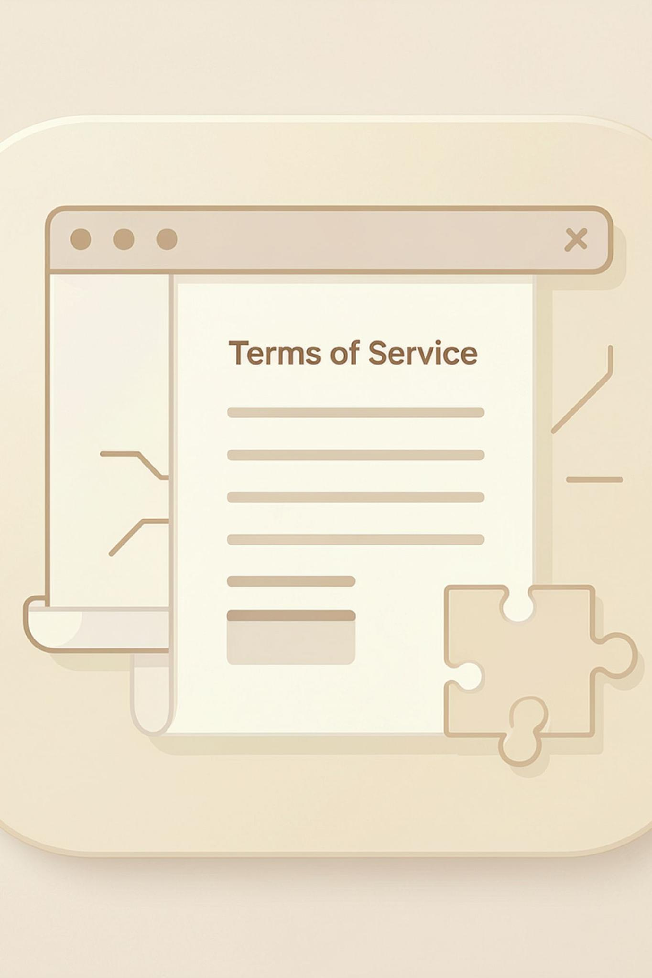
AGREEWISE
Privacy policy reader
Know before you agree.
We find the three clauses most likely to affect you.
NEXUS-26 HACKATHON
TEAM
STACK
Team ID :- 64
Team Name :- Doom Coders
Garv Shah · Dishank Shah
React + Vite · JavaScript · GROQ LLM

Slide 2
THE "TOO LONG; DIDN'T READ" PROBLEM
Companies constantly update their Terms of Service and Privacy Policies — users rarely have the time or expertise to understand the legal language.
Long & Complex
Frequently Updated
Lengthy legal language that is difficult to parse
Policies change — users miss critical updates
Blindly Accepted
Hidden Data Risks
Users click "Agree" without understanding what they consent to
Unknowing consent to AI training, data sharing & broad content rights

Slide 3

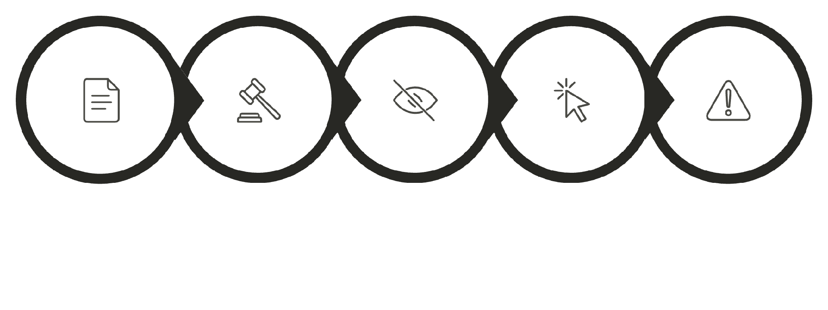

WHY THIS PROBLEM MATTERS
The challenge is not access to the policy — it is understanding what actually matters hidden inside large amounts of legal text.
🔴 HIGH RISK
"Your content may be used to improve or train AI systems."
Current User Journey
Long Policy
Complex Language
User Skips
Clicks Agree
Hidden Risk
🔵 IMPORTANT
"Certain rights or licenses may continue after account deletion."

Slide 4
EXPECTED OUTCOME
A fast, simple, and understandable way to identify the most important or potentially risky clauses — in seconds.
Before AgreeWise
After AgreeWise
Read lengthy policy manually
Search for important clauses yourself
Struggle with legal language
Unclear privacy implications
Time-consuming process
Scan the policy instantly
AI identifies important clauses
Simple plain-language explanations
Risk classification at a glance
Top 3 clauses delivered in seconds
Risk Level
Clause Title
Explanation
Why It Matters
High & Important
clearly explained label
Plain-language summary
Impact on you
Original Clause
Available for review

Slide 5
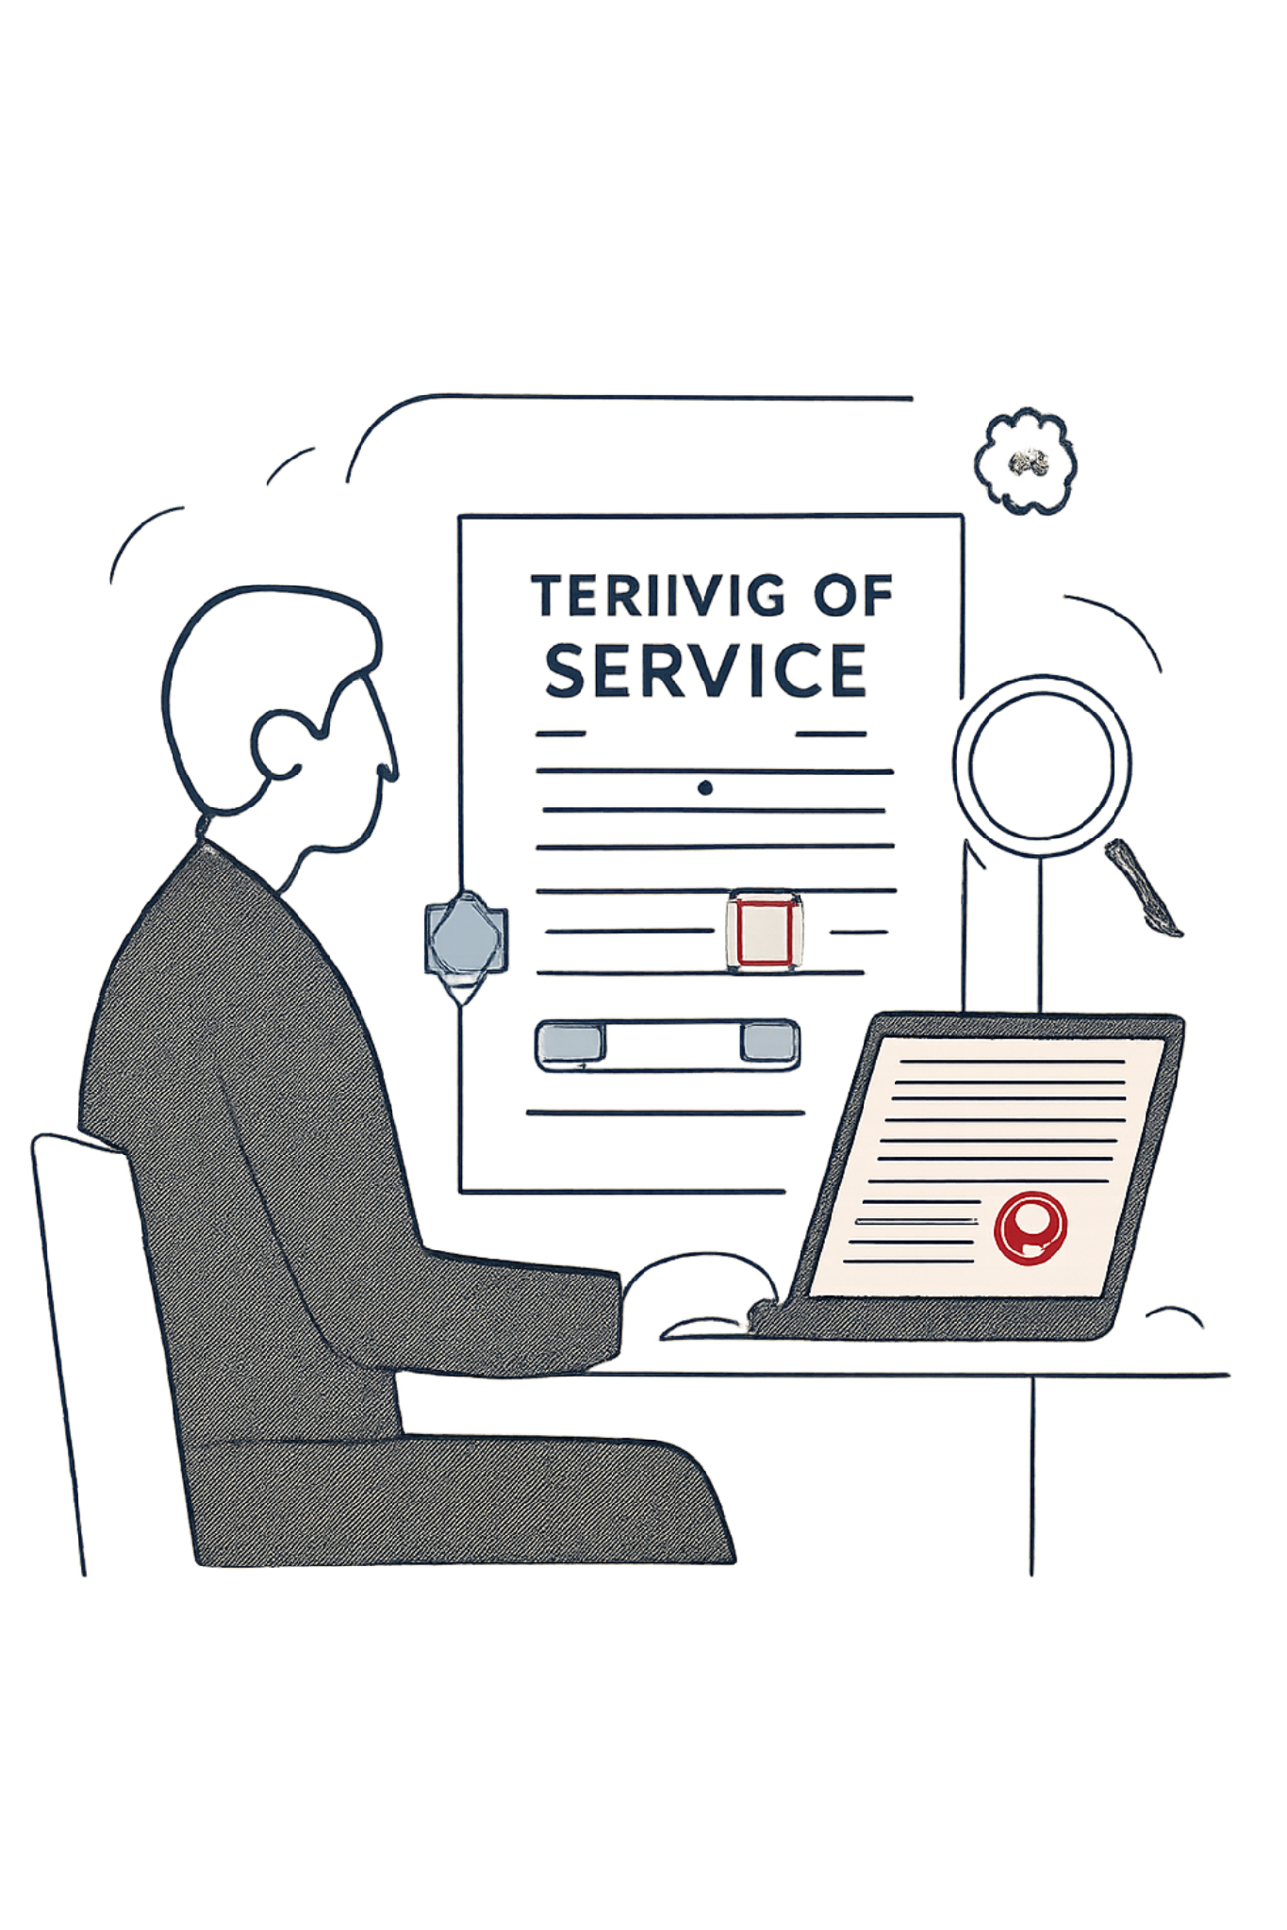



PROPOSED SOLUTION — AGREEWISE
A lightweight Chrome extension that extracts Terms of Service or Privacy Policy content, sends it to an LLM Model, and returns a concise summary of the most important or risky clauses.
Two Input Methods
Risk Levels
Scan Current Page
🔴 HIGH RISK
Extract webpage text from DOM → Analyze with AI
Critical privacy or data concerns
Upload PDF
🔵 IMPORTANT
Extract PDF text → Analyze with AI
Key details to understand

Slide 6
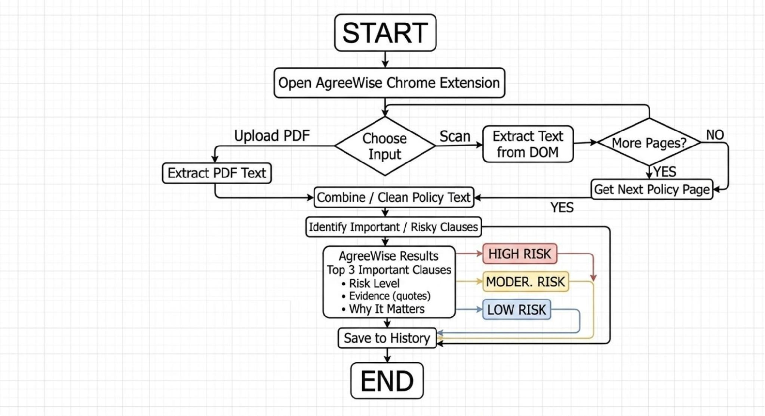
AgreeWise – System Workflow
Input
Scan webpage or upload PDF
Extract
Collect policy text from DOM or PDF
Process
Clean and combine content
Analyze
Groq LLM identifies clauses
Result
Classify risk and save to History

Slide 7
Solution | Main Approach | Key Limitation | AgreeWise
Manual Reading | User reads the complete policy | Time-consuming and difficult to understand | AI-based quick analysis
ToS;DR | Ratings and policy summaries | Focuses mainly on existing ratings/summaries | Clause-level risk analysis
Policy Pal | AI analysis + supporting quotes | Mainly focused on webpage policies | Web + PDF analysis
ToS Scanner | Risk/fairness score + red flags | Primarily webpage-focused | HIGH / MEDIUM / LOW risk findings
TermsLens | Policy/legal document analysis | Broader legal-document workflow | Simple policy-focused workflow
AgreeWise | AI-powered policy analysis | — | Web + PDF + Risk + Evidence + Explanation + History

Slide 8





TECHNOLOGIES & TOOLS
Frontend
React.js · Tailwind CSS · HTML/CSS/JS
Chrome Extension
Manifest V3 · Content Scripts · Chrome APIs
AI & LLM
Groq API · Structured AI output · Policy analysis
Storage & Design
Browser Extension Storage API

Slide 9
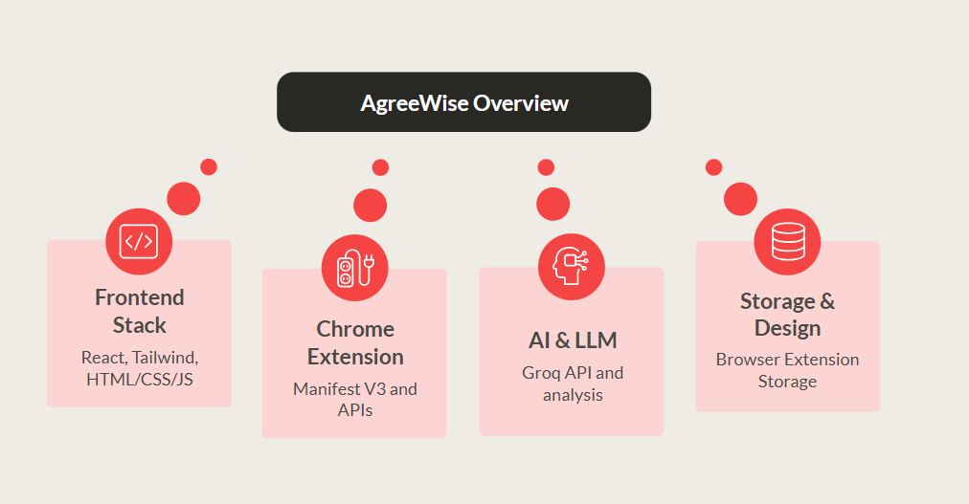
PSEUDOCODE / ALGORITHM
Logical implementation flow for AgreeWise policy analysis:
START
Get user input
IF Scan All Page:
Extract readable text from DOM
Detect supported pagination
Collect available policy content
Combine extracted text
ELSE IF Upload PDF:
Extract text from PDF
Clean and normalize text
Split large content into chunks
Send processed content to Groq LLM
Identify important clauses
Classify risk:
HIGH RISK
MODERATE RISK
IMPORTANT
Generate short explanations
Select top 3 important clauses
Display results
Save result to History
END

Slide 10



ASSUMPTIONS, CHALLENGES & FUTURE SCOPE
Assumptions
Challenges
Policy content is accessible and readable
User has internet access for LLM analysis
PDFs contain extractable text
Required browser permissions are available
AI output is informational, not legal advice
Future Scope
Multilingual support
Policy change detection & alerts
Old vs. new policy comparison
Advanced risk scoring algorithms
Support for additional browsers
Mitigation Strategies
Text cleaning and intelligent chunking
Structured prompts for consistent AI output
Show original clauses alongside AI explanations
Minimize unnecessary data storage
Token Limits
Dynamic Websites
PDF Variations
AI Consistency
Very long policy documents exceed LLM context windows
JavaScript-rendered pages complicate DOM extraction
Formatting differences affect text extraction reliability
Interpretation accuracy and output consistency challenges

Slide 11
THANK YOU
AgreeWise
“Know before you agree.”
Team
Hackathon
Stack
Garv Shah · Dishank Shah
NEXUS-26
React + Vite · JavaScript · GROQ LLM

