Slide 1
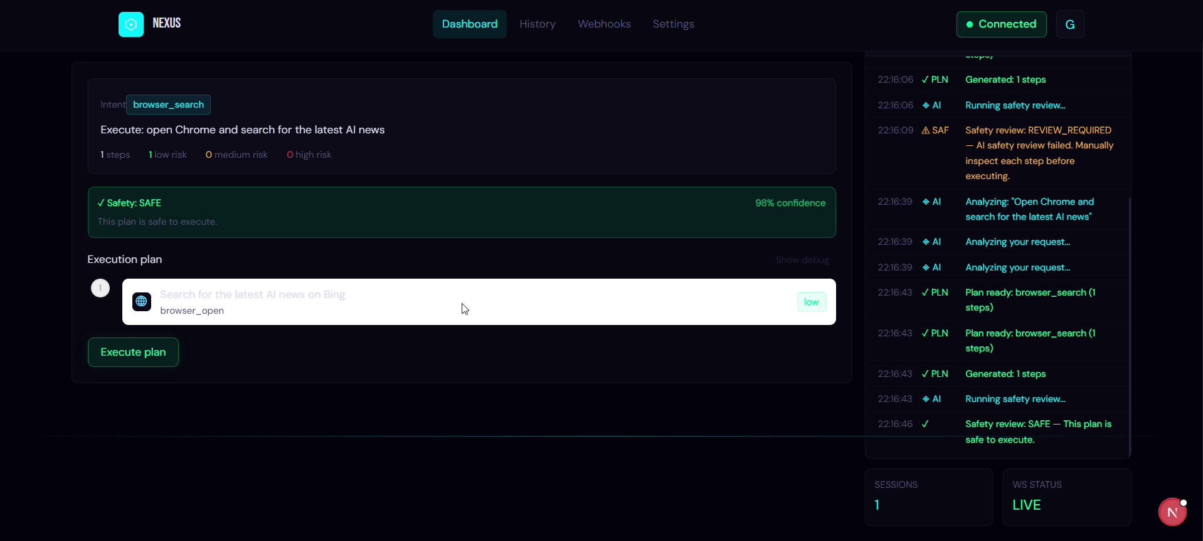
TRACK 3: AUTONOMOUS AI TEAMMATES
Nexus Execution Engine: Live Plan & Activity Stream
Paytm Build for India AI Hackathon | Bengaluru Edition
Nexus Teammate
Closes tickets directly on screen instead of answering with text.
Autonomous desktop operations teammate for Paytm customer support and merchant workflows. It executes tasks across internal tools without requiring custom APIs.
106 Logged Runs
83% task success rate
7-Tier Self-Healing
Adapts when UI changes
Real runtime UI: generates execution plan, audits security risks, and triggers automated screen steps live.
Builder: Garv Thakre | GSoC 2026 Contributor at MetaBrainz | Built 90+ production REST APIs

Slide 2
THE REALITY IN SUPPORT OPS
Support teams spend their day clicking, not solving
THE MANUAL MAZE: ONE TRANSACTION DISPUTE TRAVERSES 5 SEPARATE SCREENS
1. Ticket Queue
Zendesk / CRM
Reads user complaint
[Human clicks here]
2. Payment Portal
Merchant Console
Looks up Txn status
[Human clicks here]
3. Bank Ledger
Banking Gateway
Verifies UTR credit
[Human clicks here]
4. Dispute Engine
Internal Web Tool
Checks refund policy
[Human clicks here]
5. Payout Desk
Finance Tool
Executes reversal
[Human clicks here]
Chatbots answer, but humans still click
Conversational AI answers queries with text, but human operators still have to manually navigate portals and update records.
Internal operations tools lack APIs
Core banking portals, legacy admin consoles, and merchant tools have no programmatic endpoints. Human screens are the only interface.
Routine disputes crowd out complex cases
Agents spend over 60% of their shifts repeating the same lookup steps instead of managing escalations and merchant relationships.
INDUSTRY REALITY: SUPPORT OVERHEAD IN DIGITAL PAYMENTS
[ADD SOURCED STAT: Indian payment gateways report up to 30% of support volume comes from transient failed payment disputes and status queries (Source: CXO Digital Pulse / Industry Average)]

Slide 3
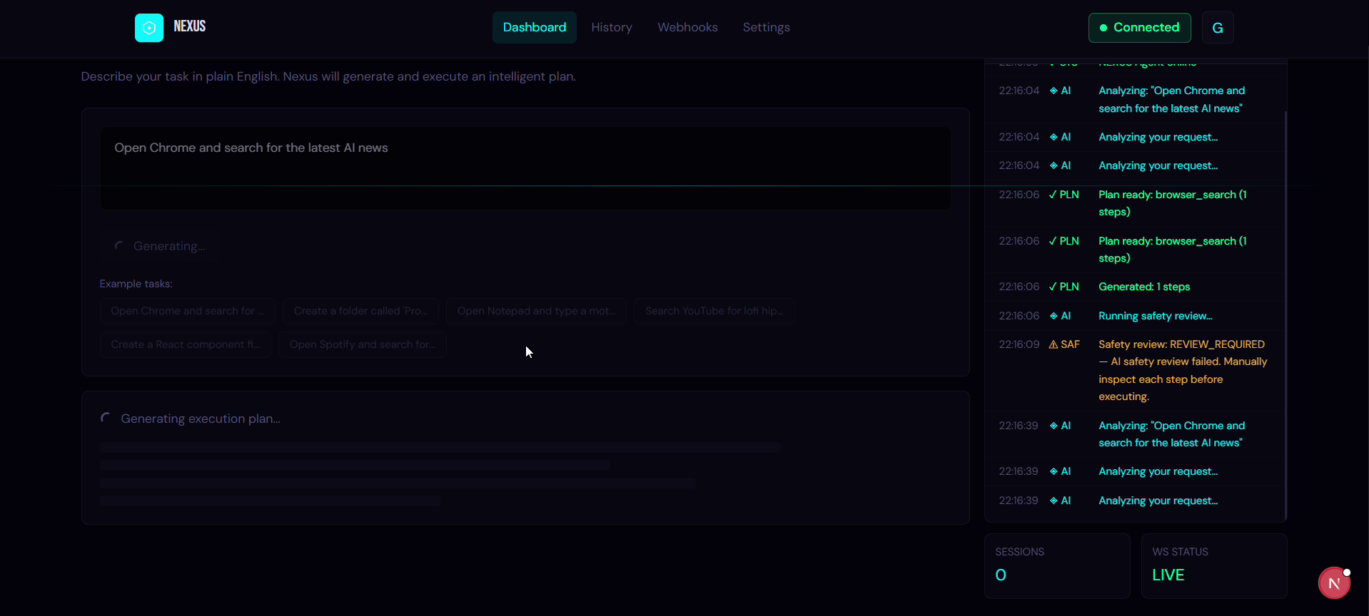
AUTONOMOUS ACTION, NOT CHAT
Nexus works the ticket from open to closed
1. READ
Ingests ticket data
Extracts transaction ID, user claim, and order details.
2. PLAN
Compiles steps
Translates task into a strict multi-step browser plan.
3. REVIEW
Audits safety risks
LLM reviews plan; confirms steps before execution.
[Human in the loop: safety verdict + confirm step]
4. ACT
Operates screens
Navigates dashboards, fills forms, clicks buttons.
5. LOG
Records every action
Appends execution trace to immutable JSONL audit log.
TARGET WORKFLOW: FAILED-PAYMENT DISPUTE
A failed-payment dispute arrives. Nexus reads context, plans steps, reviews safety, checks status in the portal, picks refund or escalate, updates the ticket, and logs every step.
Target workflow for customer operations. Humans only handle unresolved edge cases.
CALLOUTS
1. Strict JSON Plan: deterministic steps.
2. Safety Auditor: pre-run risk verdict.
3. Activity Log: real-time streaming trace.
BUILT & RUNNING: Runs on a schedule (cron DB triggers) | Switches models on failure (failover routing) | Takes voice commands (browser en-IN, hi-IN)

Slide 4
SYSTEM ARCHITECTURE
Engineered to act where APIs do not exist
TRIGGER LAYER
User Prompt (Web UI) [Built]
Plain English task entry
Scheduler Service [Built]
Cron DB stored schedules
Voice Input [Built]
Browser en-IN & hi-IN
Webhooks [Built]
Event triggers start/end
INTELLIGENCE LAYER
Planner (planner.ts)
Context budgeting (12K chars); translates prompt into JSON steps.
Safety Reviewer
Independent LLM audit: returns SAFE, REVIEW_REQUIRED, or UNSAFE.
Provider Failover [Built]
Routes to Groq Llama 3.3 70B, OpenAI GPT-4o, Anthropic Claude on errors.
7-TIER SELF-HEALING ENGINE
Browser execution cascade (Browserengine.ts):
Tier -1: Selector Memory (learned cache)
Tier 0: Direct CSS & Site Handlers
Tier 1: DOM Fuzzy Scan (keyword scoring)
Tier 2: Accessibility Tree + Groq
Tier 3: HTML Context + LLM Re-plan
Tier 4: URL Parameter Fallback
Tier 5: Vision Fallback (Gemini Flash)
ACTIONS & AUDIT
Playwright
Browser session automation.
Pywinauto
Windows native app control.
Auto-Fix Engine
6 script repair patterns.
JSONL Trace
Step-level execution logs.
PostgreSQL
AES-256-GCM encrypted BYOK.
Core Stack: TypeScript, Node.js, Express, Playwright, Python (pywinauto), Next.js, PostgreSQL (Prisma), Electron, Docker Compose.

Slide 5
COMPETITIVE MOAT
It works in tools that have no API
Capability | Chatbot | API Integration | Scripted RPA | Nexus Teammate
Takes real actions across screens | No (Answers only) | Yes | Yes | Yes
Works without custom APIs | No | No (Requires APIs) | Yes | Yes
Adapts when UI layout changes | No | No | No (Brittle scripts) | Yes (7-Tier Healing)
Pre-execution safety review | No | No | No | Yes (Safety verdict)
Full step-by-step audit trace | Conversation log | Partial API logs | Local log files | Yes (JSONL trace + DB)
Runs unattended on a schedule | No | Yes | Yes | Yes (Cron DB triggers)
Switches providers on failure | No | No | No | Yes (Automatic failover)
THE CORE DIFFERENCE: RPA breaks when a button moves. Chatbots stop at giving advice. Nexus adapts to screen changes and finishes the job.

Slide 6
PROVEN EXECUTION & MEASURED OUTCOMES
Proven execution speed with 94.4% support accuracy
HISTORICAL RUNS (GENERAL DESKTOP & WEB TASKS)
Measured across 106 logged tasks from repository execution logs:
PAYTM TRACK 3 BENCHMARK (MOCK SUPPORT CONSOLE)
18 realistic support operations (disputes, refunds, settlements, duplicate debits, KYC):
106
Recorded runs in log
83.0%
Fully completed tasks
94.4%
Support task success rate (17/18)
0.90s
Average resolution time per task
5.0
Average steps per task
70.5s
Average run duration
7
Self-healing recovery events
0.20¢
Average cost per ticket ($0.001995)
FOR CUSTOMERS
Immediate dispute resolution with zero waiting queues.
FOR SUPPORT AGENTS
Eliminates repetitive manual portal lookups entirely.
FOR PAYTM OPERATIONS
Reduces cost per resolved ticket at scale.

Slide 7
COMMERCIAL STRATEGY & VIABILITY
Pay per ticket resolved, not per seat
1. Ticket Resolved
Nexus navigates screens and closes dispute.
2. Outcome Logged
Step trace and audit evidence recorded.
3. Micro-Billing Generated
Platform billed purely on verified resolution.
INTERNAL COST SAVINGS
Paytm Support & Ops
Directly slashes first-level ticket handling overhead by automating repetitive multi-screen dispute resolutions at ~0.2 cents per execution.
OUTCOME-BASED PRICING
Pay Per Success
Eliminates rigid software seat licensing. Enterprise clients pay strictly for successfully resolved workflows verified in audit traces.
COMMERCIAL PRODUCT PATH
External Enterprise Offering
Package autonomous teammate capability for Paytm payment gateway merchants, partner banks, and NBFC support operations.
STRATEGIC ALIGNMENT: PAYTM INTERNAL AI COMMERCIALIZATION INITIATIVE
On its Q1 earnings call, Paytm stated plans to package internal AI tools in merchant support, acquisition, and business automation for external customers. (Source: CXO Digital Pulse)
Unit Economics Benchmark: [Cost per ticket today: Rs 25 to 45 (industry average) vs Cost with Nexus: Rs 0.16 compute cost]

