Slide 1
MSc AI GROUP 4 PROJECT REPORT
AI-Powered Clinical Disease
Prediction & Decision Support System
Fusing complete patient medical history with real-time physiological data to estimate and detect disease risk early, and support clinical decision-making.
Diabetes
Hypertension
Stroke
Heart Failure
Presented by: GROUP 4
[Artificial Intelligence / MSc IT ] • [University of Cape Coast] • [23rd JULY 2026]

Slide 2
INTRODUCTION
Why an AI Clinical Decision Support System?
Chronic conditions such as diabetes, hypertension, heart failure, stroke and kidney failure remain leading causes of preventable death worldwide. Advances in machine learning now make it possible to combine a patient's medical history with live physiological readings to flag rising risk long before a crisis occurs.
PROJECT AT A GLANCE
DOMAIN
Clinical AI / Decision Support
DISEASES MODELLED
This project designs, trains and deploys a multi-disease risk-prediction system that pairs five specialist XGBoost models with a simple, no-code web interface — turning scattered clinical signals into a single, actionable report for a clinician or trained health worker.
Diabetes, Hypertension, Heart Failure, Stroke
CORE ALGORITHM
XGBoost (gradient-boosted trees)
DATA SOURCE
CDC BRFSS 2015, 250,000+ records
INTERFACE
Gradio web application
OUTPUT
Risk %, vital-sign alerts, recommendations
Introduction
2

Slide 3
INTRODUCTION
Why these diseases?
High prevalence and public-health burden. Diabetes affects over 800 million adults globally, and hypertension affects about 1.4 billion people, making both strong targets for an app that can reach many users.
Serious downstream complications. Diabetes and hypertension are major risk factors for cardiovascular and cerebrovascular events, including stroke and heart failure, so predicting them can help prevent more severe outcomes.
Clear clinical relevance. Stroke has a major global burden, with tens of millions of people living with its consequences, and it is a time-sensitive condition where earlier risk identification can improve prevention and triage.
Shared risk factors. These conditions often share predictors such as age, blood pressure, obesity, physical inactivity, glucose dysregulation, and smoking, which makes them suitable for one unified AI model or a multi-task model.
Practical data availability. These diseases are commonly captured in EHRs, screening programs, and public health datasets, so they are easier to model than rare diseases and more likely to produce usable predictions in practice.
PROJECT AT A GLANCE
DOMAIN
Clinical AI / Decision Support
DISEASES MODELLED
Diabetes, Hypertension, Heart Failure, Stroke
CORE ALGORITHM
XGBoost (gradient-boosted trees)
DATA SOURCE
CDC BRFSS 2015, 250,000+ records
INTERFACE
Gradio web application
OUTPUT
Risk %, vital-sign alerts, recommendations
Introduction
2

Slide 4
INTRODUCTION
Definitions?
Tachycardia means an abnormally fast heart rate, usually over 100 beats per minute at rest in adults.
Bradycardia means an abnormally slow heart rate, usually below 60 beats per minute in adults, though it can be normal in some healthy people such as athletes.
Either one can be harmless in some situations, but they can also be a sign of an underlying heart problem or another medical condition. Symptoms can include dizziness, fainting, shortness of breath, fatigue, or palpitations.
PROJECT AT A GLANCE
DOMAIN
Clinical AI / Decision Support
DISEASES MODELLED
Diabetes, Hypertension, Heart Failure, Stroke
CORE ALGORITHM
XGBoost (gradient-boosted trees)
DATA SOURCE
CDC BRFSS 2015, 250,000+ records
INTERFACE
Gradio web application
OUTPUT
Risk %, vital-sign alerts, recommendations
Introduction
2

Slide 5
PROBLEM STATEMENT
The Clinical Challenge Being Solved
❤
⏱
⚕
＋
Overlapping conditions
Diagnosis usually comes late
Screening capacity is limited
No unified early-warning tool
Diabetes, hypertension, heart failure and stroke are closely linked, risk of one often signals risk of the others.
Warning signs are scattered across lab history, lifestyle data and vital-sign monitors that clinicians rarely see side-by-side.
Many health systems lack enough specialists to individually screen every patient for every condition at every visit.
There is no single, accessible system fusing full medical history with live physiological signals to flag risk before a crisis.
RESEARCH QUESTION
Can a single machine-learning-driven system combine historical and real-time patient data to reliably estimate multi-disease risk and guide clinical decisions and actions?
Problem Statement
3

Slide 6
OBJECTIVES
Objectives of the System
1
Unify prediction across five diseases
Build one shared pipeline that estimates risk for diabetes, hypertension, heart failure and stroke, from a common set of patient inputs.
Combine history with the present moment
Merge longitudinal medical history with real-time vitals (heart rate, SpO2) so risk is monitored continuously, not just at a single checkup.
2
3
Turn numbers into action
Pair every risk percentage with a plain-language clinical recommendation, so results are usable at the point of care.
4
Make it accessible, not just accurate
Package the model behind a simple, no-code web interface any clinician or trained health worker can operate.
Build for retraining
Establish a reproducible ML pipeline that can be updated as more, and better-labelled, clinical data becomes available.
5
Objectives of the System
4

Slide 7
SCOPE
Scope of the System
✓ IN SCOPE
✕ OUT OF SCOPE
Risk estimation for 4 chronic diseases: diabetes, hypertension, heart failure and stroke
Use of the CDC BRFSS 2015 dataset (250,000+ adult records, 21 indicators) as the training source
Medical-history / demographic inputs plus two live vitals (heart rate, SpO2)
One specialist XGBoost model trained per disease
A rule-based recommendation layer translating risk into text-based next steps
A Gradio-based, web interface for capturing data and viewing results
Clinical diagnosis: the system produces screening risk signals, not confirmed diagnoses
Direct integration with hospital Electronic Health Record (EHR) systems
Live streaming from wearable / IoT vital-sign devices (vitals are entered manually in this version)
Populations based on the BRFSS 2015 sample dataset
The current deployment is a web application only
Regulatory certification as a medical device
Scope of the System
5

Slide 8
SCOPE
Scope of the System
✓ Viable users of the application
✓ Viable users of the application
Community health workers / CHPS compound staff in Ghana: the scales are already localized to Ghanaian education tiers (Primary/JHS/SHS/Tertiary), suggesting this was designed with that context in mind. A low-cost screening aid at the community level could genuinely help flag patients for referral where lab access is limited.
Primary healthcare professionals as a quick pre-visit screening aid to prioritize which patients need labs (HbA1c, lipid panel) or specialist referral, a decision-support tool
Corporate/occupational wellness programs running periodic health screenings for staff, where BMI/lifestyle/vitals data is already being collected
Public health researchers studying disease risk patterns across survey data, using it as an exploratory tool rather than for individual diagnosis
Telehealth/remote monitoring platforms that already ingest real-time vitals (heart rate, SpO2 from wearables) and want a lightweight layer to combine that stream with static risk factors
Scope of the System
5

Slide 9
METHODOLOGY
How the System Was Built
1
Data Acquisition
2
Preprocessing
3
Train / Test Split
Download the CDC BRFSS 2015 Health Indicators dataset from Kaggle, so the pipeline is fully reproducible from a single script.
Load the data, select the 15 features relevant to the five diseases, and apply StandardScaler so no single feature (e.g. BMI) dominates.
Split records 80/20: 80% train the models, the remaining 20% are held back to test performance on unseen patients. This prevents overfitting mainly
4
Model Selection
5
Model Training
6
Evaluation & Deployment
Compare Logistic Regression, Random Forest, SVM, a Neural Network and XGBoost against the project's needs; select XGBoost.
Train five independent XGBoost 'specialist' models in parallel, one per disease, each learning patterns specific to that condition.
Score each model on its hold-out set with scikit-learn's classification_report, then wire the output into a Gradio web application.
Methodology
6

Slide 10
METHODOLOGY
How the System Was Built
Rationale behind the model selection:
Gradient Boosted Decision Trees (XGBoost) was chosen for
Best in-class performance on tabular clinical data, XGBoost reigns supreme on Tabular data
efficient training across five disease targets
Methodology
6

Slide 11
SYSTEM DESIGN
System Architecture (Data Flow)
Kaggle Dataset
Preprocess
5 XGBoost Models
Prediction Engine
Clinical Recommendations
Gradio Web UI
➜
➜
➜
➜
➜
CDC BRFSS 2015 health indicators, 250k+ records
Select 15 features, scale numeric ranges
One specialist model per disease, trained in parallel
Risk % + real-time vital-sign safety checks
Rule-based next steps for each risk pattern
Interactive report for clinicians / patients
DESIGN PRINCIPLE
The pipeline trains once, offline, then serves live predictions instantly through the web interface. No re-training is required per patient. This separates the heavier, periodic training workload from the lightweight, real-time workload, keeping the app fast and simple.
System Design
7

Slide 12
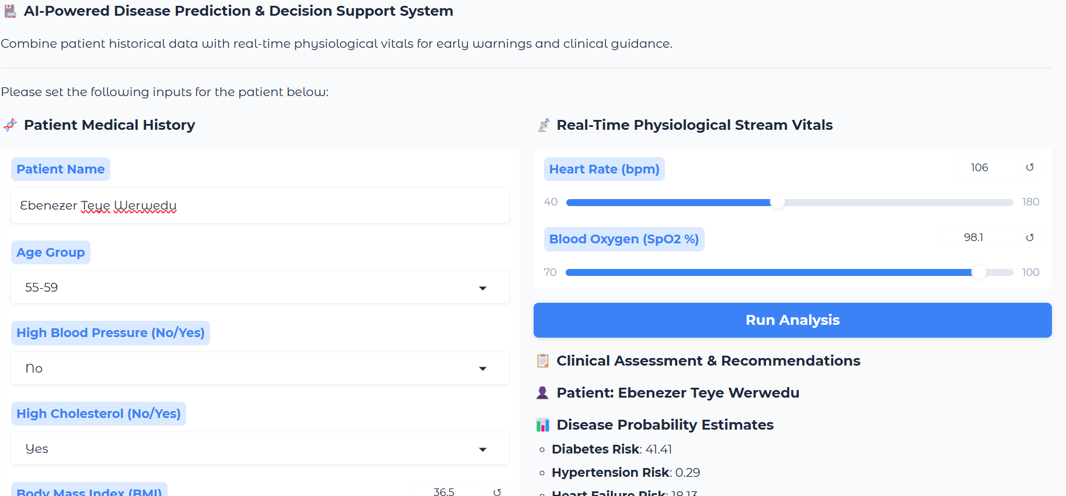
INTERFACE DESIGN
Graphical User Interface
The interface is built with Gradio, a Python library that turns a single function into a web application without much front-end code. The layout groups inputs by purpose and displays the results in an output panel visible at all times.
Run AI Assessment

Slide 13
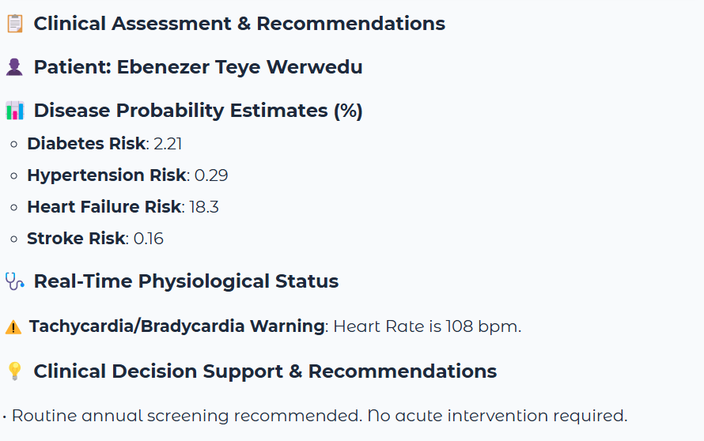
RESULTS
Screenshots and Outputs
WHAT THE OUTPUT COMMUNICATES
Disease Probability Estimates
A percentage per disease showing how closely the patient's data resembles higher-risk patients in training, a screening signal and not a diagnosis.
Real-Time Physiological Status
Immediate flags when heart rate or SpO2 fall outside safe ranges. They are manually generated independently of the ML models as a live safety net.
Clinical Decision Support Recommendations
Plain-text English next steps, such as a specific lab test or specialist referral, translating risk scores into something actionable.
Screenshots and Outputs
10

Slide 14
PROJECT CODE
GitHub Repository
🔗
https://github.com/garwebgroup/ai-disease-predictor
GitHub Repository Link
11

Slide 15
CHALLENGES
Challenges Encountered
!
!
!
Proxy labels, not confirmed diagnoses
Self-reported survey data
Class imbalance
Hypertension, heart-failure, stroke targets had to be approximated from existing survey columns, since the dataset only directly labels diabetes.
BRFSS responses rely on patient memory and honesty, introducing potential recall and reporting bias into training data.
Positive cases were far fewer than negative ones for most conditions, requiring careful model tuning to avoid missing real risk cases.
!
Combining static history with live vitals
Merging one-time survey answers with continuously changing vital signs required a separate, independent safety-check layer.
Challenges Encountered
12

Slide 16
RECOMMENDATIONS
Recommendations for Future Work
1
Adopt confirmed clinical labels
3
Strengthen evaluation
Retrain on verified diagnoses from EHR or lab data instead of survey-based proxy labels to improve validity.
Add ROC-AUC, k-fold cross-validation, confusion matrices and calibration checks per disease.
2
Integrate live wearable data
4
Prepare for broader deployment
Connect to real wearable/IoT vitals feeds instead of manual sliders, enabling true continuous monitoring.
Add multi-language support, offline-friendly design, and address data privacy / informed consent for real-world use.
5
Recommendations
14

Slide 17
CONCLUSION
One Pipeline, Five Diseases, Earlier Intervention
By combining a patient's complete medical history with real-time physiological data in a single XGBoost-driven pipeline, this system turns scattered clinical signals into clear, actionable, early risk estimates, packaged in an interface any healthcare team can use.
Thank You and Questions are Welcome
Conclusion
13

Slide 18
REFERENCES
Sources & Further Reading
1
Chen, T., & Guestrin, C. (2016). XGBoost: A Scalable Tree Boosting System. Proceedings of the 22nd ACM SIGKDD International Conference on Knowledge Discovery and Data Mining.
2
Teboul, A. Diabetes Health Indicators Dataset. Kaggle. Derived from the CDC Behavioral Risk Factor Surveillance System (BRFSS), 2015.
3
Centers for Disease Control and Prevention. Behavioral Risk Factor Surveillance System (BRFSS) Overview.
4
Pedregosa, F., et al. (2011). Scikit-learn: Machine Learning in Python. Journal of Machine Learning Research.
5
Gradio Documentation. Building and sharing interactive machine learning web apps in Python.
References
15

