Slide 1

The Learning Channel
The Learning Channel
Notes:
Layer 1: Physical cables such as Twisted pairs, Fiber optic, Coax plus Wireless devices define Layer 1.
Layer 2: A place where we move traffic from one device to another (i.e. segments).
Layer 3: IP addressing and Routing allows us move data across longer distances.

Slide 2
Cilium Kubernetes CNI Provider Deep Dive: Part 1
Agenda
What is Cilium?
Iptables performance issues
eBPF overview
How Cilium leverages eBPF for load balancing
Cilium installation step by step
Notes:
Layer 1: Physical cables such as Twisted pairs, Fiber optic, Coax plus Wireless devices define Layer 1.
Layer 2: A place where we move traffic from one device to another (i.e. segments).
Layer 3: IP addressing and Routing allows us move data across longer distances.

Slide 3


What is Cilium?
Networking
Observability
Security
Service Mesh
(Beat)
CNI provider
“Hubble” provides distributed networking and security observability
L3/4 , L7, and DNS based network polices
L7 traffic management & load-balancing, TLS termination, etc.
Notes:
Layer 1: Physical cables such as Twisted pairs, Fiber optic, Coax plus Wireless devices define Layer 1.
Layer 2: A place where we move traffic from one device to another (i.e. segments).
Layer 3: IP addressing and Routing allows us move data across longer distances.

Slide 4
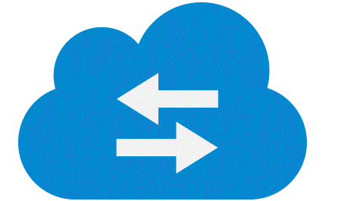

iptables Kube-Proxy Mode Performance Issues for Large Kubernetes Installations
etcd
kube-master
Control Plane
Controller Manager
Hello-world svc
API Server
KUBE-SERVICES is the entry point for service packets. It match the destination IP:port and dispatch the packet to the corresponding KUBE-SVC-* chain.
Scheduler
For each service add, multitude of iptables rules must be added.
eth0
KUBE-SVC-* chain acts as a load balancer, and distributes the packet to KUBE-SEP-* chain equally.
192.168.0.20
kube-node1
Tables are not indexed. Sequential search is done to find which chains and rules applied to a packet.
kube-node2
Kubelet
Kube-Proxy
Worker Node
terminal
Kubelet
Kube-Proxy
Kubelet
gary@kube-node1:~$
sudo iptables -n -t nat -L KUBE-SERVICES
Kube-Proxy
KUBE-SEP-* chain represents a Service EndPoint. It simply does DNAT, replacing service IP:port with pod's endpoint IP:Port.
Incremental changes are not supported (Copy all rules, make changes, save back)
target prot opt source destination
KUBE-SVC-NPX46M4PTMTKRN6Y tcp -- 0.0.0.0/0 10.96.0.1 /* default/kubernetes:https cluster IP */ tcp dpt:443
KUBE-SVC-TCOU7JCQXEZGVUNU udp -- 0.0.0.0/0 10.96.0.10 /* kube-system/kube-dns:dns cluster IP */ udp dpt:53
KUBE-SVC-ERIFXISQEP7F7OF4 tcp -- 0.0.0.0/0 10.96.0.10 /* kube-system/kube-dns:dns-tcp cluster IP */ tcp dpt:53
KUBE-SVC-JD5MR3NA4I4DYORP tcp -- 0.0.0.0/0 10.96.0.10 /* kube-system/kube-dns:metrics cluster IP */ tcp dpt:9153
KUBE-SVC-I6CTHWSTJGL5RHWT tcp -- 0.0.0.0/0 10.101.86.173 /* default/hello-world-service cluster IP */ tcp dpt:80
Host Network Name Space
Host Network Name Space
Container Runtime
CRI
CNI
CRI
It was never designed to be an efficient load balancer in extremely demanding situations.
CNI
ClusterIP
CRI
ClusterIP
CNI Plug-in
10.101.86.173:80
10.101.86.173:80
172.16.9.68:8080
gary@kube-node1:~$
sudo iptables -n -t nat -L KUBE-SVC-I6CTHWSTJGL5RHWT
172.16.9.68:8080
iptables
target prot opt source destination
KUBE-MARK-MASQ tcp -- 0.0.0.0/0 0.0.0.0/0 /* default/hello-world-service */ tcp dpt:30001
KUBE-SEP-DBUZDH4A34C65KQT all -- 0.0.0.0/0 0.0.0.0/0 /* default/hello-world-service */ statistic mode random probability 0.50000000000
KUBE-SEP-PTQOICECNOXPELPH all -- 0.0.0.0/0 0.0.0.0/0 /* default/hello-world-service */
POD
iptables
POD
POD
172.16.209.144:8080
HelloWorld
172.16.209.144:8080
HelloWorld
POD Network Name Space
gary@kube-node1:~$
sudo iptables -n -t nat -L KUBE-SEP-DBUZDH4A34C65KQT
POD Network Name Space
target prot opt source destination
KUBE-MARK-MASQ all -- 172.16.209.144 0.0.0.0/0 /* default/hello-world-service */
DNAT tcp -- 0.0.0.0/0 0.0.0.0/0 /* default/hello-world-service */ tcp to:172.16.209.144:8080
POD Network Name Space
gary@kube-node1:~$
sudo iptables -n -t nat -L KUBE-SEP-PTQOICECNOXPELPH
10.244.0.2
eth0
POD Network Name Space
eth0
eth0
target prot opt source destination
KUBE-MARK-MASQ all -- 172.16.9.68 0.0.0.0/0 /* default/hello-world-service */
DNAT tcp -- 0.0.0.0/0 0.0.0.0/0 /* default/hello-world-service */ tcp to:172.16.9.68:8080
172.16.9.68
192.168.0.22
192.168.0.2
eth0
eth0
eth0
172.16.209.144
192.168.0.26
192.168.0.2
Kube-Proxy iptables mode perf Issues (for large installations)
Notes:
-n — Displays IP addresses and port numbers in numeric format, rather than the default hostname and network service format.
-t — Specifies a table name.
-L — Lists all of the rules in the chain specified after the command.
-v — Displays verbose output, such as the number of packets and bytes each chain has seen, the number of packets and bytes each rule has matched, and which interfaces apply to a particular rule.
- P packets while within a Linux host have an attribute called packet mark. That is just a number.
These rules accept packets which have been given a packet mark value 0x1068 or 0x4000 (in the PREROUTING chain of the mangle, raw or nat chains)

Slide 5

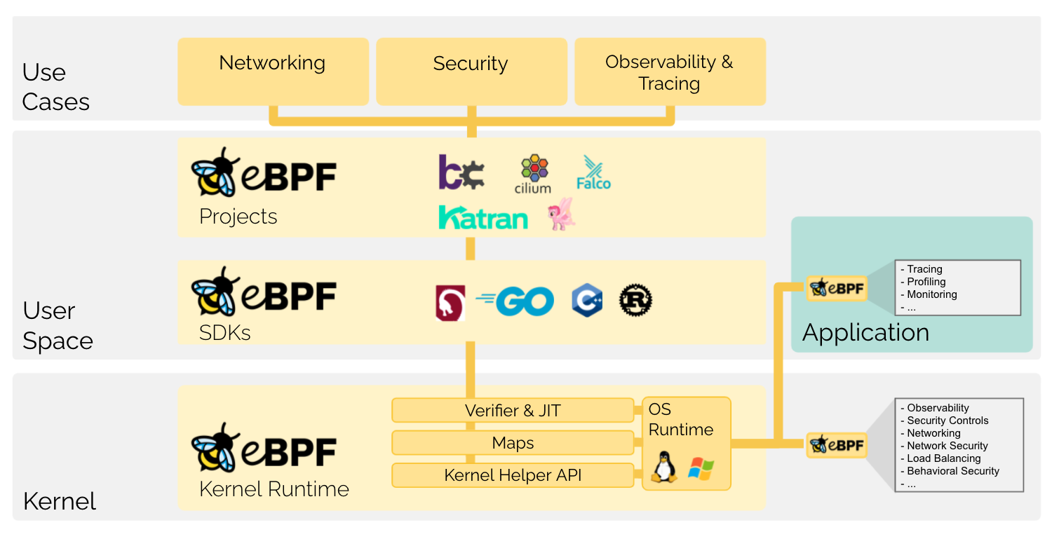
What is eBPF?
eBPF (Extended Berkeley Packet Filter) is a revolutionary technology with origins in the Linux kernel that can run sandboxed programs in an operating system kernel. It is used to safely and efficiently extend the capabilities of the kernel without requiring to change kernel source code or load kernel modules.
Historically, the operating system has always been an ideal place to implement observability, security, and networking functionality. However, an operating system kernel is hard to evolve due to its central role and high requirement towards stability and security.
By allowing to run sandboxed programs within the operating system, application developers can run eBPF programs to add additional capabilities to the operating system at runtime. The operating system then guarantees safety and execution efficiency as if natively compiled with the aid of a Just-In-Time (JIT) compiler and verification engine.
The Linux kernel supports a set of BPF hooks in the networking stack that can be used to run BPF programs. The Cilium datapath uses these hooks to load BPF programs that when used together create higher level networking constructs:
XDP: The XDP BPF hook is at the earliest point possible in the networking driver and triggers a run of the BPF program upon packet reception.
Traffic Control Ingress/Egress: BPF programs attached to the traffic control (tc) ingress hook are attached to a networking interface, same as XDP, but will run after the networking stack has done initial processing of the packet.
Socket operations: The socket operations hook is attached to a specific cgroup and runs on TCP events.
Socket send/recv: The socket send/recv hook runs on every send operation performed by a TCP socket.
Notes:
Layer 1: Physical cables such as Twisted pairs, Fiber optic, Coax plus Wireless devices define Layer 1.
Layer 2: A place where we move traffic from one device to another (i.e. segments).
Layer 3: IP addressing and Routing allows us move data across longer distances.

Slide 6
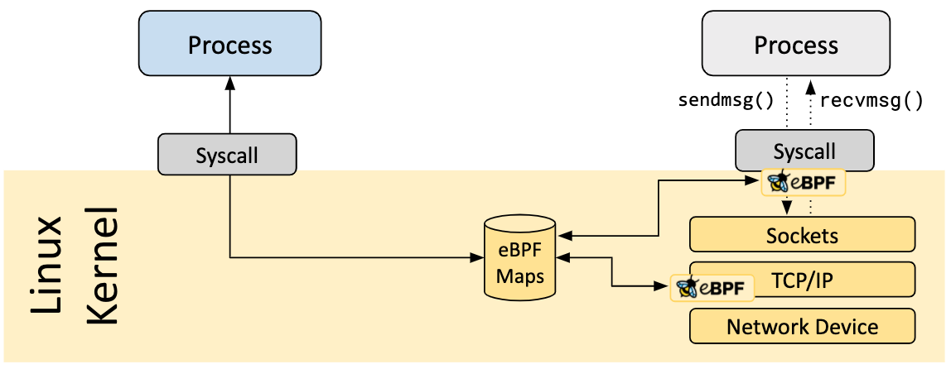
eBPF Maps
A vital aspect of eBPF programs is the ability to share collected information and to store state. For this purpose, eBPF programs can leverage the concept of eBPF maps to store and retrieve data in a wide set of data structures. eBPF maps can be accessed from eBPF programs as well as from applications in user space via a system call.
The following is an incomplete list of supported map types :
Hash tables, Arrays
LRU (Least Recently Used)
Ring Buffer
Stack Trace
LPM (Longest Prefix match)
Notes:
Layer 1: Physical cables such as Twisted pairs, Fiber optic, Coax plus Wireless devices define Layer 1.
Layer 2: A place where we move traffic from one device to another (i.e. segments).
Layer 3: IP addressing and Routing allows us move data across longer distances.

Slide 7

eBPF Programing
All packets that arrive at VM’s network interface (eth0) and are destined for port 80, forward them through the veth pair to the Hello-World service hosted on the POD
POD
Hello-world
.
.
.
.
.
.
.
.
.
.
.
.
.
.
.
.
.
.
.
.
.
.
.
.
.
.
.
.
.
.
.
.
.
.
.
.
.
.
.
.
.
.
.
eth0
10.0.0.247
lxc0
SEC(“to_netdev”)
int handle(struct sk_buff *skb) {
…
if (tcp->dport == 80)
redirect(lxc0);
return DROP_PACKET;
}
BPBF
Maps
Native Code
clang –target bpf [….]
JIT
Foo.o
eBPF loader
bpf(BPF_PROG_LOAD,…)
eBPF verifier
eth0
User Mode
Kernel Mode
192.168.0.45
packet
packet
packet
packet
packet
LAN
Notes:
Layer 1: Physical cables such as Twisted pairs, Fiber optic, Coax plus Wireless devices define Layer 1.
Layer 2: A place where we move traffic from one device to another (i.e. segments).
Layer 3: IP addressing and Routing allows us move data across longer distances.

Slide 8
Service Load Balancing and eBPF (Part 1)
etcd
kube-master
Control Plane
Controller Manager
Hello-world svc
API Server
Hello-world End points:
10.0.1.62:8080 10.0.1.75:8080 10.0.0.183:8080
10.0.0.188:8080
Service IP | Port | ID | Endpoint ID | Endpoint IP | Port
10.107.72.75
1
Scheduler
10.0.1.62
8080
4
8080
10.107.72.75
8080
1
5
10.0.0.183
8080
eth0
10.0.0.134
10.107.72.75
8080
1
6
10.0.1.75
8080
kube-node2
Kube-Proxy
Worker Node
kube-node1
Kube-Proxy
Worker Node
10.107.72.75
8080
Cilium Agent
10.0.0.188
Worker Node
Cilium Agent
1
7
8080
(ipvs mode)
(iptables mode)
(iptables mode)
Kubelet
(ipvs mode)
Kube-Proxy
Kubelet
Kube-Proxy
Host Network Name Space
Host Network Name Space
Container Runtime
CRI
Container Runtime
CRI
ClusterIP
ClusterIP
CNI Plug-in
10.107.72.75:8080
CNI Plug-in
10.107.72.75:8080
POD (Hello-world)
192.168.9.86:8080
eBPF
POD (hello-world)
192.168.9.86:8080
eBPF
192.168.9.87:8080
iptables
192.168.9.87:8080
iptables
IPVS
IPVS
POD Network Name Space
SVC
MAP
POD Network Name Space
SVC
MAP
POD
192.168.233.207:8080
POD
192.168.233.207:8080
eth0
192.168.233.206:8080
eth0
192.168.233.206:8080
POD Network Name Space
POD Network Name Space
192.168.9.86
192.168.233.207
POD (Hello-world)
POD (hello-world)
POD Network Name Space
POD Network Name Space
eth0
eth0
10.244.0.2
eth0
eth0
10.244.0.2
eth0
eth0
192.168.9.87
10.0.0.135
eth0
192.168.233.206
eth0
192.168.0.2
10.0.0.164
192.168.0.2
Notes:
Kubectl generates a manifest describing a Deployment
The manifest is sent to the API Server
The manifest is validated by the API Server, and persisted to “etcd”

Slide 9
Service Load Balancing and eBPF (Part 2)
ClusterIP
10.107.72.75 :8080
POD
POD
POD
IP Packet
curl http://10.107.72.75:8080
IP Packet
IP Packet
#
Hello-world SVC
Hello-world UI
Hello-world SVC
Source: 10.0.1.184
Destination:
Port: 8080
Source: 10.0.0.247
Destination:
Port: 8080
Source: 10.0.1.184
Destination:
Port: 8080
10.0.0.247
10.0.0.247
Hello, world!
Version: 1.0.0
Hostname: hello-world-57fbf88c7-xv75x
10.0.1.183
Payload: Response
Payload: Response
Payload: Request
eth0
eth0
eth0
10.0.0.247
10.0.1.184
10.0.1.183
IP Packet
Source: 10.0.0.247
Destination: 10.107.72.75
Port: 8080
Source: 10.0.0.247
Destination:
Port: 8080
IP Packet
lxcc4b87faa7e82
10.0.1.183
IP Packet
lxc142af750fbe9
lxce9626b0b3d0c
Source: 10.0.1.184
Destination:
Port: 8080
Source: 10.0.0.247
Destination:
Port: 8080
10.0.0.247
10.0.1.183
Do we already have an established connection?
Payload: Request
IP to ID Mapping
IP: 10.0.0.247
ID: 848
Is ID 848 allowed on port 8080?
Payload: Response
Linux kernel
Payload: Request
eBPF: lxcc4b87faa7e82
IP Packet
Source: 10.0.0.247
Destination:
Port: 8080
IP Packet
IP Packet
10.0.1.183
Source: 10.0.1.184
Destination:
Port: 8080
Source:
Destination:
Port: 8080
Service
Connection
Identity
Policy
Endpoint
10.107.72.75
10.0.0.247
10.0.0.247
Payload: Request
Payload: Response
Payload: Response
cilium_vxlan
IP Packet
cilium_vxlan
eBPF Conn Track Map
Source: 10.0.0.247
Destination:
Port: 8080
eBPF Conn Track Map
eBPF Service Has Map
10.0.1.183
IP Packet
Source IP | Source Port | Dest IP | Dest Port | Type | Endpoint ID | Service ID
10.0.0.247 | 4321 | 10.107.72.75 | 8080 | SVC | 4
10.0.0.247 | 4321 | 10.0.1.183 | 8080 | Egress |  | 1
IP Packet
Service IP | Port | ID | Endpoint ID | Endpoint IP | Port
10.107.72.75 | 8080 | 1 | 4 | 10.0.1.183 | 8080
10.107.72.75 | 8080 | 1 | 5 | 10.0.1.184 | 8080
Source IP | Source Port | Dest IP | Dest Port | Type | Endpoint ID | Service ID
10.0.0.247 | 4321 | 10.107.72.75 | 8080 | SVC | 4
10.0.0.247 | 4321 | 10.0.1.183 | 8080 | Egress |  | 1
Source: 10.0.1.184
Destination:
Port: 8080
eth0
Payload: Request
Source: 10.0.0.247
Destination:
Port: 8080
eth0
10.0.0.247
192.168.0.45
10.0.1.183
192.168.0.40
Payload: Response
Payload: Request
eBPF Programing
Notes:
Layer 1: Physical cables such as Twisted pairs, Fiber optic, Coax plus Wireless devices define Layer 1.
Layer 2: A place where we move traffic from one device to another (i.e. segments).
Layer 3: IP addressing and Routing allows us move data across longer distances.

Slide 10
Cilium Installation
Agent: Runs on each node in the cluster and listens for events from orchestration systems such as Kubernetes to learn when containers or workloads are started and stopped. It also manages the eBPF programs which the Linux kernel uses to control all network access in / out of those containers.
The Cilium CLI is a command-line tool that is installed along with the Cilium agent. It interacts with the REST API of the Cilium agent running on the same node. The CLI allows inspecting the state and status of the local agent. It also provides tooling to directly access the eBPF maps to validate their state.
Agent
Cilium CLI
Operator
CNI Plugin
The Cilium Operator is responsible for managing duties in the cluster which should logically be handled once for the entire cluster, rather than once for each node in the cluster.
The Hubble server: runs on each node and retrieves the eBPF-based visibility from Cilium. It is embedded into the Cilium agent in order to achieve high performance and low-overhead. It offers a gRPC service to retrieve flows and Prometheus metrics.
Hubble
Server
Relay
CLI
UI
Relay (hubble-relay) is a standalone component which is aware of all running Hubble servers and offers cluster-wide visibility by connecting to their respective gRPC APIs and providing an API that represents all servers in the cluster.
Notes:
Layer 1: Physical cables such as Twisted pairs, Fiber optic, Coax plus Wireless devices define Layer 1.
Layer 2: A place where we move traffic from one device to another (i.e. segments).
Layer 3: IP addressing and Routing allows us move data across longer distances.

