Slide 1
The IBM Hack Challenge Friend Affinity Finder

Slide 2



Team EDGE – 4 Members
Gaurav Goswami
Eshani Agarwal
Enosh Kumar
Divyanshu Gaur
Frontend / Cloud Dev | Backend Dev | Tester / Ideator | ML Expert
JavaScript | Python | C | Python
HTML5 | Java | Mentor | Machine Learning
CSS3 | C | HTML | Java
Java | Leader Qualities | Java | Android

Slide 3
Technologies/Platforms/APIs/Libraries
Visual Studio Code
Python3
pip v19.1.1
Tweepy
IBM Watson
Flask
JavaScript
jQuery
HTML5
CSS3
Semantic UI
pca-js
plotly-js
toastify-js

Slide 4
Architecture Diagram
Friend Affinity Finder App (Frontend)
Authentication
Data Fetch
Analysis
Display Card
Generate 3D Graph
Python Backend
Twitter DB
IBM Watson (NLU & Personality Insights)

Slide 5
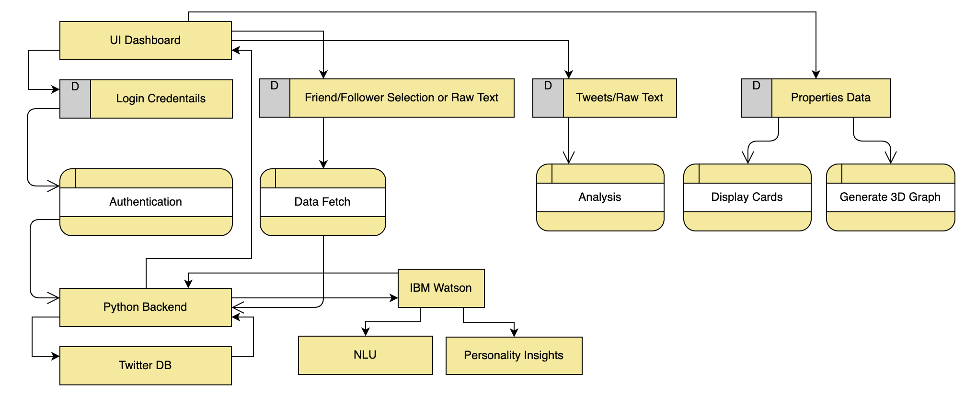
DFD – Level 1

Slide 6
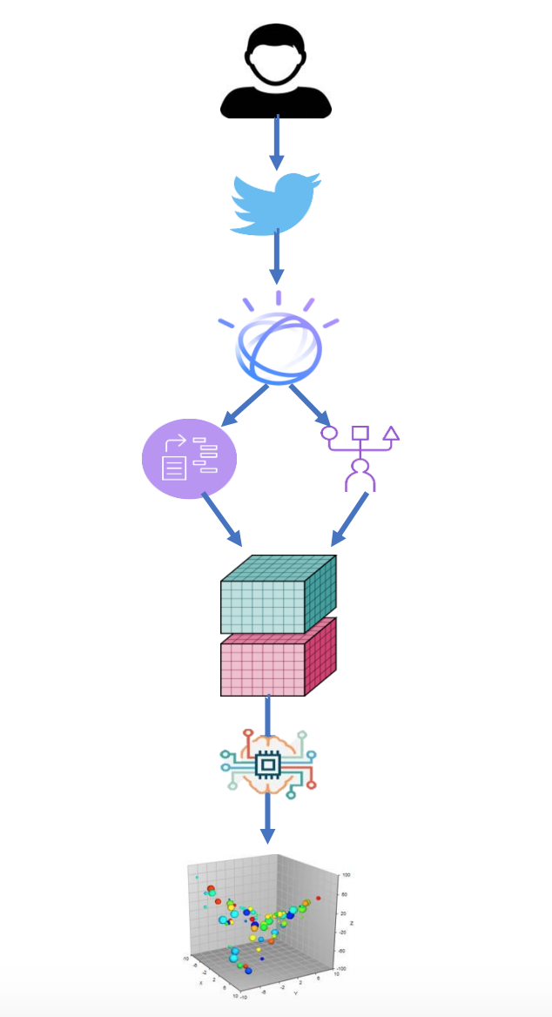
Flow Diagram
User logs in with Twitter Developer Account Credentials.
User analyzes textual data (either raw text or tweets fetched from any friend or followers Twitter Handle).
User is displayed card with properties and corresponding scores of every person analyzed.
User is shown a 3D affinity graph which gives an estimate about affinity among the analyzed people.

Slide 7
Frameworks/Tools for UI/UX
Semantic UI – Web Framework for UI/UX
https://semantic-ui.com/
The framework allows to use high-end, stylish web components in React, Meteor, Ember, NodeJS, AngularJS and etc. It has a lot of theming options too which makes UI look and feel out of the world. The framework can be meshed up with other frameworks too. The organization provides a lot ways to use the framework, download, use CDN, install or etc.
Along with being fast and stylish, the framework is a non-profit organization too.
Much more wonders done with: JQuery and CSS3

Slide 8
THANK
YOU

