Slide 1
機器學習及應用期末報告
Reporter:謝佳峻
Student ID:112033640

Slide 2
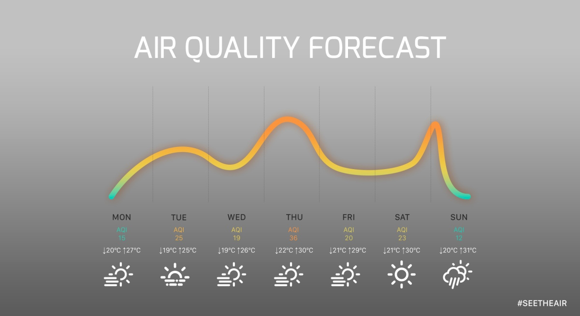
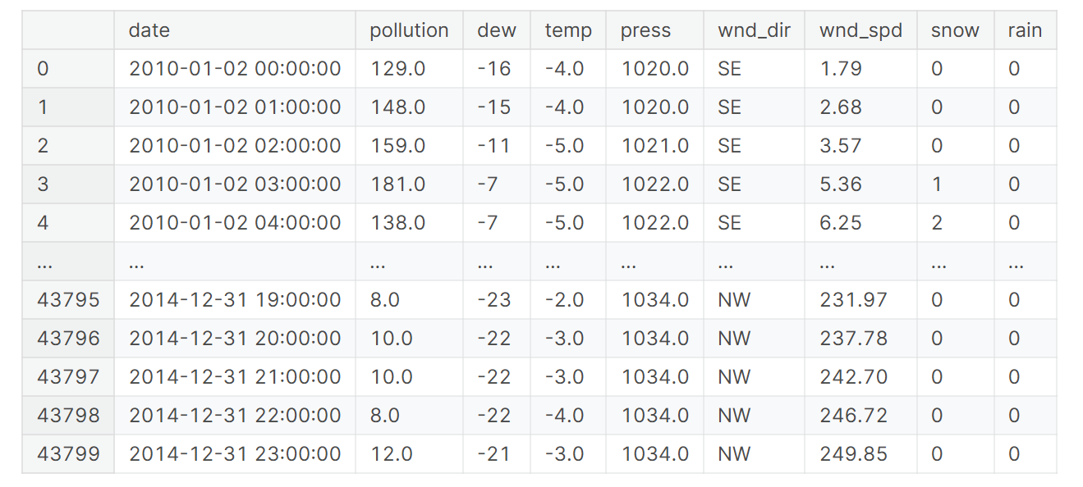
Air pollution forecasting data
Air quality forecast
Training data set
https://seetheair.org/2021/07/06/air-quality-forecast-app-comparison/

Slide 3
Training processing
Air pollution forcecate
model
Data analysis
Select model
Data processing
Train model
BiLstm
BiGRU
RLstm
Compute accuracy

Slide 4
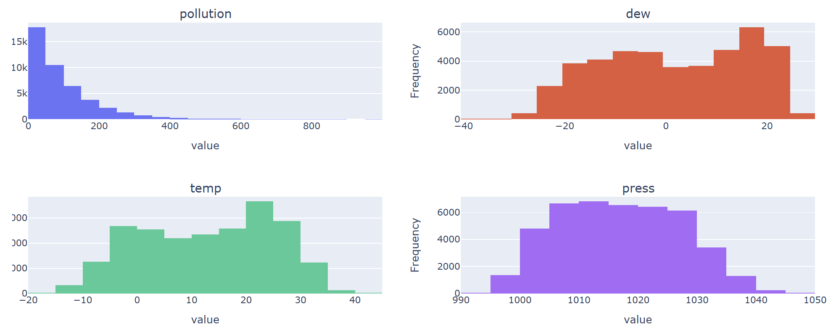
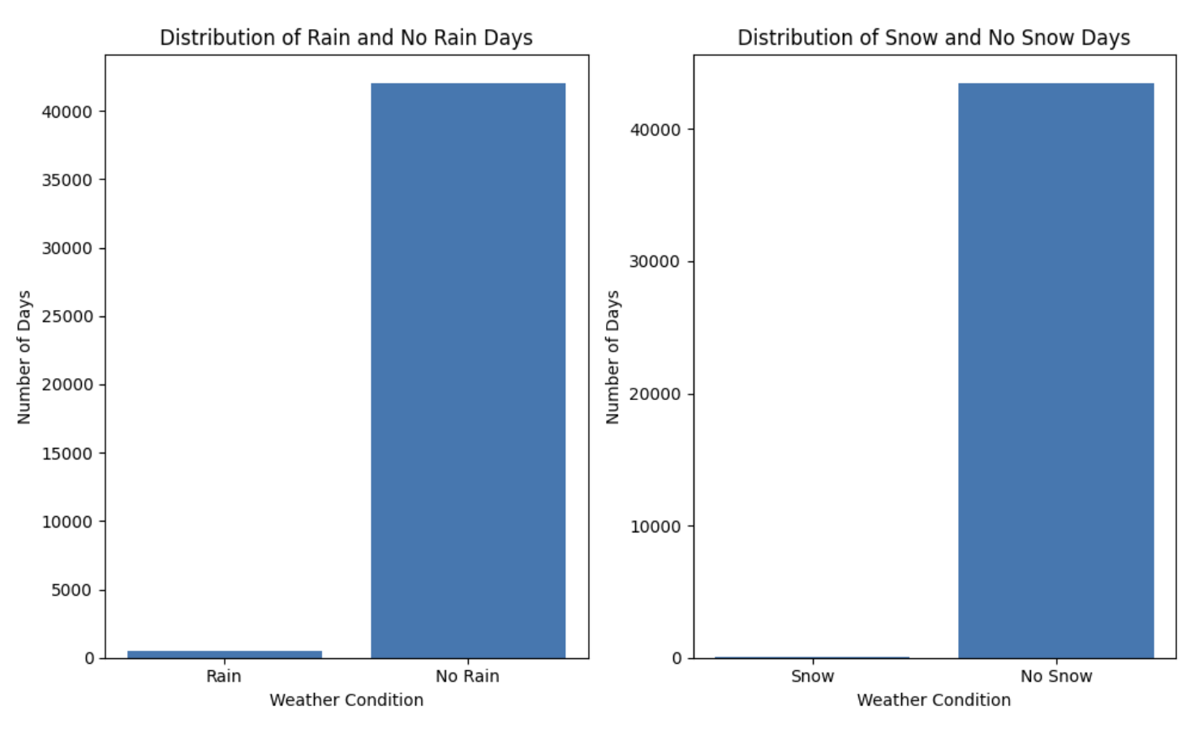
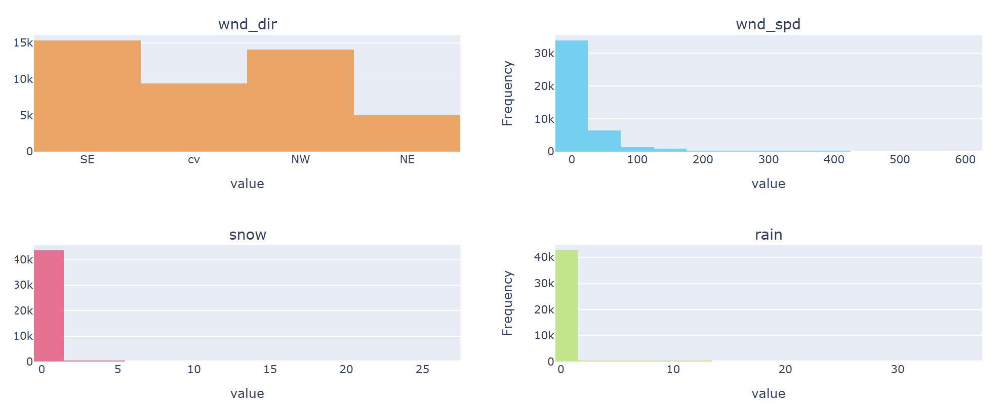
Data analysis
Distribution of Variables

Slide 5
One hot encoding
Advantage :
Allows the use of categorical variables in models that require numerical input
Avoid the problem of ordinality, which can occur when a categorical variable has a natural ordering (e.g. “small”, “medium”, “large”)
Wind_dir
SE
NE
NW
SW
SE
1
0
0
0
SW
0
0
0
1
NE
0
1
0
0
NW
0
0
1
0
One Hot Encoding

Slide 6
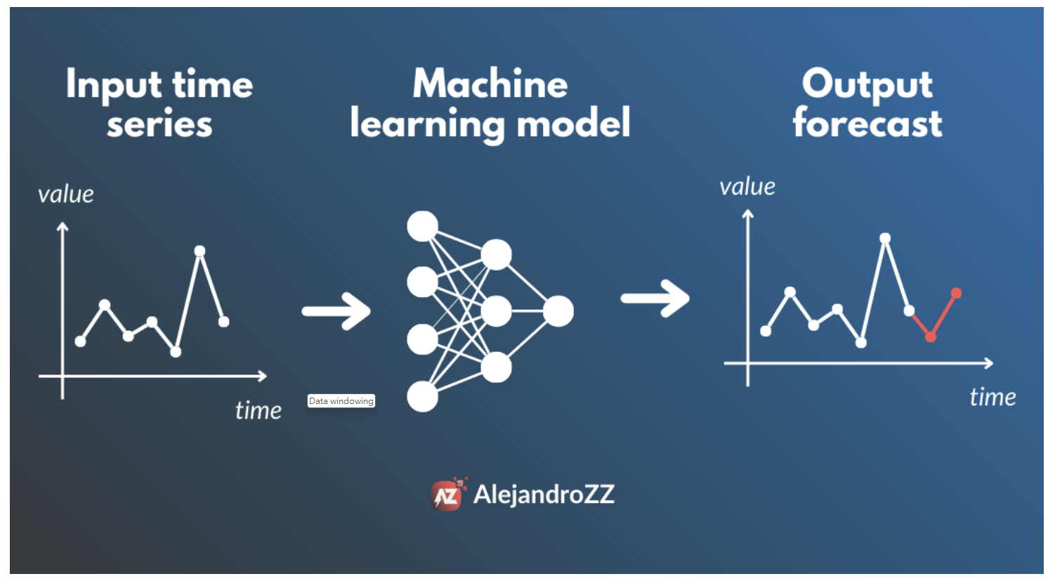
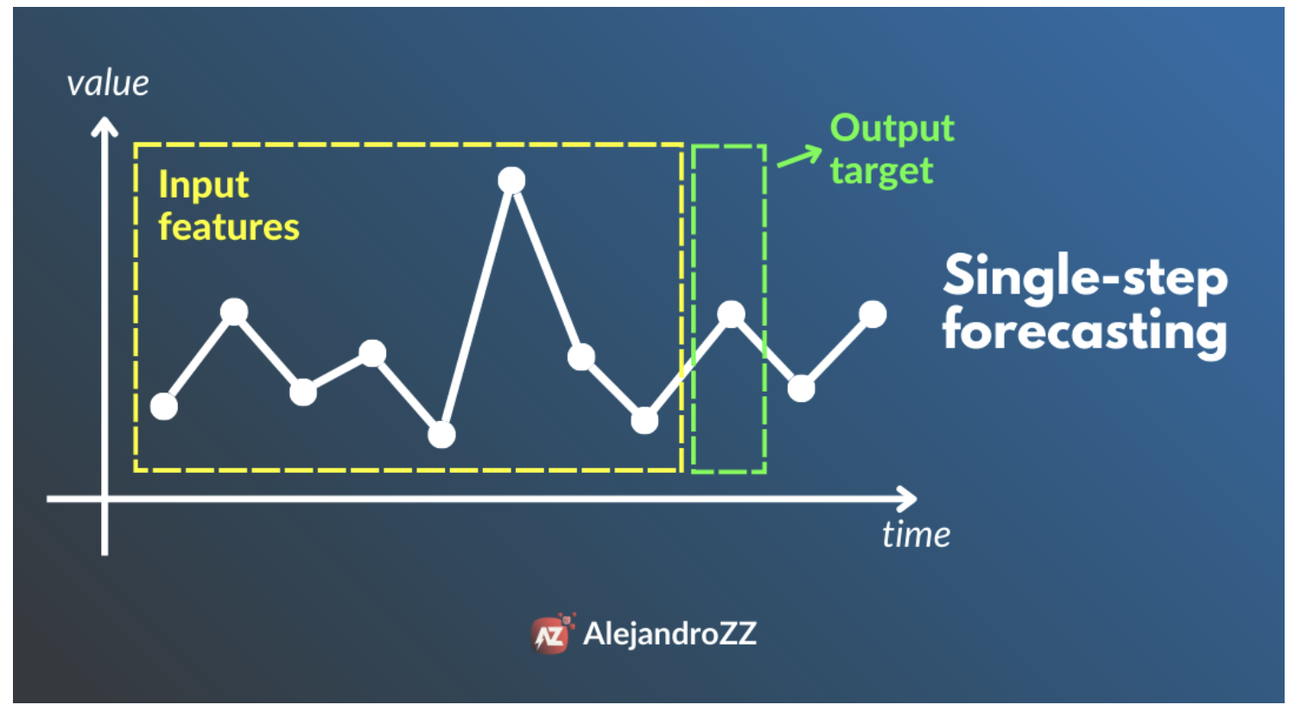
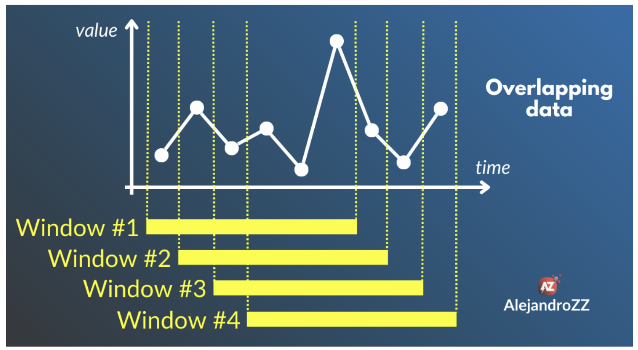
Data windowing
Advantage:
Reduction of Edge Effects
Improvement of Frequency Analysis
Enhancement of Spectral Resolution
Enhancement of Signal-to-Noise Ratio (SNR)
https://www.linkedin.com/pulse/data-windowing-technique-used-time-series-forecasting-alejandro

Slide 7
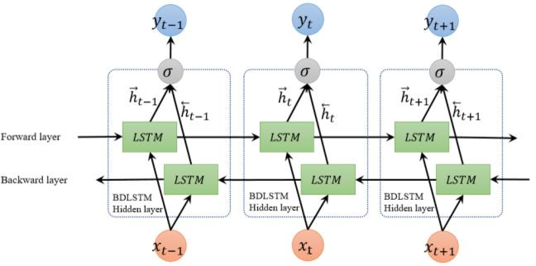
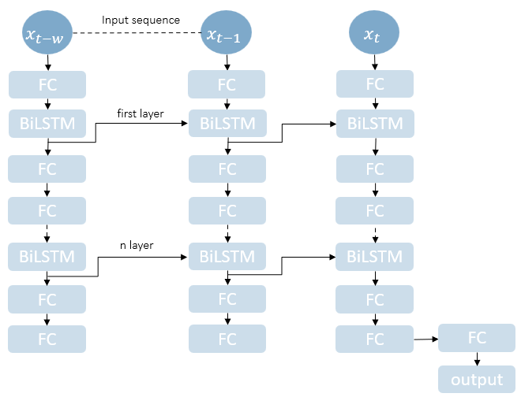
Bidirectional LSTM
Bidirectional LSTM
Capturing Sequence Context
Reducing Information Loss During Forgetting
Improved Predictive Power
Mitigating Gradient Vanishing Issues
Muti-BiLSTM
https://www.gabormelli.com/RKB/Bidirectional_LSTM_%28BiLSTM%29_Training_System
Notes:
Capturing Sequence Context: Bidirectional LSTMs can capture context information from both directions (forward and backward) in a sequence. This means they can utilize information from both before and after any position in the sequence to predict the output at the current position, thereby better understanding the intrinsic structure of the sequence.
Reducing Information Loss During Forgetting: Traditional unidirectional LSTMs may forget early information in a sequence when processing long sequences, as information needs to be propagated sequentially throughout the entire sequence. Bidirectional LSTMs, by processing from both ends of the sequence simultaneously, mitigate this loss of information.
Improved Predictive Power: Due to their ability to comprehensively understand contextual information within a sequence, bidirectional LSTMs often provide more accurate predictions. This is highly advantageous for many sequence modeling tasks such as language modeling, speech recognition, time series prediction, etc.
Mitigating Gradient Vanishing Issues: Long sequences often suffer from gradient vanishing issues, where distant dependencies cannot be effectively updated during backpropagation, leading to poor parameter updates. Bidirectional LSTMs, by propagating gradients both forward and backward, better handle this gradient vanishing problem, thereby accelerating convergence and improving model performance.

Slide 8
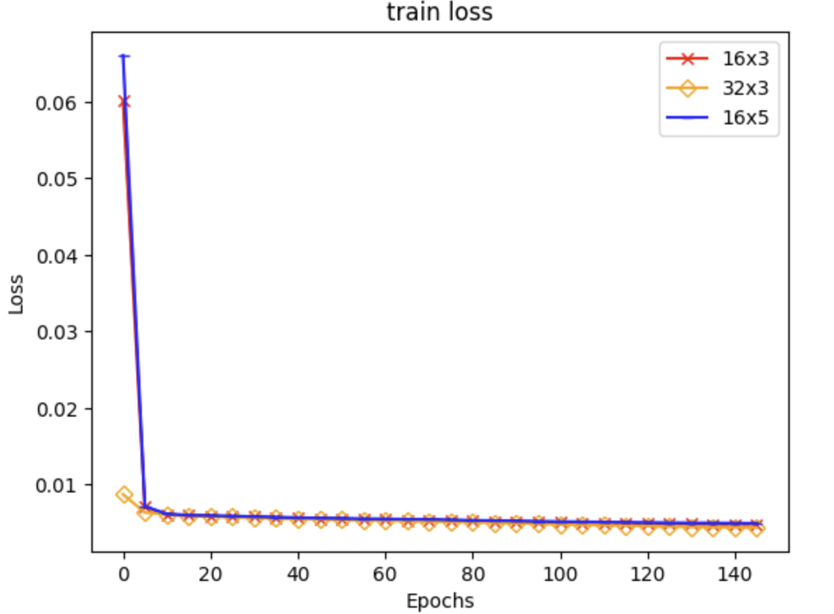
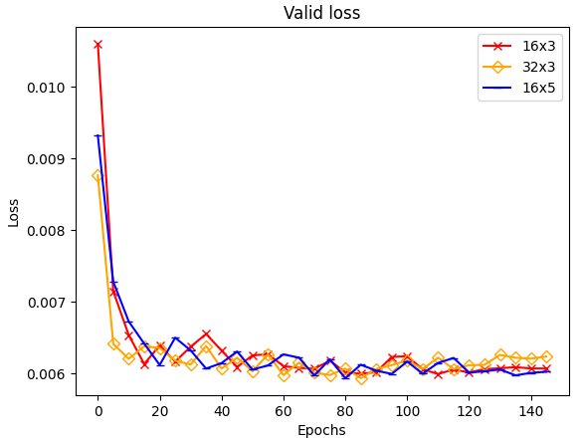
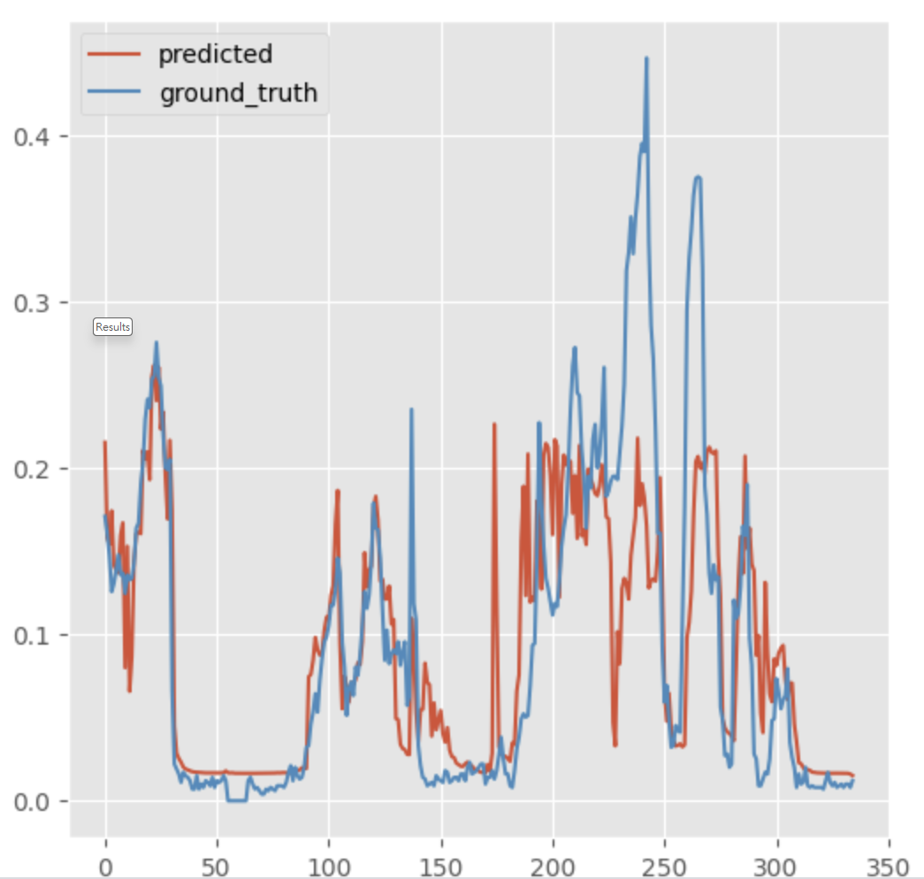
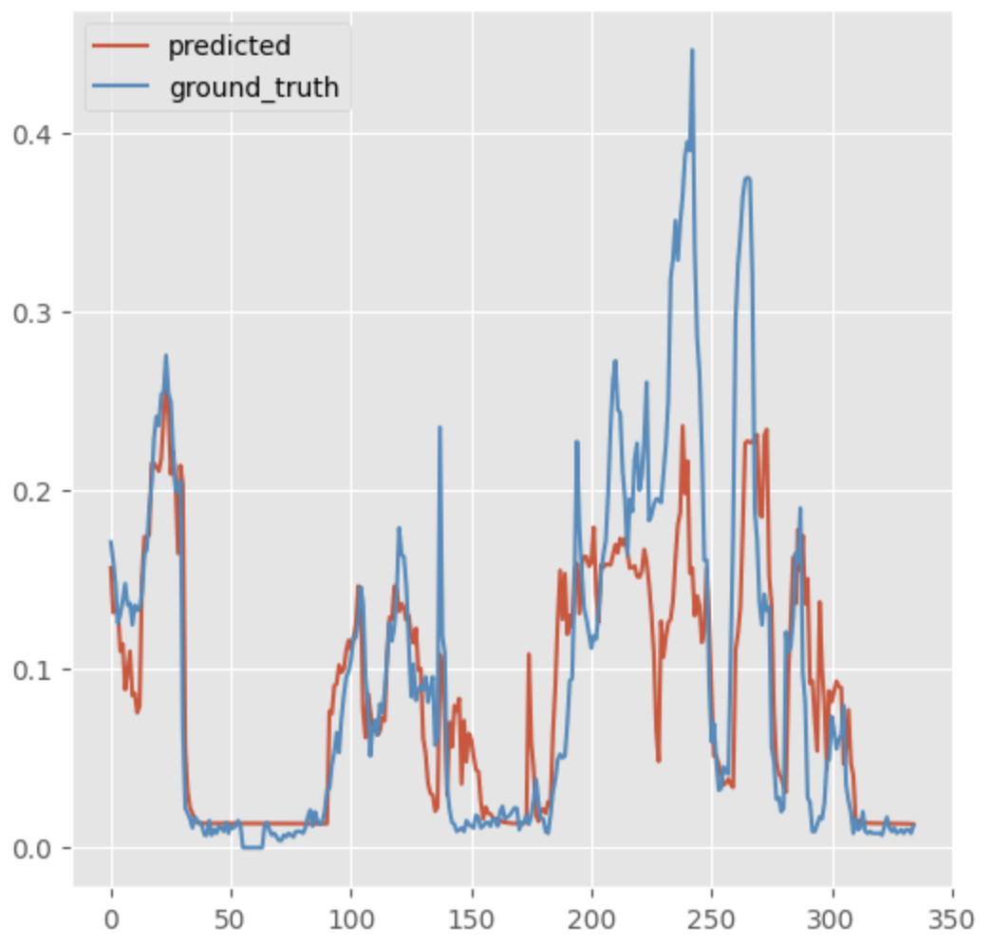
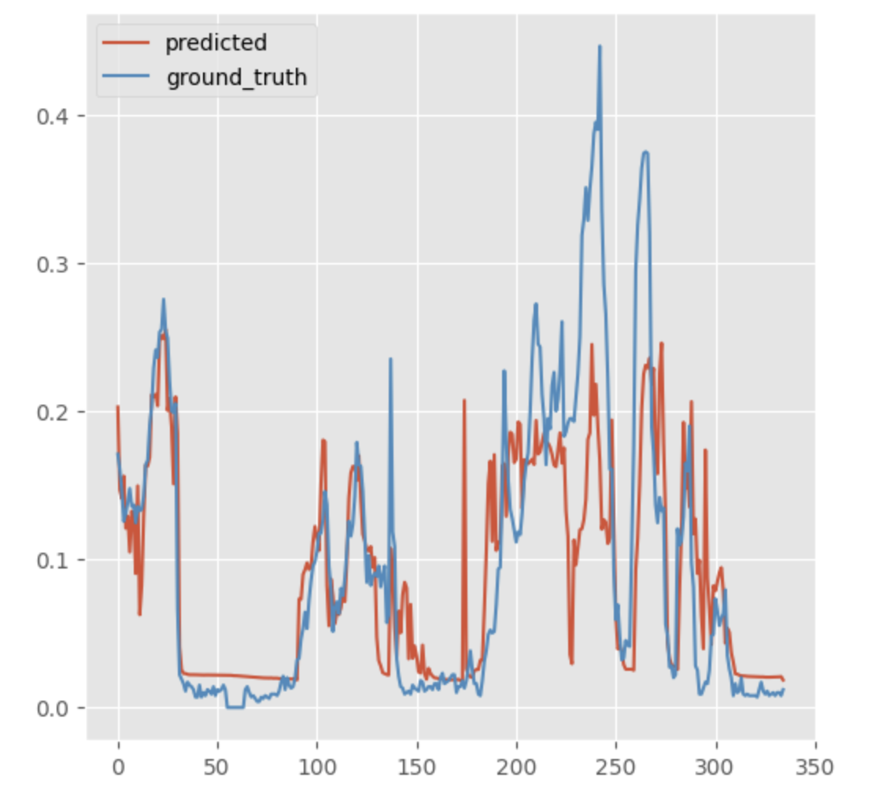
Results
Nodes &Layers | RMSE | MAE | R
16×3 | 0.064 | 0.038 | 0.591
32×3 | 0.061 | 0.037 | 0.627
16×5 | 0.062 | 0.038 | 0.610
16x3
32x3
16x5

Slide 9

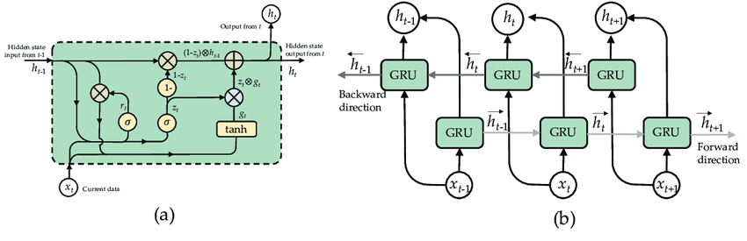
Bidirectional Gated Recurrent Unit
Simpler Architecture
Efficient Training
Less Susceptible to Vanishing Gradient Problem
Better Performance on Short Sequences
Muti-BiGRU
https://www.researchgate.net/figure/Structure-of-Bidirectional-GRU-BiGRU-a-GRU-cell-and-b-unroll-BiGRU_fig5_360614707
https://www.kaggle.com/competitions/tlvmc-parkinsons-freezing-gait-prediction/discussion/416410
Notes:
Simpler Architecture: GRUs have a simpler architecture compared to LSTM networks. They combine the forget and input gates into a single "update gate," reducing the number of parameters and making them easier to train and implement.
Efficient Training: GRUs are generally faster to train compared to LSTM networks due to their simpler structure and fewer parameters. This efficiency makes them well-suited for training on large datasets and in scenarios where computational resources are limited.
Less Susceptible to Vanishing Gradient Problem: GRUs address the vanishing gradient problem more effectively than traditional RNNs. By introducing the reset gate and update gate mechanisms, GRUs can maintain information over longer sequences and mitigate the vanishing gradient problem during training.
Better Performance on Short Sequences: GRUs often outperform traditional RNNs and LSTMs on tasks involving short sequences, such as language modeling, sentiment analysis, and speech recognition. Their ability to capture dependencies over shorter time scales while avoiding overfitting makes them advantageous in these scenarios.

Slide 10
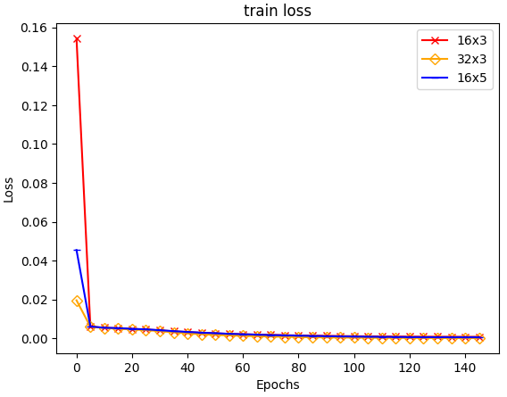
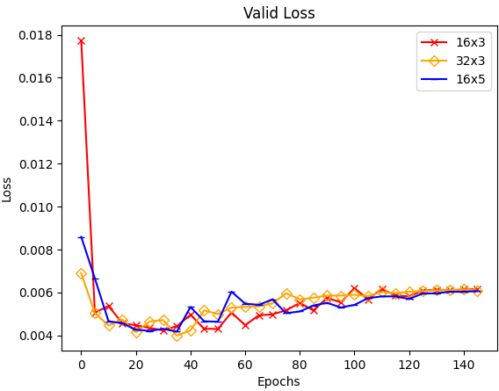
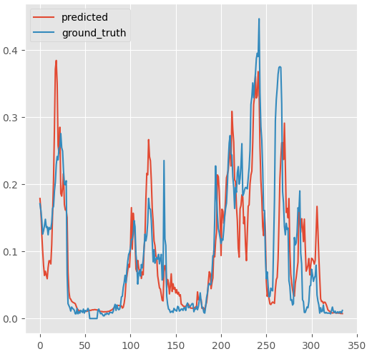
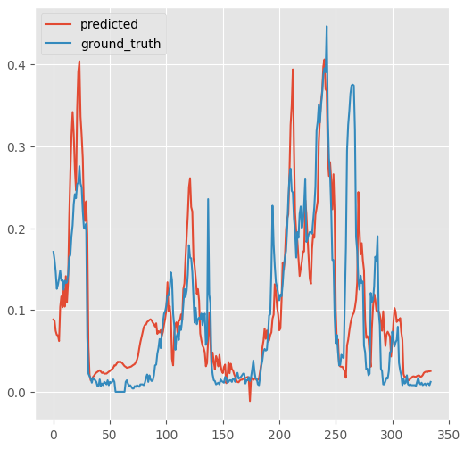
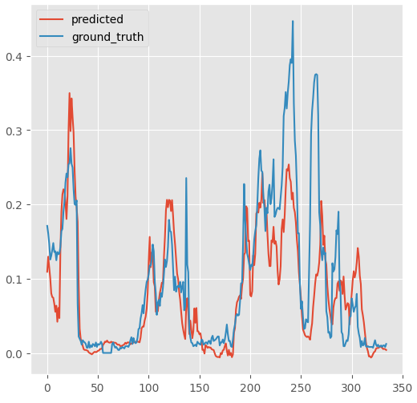
Results
Nodes &Layers | RMSE | MAE | R
16×3 | 0.058 | 0.036 | 0.664
32×3 | 0.061 | 0.040 | 0.616
16×5 | 0.065 | 0.040 | 0.576
16x3
32x3
16x5

Slide 11
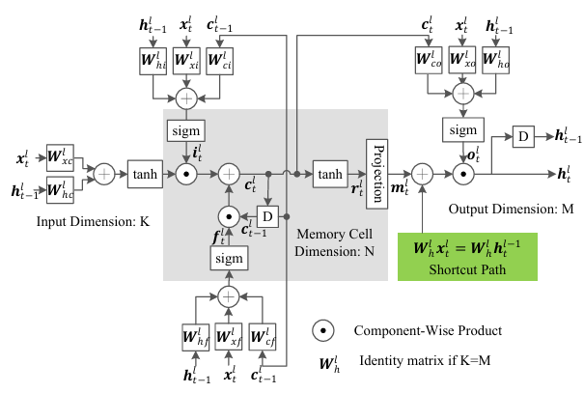
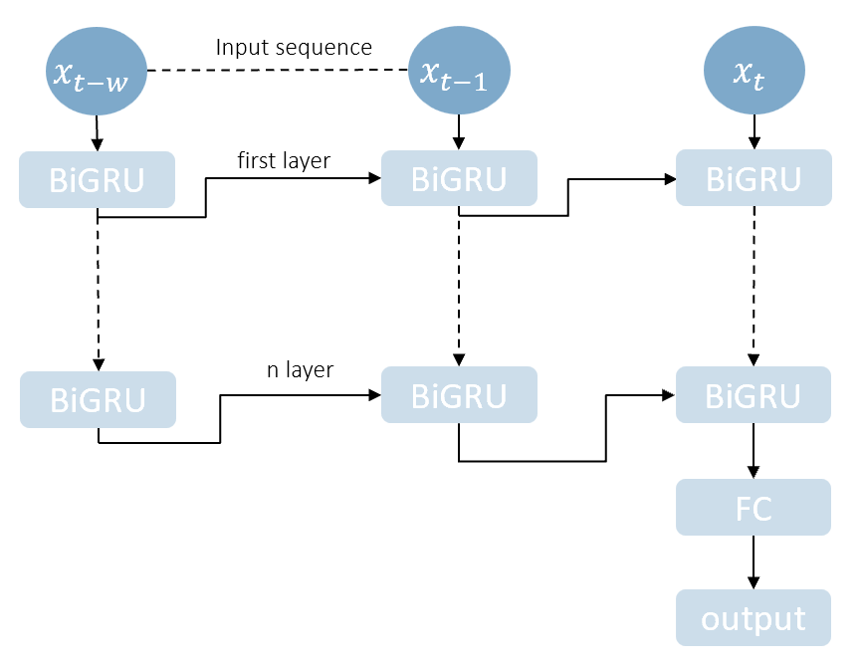
Residual LSTM
Combination of Residual Connections and LSTM Cells
Alleviation of Vanishing Gradient Problem
Efficient Training of Deep Recurrent Networks
Kim, Jaeyoung, Mostafa El-Khamy, and Jungwon Lee. "Residual LSTM: Design of a deep recurrent architecture for distant speech recognition." arXiv preprint arXiv:1701.03360 (2017)
Notes:
Combination of Residual Connections and LSTM Cells: RLSTM combines the residual connections from ResNet with the Long Short-Term Memory (LSTM) architecture. This integration aims to leverage the benefits of residual connections for alleviating the vanishing gradient problem in deep networks, along with the sequence modeling capabilities of LSTM cells.
Alleviation of Vanishing Gradient Problem: The use of residual connections in RLSTM helps mitigate the vanishing gradient problem, which is a common challenge in training deep neural networks. By providing shortcut connections that enable the direct flow of gradients, RLSTM facilitates more effective gradient propagation during training.
Efficient Training of Deep Recurrent Networks: RLSTM enables the training of deep recurrent neural networks (RNNs) with improved efficiency and convergence properties. The incorporation of residual connections allows for the training of deeper networks without encountering as many issues related to vanishing gradients or optimization difficulties.

Slide 12
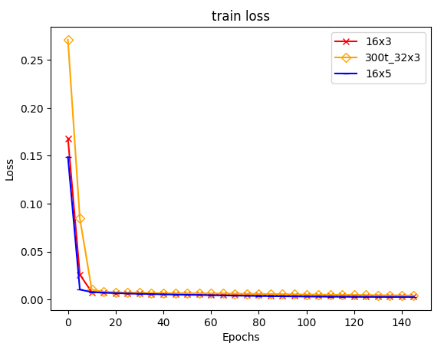
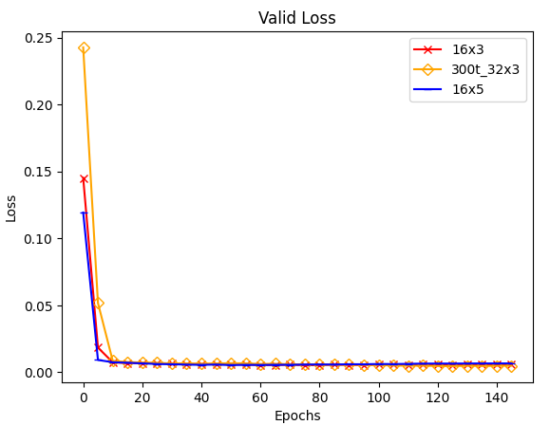
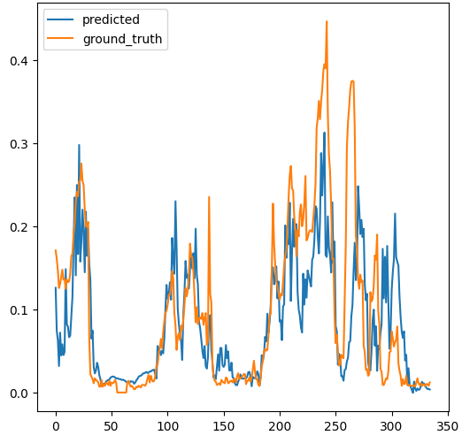
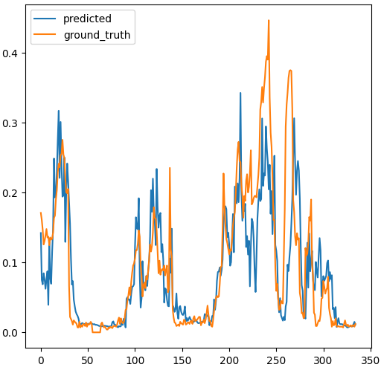
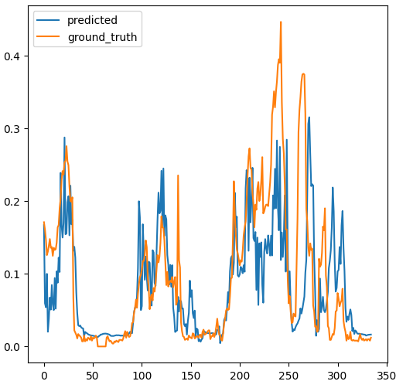
Results
Nodes &Layers | RMSE | MAE | R
16×3 | 0.071 | 0.045 | 0.487
32×3 | 0.064 | 0.039 | 0.587
16×5 | 0.079 | 0.050 | 0.366
16x3
32x3
16x5

Slide 13
Comparison Result
Method | RMSE | MAE | R
BiLSTM | 0.061 | 0.037 | 0.627
BiGRU | 0.058 | 0.036 | 0.664
RLSTM | 0.064 | 0.039 | 0.587
Bi-LSTM
Bi-GRU
Residual LSTM

Slide 14
“Thank You”
for your listening

