Slide 1

Image Annotation of 1980s Scene
Gary Dahnke
Image Annotation of people in a 1990s Scene Using Bounding Boxes and Skeletons with Attributes and Tags
CVAT Data Annotation Portfolio
Version 1.0 – June 27, 2026

Slide 2
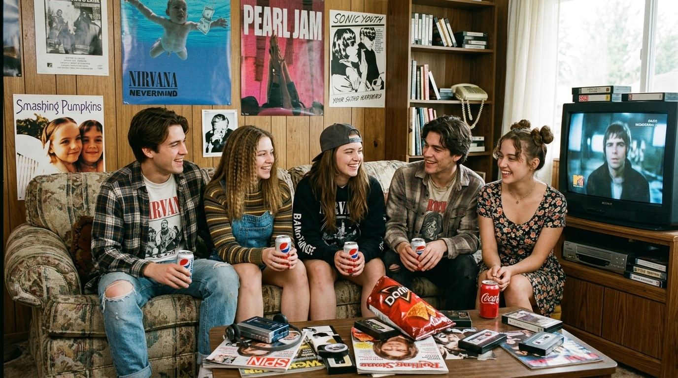
Image to be Annotated

Slide 3
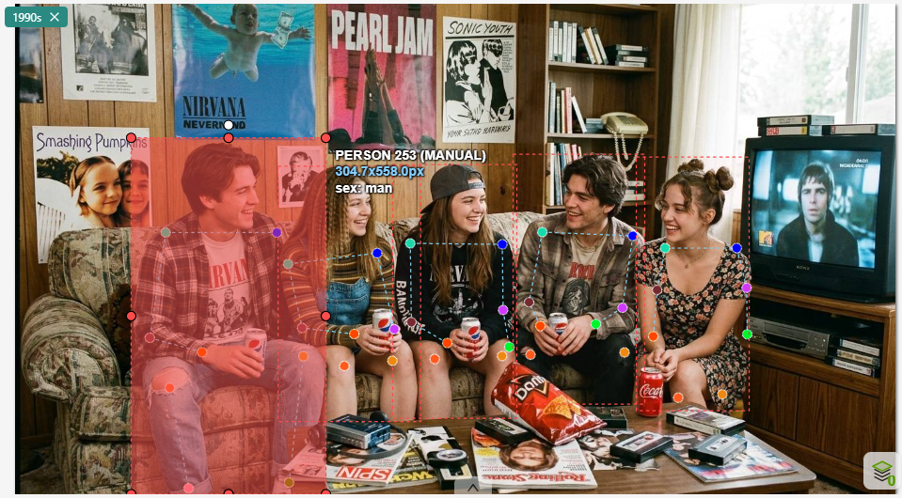
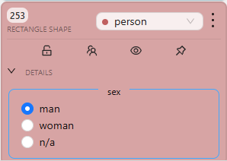
Annotated Image of Person 1: Bounding Box

Slide 4
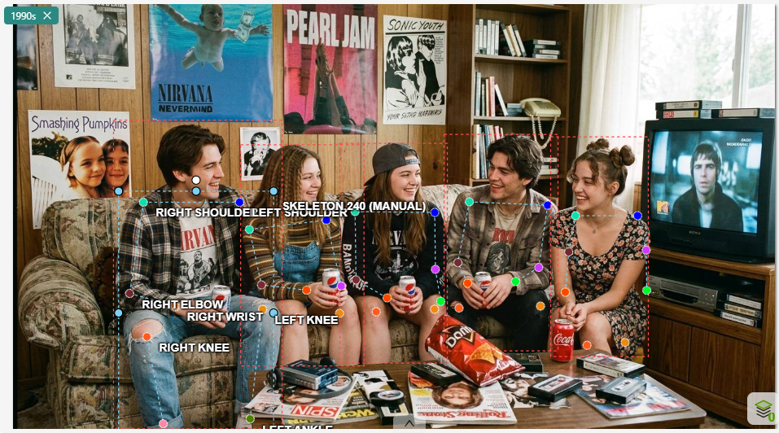
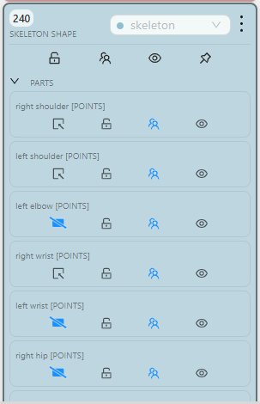
Annotated Image of Person 1: Skeleton

Slide 5
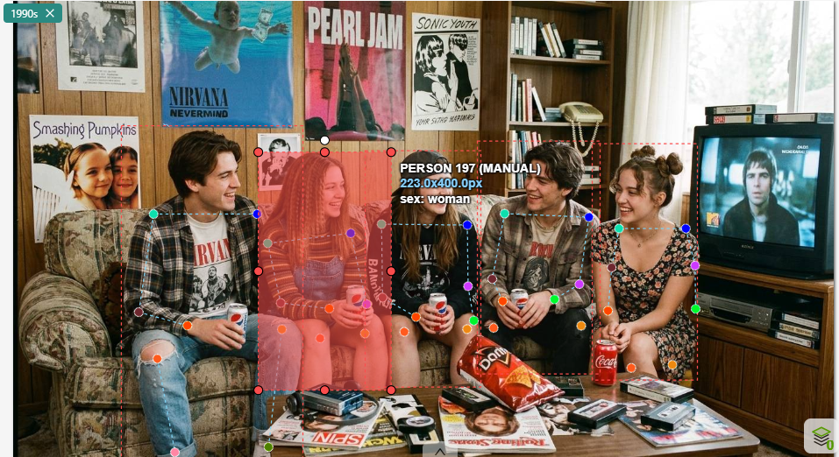
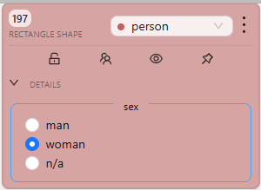
Annotated Image of Person 2: Bounding Box

Slide 6
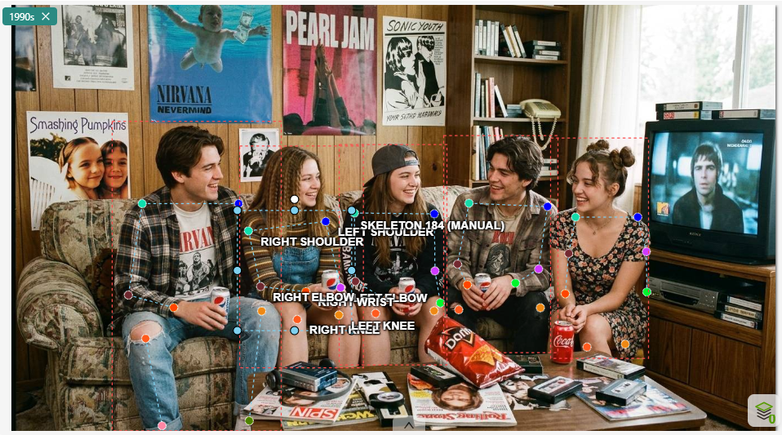
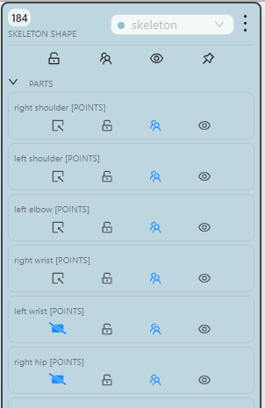
Annotated Image of Person 2: Skeleton

Slide 7
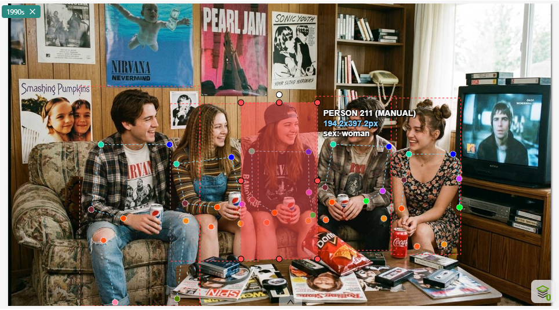
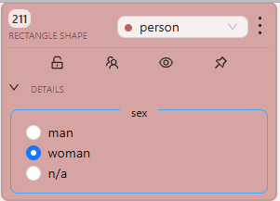
Annotated Image of Person 3: Bounding Box

Slide 8

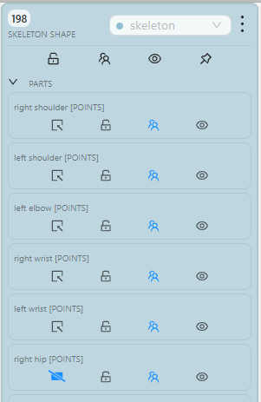
Annotated Image of Person 3: Skeleton

Slide 9
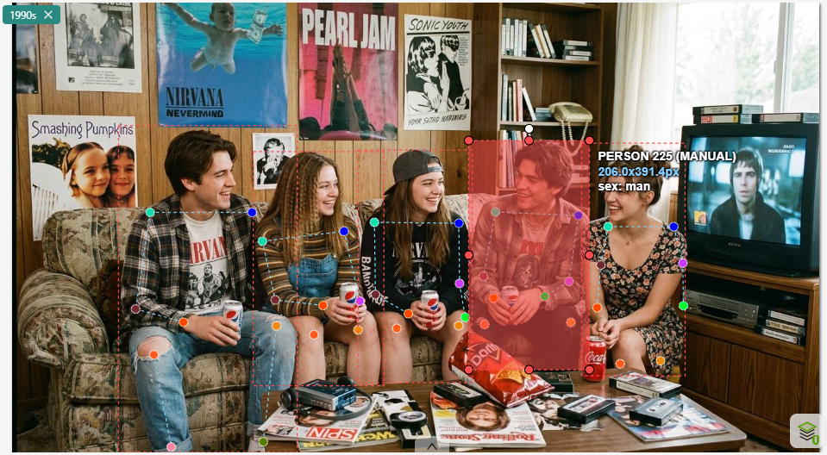
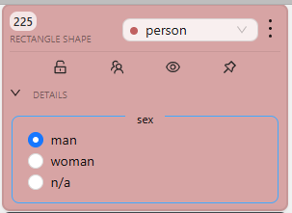
Annotated Image of Person 4: Bounding Box

Slide 10
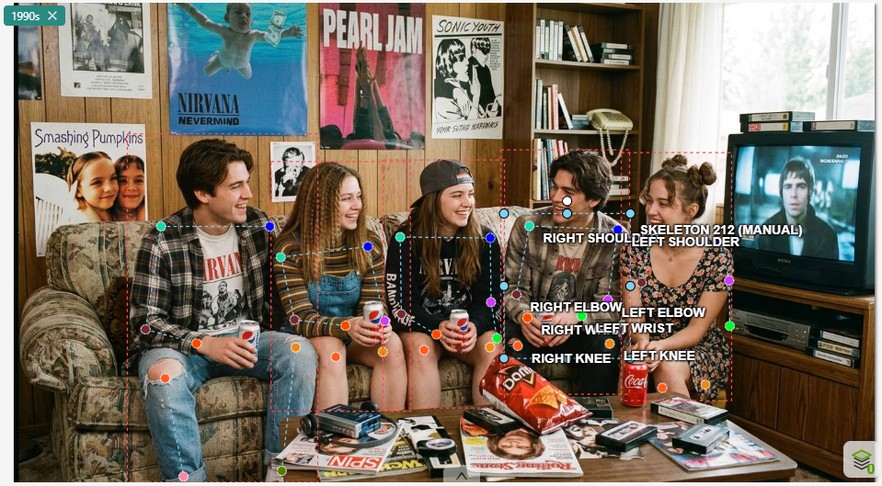
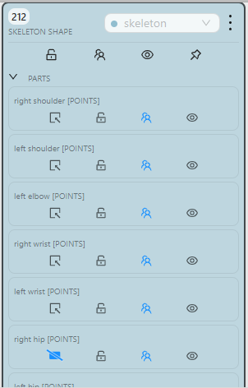
Annotated Image of Person 4: Skeleton

Slide 11
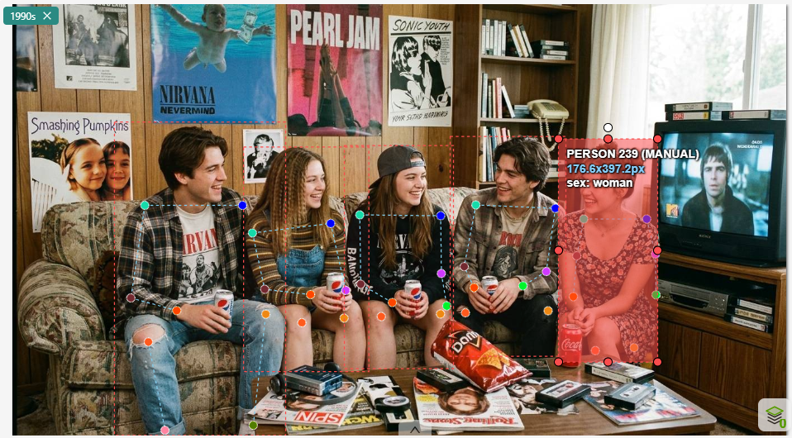
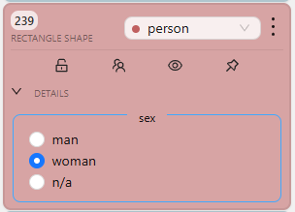
Annotated Image of Person 5: Bounding Box

Slide 12
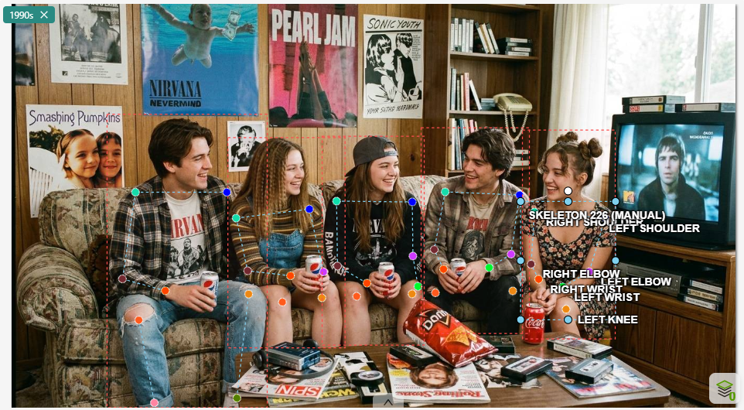
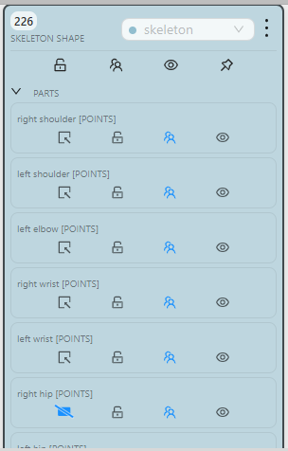
Annotated Image of Person 5: Skeleton

