Slide 1
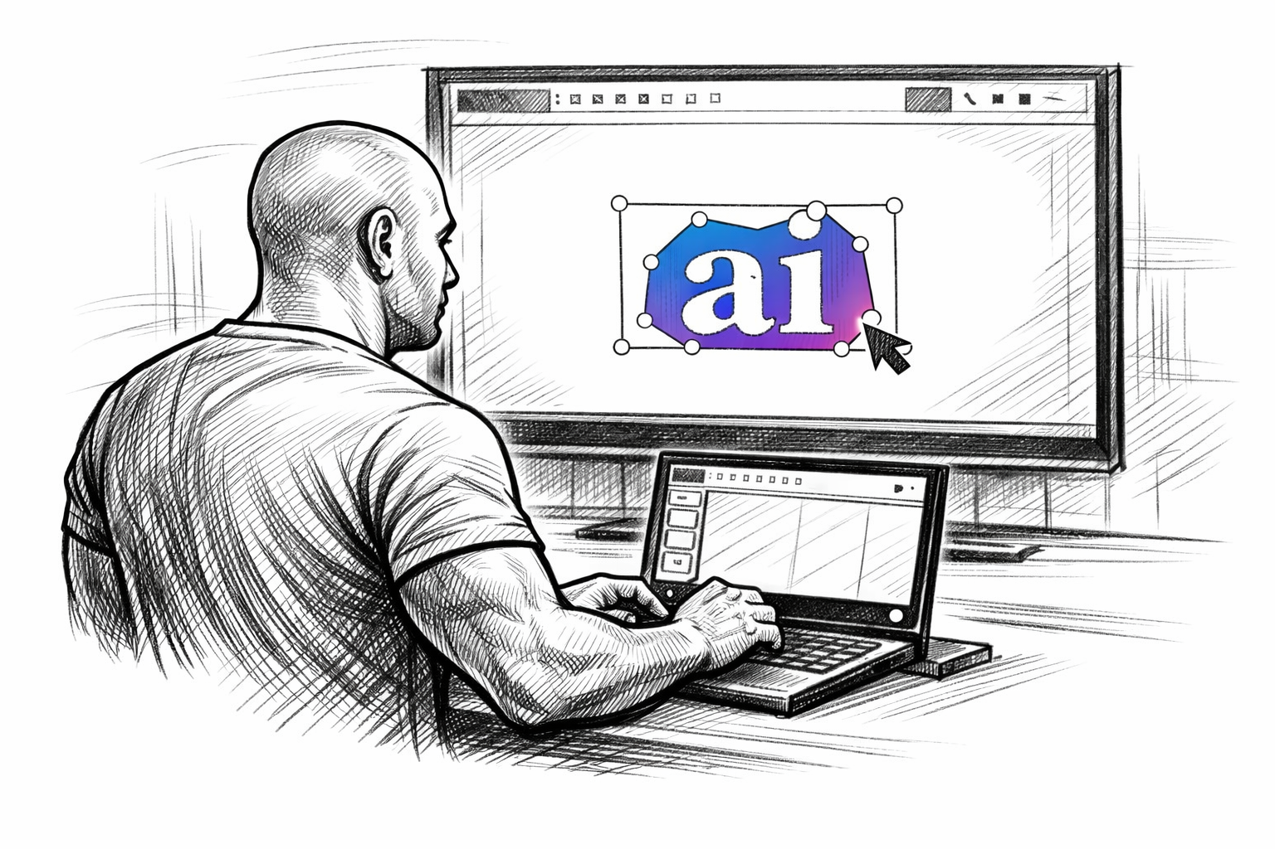
Image Annotation of Cars
Gary Dahnke
Image Annotation of Cars in a 1990s Scene Using Polygons with Attributes
CVAT Data Annotation Portfolio
Version 1.0 – June 27, 2026

Slide 2
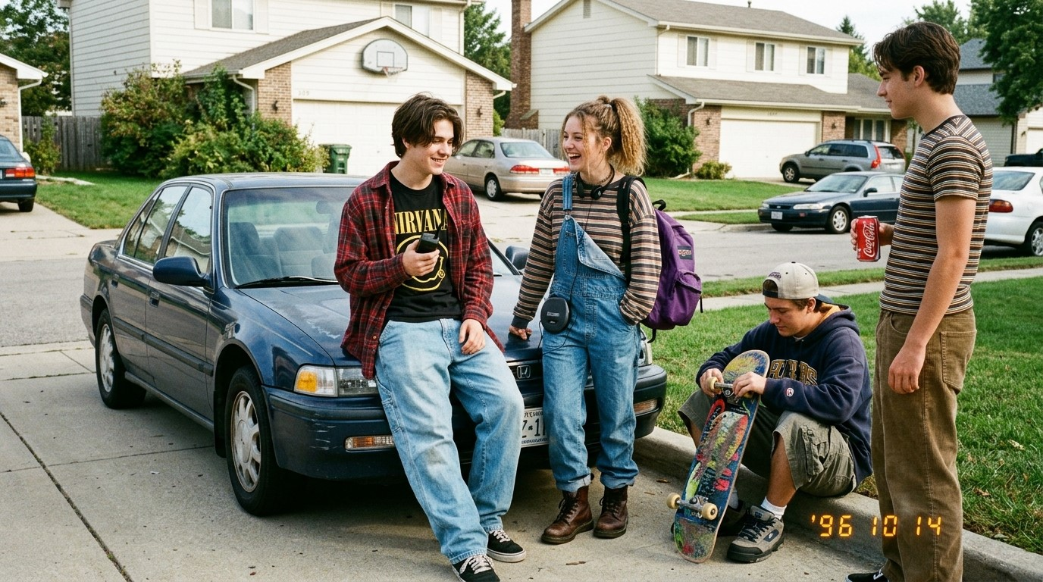
Image to be Annotated

Slide 3
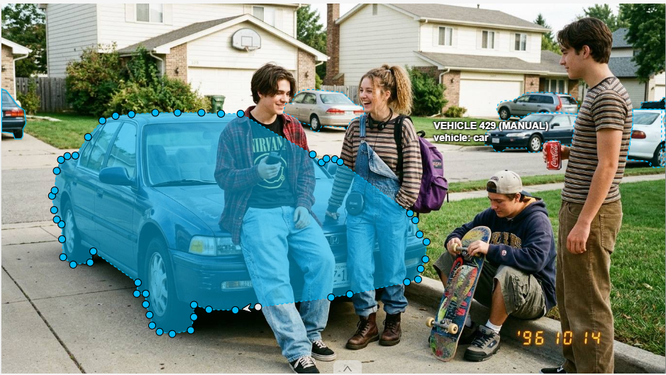
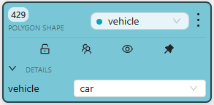
Annotated Car Image 1 with Polygon

Slide 4
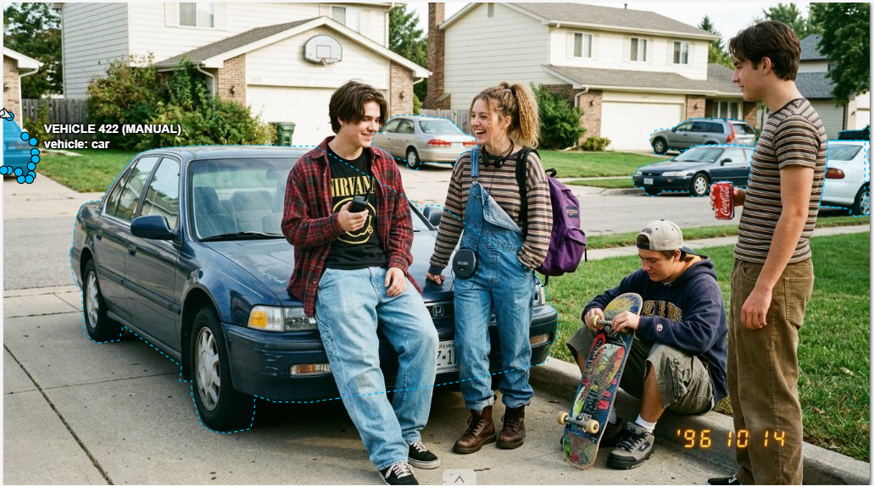
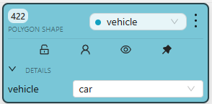
Annotated Car Image 2 with Polygon

Slide 5

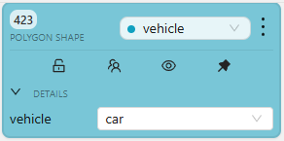
Annotated Car Image 3 with Polygon

Slide 6

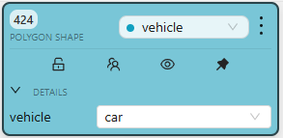
Annotated Car Image 4 with Polygon

Slide 7
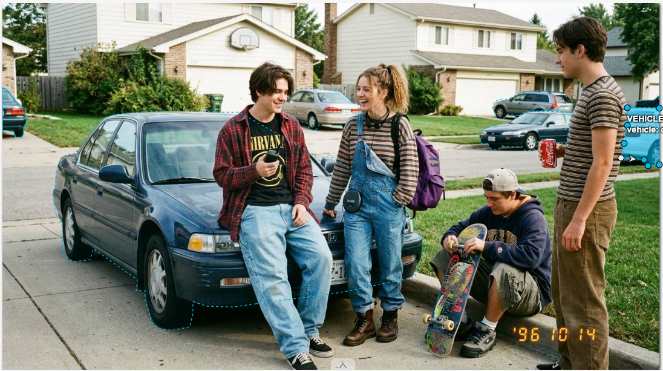
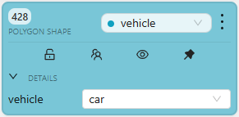
Annotated Car Image 5 with Polygon

Slide 8
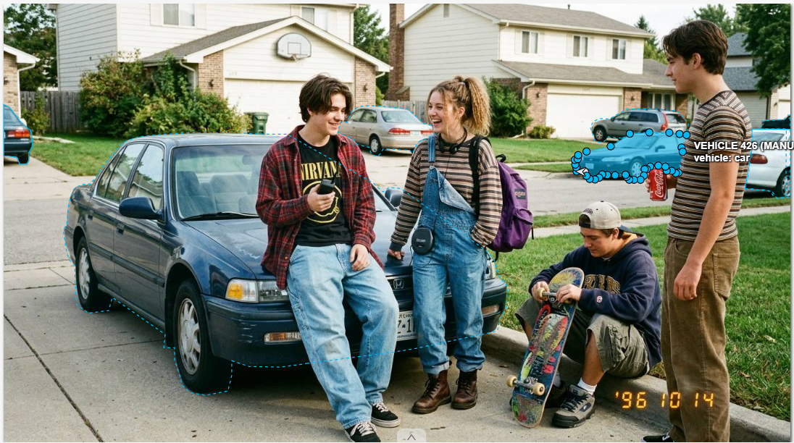
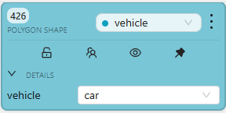
Annotated Car Image 6 with Polygon

Slide 9

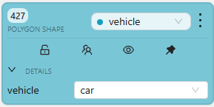
Annotated Car Image 6 with Polygon

