Slide 1

Video Annotation of an Semi-Truck
Gary Dahnke
Video Annotation of a Semi-Truck Using a Cuboid
Displays Frame 50 to 80 of a 166 Frame Video
CVAT Data Annotation Portfolio
Version 1.0 – September 23, 2026

Slide 2
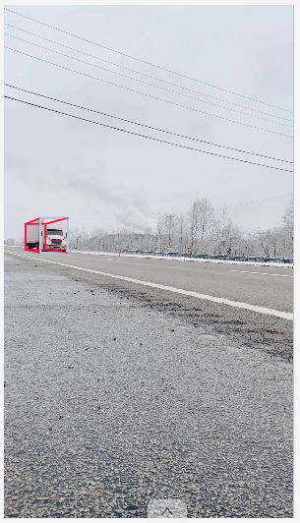
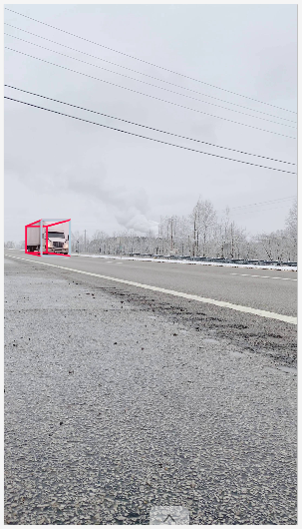
Cuboid Annotation – Video Frames 50, 51

Slide 3
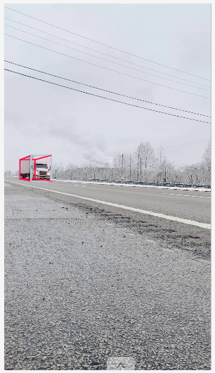
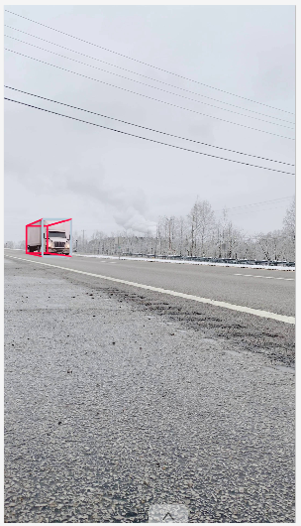
Cuboid Annotation – Video Frames 52, 53

Slide 4
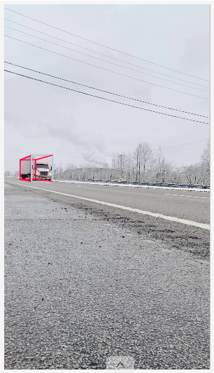
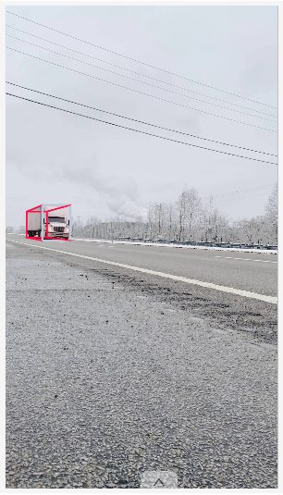
Cuboid Annotation – Video Frames 54, 55

Slide 5
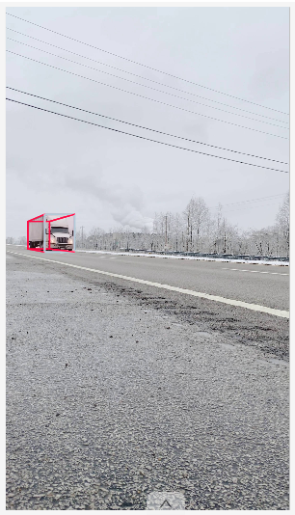
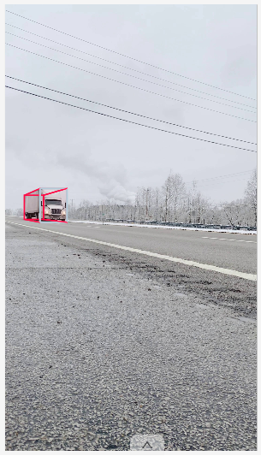
Cuboid Annotation – Video Frames 56, 57

Slide 6
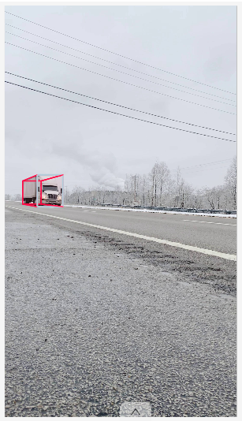
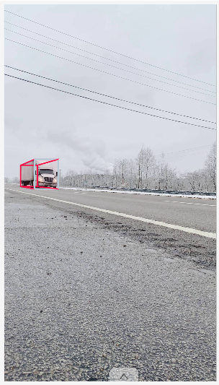
Cuboid Annotation – Video Frames 58, 59

Slide 7
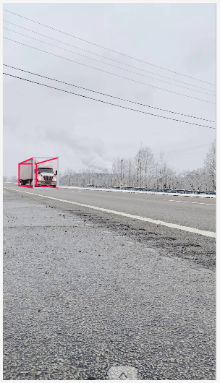
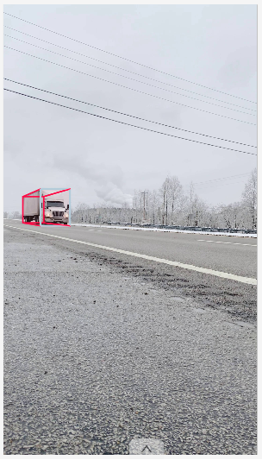
Cuboid Annotation – Video Frames 60, 61

Slide 8
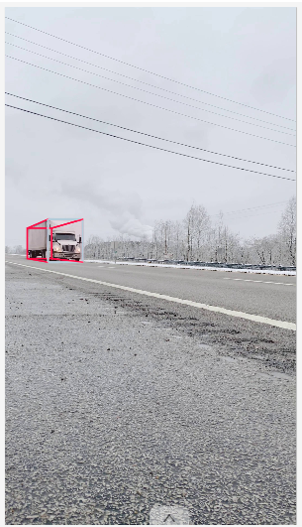
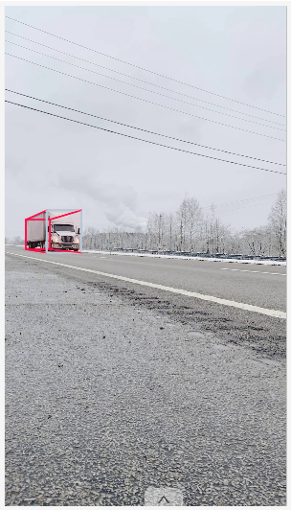
Cuboid Annotation – Video Frames 62, 63

Slide 9
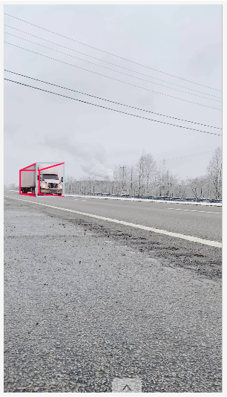
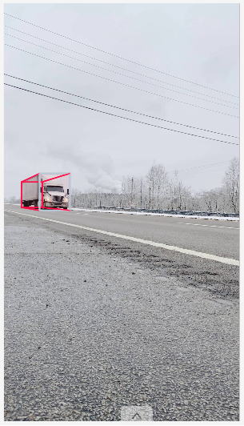
Cuboid Annotation – Video Frames 64, 65

Slide 10
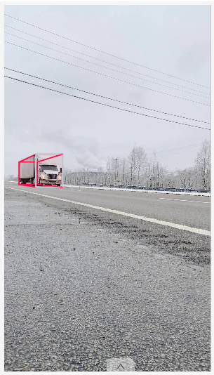
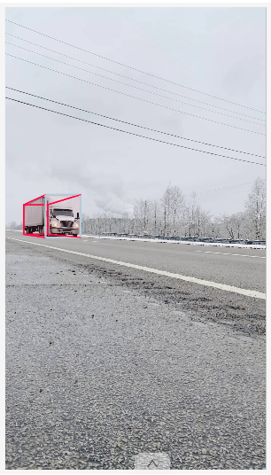
Cuboid Annotation – Video Frames 66, 67

Slide 11
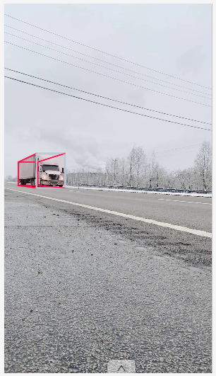
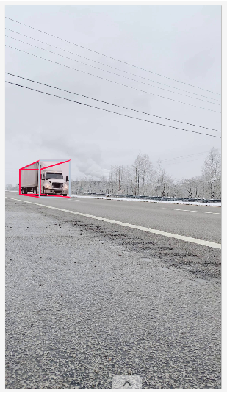
Cuboid Annotation – Video Frames 68, 69

Slide 12
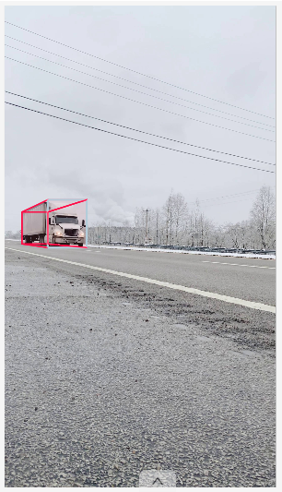
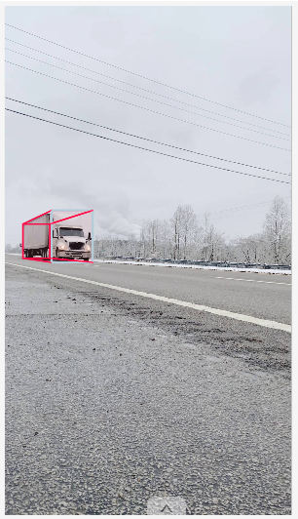
Cuboid Annotation – Video Frames 70, 71

Slide 13

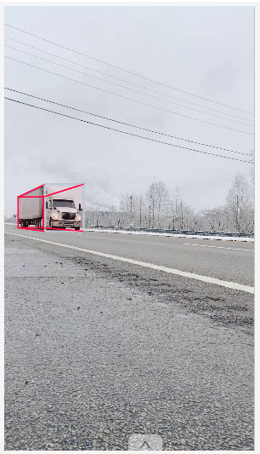
Cuboid Annotation – Video Frames 72, 73

Slide 14
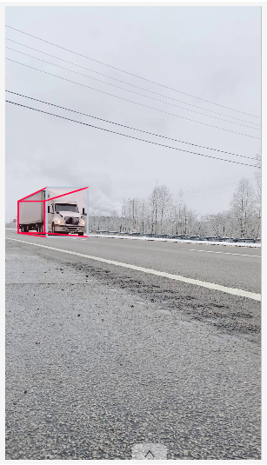
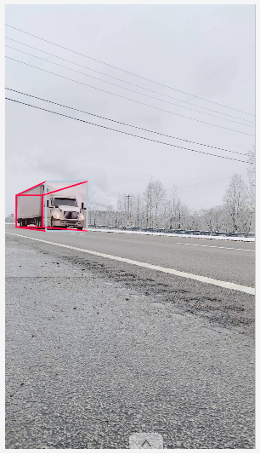
Cuboid Annotation – Video Frames 74, 75

Slide 15

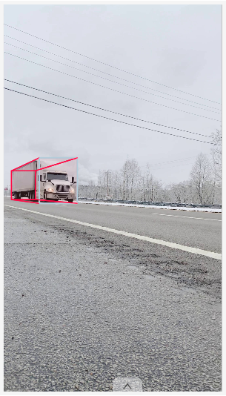
Cuboid Annotation – Video Frames 76, 77

Slide 16
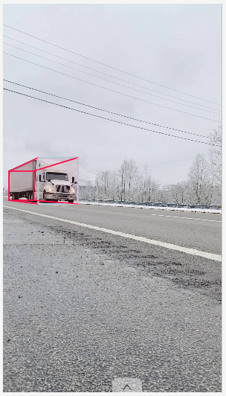
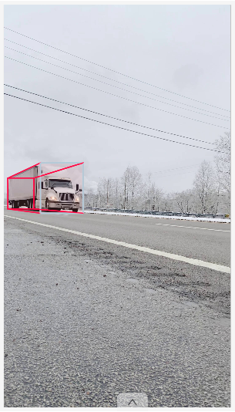
Cuboid Annotation – Video Frames 78, 79

