Slide 1

Video Annotation of an Semi-Truck
Gary Dahnke
Video Annotation of a Semi-Truck Using a Cuboid
Displays Every 10th Frame of a 166 Frame Video
CVAT Data Annotation Portfolio
Version 1.0 – September 23, 2026

Slide 2
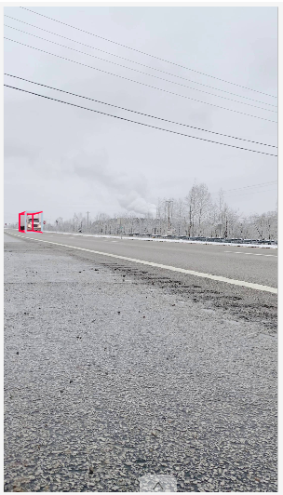
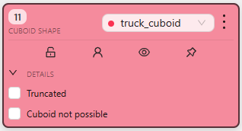
Cuboid Annotation – Video Frame 10

Slide 3
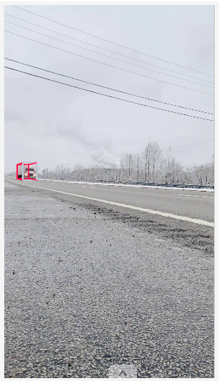
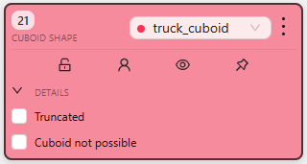
Cuboid Annotation – Video Frame 20

Slide 4
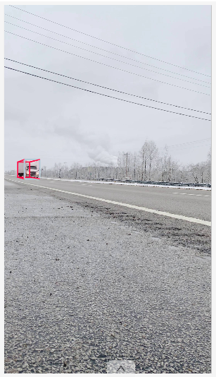
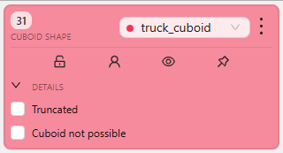
Cuboid Annotation – Video Frame 30

Slide 5
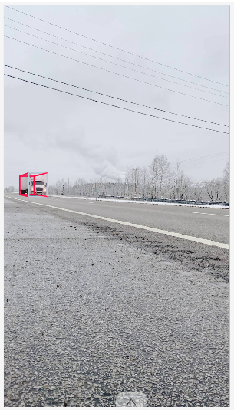
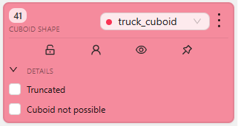
Cuboid Annotation – Video Frame 40

Slide 6
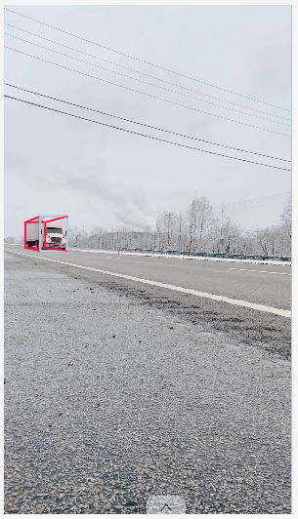
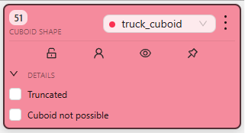
Cuboid Annotation – Video Frame 50

Slide 7
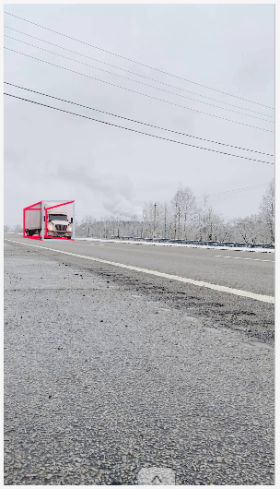
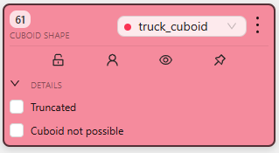
Cuboid Annotation – Video Frame 60

Slide 8
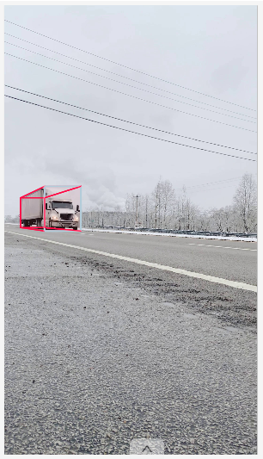
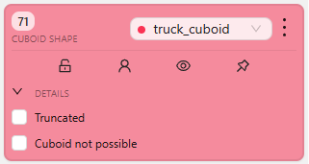
Cuboid Annotation – Video Frame 70

Slide 9
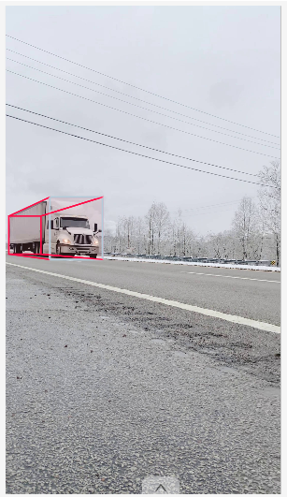
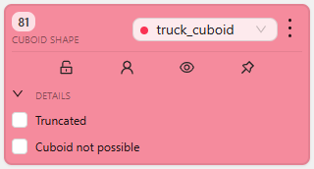
Cuboid Annotation – Video Frame 80

Slide 10
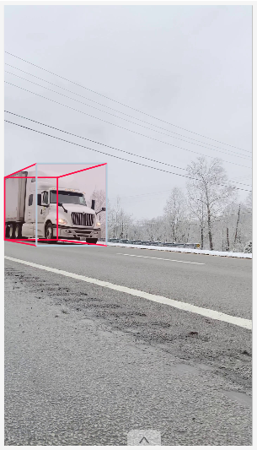
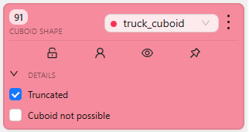
Cuboid Annotation – Video Frame 90

Slide 11
Cuboid Annotation – Video Frame 100

Slide 12
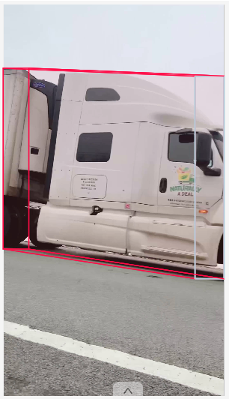
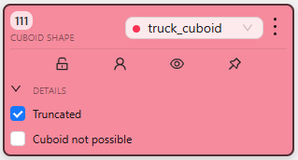
Cuboid Annotation – Video Frame 110

Slide 13
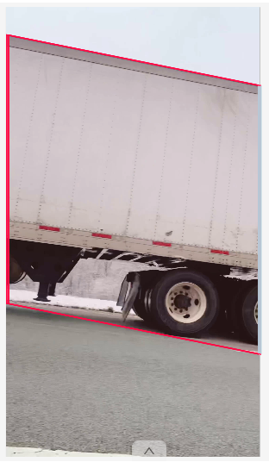

Cuboid Annotation – Video Frame 120

Slide 14
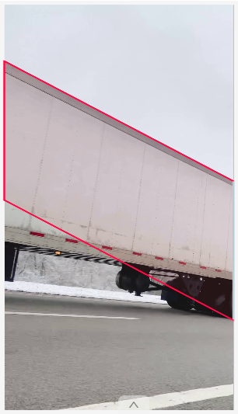
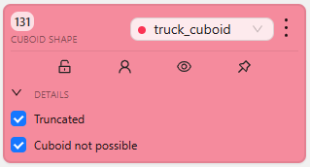
Cuboid Annotation – Video Frame 130

Slide 15
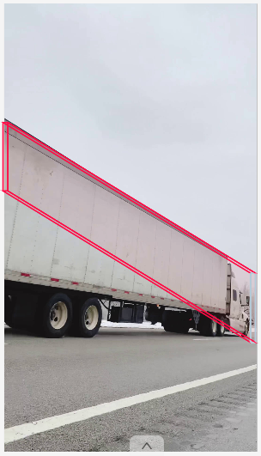
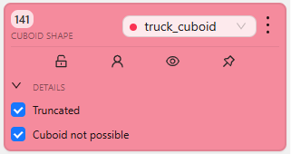
Cuboid Annotation – Video Frame 140

Slide 16
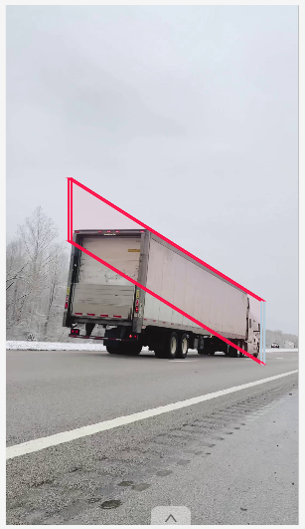
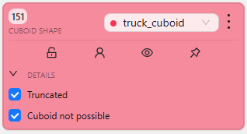
Cuboid Annotation – Video Frame 150

Slide 17
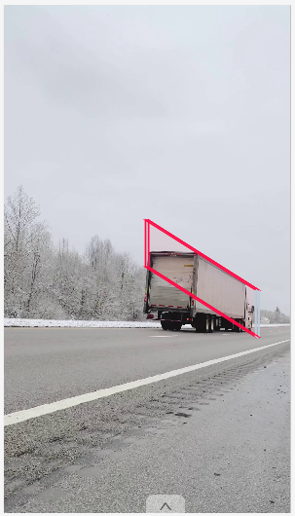
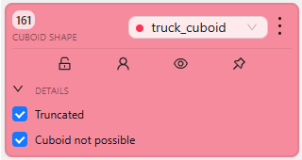
Cuboid Annotation – Video Frame 160

