Slide 1
Image Annotation of an Apple
Gary Dahnke
Image Annotation of 3D Shapes Using a Mask
CVAT Data Annotation Portfolio
Version 1.0 – July 9, 2026

Slide 2
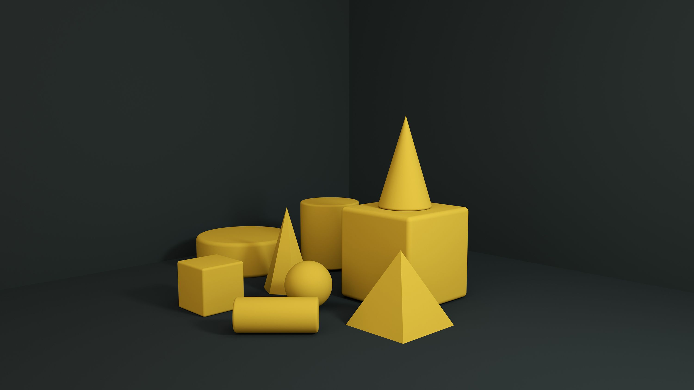
Image to be Annotated

Slide 3
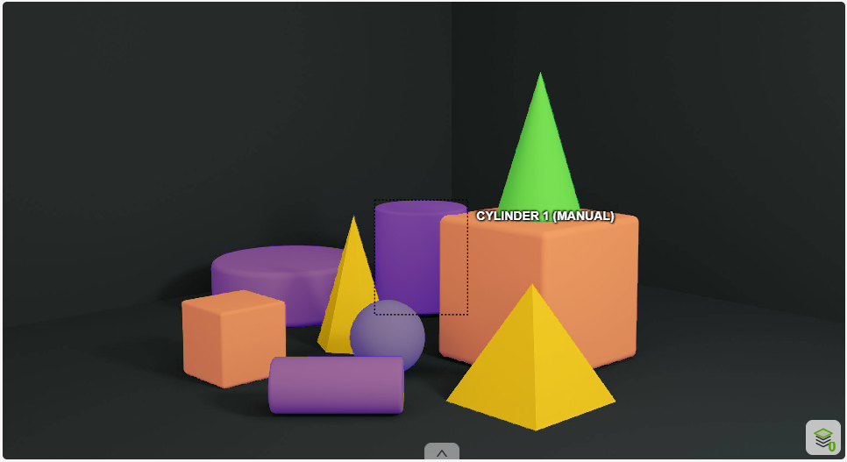

Annotated Image - Cylinder

Slide 4
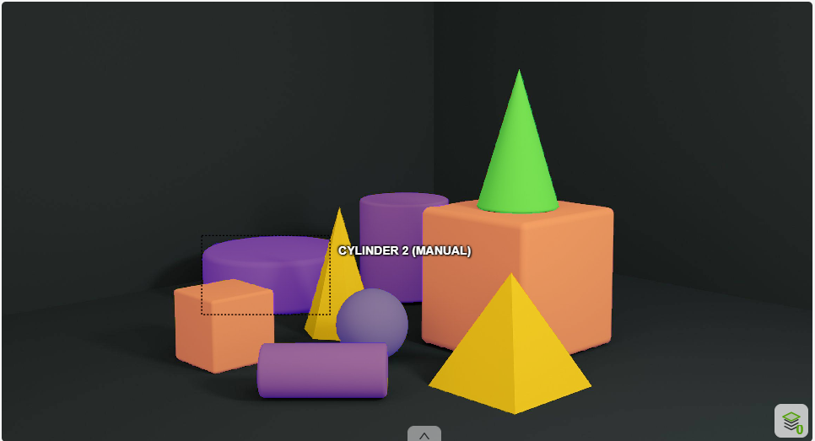

Annotated Image - Cylinder

Slide 5


Annotated Image - Cube

Slide 6


Annotated Image - Pyramid

Slide 7
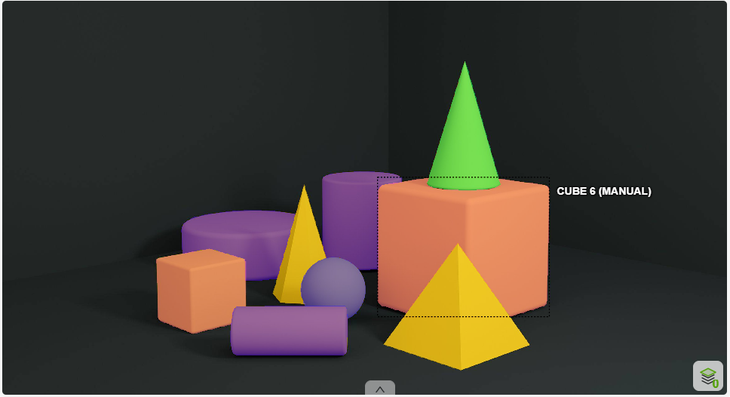

Annotated Image - Cube

Slide 8


Annotated Image - Cone

Slide 9


Annotated Image - Cone

Slide 10
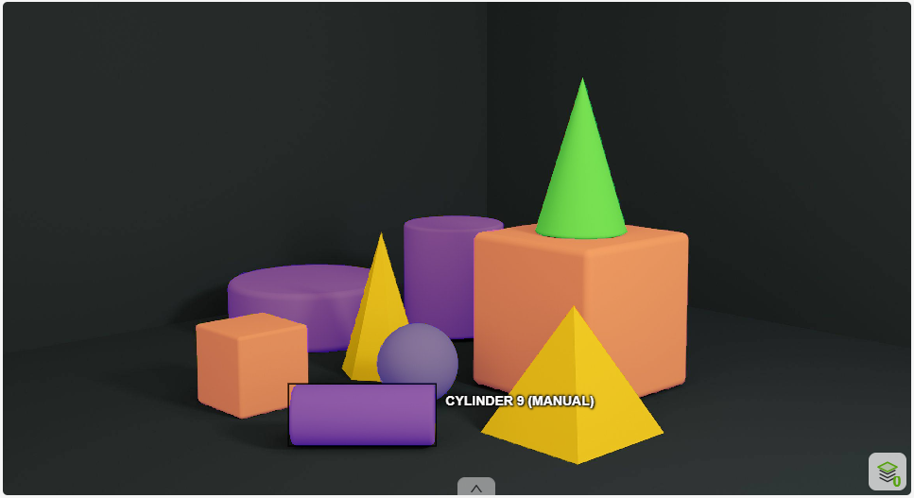

Annotated Image - Cylinder

Slide 11
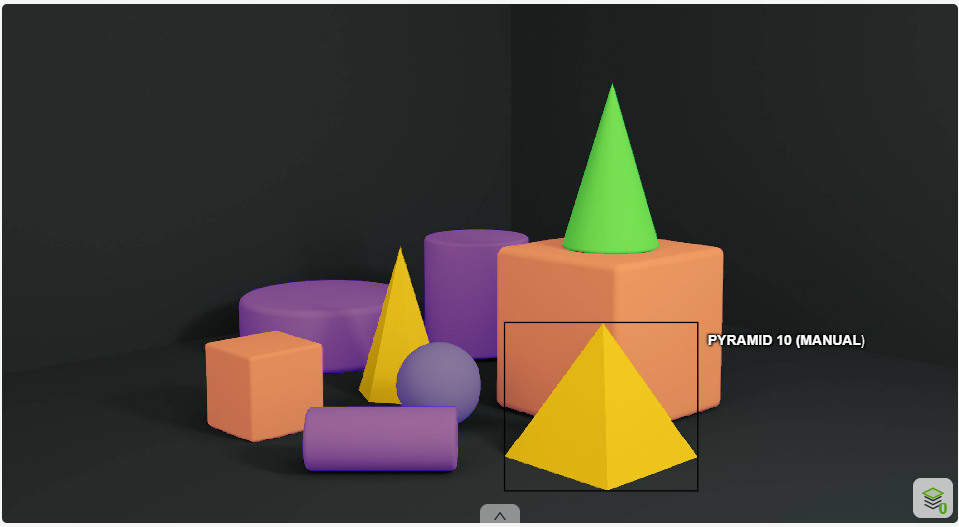

Annotated Image - Pyramid

