Slide 1
Image Annotation of an Apple
Gary Dahnke
Image Annotation of an Apple Using a Mask
CVAT Data Annotation Portfolio
Version 1.0 – June 26, 2026

Slide 2
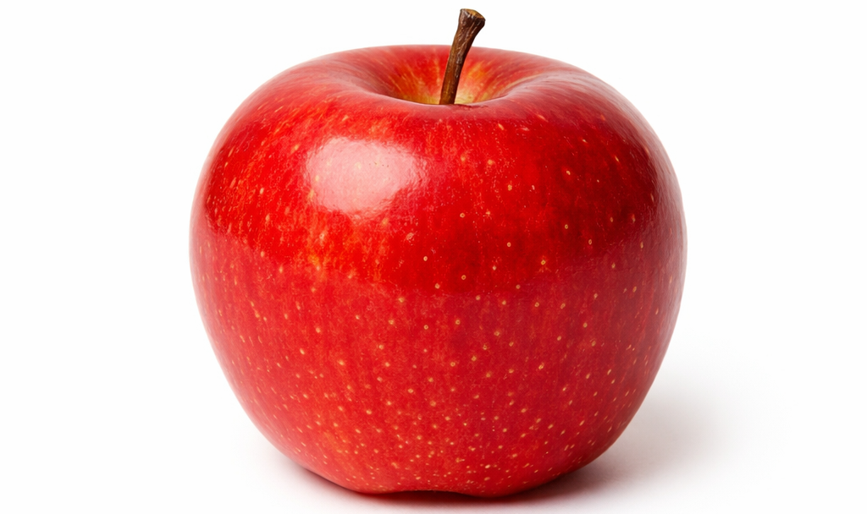
Image to be Annotated

Slide 3
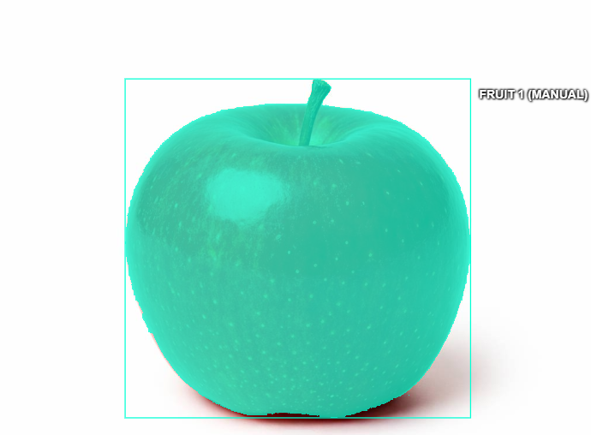

Annotated Image

