Slide 1
Mask Annotation of Table and Two Chairs
Gary Dahnke
Image Annotation of Table and Two Chairs with Five Masks
CVAT Data Annotation Portfolio
Version 1.0 – June 26, 2026

Slide 2
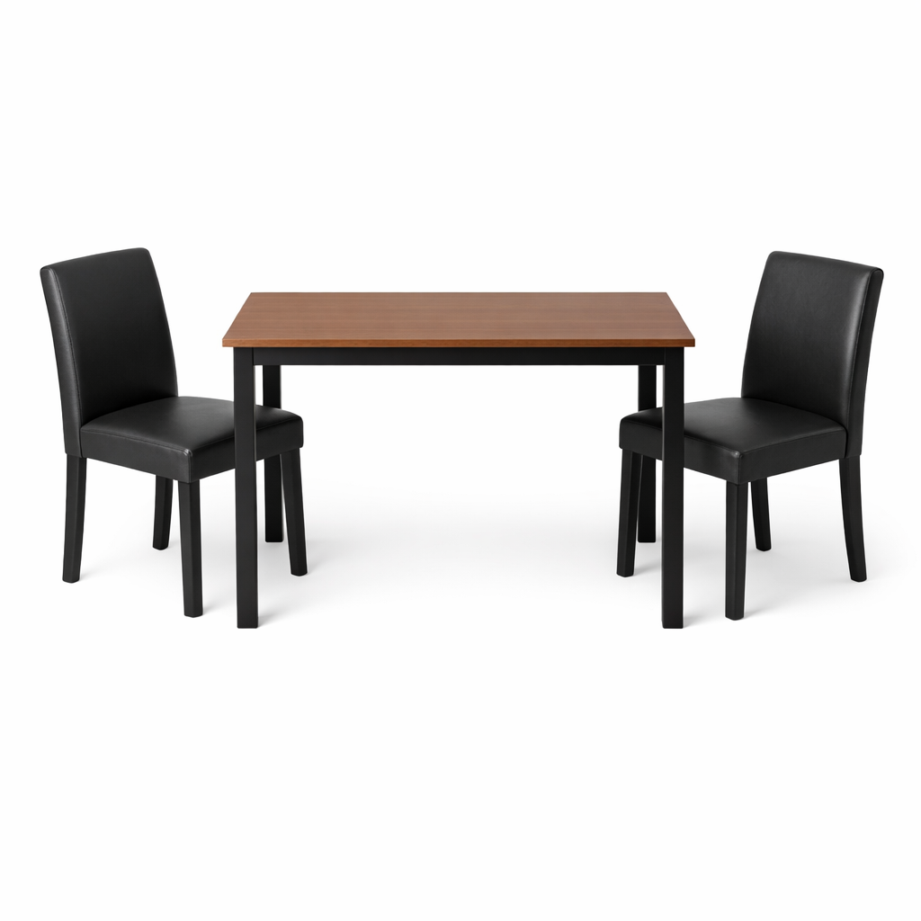
Image to be Annotated

Slide 3
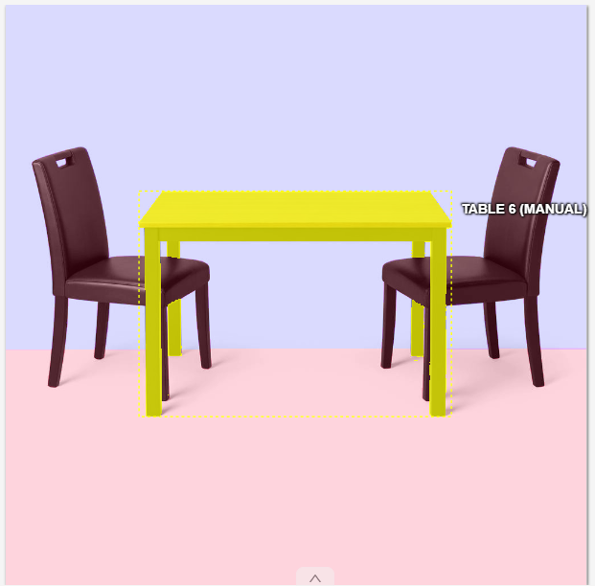

Annotated Image of Table

Slide 4
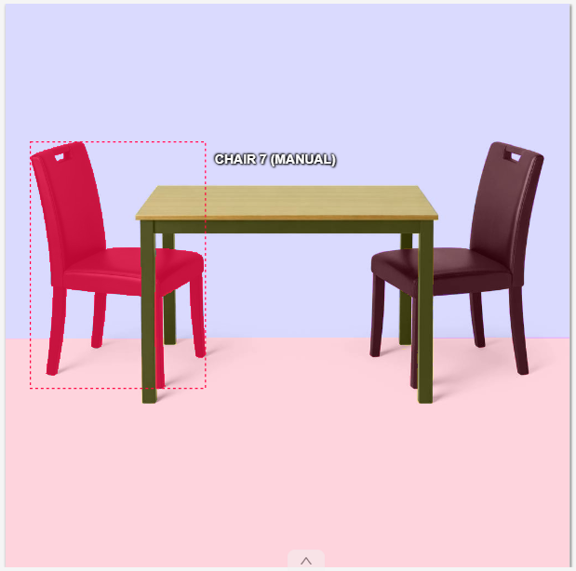

Annotated Image of Chair on Left

Slide 5
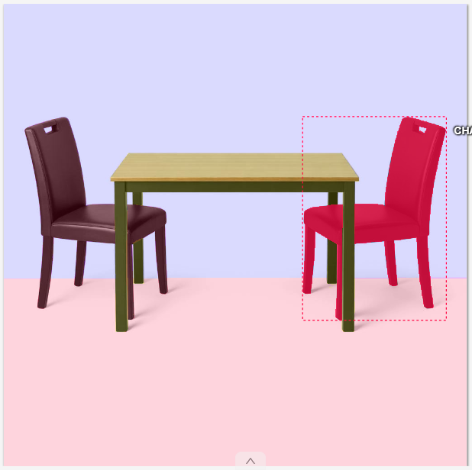

Annotated Image of Chair on Right

Slide 6
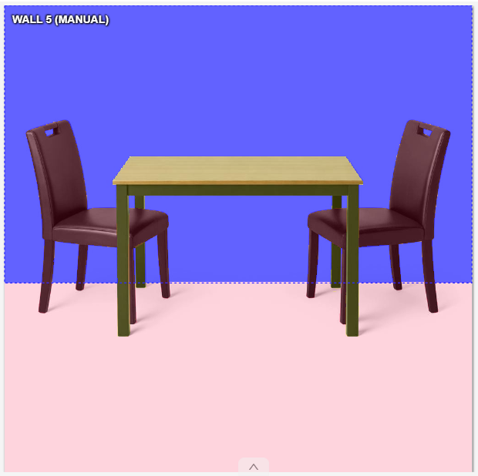

Annotated Image of Wall

Slide 7
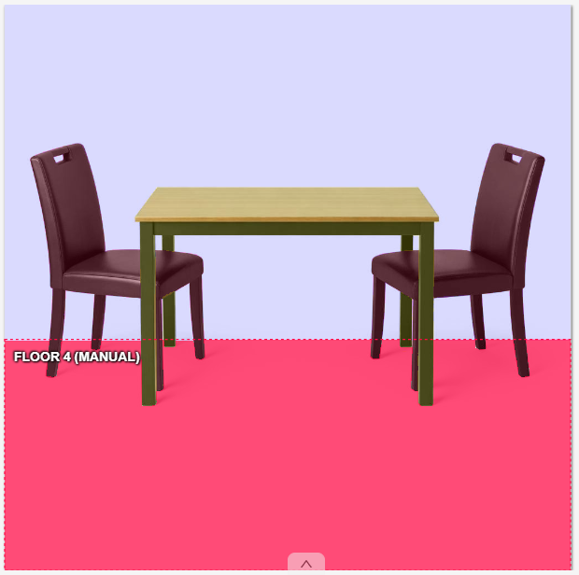

Annotated Image of Floor

