Slide 1
Image Annotation of an Apple
Gary Dahnke
Image Annotation of Three Tools (Hammer, Wrench, Screwdriver) Using a Mask
CVAT Data Annotation Portfolio
Version 1.0 – June 29, 2026

Slide 2
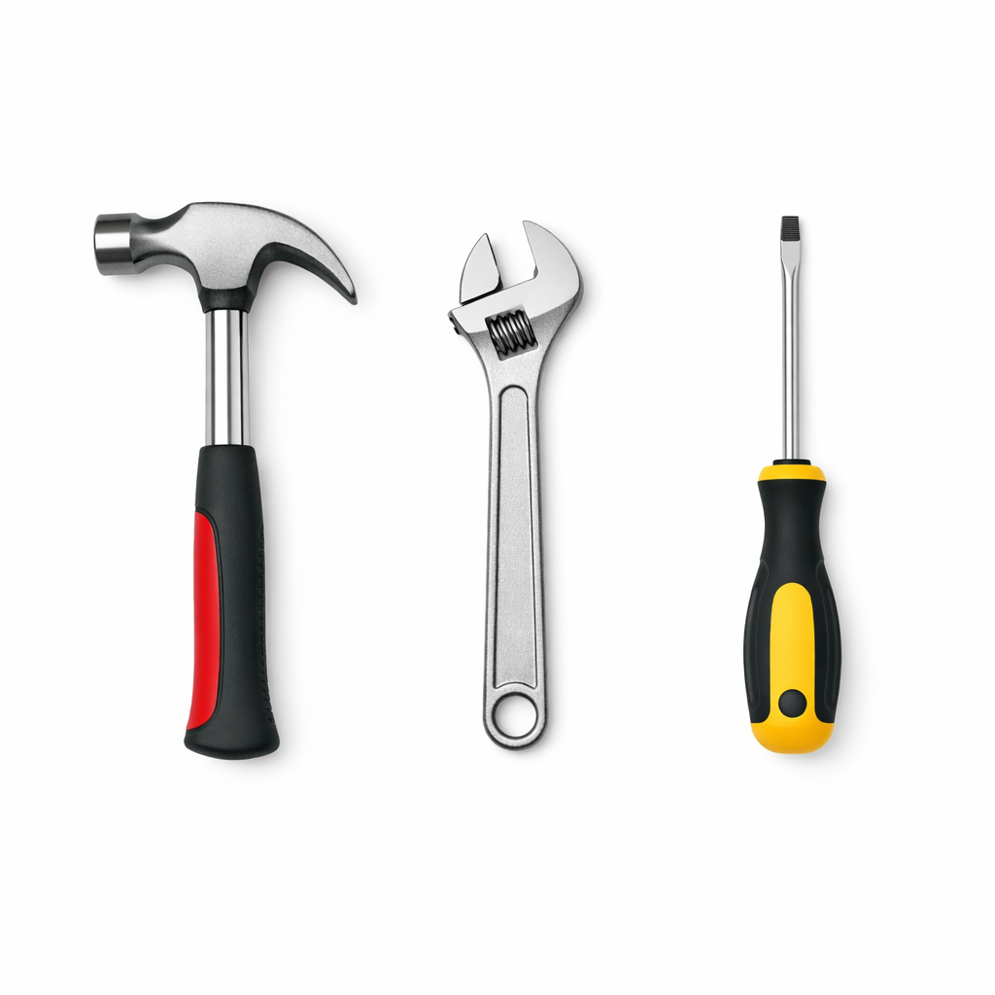
Image to be Annotated

Slide 3
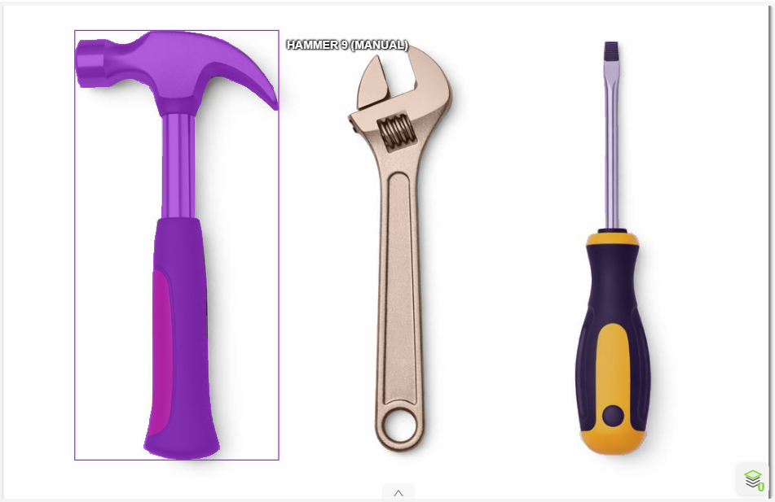

Annotated Image - Hammer

Slide 4
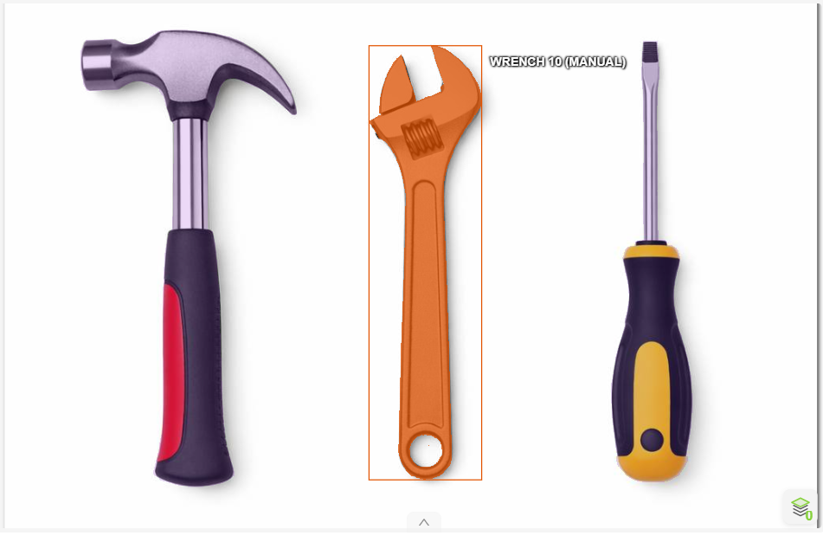

Annotated Image - Wrench

Slide 5
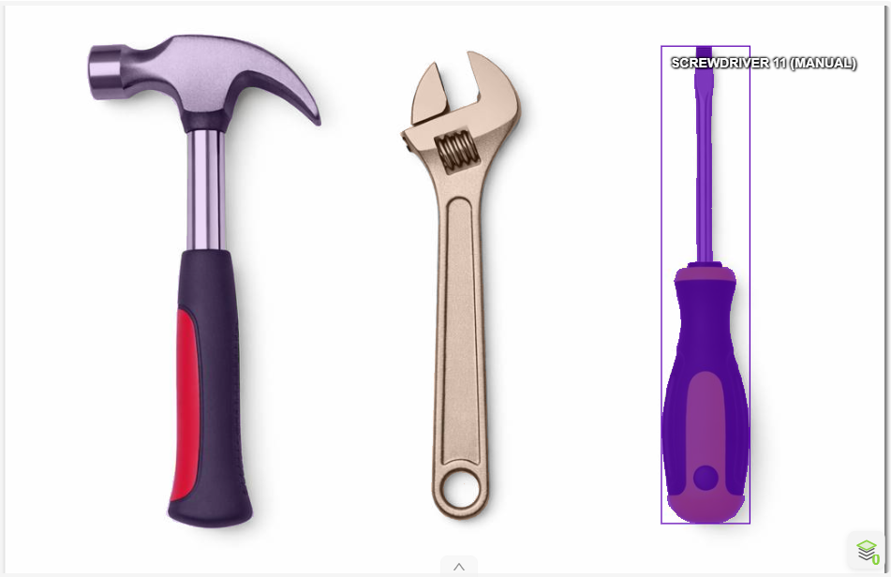

Annotated Image - Screwdriver

