Slide 1
Mask Annotation of Two Cars
Gary Dahnke
Image Annotation of Two Cars with Two Masks
CVAT Data Annotation Portfolio
Version 1.0 – June 26, 2026

Slide 2
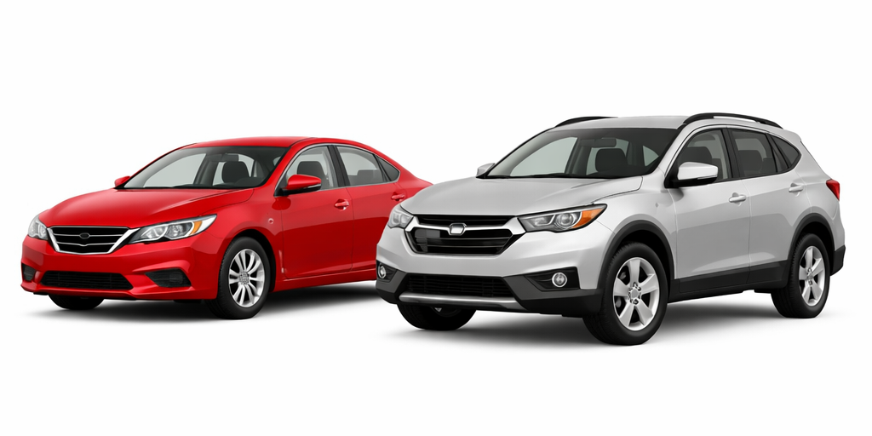
Image to be Annotated

Slide 3
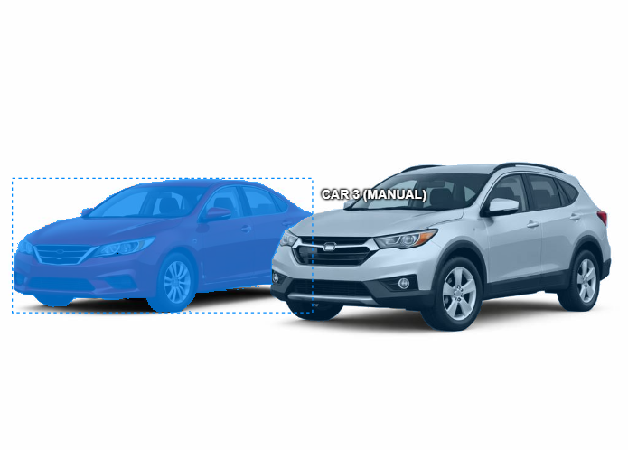

Annotated Image of Car on Left

Slide 4
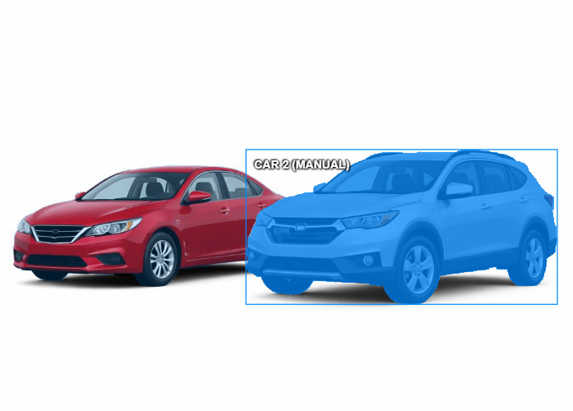

Annotated Image of Car on Right

