Slide 1

Every one of us is somewhere on a journey.
Toward God, through doubt, in the middle of growing.
Notes:
NARRATION: "Every one of us is somewhere on a journey — toward God, through doubt, in the middle of growing." VISUAL: Warm still life, open journal and Bible on a wooden table, morning light. Calm, contemplative opening shot.

Slide 2

We’re inviting you to take the Jesus Journey Survey.
A short, honest reflection on where you are right now in your faith.
Notes:
NARRATION: "That's why our church is inviting you to take the Jesus Journey Survey — a short, honest reflection on where you are right now in your faith." VISUAL: Close-up of hands writing in a journal, warm window light.

Slide 3
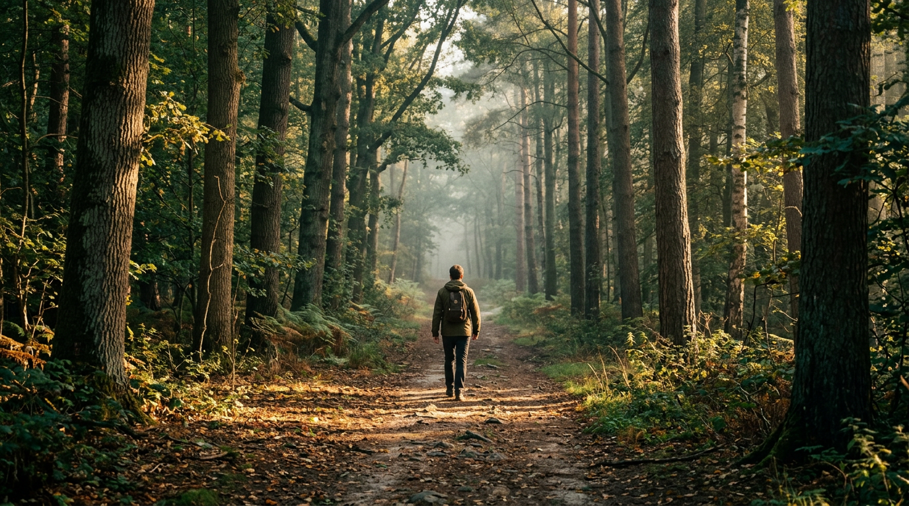
Ten minutes. No right or wrong answers.
Everything you share stays completely anonymous.
Notes:
NARRATION: "It takes about ten minutes. There are no right or wrong answers, and everything you share stays completely anonymous." VISUAL: Wide shot of a person walking a quiet forest path, golden light — symbolizes the journey.

Slide 4
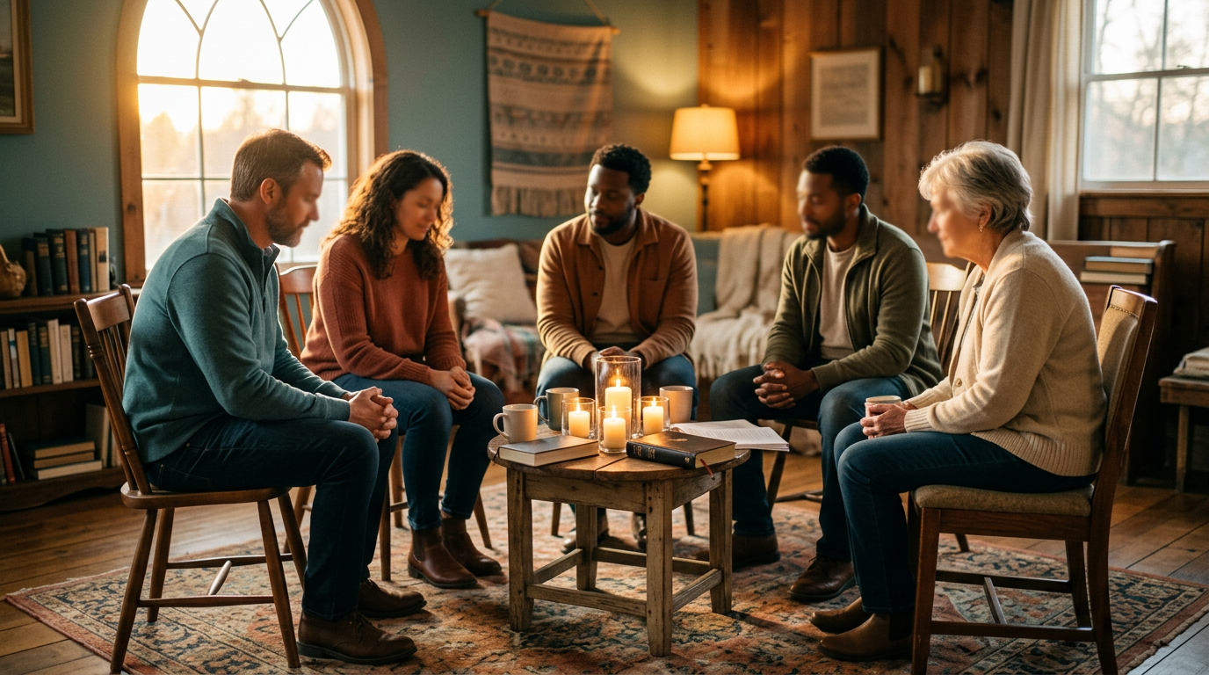
Your voice helps shape how we walk together.
Where to encourage growth — and where to offer support.
Notes:
NARRATION: "Your answers help our church family understand how to walk alongside you better — where to encourage growth, and where to offer support." VISUAL: Small group gathered warmly, candlelight, sense of belonging.

Slide 5

Here’s how to join in.
Visit the link below and enter your church’s join code.
YOUR CHURCH JOIN CODE
[ Type your join code here ]
jesusjourney.life
Takes about 10 minutes • Completely anonymous
Notes:
NARRATION: "Enter your church's join code at jesusjourney.life to begin." VISUAL: Clean brand card — this is also the closing slide; the church can leave this displayed with their code already typed into the box while people fill out the survey.

