Slide 1
Bentley Academic Course Demand Analytics
A Business Intelligence Project ~ CS753

Slide 2
By:
Larry Razenj
Sangam Lama
Zehang Gao
MacDonald Chikapa
Point of Contact:
Anne P Pugliese, Director of Administrative Services Bentley ATC

Slide 3

The purpose of this Business Intelligence exercise was an examination of the course offerings and demand of the Bentley University undergraduate program.
The intrinsic goal of any higher learning academic institution to provide its consumer-base (students) a desirable array of products (degrees) and options (courses).

Slide 4


Bentley Academic Technology Center (ATC).
Supporting Bentley Academic
Affairs in the provision of...
-instructional resources
-research resources
Supporting High Tech Facilities
-CIS Sandbox
-Hughey Center for financial services
-ACELAB
-Center for Languages
and International Collaboration
-User Experience Center
-Media & Culture Lab
-And Many More

Slide 5
Bentley Academic Technology Center (ATC).
Our Contact
-Anne P Pugliese,
-Director of Administrative Services
Providing functional technical support to all administrative offices
-registrar
-graduate admissions
-graduate advising
Maintaining and modifying all administrative systems at Bentley
-Banner
-Advance
-Infor Enterprise Reporting

Slide 6
The (ATC) BI OBJECTIVE
Allocation of resources to clearly defined course offerings
Offering courses which are in highest demand while also offering courses which are structurally necessary for degree completion.
Limited Resources
-facilities (classrooms),
-facility size (classroom size)
-specialized faculty
-time slots
linked intrinsically to finite quantities of facilities, faculty and impossibility of simultaneous use of individual resources
Current Student
Enrollment Data
-stored on Banner system: SQL based RDBMS
-nightly ETL'd to COGNOS: DWS

Slide 7
The GOAL OF BI: ACTIONABLE KNOWLEDGE
Intelligent Usage of Realistic Measures
Feasible Options
-facility allocation
-time slot changes (seasonal as well as daily)
Unfeasible Options
-radical facility expansion
-radical staffing changes
-course curriculum/prerequisite changes

Slide 8
E.T.L.

Slide 9
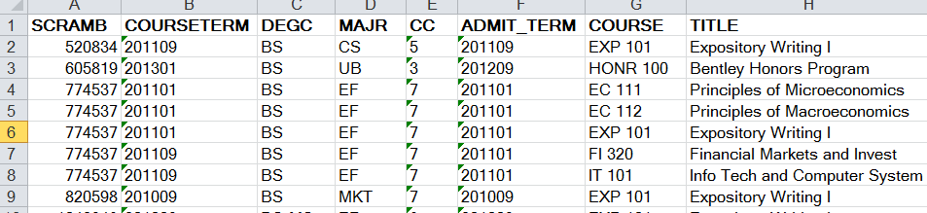
RAW DATA
1 Table
8 Columns
888 Courses
4,169 Students
120,355 Lines of Information
4 Tables
6-8 Columns
122,298 Lines of Information

Slide 10
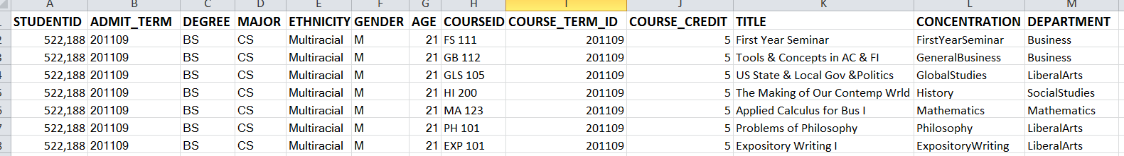
Descriptive DATA
1 Table
2 Genders
8 Ethnicities
13 Columns
17 Departments
21 Distinct Ages
35 Majors
38 Concentrations
888 Courses
4169 Students
120355 Lines of Information

Slide 11
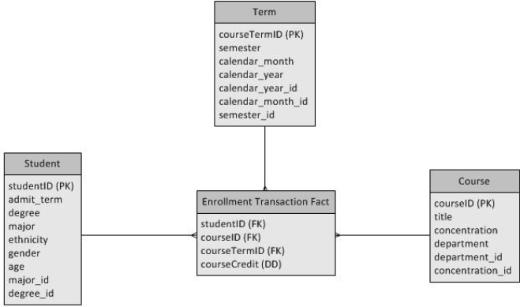
USEFUL DATA STRUCTURES

Slide 12
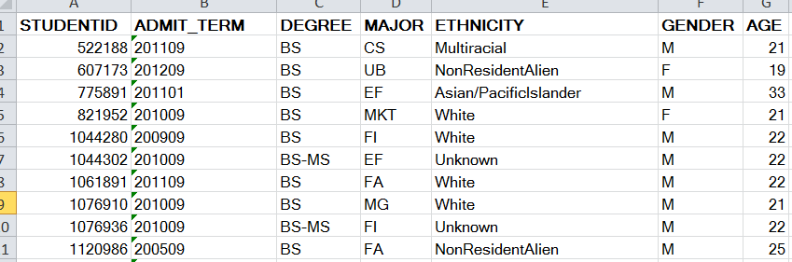
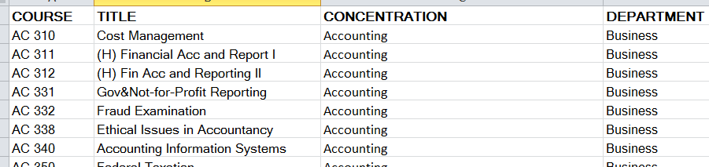
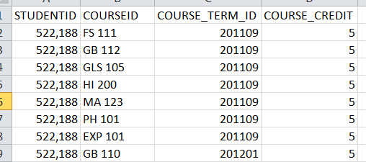
USEFUL TABLES
STUDENTS
Courses
Enrollment

Slide 13
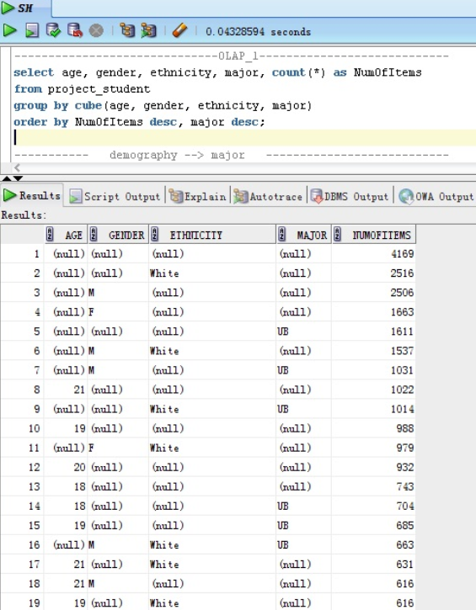

OLAP QUERIES PART 1

Slide 14
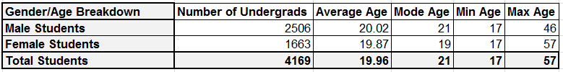
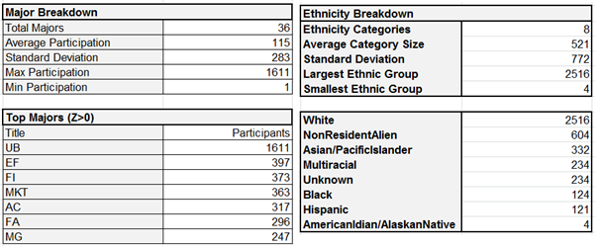
REFINED OLAP 1 RESULTS

Slide 15
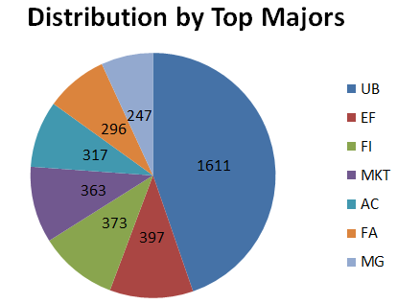
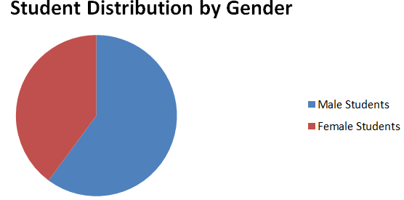
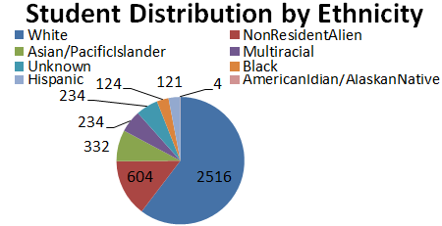
OLAP 1 INFOGRAPHICS

Slide 16
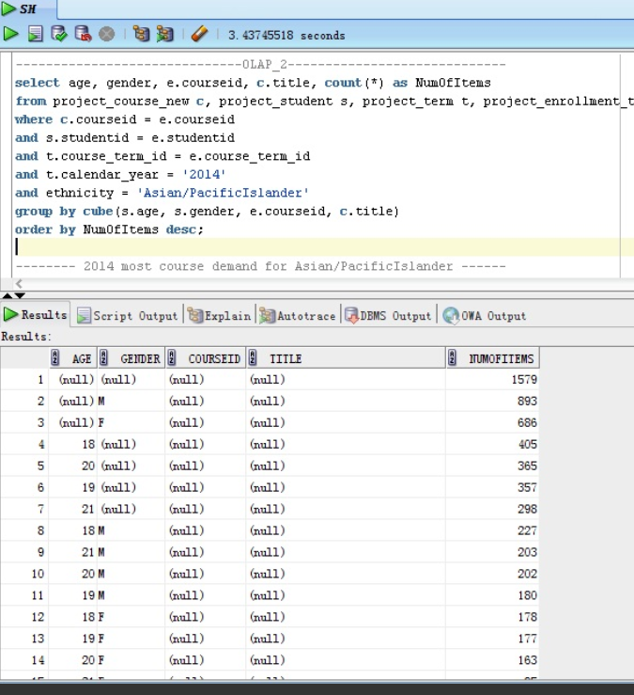
OLAP QUERIES PART 2

Slide 17
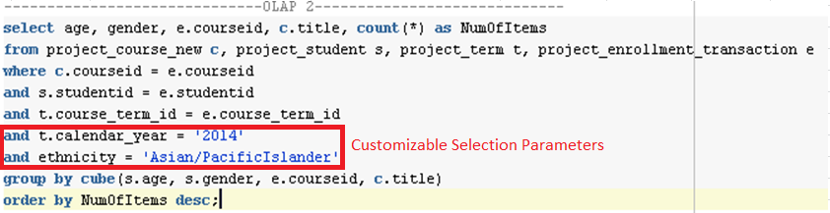
OLAP QUERIES PART 2

Slide 18
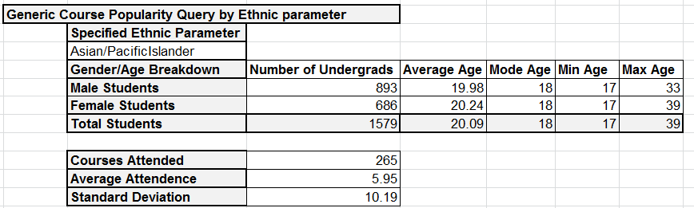
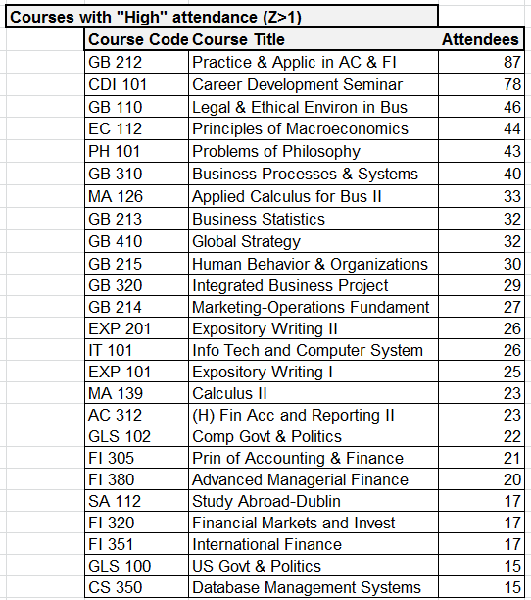
REFINED OLAP 2 RESULTS
Similar Data easily available for ANY Demographic Group

Slide 19
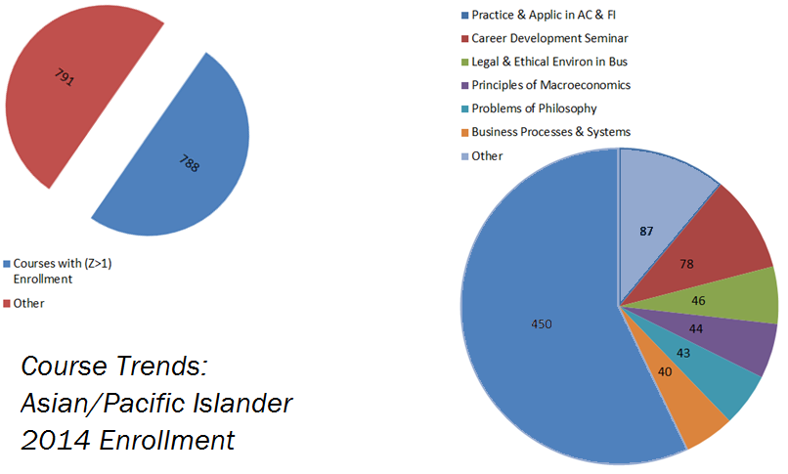
OLAP 2 INFOGRAPHICS

Slide 20
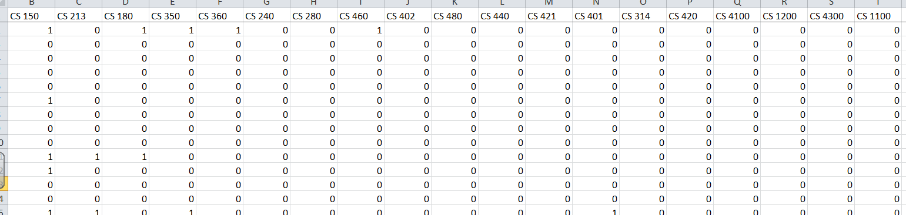
Association
Standard Data Format Unusable
Special Format Necessary

Slide 21
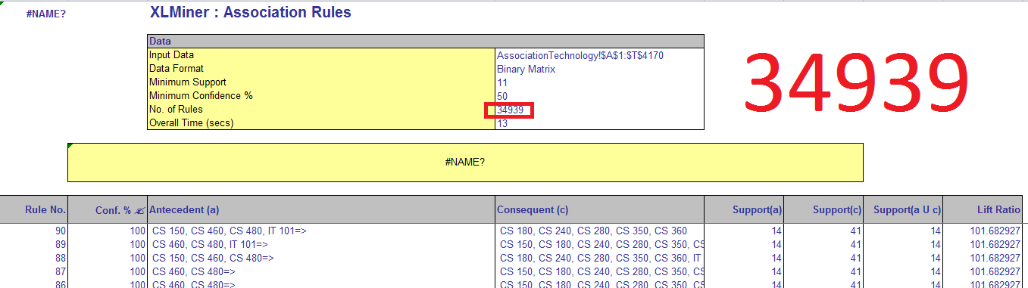
Association
Challenge
Massive Result Set
Goal
Finding Interesting Rules
Finding Meaningful Rules

Slide 22
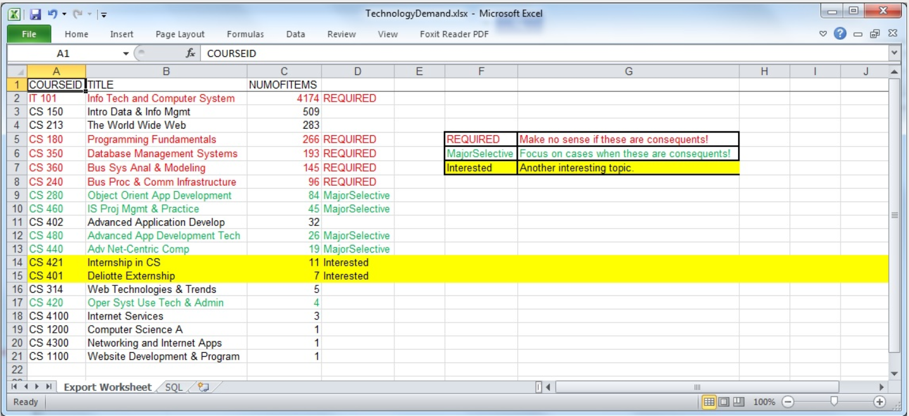
ASSOCIATION

Slide 23
ASSOCIATION
Interesting Findings

Slide 24
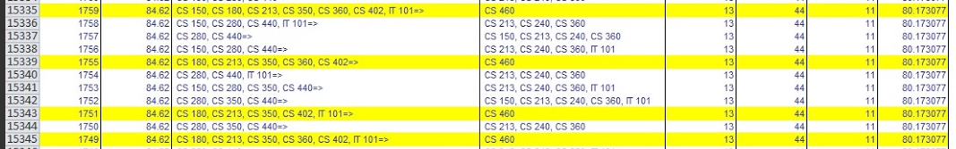
ASSOCIATION
Useful Findings
Extensible Format

Slide 25
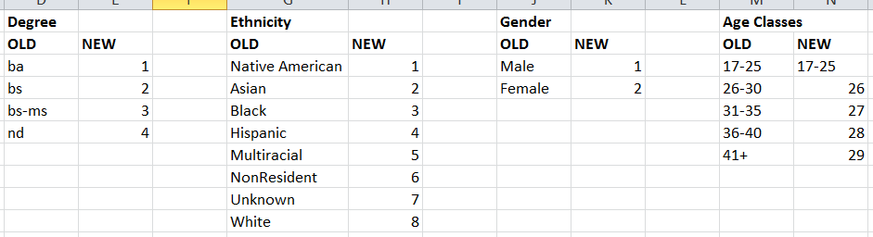
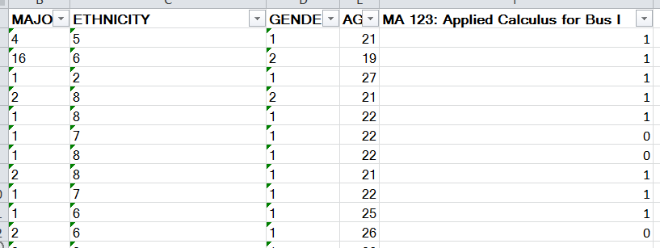
CLASSIFICATION
Standard Data Format Unusable
Condensation Required
Useful Formatting

Slide 26
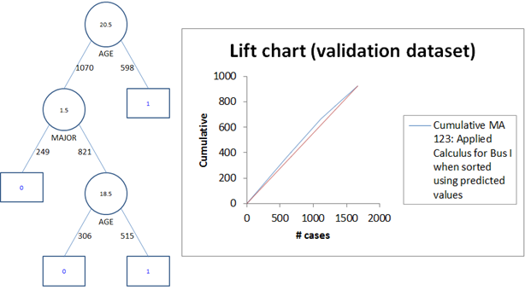
CLASSIFICATION

Slide 27
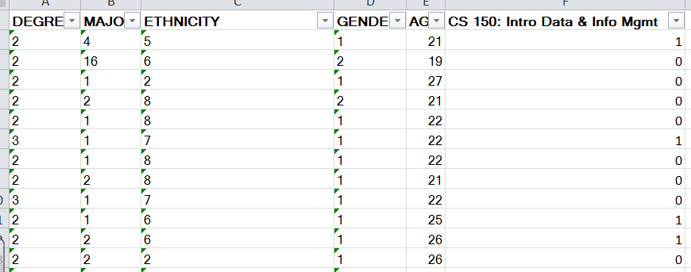
EXTENSIBLE CLASSIFICATION
And Beyond…

Slide 28
THANK YOU FOR LISTENING

Slide 29
THANK YOU FOR LISTENING
We Will Be Taking Questions Now

