Slide 1

Chapter 3
Transport Layer
A note on the use of these ppt slides:
We’re making these slides freely available to all (faculty, students, readers). They’re in powerpoint form so you can add, modify, and delete slides (including this one) and slide content to suit your needs. They obviously represent a lot of work on our part. In return for use, we only ask the following:
If you use these slides (e.g., in a class) in substantially unaltered form, that you mention their source (after all, we’d like people to use our book!)
If you post any slides in substantially unaltered form on a www site, that you note that they are adapted from (or perhaps identical to) our slides, and note our copyright of this material.
Thanks and enjoy! JFK/KWR
All material copyright 1996-2004
J.F Kurose and K.W. Ross, All Rights Reserved
Computer Networking: A Top Down Approach Featuring the Internet,
3nd edition.
Jim Kurose, Keith Ross
Addison-Wesley, July 2004.

Slide 2
Chapter 3: Transport Layer
Our goals:
understand principles behind transport layer services:
  multiplexing/demultiplexing
  reliable data transfer
  flow control
  congestion control
learn about transport layer protocols in the Internet:
  UDP: connectionless transport
  TCP: connection-oriented transport
  TCP congestion control

Slide 3
Chapter 3 outline
3.1 Transport-layer services
3.2 Multiplexing and demultiplexing
3.3 Connectionless transport: UDP
3.4 Principles of reliable data transfer
3.5 Connection-oriented transport: TCP
  segment structure
  reliable data transfer
  flow control
  connection management
3.6 Principles of congestion control
3.7 TCP congestion control

Slide 4





Transport services and protocols
provide logical communication between app processes running on different hosts
transport protocols run in end systems
  send side: breaks app messages into segments, passes to network layer
  rcv side: reassembles segments into messages, passes to app layer
more than one transport protocol available to apps
  Internet: TCP and UDP
application
transport
network
data link
physical
network
data link
physical
network
data link
physical
network
data link
physical
logical end-end transport
network
data link
physical
network
data link
physical
application
transport
network
data link
physical

Slide 5
Transport vs. network layer
network layer: logical communication between hosts
transport layer: logical communication between processes
  relies on, enhances, network layer services
Household analogy:
12 kids sending letters to 12 kids
processes = kids
app messages = letters in envelopes
hosts = houses
transport protocol = Ann and Bill
network-layer protocol = postal service

Slide 6
Internet transport-layer protocols
reliable, in-order delivery (TCP)
  congestion control
  flow control
  connection setup
unreliable, unordered delivery: UDP
  no-frills extension of “best-effort” IP
services not available:
  delay guarantees
  bandwidth guarantees
application
transport
network
data link
physical
network
data link
physical
network
data link
physical
network
data link
physical
logical end-end transport
network
data link
physical
network
data link
physical
application
transport
network
data link
physical

Slide 7
Chapter 3 outline
3.1 Transport-layer services
3.2 Multiplexing and demultiplexing
3.3 Connectionless transport: UDP
3.4 Principles of reliable data transfer
3.5 Connection-oriented transport: TCP
  segment structure
  reliable data transfer
  flow control
  connection management
3.6 Principles of congestion control
3.7 TCP congestion control

Slide 8
Multiplexing/demultiplexing
Demultiplexing at rcv host:
Multiplexing at send host:
delivering received segments
to correct socket
gathering data from multiple
sockets, enveloping data with
header (later used for
demultiplexing)
= socket
= process
application
application
application
P4
P3
P1
P2
P1
transport
transport
transport
network
network
network
link
link
link
physical
physical
physical
host 1
host 2
host 3

Slide 9
How demultiplexing works
host receives IP datagrams
  each datagram has source IP address, destination IP address
  each datagram carries 1 transport-layer segment
  each segment has source, destination port number
  (recall: well-known port numbers for specific applications)
host uses IP addresses & port numbers to direct segment to appropriate socket
32 bits
source port #
dest port #
other header fields
application
data
(message)
TCP/UDP segment format

Slide 10
Connectionless (UDP) demultiplexing
When host receives UDP segment:
  checks destination port number in segment
  directs UDP segment to socket with that port number
IP datagrams with different source IP addresses and/or source port numbers may be directed to the same socket
Create UDP sockets with port numbers:
DatagramSocket mySocket1 = new DatagramSocket(99111);
DatagramSocket mySocket2 = new DatagramSocket(99222);
UDP socket identified by two-tuple:
(dest IP address, dest port number)

Slide 11
Connectionless demux (cont)
DatagramSocket serverSocket = new DatagramSocket(6428);
P3
P1
P3
P1
SP: 6428
SP: 6428
DP: 9157
DP: 5775
SP: 9157
SP: 5775
client
IP: A
DP: 6428
server
IP: C
DP: 6428
Client
IP:B
SP (source port number) provides “return address”
Complete return address: (source IP address, source port number)

Slide 12
Connection-oriented (TCP) demux
TCP socket identified by 4-tuple:
  source IP address
  source port number
  dest IP address
  dest port number
recv host uses all four values to direct segment to appropriate socket
Server host may support many simultaneous TCP sockets:
  each socket identified by its own 4-tuple
Web servers have different sockets for each connecting client
  non-persistent HTTP will have different socket for each request

Slide 13
Connection-oriented demux (cont)
P1
P4
P5
P6
P2
P1
P3
SP: 5775
DP: 80
S-IP: B
D-IP:C
SP: 9157
SP: 9157
client
IP: A
DP: 80
server
IP: C
DP: 80
Client
IP:B
S-IP: A
S-IP: B
D-IP:C
D-IP:C
The server spawn one process for each new client connection.

Slide 14
Connection-oriented demux: Threaded Web Server
P1
P4
P2
P1
P3
SP: 5775
DP: 80
S-IP: B
D-IP:C
SP: 9157
SP: 9157
client
IP: A
DP: 80
server
IP: C
DP: 80
Client
IP:B
S-IP: A
S-IP: B
D-IP:C
D-IP:C
The server create a new thread for each new client connection.

Slide 15
Chapter 3 outline
3.1 Transport-layer services
3.2 Multiplexing and demultiplexing
3.3 Connectionless transport: UDP
3.4 Principles of reliable data transfer
3.5 Connection-oriented transport: TCP
  segment structure
  reliable data transfer
  flow control
  connection management
3.6 Principles of congestion control
3.7 TCP congestion control

Slide 16
UDP: User Datagram Protocol [RFC 768]
“no frills,” “bare bones” Internet transport protocol
“best effort” service, UDP segments may be:
  lost
  delivered out of order to app
connectionless:
  no handshaking between UDP sender, receiver
  each UDP segment handled independently of others
Why is there a UDP?
no connection establishment (which can add delay)
simple: no connection state at sender, receiver
small segment header
no congestion control:
  UDP can blast away as fast as desired
  Applications have Better control over what and when to sent

Slide 17
UDP: more
often used for streaming multimedia apps
  loss tolerant
  rate sensitive
other UDP uses
  DNS
  SNMP
reliable transfer over UDP: add reliability at application layer
  application-specific error recovery!
32 bits
Length, in
bytes of UDP
segment,
including
header
source port #
dest port #
length
checksum
Application
data
(message)
UDP segment format

Slide 18
UDP checksum
Goal: detect “errors” (e.g., flipped bits) in transmitted segment
Sender:
treat segment contents as sequence of 16-bit integers
checksum: addition (1’s complement sum) of segment contents
sender puts checksum value into UDP checksum field
Receiver:
compute checksum of received segment
check if computed checksum equals checksum field value:
  NO - error detected
  YES - no error detected. But maybe errors nonetheless? More later ….

Slide 19
Internet Checksum Example
Note
  When adding numbers, a carryout from the most significant bit needs to be added to the result
Example: add two 16-bit integers
1 1 1 1 0 0 1 1 0 0 1 1 0 0 1 1 0
1 1 1 0 1 0 1 0 1 0 1 0 1 0 1 0 1
1 1 0 1 1 1 0 1 1 1 0 1 1 1 0 1 1
1 1 0 1 1 1 0 1 1 1 0 1 1 1 1 0 0
1 0 1 0 0 0 1 0 0 0 1 0 0 0 0 1 1
wraparound
sum
checksum

Slide 20
Chapter 3 outline
3.1 Transport-layer services
3.2 Multiplexing and demultiplexing
3.3 Connectionless transport: UDP
3.4 Principles of reliable data transfer
3.5 Connection-oriented transport: TCP
  segment structure
  reliable data transfer
  flow control
  connection management
3.6 Principles of congestion control
3.7 TCP congestion control

Slide 21

Principles of Reliable data transfer
important in implementing reliable data transfer in application, transport, link layers
top-10 list of important networking topics!
Network
layer
Unreliable data transfer
characteristics of unreliable channel will determine complexity of reliable data transfer protocol (rdt)

Slide 22

Reliable data transfer: getting started
rdt_send(): called from above, (e.g., by app.). Pass data to be
delivered to receiver upper layer
deliver_data(): called by rdt to deliver data to upper layer
send
side
receive
side
udt_send(): called by rdt,
to transfer packet over
unreliable channel to receiver
rdt_rcv(): called when packet arrives on rcv-side of channel

Slide 23
Reliable data transfer: getting started
We’ll:
incrementally develop sender, receiver sides of reliable data transfer protocol (rdt)
consider only unidirectional data transfer
  but control information will flow on both directions!
use finite state machines (FSM) to specify sender, receiver
event causing state transition
actions taken on state transition
state: when in this “state” next state uniquely determined by next event
state
1
state
2
event
actions

Slide 24
Rdt1.0: reliable transfer over a reliable channel
Assume that the underlying channel is perfectly reliable
  no bit errors
  no loss of packets
separate FSMs for sender, receiver:
  sender sends data into underlying channel
  receiver read data from underlying channel
  No need for the receiver side to provide any feedback to the sender since the channel is perfectly reliable
Wait for call from above
rdt_send(data)
Wait for call from below
rdt_rcv(packet)
extract (packet,data)
deliver_data(data)
packet = make_pkt(data)
udt_send(packet)
sender
receiver

Slide 25
Rdt2.0: assume channel with bit errors
underlying channel may flip bits in packet
  recall: UDP checksum to detect bit errors
the question: how to recover from errors:
  acknowledgements (ACKs): receiver explicitly tells sender that packet received OK
  negative acknowledgements (NAKs): receiver explicitly tells sender that packet had errors
  sender retransmits packet on receipt of NAK
  human scenarios using ACKs, NAKs?
new mechanisms in rdt2.0 (beyond rdt1.0):
  error detection
  receiver feedback:
  control messages (ACK,NAK) receiver --> sender
  retransmission

Slide 26
rdt2.0: FSM specification
rdt_send(data)
sndpkt = make_pkt(data, checksum)
udt_send(sndpkt)
receiver
rdt_rcv(rcvpkt) &&
isNAK(rcvpkt)
Wait for call from above
Wait for ACK or NAK
rdt_rcv(rcvpkt) &&
corrupt(rcvpkt)
udt_send(sndpkt)
udt_send(NAK)
rdt_rcv(rcvpkt) && isACK(rcvpkt)
Λ
Wait for call from below
sender
rdt_rcv(rcvpkt) &&
notcorrupt(rcvpkt)
extract(rcvpkt,data)
deliver_data(data)
udt_send(ACK)

Slide 27
rdt2.0: operation with no errors
rdt_send(data)
snkpkt = make_pkt(data, checksum)
udt_send(sndpkt)
rdt_rcv(rcvpkt) &&
isNAK(rcvpkt)
Wait for call from above
Wait for ACK or NAK
rdt_rcv(rcvpkt) &&
corrupt(rcvpkt)
udt_send(sndpkt)
udt_send(NAK)
rdt_rcv(rcvpkt) && isACK(rcvpkt)
Wait for call from below
Λ
rdt_rcv(rcvpkt) &&
notcorrupt(rcvpkt)
extract(rcvpkt,data)
deliver_data(data)
udt_send(ACK)

Slide 28
rdt2.0: error scenario
rdt_send(data)
snkpkt = make_pkt(data, checksum)
udt_send(sndpkt)
rdt_rcv(rcvpkt) &&
isNAK(rcvpkt)
Wait for call from above
Wait for ACK or NAK
rdt_rcv(rcvpkt) &&
corrupt(rcvpkt)
udt_send(sndpkt)
udt_send(NAK)
rdt_rcv(rcvpkt) && isACK(rcvpkt)
Wait for call from below
Λ
rdt_rcv(rcvpkt) &&
notcorrupt(rcvpkt)
extract(rcvpkt,data)
deliver_data(data)
udt_send(ACK)

Slide 29
rdt2.0 has a fatal flaw!
What happens if ACK/NAK corrupted?
sender doesn’t know what happened at receiver!
can’t just retransmit: possible duplicate
  Corrupted ACK – retransmitted packet is a duplicate
  Corrupted NAK – retransmitted packet is not a duplicate
Receiver needs to know which packet is a duplicate
Handling duplicates:
sender adds sequence number to each packet
sender retransmits current packet if ACK/NAK garbled
receiver discards (doesn’t deliver up) duplicate packet
stop and wait
Sender sends one packet,
then waits for receiver
response

Slide 30
rdt2.1: sender, handles garbled ACK/NAKs
rdt_send(data)
sndpkt = make_pkt(0, data, checksum)
udt_send(sndpkt)
rdt_rcv(rcvpkt) &&
( corrupt(rcvpkt) ||
isNAK(rcvpkt) )
Wait for call 0 from above
Wait for ACK or NAK 0
udt_send(sndpkt)
rdt_rcv(rcvpkt)
&& notcorrupt(rcvpkt)
&& isACK(rcvpkt)
rdt_rcv(rcvpkt)
&& notcorrupt(rcvpkt)
&& isACK(rcvpkt)
Λ
Λ
Wait for ACK or NAK 1
Wait for
call 1 from above
rdt_rcv(rcvpkt) &&
( corrupt(rcvpkt) ||
isNAK(rcvpkt) )
rdt_send(data)
udt_send(sndpkt)
sndpkt = make_pkt(1, data, checksum)
udt_send(sndpkt)

Slide 31
rdt2.1: receiver, handles garbled ACK/NAKs
rdt_rcv(rcvpkt) && notcorrupt(rcvpkt)
&& has_seq0(rcvpkt)
extract(rcvpkt,data)
deliver_data(data)
sndpkt = make_pkt(ACK, chksum)
udt_send(sndpkt)
rdt_rcv(rcvpkt) && (corrupt(rcvpkt)
rdt_rcv(rcvpkt) && (corrupt(rcvpkt)
sndpkt = make_pkt(NAK, chksum)
udt_send(sndpkt)
sndpkt = make_pkt(NAK, chksum)
udt_send(sndpkt)
Wait for
0 from below
Wait for
1 from below
rdt_rcv(rcvpkt) &&
not corrupt(rcvpkt) &&
has_seq1(rcvpkt)
rdt_rcv(rcvpkt) &&
not corrupt(rcvpkt) &&
has_seq0(rcvpkt)
sndpkt = make_pkt(ACK, chksum)
udt_send(sndpkt)
sndpkt = make_pkt(ACK, chksum)
udt_send(sndpkt)
rdt_rcv(rcvpkt) && notcorrupt(rcvpkt)
&& has_seq1(rcvpkt)
Wrong sequence number
Duplicated packet
Send ACK
Doesn’t deliver packet
extract(rcvpkt,data)
deliver_data(data)
sndpkt = make_pkt(ACK, chksum)
udt_send(sndpkt)

Slide 32
rdt2.1: discussion
Sender:
seq # added to packet
two seq. #’s (0,1) will suffice. Why?
must check if received ACK/NAK corrupted
twice as many states
  state must “remember” whether “current” packet has 0 or 1 seq. #
Receiver:
must check if received packet is duplicate
  state indicates whether 0 or 1 is expected pkt seq #
note: receiver can not know if its last ACK/NAK received OK at sender

Slide 33
rdt2.2: a NAK-free protocol
same functionality as rdt2.1, using ACKs only
instead of NAK, receiver sends ACK for last pkt received OK
  receiver must explicitly include seq # of packet being ACKed
duplicate ACK at sender means that the packet following the packet being ACKed twice is corrupted
duplicate ACK at sender results in the same action as NAK: retransmit current packet

Slide 34
rdt2.2: sender fragments
rdt_send(data)
sndpkt = make_pkt(0, data, checksum)
udt_send(sndpkt)
rdt_rcv(rcvpkt) &&
( corrupt(rcvpkt) ||
isNAK(rcvpkt) )
Wait for call 0 from above
Wait for ACK or NAK 0
udt_send(sndpkt)
rdt_rcv(rcvpkt)
&& notcorrupt(rcvpkt)
&& isACK(rcvpkt)
rdt_send(data)
sndpkt = make_pkt(0, data, checksum)
udt_send(sndpkt)
Λ
rdt_rcv(rcvpkt) &&
( corrupt(rcvpkt) ||
isACK(rcvpkt,1) )
Wait for ACK
0
Rdt2.1
Wait for call 0 from above
udt_send(sndpkt)
sender FSM
fragment
rdt_rcv(rcvpkt)
&& notcorrupt(rcvpkt)
&& isACK(rcvpkt,0)
Rdt2.2
Λ

Slide 35
rdt2.2: receiver fragments
rdt_rcv(rcvpkt) && (corrupt(rcvpkt)
sndpkt = make_pkt(NAK, chksum)
udt_send(sndpkt)
Rdt2.1
Wait for
0 from below
rdt_rcv(rcvpkt) &&
not corrupt(rcvpkt) &&
has_seq1(rcvpkt)
Rdt2.2
sndpkt = make_pkt(ACK, chksum)
udt_send(sndpkt)
rdt_rcv(rcvpkt) && notcorrupt(rcvpkt)
&& has_seq1(rcvpkt)
rdt_rcv(rcvpkt) &&
(corrupt(rcvpkt) ||
has_seq1(rcvpkt))
extract(rcvpkt,data)
deliver_data(data)
sndpkt = make_pkt(ACK, chksum)
udt_send(sndpkt)
Wait for
0 from below
receiver FSM
fragment
udt_send(sndpkt)
rdt_rcv(rcvpkt) && notcorrupt(rcvpkt)
&& has_seq1(rcvpkt)
Same packet
extract(rcvpkt,data)
deliver_data(data)
sndpkt = make_pkt(ACK1, chksum)
udt_send(sndpkt)

Slide 36
rdt3.0: channels with errors and loss
New assumption: underlying channel can also lose packets (data or ACKs)
  checksum, seq. #, ACKs, retransmissions will be of help, but not enough
Approach: sender waits “reasonable” amount of time for ACK
retransmits if no ACK received in this time
if packet (or ACK) just delayed (not lost):
  retransmission will be duplicate, but use of seq. #’s already handles this
  receiver must specify seq # of packet being ACKed
requires countdown timer

Slide 37
rdt3.0 sender
rdt_send(data)
rdt_rcv(rcvpkt) &&
( corrupt(rcvpkt) ||
isACK(rcvpkt,1) )
sndpkt = make_pkt(0, data, checksum)
udt_send(sndpkt)
start_timer
rdt_rcv(rcvpkt)
Λ
Λ
Wait for
call 0 from above
Wait for ACK0
timeout
udt_send(sndpkt)
start_timer
rdt_rcv(rcvpkt)
&& notcorrupt(rcvpkt)
&& isACK(rcvpkt,1)
rdt_rcv(rcvpkt)
&& notcorrupt(rcvpkt)
&& isACK(rcvpkt,0)
stop_timer
stop_timer
Wait for ACK1
Wait for
call 1 from above
timeout
udt_send(sndpkt)
start_timer
rdt_rcv(rcvpkt)
rdt_send(data)
Λ
rdt_rcv(rcvpkt) &&
( corrupt(rcvpkt) ||
isACK(rcvpkt,0) )
sndpkt = make_pkt(1, data, checksum)
udt_send(sndpkt)
start_timer
Λ

Slide 38

rdt3.0 in action

Slide 39

rdt3.0 in action

Slide 40

Performance of rdt3.0
rdt3.0 works, but performance stinks
example: 1 Gbps link, 1KB packet
15 ms end-to-end propagation delay,
T
=
L (packet length in bits)
8kb/pkt
transmit
=
= 8 microsec
R (transmission rate, bps)
10**9 b/sec
  U _{sender}: utilization – fraction of time sender busy sending
  1KB pkt every 30 msec -> 33kB/sec throughput over 1 Gbps link
  network protocol limits use of physical resources!

Slide 41
rdt3.0: stop-and-wait operation
sender
receiver
first packet bit transmitted, t = 0
last packet bit transmitted, t = L / R
first packet bit arrives
RTT
last packet bit arrives, send ACK
ACK arrives, send next
packet, t = RTT + L / R
Utilization:

Slide 42

Pipelined protocols
Pipelining: sender allows multiple, “in-flight”, yet-to-be-acknowledged packets
  range of sequence numbers must be increased
  buffering at sender and/or receiver
Two generic forms of pipelined protocols: go-Back-N, selective repeat

Slide 43

Pipelining: increased utilization
sender
receiver
first packet bit transmitted, t = 0
last bit transmitted, t = L / R
first packet bit arrives
RTT
last packet bit arrives, send ACK
last bit of 2nd packet arrives, send ACK
last bit of 3rd packet arrives, send ACK
ACK arrives, send next
packet, t = RTT + L / R
Increase utilization
by a factor of 3!

Slide 44

Go-Back-N
Sender:
k-bit seq # in pkt header
“window” of up to N, consecutive unack’ed pkts allowed
send_base: seq # of the oldest unack’ed packet
nextseqnum: smallest unused sequence number
ACK(n): ACKs all pkts up to, including seq # n - “cumulative ACK”
  may receive duplicate ACKs (see receiver)
timer for each in-flight pkt
timeout(n): retransmit pkt n and all higher seq # pkts in window

Slide 45
GBN: sender extended FSM
rdt_send(data)
if (nextseqnum < base+N) {
sndpkt[nextseqnum] = make_pkt(nextseqnum,data,chksum)
udt_send(sndpkt[nextseqnum])
if (base == nextseqnum)
start_timer
nextseqnum++
}
else
refuse_data(data)
Λ
the first unack’ed packet?
base=1
nextseqnum=1
timeout
Wait
start_timer
udt_send(sndpkt[base])
udt_send(sndpkt[base+1])
…
udt_send(sndpkt[nextseqnum-1])
rdt_rcv(rcvpkt)
&& corrupt(rcvpkt)
rdt_rcv(rcvpkt) &&
notcorrupt(rcvpkt)
base = getacknum(rcvpkt)+1
If (base == nextseqnum)
stop_timer
else
start_timer
no more unack’ed packet?

Slide 46
GBN: receiver extended FSM
default
all other cases, discards packet and resends ACK
udt_send(sndpkt)
rdt_rcv(rcvpkt)
&& notcurrupt(rcvpkt)
&& hasseqnum(rcvpkt,expectedseqnum)
Λ
Wait
extract(rcvpkt,data)
deliver_data(data)
sndpkt = make_pkt(expectedseqnum,ACK,chksum)
udt_send(sndpkt)
expectedseqnum++
expectedseqnum=1
sndpkt =
make_pkt(expectedseqnum,ACK,chksum)
ACK-only: always send ACK for correctly-received pkt with highest in-order seq #
  may generate duplicate ACKs
  need only remember expectedseqnum
out-of-order pkt:
  discard (don’t buffer) -> no receiver buffering!
  Re-ACK pkt with highest in-order seq #

Slide 47

GBN in action
deliver
deliver

Slide 48
Selective Repeat
Drawback of Go-Back-N protocol
A single packet error can cause the protocol to retransmit a large number of packets
Selected repeat
receiver individually acknowledges all correctly received packets
  buffers packets, as needed, for eventual in-order delivery to upper layer
sender only resends packets for which ACK not received
  sender timer for each unACKed packet
sender window
  N consecutive seq #’s
  again limits seq #s of sent and unACKed packets

Slide 49

Selective repeat: sender, receiver windows

Slide 50
Selective repeat
sender
receiver
data from above :
if next available seq # in window, send packet
timeout(n):
resend pkt n, restart timer
receives ACK(n) in [sendbase,sendbase+N-1]:
mark pkt n as received
if n is the smallest unACKed packet, advance window base to next unACKed seq #
receives packet n in
[rcvbase, rcvbase+N-1]
send ACK(n)
out-of-order: buffer the packet
in-order: deliver (also deliver buffered, in-order packets), advance window to next not-yet-received packet
receive packet n in
[rcvbase-N,rcvbase-1]
Already ACKed before, send ACK(n) again
otherwise:
ignore the packet

Slide 51

Selective repeat in action
Window full

Slide 52

Selective repeat: dilemma
Example:
seq #’s: 0, 1, 2, 3
window size=3
receiver sees no difference in two scenarios!
incorrectly passes duplicate data as new in (a)
Q: what relationship between seq # size and window size?
window size ≤ (size of seq #)/2

Slide 53
Chapter 3 outline
3.1 Transport-layer services
3.2 Multiplexing and demultiplexing
3.3 Connectionless transport: UDP
3.4 Principles of reliable data transfer
3.5 Connection-oriented transport: TCP
  segment structure
  reliable data transfer
  flow control
  connection management
3.6 Principles of congestion control
3.7 TCP congestion control

Slide 54

TCP: Overview RFCs: 793, 1122, 1323, 2018, 2581
point-to-point:
  one sender, one receiver
reliable, in-order byte stream:
  no “message boundaries”
pipelined:
  TCP congestion and flow control set window size
send & receive buffers
full duplex data:
  bi-directional data flow in same connection
  MSS: maximum segment size
connection-oriented:
  handshaking (exchange of control msgs) init’s sender, receiver state before data exchange
flow controlled:
  sender will not overwhelm receiver

Slide 55
TCP segment structure
32 bits
URG: urgent data
(generally not used)
counting
by bytes
of data
(not segments!)
source port #
dest port #
sequence number
ACK: ACK #
valid
acknowledgement number
head
len
not
used
U
Receive window
A
PSH: push data to
upper layer now
(generally not used)
P
R
S
F
checksum
# bytes receiver
is willing
to accept
Urg data pnter
Options (variable length)
RST, SYN, FIN:
connection estab
(setup, teardown
commands)
location of the
last byte of
urgent data
application
data
(variable length)
Internet
checksum
(as in UDP)

Slide 56
TCP seq. #’s and ACKs
simple telnet scenario
Seq. #’s:
  byte-stream “number” of first byte in segment’s data
ACKs:
  seq # of next byte expected from other side
  cumulative ACK
Q: how receiver handles out-of-order segments
  A: TCP spec doesn’t say, - up to implementor
  two options: discard or buffer
Host A
Host B
User
types
‘C’
Seq=42, ACK=79, data = ‘C’
host ACKs
receipt of
‘C’, echoes
back ‘C’
Seq=79, ACK=43, data = ‘C’
host ACKs
receipt
of echoed
‘C’
Seq=43, ACK=80
time

Slide 57
TCP Round Trip Time and Timeout
Q: how to set TCP timeout value?
longer than RTT
  but RTT varies
too short: premature timeout
  unnecessary retransmissions
too long: slow reaction to segment loss
Q: how to estimate RTT?
SampleRTT: measured time from segment transmission until ACK receipt
  Takes one SampleRTT measurement at a time
  obtain a new value approximately once every RTT
  Never computes a SampleRTT for a retransmitted segment
SampleRTT will vary, want estimated RTT “smoother”
  average several recent measurements, not just current SampleRTT
  the average is called EstimatedRTT

Slide 58
TCP Round Trip Time and Timeout
EstimatedRTT = (1- α)*EstimatedRTT + α*SampleRTT
Exponential weighted moving average (EWMA)
influence of past sample decreases exponentially fast
typical value: α = 0.125 i.e. 1/8

Slide 59

Example RTT estimation:

Slide 60
TCP Round Trip Time and Timeout
Setting the timeout
EstimtedRTT plus “safety margin”
  large variation in EstimatedRTT -> larger safety margin
first estimate of how much SampleRTT deviates from EstimatedRTT:
DevRTT = (1-β)*DevRTT +
β*|SampleRTT - EstimatedRTT|
(typically, β = 0.25)
Then set timeout interval:
TimeoutInterval = EstimatedRTT + 4*DevRTT

Slide 61
Chapter 3 outline
3.1 Transport-layer services
3.2 Multiplexing and demultiplexing
3.3 Connectionless transport: UDP
3.4 Principles of reliable data transfer
3.5 Connection-oriented transport: TCP
  segment structure
  reliable data transfer
  flow control
  connection management
3.6 Principles of congestion control
3.7 TCP congestion control

Slide 62
TCP reliable data transfer
TCP creates reliable data transfer (rdt) service on top of IP’s unreliable service
Pipelined segments
Cumulative acks
TCP uses single retransmission timer
Retransmissions are triggered by:
  timeout events
  duplicate acks
Initially consider simplified TCP sender:
  ignore duplicate acks
  ignore flow control, congestion control

Slide 63
TCP sender events:
Three major events related to data transmission and
retransmission:
1) data rcvd from app:
Create segment with seq #
seq # is byte-stream number of first data byte in segment
start timer if not already running (think of timer as for oldest unacked segment)
expiration interval: TimeOutInterval
2) timeout:
retransmit segment that caused timeout
restart timer
3) Ack rcvd:
If acknowledges previously unacked segments
  update what is known to be acked
  start timer if there are outstanding segments

Slide 64
TCP sender
(simplified)
NextSeqNum = InitialSeqNum
SendBase = InitialSeqNum
loop (forever) {
switch(event)
event: data received from application above
create TCP segment with sequence number NextSeqNum
if (timer currently not running)
start timer
pass segment to IP
NextSeqNum = NextSeqNum + length(data)
event: timer timeout
retransmit not-yet-acknowledged segment with
smallest sequence number
start timer
event: ACK received, with ACK field value of y
if (y > SendBase) {
SendBase = y
if (there are currently not-yet-acknowledged segments)
start timer
}
} /* end of loop forever */
Comment:
SendBase-1: last
cumulatively
ack’ed byte
Example:
SendBase-1 = 71;
y= 73, so the rcvr
wants 73+ ;
y > SendBase, so
that new data is
acked

Slide 65
TCP: retransmission scenarios
Host A
Host B
Host A
Host B
Seq=92, 8 bytes data
Seq=92, 8 bytes data
Seq=100, 20 bytes data
timeout
ACK=100
Seq=92 timeout
X
ACK=100
loss
ACK=120
Seq=92, 8 bytes data
Sendbase
= 100
Seq=92, 8 bytes data
SendBase
= 120
Seq=92 timeout
ACK=120
ACK=100
SendBase
= 100
SendBase
= 120
time
time
premature timeout,
segment 100 not retransmitted
lost ACK scenario

Slide 66
TCP retransmission scenarios (more)
Host A
Host B
Seq=92, 8 bytes data
ACK=100
timeout
Seq=100, 20 bytes data
X
loss
SendBase
= 120
ACK=120
time
Cumulative ACK scenario,
avoid retransmission of segment 92

Slide 67
TCP ACK generation [RFC 1122, RFC 2581]
Event at Receiver
Arrival of in-order segment with
expected seq #. All data up to
expected seq # already ACKed
Arrival of in-order segment with
expected seq #. One other in-order segment waiting for ACK transmission
Arrival of out-of-order segment
higher-than-expect seq. # .
Gap detected
Arrival of segment that
partially or completely fills gap
TCP Receiver action
Delayed ACK. Wait up to 500ms
for next segment. If no next segment,
send ACK
Immediately send single cumulative
ACK, ACKing both in-order segments
Immediately send duplicate ACK,
indicating seq. # of next expected byte
Immediate send ACK, provided that
segment starts at lower end of gap

Slide 68
Fast Retransmit
Time-out period often relatively long:
  long delay before resending lost packet
Detect lost segments via duplicate ACKs.
  Sender often sends many segments back-to-back
  If segment is lost, there will likely be many duplicate ACKs.
If sender receives 3 ACKs for the same data, it supposes that segment after ACKed data was lost:
  fast retransmit: resend segment before timer expires

Slide 69
Fast retransmit algorithm:
event: ACK received, with ACK field value of y
if (y > SendBase) {
SendBase = y
if (there are currently not-yet-acknowledged segments)
start timer
}
else {
increment count of dup ACKs received for y
if (count of dup ACKs received for y = 3) {
resend segment with sequence number y
}
a duplicate ACK for
already ACKed segment
fast retransmit

Slide 70
Chapter 3 outline
3.1 Transport-layer services
3.2 Multiplexing and demultiplexing
3.3 Connectionless transport: UDP
3.4 Principles of reliable data transfer
3.5 Connection-oriented transport: TCP
  segment structure
  reliable data transfer
  flow control
  connection management
3.6 Principles of congestion control
3.7 TCP congestion control

Slide 71

TCP Flow Control
flow control
sender won’t overflow
receiver’s buffer by
transmitting too much,
too fast
receive side of TCP connection has a receive buffer:
speed-matching service: matching the send rate to the receiving app’s drain rate
app process may be slow at reading from buffer

Slide 72
TCP Flow control: how it works
Rcvr advertises spare room by including value of RcvWindow in segments
Sender limits unACKed data to RcvWindow
  guarantees receive buffer doesn’t overflow
(Suppose TCP receiver discards out-of-order segments)
spare room in buffer
= RcvWindow
= RcvBuffer-[LastByteRcvd - LastByteRead]

Slide 73
TCP Flow control: how it works
Is sender blocked when RcvWindow = 0 ?
Sender must be prepared to accept from the application and send at least one byte of new data even if RcvWindow = 0
Sender must regularly retransmit to the receiver even when RcvWindow = 0
(Two minutes is recommended for the retransmission interval)
This retransmission is essential to guarantee that when either RcvWindow = 0 or re-opening of the window will be reported to sender

Slide 74
Chapter 3 outline
3.1 Transport-layer services
3.2 Multiplexing and demultiplexing
3.3 Connectionless transport: UDP
3.4 Principles of reliable data transfer
3.5 Connection-oriented transport: TCP
  segment structure
  reliable data transfer
  flow control
  connection management
3.6 Principles of congestion control
3.7 TCP congestion control

Slide 75
TCP Connection Management
Recall: TCP sender, receiver establish “connection” before exchanging data segments
initialize TCP variables:
  seq. #s
  buffers, flow control info (e.g. RcvWindow)
client: connection initiator
Socket clientSocket =
new Socket("hostname","port number");
server: contacted by client
Socket connectionSocket = welcomeSocket.accept();

Slide 76
TCP Connection Management (cont.)
Three way handshake:
Step 1: client host sends TCP SYN segment to server
  specifies initial seq #
  no data
Step 2: server host receives SYN, replies with SYNACK segment
  server allocates buffers
  specifies server initial seq. #
Step 3: client receives SYNACK, replies with ACK segment, which may contain data
client
server
Connection
request
SYN=1, seq=client_isn
Connection
granted
SYN=1, seq=server_isn,
ACK =1, ack=client_isn+1
ACK
SYN=0, seq=client_isn+1,
ACK=1, ack=server_isn+1

Slide 77
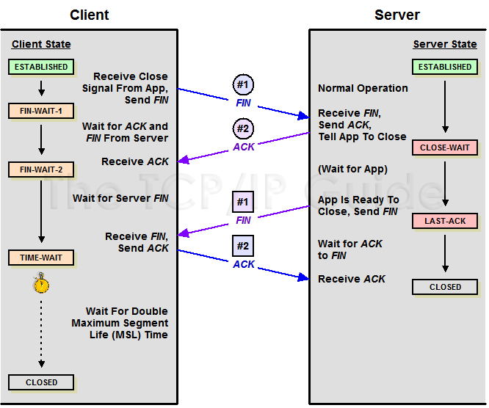
TCP Connection Management (cont.)
Closing a connection:

Slide 78

TCP Connection Management (cont)
TCP client lifecycle

Slide 79

TCP Connection Management (cont)
TCP server lifecycle

Slide 80
Chapter 3 outline
3.1 Transport-layer services
3.2 Multiplexing and demultiplexing
3.3 Connectionless transport: UDP
3.4 Principles of reliable data transfer
3.5 Connection-oriented transport: TCP
  segment structure
  reliable data transfer
  flow control
  connection management
3.6 Principles of congestion control
3.7 TCP congestion control

Slide 81
Principles of Congestion Control
Congestion:
informally: “too many sources sending too much data too fast for network to handle”
different from flow control!
manifestations:
  lost packets (buffer overflow at routers)
  long delays (queueing in router buffers)
a top-10 problem!

Slide 82

Causes/costs of congestion: scenario 1
two senders, two receivers
one router, infinite buffers
no retransmission
Host A
λ_{in} : original data
λ_{out}
Host B
unlimited shared output link buffers
large delays when congested
maximum achievable throughput

Slide 83
Causes/costs of congestion: scenario 2
one router, finite buffers
sender retransmission of lost packet
Host A
λ_{in} : original data
λ_{out}
λ'_{in} : original data, plus retransmitted data
Host B
finite shared output link buffers

Slide 84
Causes/costs of congestion: scenario 2
λ
=
λ
always: (goodput)
“perfect” retransmission only when loss:
retransmission of delayed (not lost) packet makes larger (than perfect case) for same
in
out
λ
>
λ
in
out
λ
λ
in
out
R/2
R/2
R/2
R/3
λ_{out}
λ_{out}
λ_{out}
R/4
λ_{in}
R/2
λ_{in}
R/2
λ_{in}
R/2
a.
b.
c.
“costs” of congestion:
more work (retransmissions) for given “goodput”
unneeded retransmissions: link carries multiple copies of packet

Slide 85
Causes/costs of congestion: scenario 3
λ
four senders
multihop paths
timeout/retransmit
Q: what happens as and increase ?
λ
in
in
Host A
λ_{in} : original data
λ_{out}
λ'_{in} : original data, plus retransmitted data
finite shared output link buffers
Host B

Slide 86

Causes/costs of congestion: scenario 3
Host A
λ_{out}
Host B
Another “cost” of congestion:
when packet dropped, any “upstream transmission capacity used for that packet was wasted!

Slide 87
Approaches towards congestion control
Two broad approaches towards congestion control:
End-end congestion control:
no explicit feedback from network
congestion inferred from end-system observed loss, delay
approach taken by TCP
Network-assisted congestion control:
routers provide feedback to end systems
  single bit indicating congestion (SNA, DECbit, TCP/IP ECN, ATM)
  explicit rate sender should send at

Slide 88
Network-assisted congestion control example: ATM ABR congestion control
ABR: available bit rate:
“elastic service”
if sender’s path “underloaded”:
  sender should use available bandwidth
if sender’s path congested:
  sender throttled to minimum guaranteed rate
RM (resource management) cells:
sent by sender, interspersed with data cells (every 32 data cells)
bits in RM cell set by switches (“network-assisted”)
  NI bit: no increase in rate (mild congestion)
  CI bit: congestion indication
RM cells returned to sender by receiver, with NI and CI bits intact

Slide 89

Case study: ATM ABR congestion control
two-byte ER (explicit rate) field in RM cell
  congested switch may lower ER value in cell
  sender’ send rate at minimum supportable rate on path
EFCI (explicit forward congestion indication) bit in data cells: set to 1 in congested switch
  if data cell preceding RM cell has EFCI set, receiver sets CI bit in returned RM cell

Slide 90
Chapter 3 outline
3.1 Transport-layer services
3.2 Multiplexing and demultiplexing
3.3 Connectionless transport: UDP
3.4 Principles of reliable data transfer
3.5 Connection-oriented transport: TCP
  segment structure
  reliable data transfer
  flow control
  connection management
3.6 Principles of congestion control
3.7 TCP congestion control

Slide 91
TCP Congestion Control
end-end control (no network assistance)
If the sender perceives that there is little congestion, the sender increases its send rate
If the sender perceives that there is a congestion, the sender reduces its send rate
This approaches raises three questions:
How does the sender limits its sent rate?
Hoe does the sender perceives that there is a congestion?
What algorithm should the sender use to change its send rate as a function of perceived end-to-end congestion?

Slide 92
TCP Congestion Control(CONT)
How does sender limits send rate?
The amount of unACKed data at sender may not exceed min(CongWin, RcvWindow); i.e.,
LastByteSent – LastByteAcked
≤ min(CongWin, RcvWindow)
To focus on congestion control, ignore flow control. Assume rcvWindow > CongWin
Roughly,
Sender adjusts send rate by adjusting CongWin
CongWin
rate =
Bytes/sec
RTT

Slide 93
TCP Congestion Control(cont)
How does sender perceive congestion?
loss event = timeout or 3 duplicate acks
TCP sender reduces rate (CongWin) after loss event
What algorithm is used to regulate send rate?
Three components of the TCP congestion control algorithm
  Additive-increase, multiplicative-decrease (AIMD)
  slow start
  Reaction to timeout events

Slide 94

TCP AIMD
multiplicative decrease:
cut CongWin in half after loss event
CongWin is not allowed to drop below 1 maximum segment size (MSS)
additive increase: increase CongWin by 1 maximum segment size (MSS) every RTT in the absence of loss events: probing for additional available bandwidth
Long-lived TCP connection

Slide 95
TCP Slow Start
When connection begins, increase rate exponentially fast until first loss event: Double its value of CongWin every RTT
When the first lost event occurs, CongWin is cut in half and then increases linearly
When connection begins, CongWin = 1 MSS (slow start)
  Example: MSS = 500 bytes & RTT = 200 msec
  initial rate = (500x8)/(200x10E-3) = 20 kbps
available bandwidth may be >> MSS/RTT
  desirable to quickly ramp up to respectable rate

Slide 96
TCP Slow Start (more)
When connection begins, increase rate exponentially until first loss event:
  double CongWin every RTT
  done by incrementing CongWin for every ACK received
Summary: initial rate is slow but ramps up exponentially fast
Host A
Host B
one segment
RTT
two segments
four segments
time

Slide 97
Reaction to timeout events
Philosophy:
3 dup ACKs indicates
network capable of
delivering some segments
timeout before 3 dup
ACKs is “more alarming”
After 3 dup ACKs:
  CongWin is cut in half
  window then grows linearly
But after timeout event:
  CongWin set to 1 MSS;
  window then grows exponentially
  to a threshold, then grows linearly

Slide 98

Reaction to timeout events (more)
Q: When should the exponential increase switch to linear?
A: When CongWin gets to 1/2 of its value before timeout.
Triple duplicate ACK
Implementation:
Maintains a variable: Threshold
At loss event, Threshold is set to 1/2 of CongWin just before loss event
TCP Tahoe sets its congestion window to 1 MSS and enters slow start phase after either type of loss event
TCP Reno cancels the slow start phase of TCP Tahoe after a triple duplicate ACK (fast recovery)

Slide 99
Summary: TCP Congestion Control
When CongWin is below Threshold, sender in slow-start phase, window grows exponentially.
When CongWin is above Threshold, sender is in congestion-avoidance phase, window grows linearly.
When a triple duplicate ACK occurs, Threshold set to CongWin/2 and CongWin set to Threshold.
When timeout occurs, Threshold set to CongWin/2 and CongWin is set to 1 MSS.

Slide 100
TCP sender congestion control
Event | State | TCP Sender Action | Commentary
ACK receipt for previously unacked data | Slow Start (SS) | CongWin = CongWin + MSS, If (CongWin > Threshold) set state to “Congestion Avoidance” | Resulting in a doubling of CongWin every RTT
ACK receipt for previously unacked data | Congestion Avoidance (CA) | CongWin = CongWin+MSS * (MSS/CongWin) | Additive increase, resulting in increase of CongWin by 1 MSS every RTT
Loss event detected by triple duplicate ACK | SS or CA | Threshold = CongWin/2, CongWin = Threshold, Set state to “Congestion Avoidance” | Fast recovery, implementing multiplicative decrease. CongWin will not drop below 1 MSS.
Timeout | SS or CA | Threshold = CongWin/2, CongWin = 1 MSS, Set state to “Slow Start” | Enter slow start
Duplicate ACK | SS or CA | Increment duplicate ACK count for segment being acked | CongWin and Threshold not changed

Slide 101
Average throughput
W: the window size when a lost event occurs
RTT: round-trip time
Assume W and RTT are approximately constant
Ignore the slow start phases that occur after timeout events
throughput
W/RTT
W/(2RTT)
Average throughput
time
Average throughput = (0.75W)/RTT

Slide 102

TCP Futures
Example: 1500 byte segments, 100ms RTT, want 10 Gbps throughput
Requires window size W = 83,333 in-flight segments
Throughput in terms of loss rate:
Segment loss probability :➜ L = 2·10⁻¹⁰ Wow
New versions of TCP for high-speed needed!

Slide 103
TCP Fairness
Fairness goal: if K TCP sessions share same bottleneck link of bandwidth R, each should have average rate of R/K
TCP connection 1
TCP
connection 2
bottleneck
router
capacity R

Slide 104
Why is TCP fair?
Two competing sessions:
Additive increase gives slope of 1, as throughout increases
multiplicative decrease decreases throughput by factor of 2
R
Full bandwidth
utilization line
equal bandwidth share
A: congestion avoidance: both connections additive increase
G
B: loss: both connections decrease window
by factor of 2
D
Connection 2 throughput
C: congestion avoidance: both connections additive increase
B
D: loss: both connections decrease window
by factor of 2
F
C
...
A
Finally, fluctuates along
the equal bandwidth share line
Connection 1 throughput
R

Slide 105
Fairness (more)
Fairness and UDP
Multimedia apps often do not use TCP
  do not want rate throttled by congestion control
Instead use UDP:
  pump audio/video at constant rate, tolerate packet loss
Research area: congestion control for UDP
Fairness and parallel TCP connections
nothing prevents app from opening parallel connections between 2 hosts.
Web browsers do this
Example: link of rate R supporting 9 connections;
  new app asks for 1 TCP, gets rate R/10
  new app asks for 11 TCPs, gets R/2

Slide 106
Delay modeling
Notation, assumptions:
Assume one link between client and server of rate R
S: MSS (bits)
O: object size (bits)
no retransmissions (no loss, no corruption)
Window size:
First assume: fixed congestion window, W segments
Then dynamic window, modeling slow start
Q: How long does it take to receive an object from a Web server after sending a request?
Ignoring congestion, delay is influenced by:
TCP connection establishment
data transmission delay
TCP slow start

Slide 107
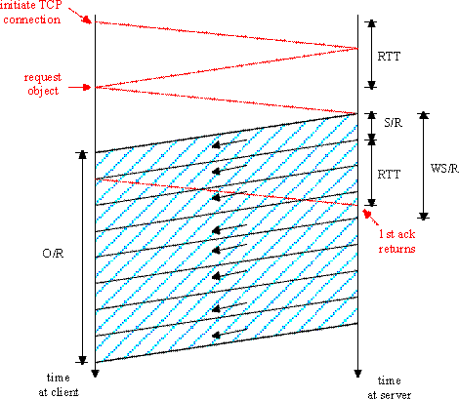
Fixed congestion window (1)
Two cases:
First case:
WS/R ≥ RTT + S/R: ACK for first segment in window returns before window’s worth of data is sent
Second case:
WS/R < RTT + S/R: wait for ACK after sending window’s worth of data is sent
Time to send window worth of data

Slide 108
Fixed congestion window (2)
First case:
WS/R ≥ RTT + S/R: ACK for first segment in window returns before window’s worth of data is sent
Time for sending one window’s data ≥ Time for the first ACK to return
The server can send data without stopping
Time to send window worth of data
delay = 2RTT + O/R

Slide 109
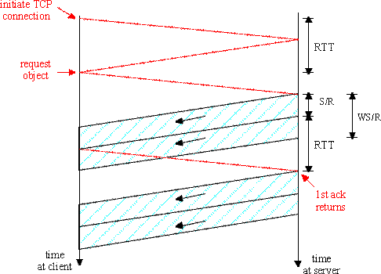
Fixed congestion window (3)
Second case:
WS/R < RTT + S/R: wait for ACK after sending window’s worth of data is sent
Time for sending one window’s data < Time for the first ACK to return
K = O/WS: the number of widows that cover the object
Time to send window worth of data
S/R + RTT - WS/R
delay = 2RTT + O/R + (K-1)[S/R + RTT - WS/R]

Slide 110
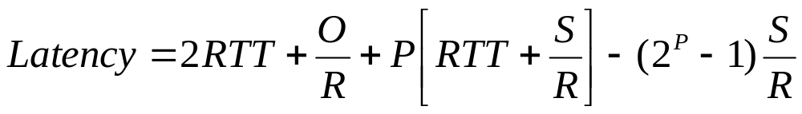

TCP Delay Modeling: Slow Start (1)
Now suppose window grows according to slow start
Will show that the delay for one object is:
where P is the number of times TCP idles at server:
- where Q is the number of times the server idles
if the object were of infinite size.
- and K is the number of windows that cover the object.

Slide 111
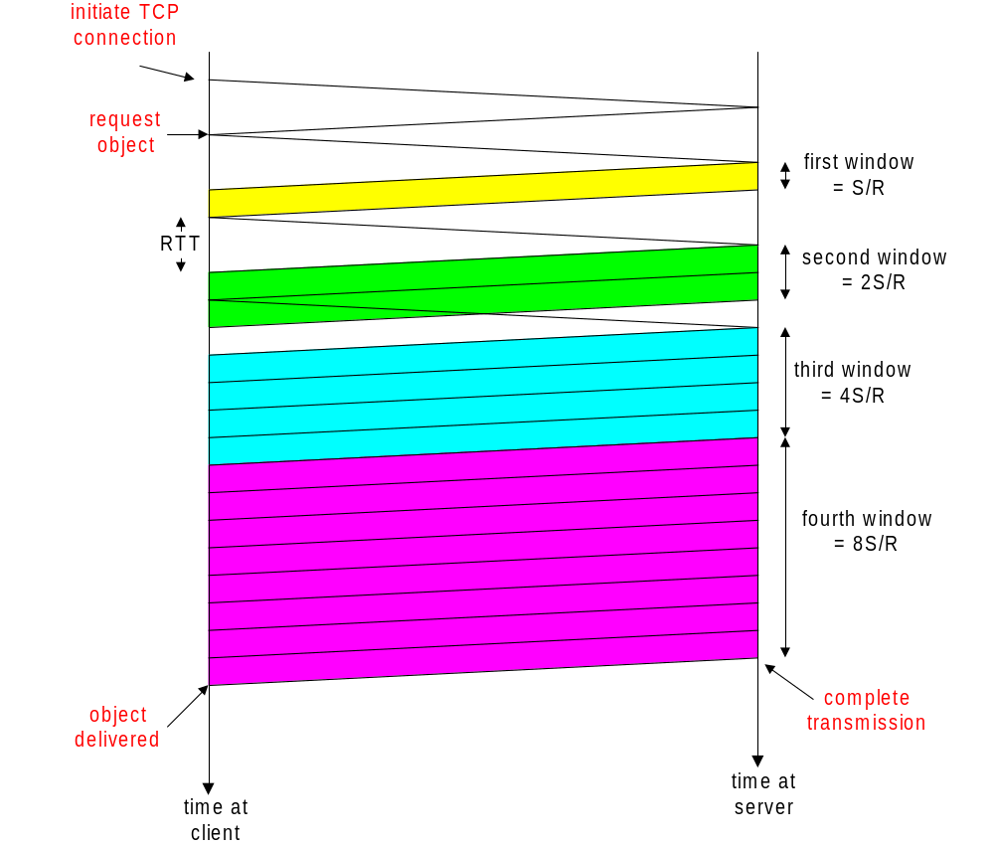
TCP Delay Modeling: Slow Start (2)
Delay components:
2 RTT for connection estab and request
O/R to transmit object
time server idles due to slow start

Slide 112
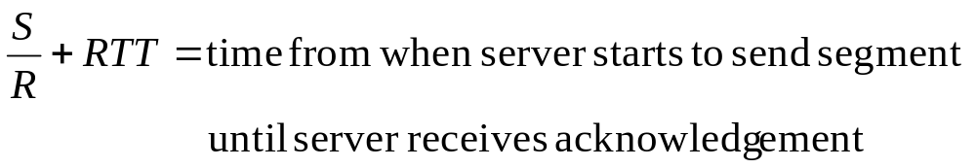
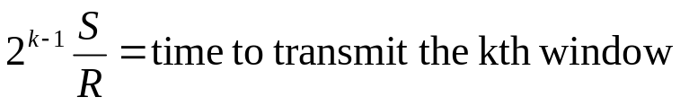
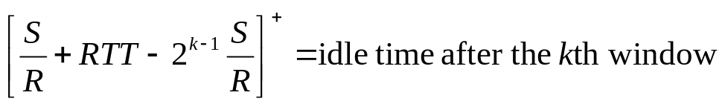
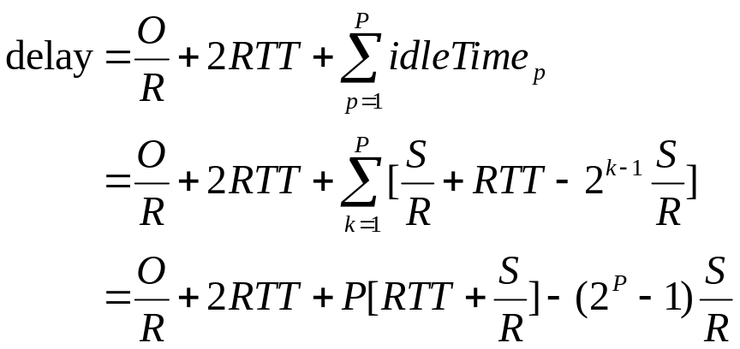
TCP Delay Modeling (3)
O/R = Time to transmit the object
P : the number of times TCP idles at server

Slide 113
TCP Delay Modeling (4)
How to calculate P?
P : the number of times TCP idles at server
Q : the number of times the server idles if the object were of infinite size
K : the number of windows that cover the object.
Example:
O/S = 15 segments
K = 4 windows
Q = 2
P = min{K-1,Q} = 2
Server idles P=2 times

Slide 114
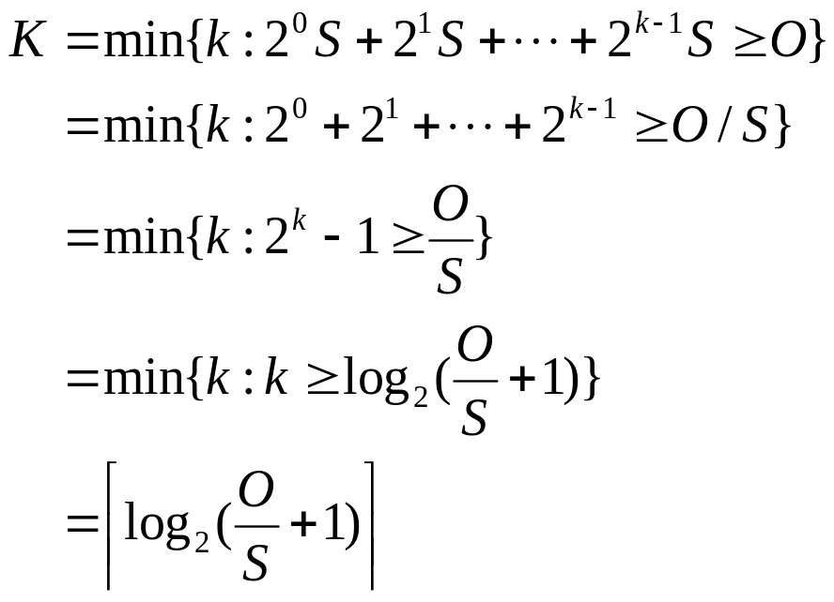
TCP Delay Modeling (5)
Recall K = number of windows that cover object
How do we calculate K ?
S: MSS (bits)
O: object size (bits)

Slide 115
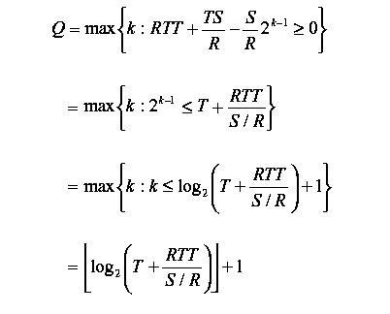
TCP Delay Modeling (6)
Recall Q = the number of times the server idles if the object were of infinite size
How do we calculate Q ?

Slide 116
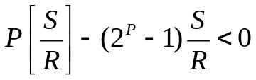
TCP latency – congestion control vs. no congestion control
With congestion control:
Without congestion control: no congestion window constraint
latency = 2RTT + O/R
minimum latency
latency
P
< 1 +
minimum latency
O/(R*RTT) + 2
RTT << O/R or
small R*RTT (delay•bandwidth)
⇒
TCP slow start does not
significantly increase latency
Otherwise; or
large R*RTT (delay•bandwidth)
⇒
TCP slow start significantly increases latency

Slide 117
HTTP Modeling
Assume Web page consists of:
  1 base HTML page (of size O bits)
  M images (each of size O bits)
Non-persistent HTTP:
  M+1 TCP connections in series
  Response time = (M+1)O/R + (M+1)2RTT + sum of idle times
Persistent HTTP:
  2 RTT to request and receive base HTML file
  1 RTT to request and receive M images
  Response time = (M+1)O/R + 3RTT + sum of idle times
Non-persistent HTTP with X parallel connections
  Suppose M / X integer.
  1 TCP connection for base file
  M / X sets of parallel connections for images.
  Response time = (M+1)O/R + (M/X + 1)2RTT + sum of idle times

Slide 118
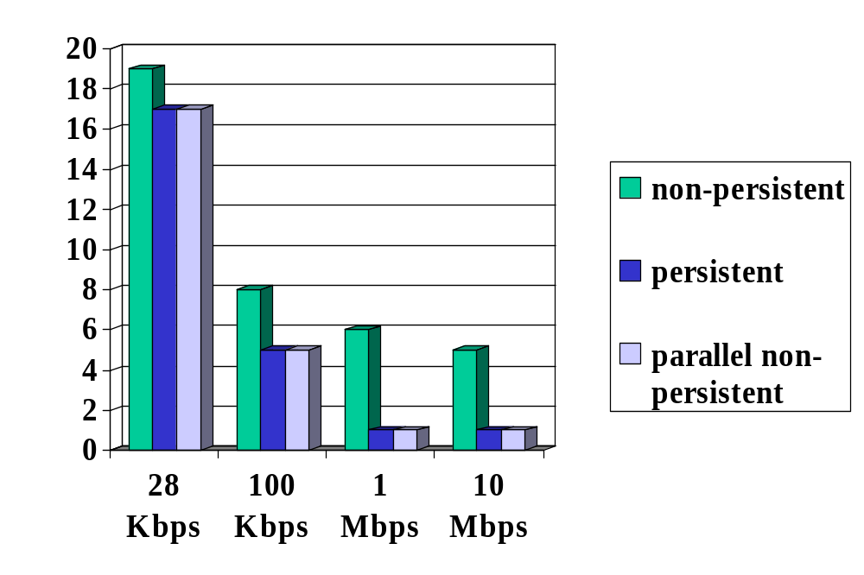
HTTP Response time (in seconds)
RTT = 100 msec, O = 5 Kbytes, M=10 and X=5
Latency
Small RTT
Transmission rate, R
For low bandwidth (low delay•bandwidth), connection & response time dominated by transmission time.
Persistent connections only give minor improvement over parallel
connections.

Slide 119
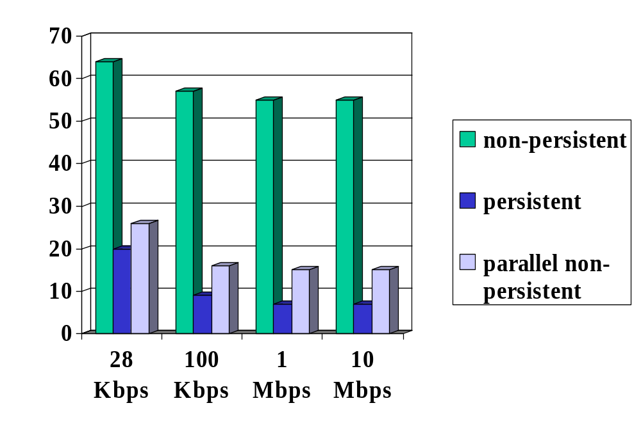
HTTP Response time (in seconds)
RTT =1 sec, O = 5 Kbytes, M=10 and X=5
Latency
Transmission rate, R
For larger RTT, response time dominated by TCP establishment
& slow start delays. Persistent connections now give important
improvement: particularly in high delay•bandwidth networks.

Slide 120
Chapter 3: Summary
principles behind transport layer services:
  multiplexing, demultiplexing
  reliable data transfer
  flow control
  congestion control
instantiation and implementation in the Internet
  UDP
  TCP
Next:
leaving the network “edge” (application, transport layers)
into the network “core”

