Slide 1

Chapter 5
Data Link Layer
A note on the use of these ppt slides:
We’re making these slides freely available to all (faculty, students, readers). They’re in PowerPoint form so you can add, modify, and delete slides (including this one) and slide content to suit your needs. They obviously represent a lot of work on our part. In return for use, we only ask the following:
If you use these slides (e.g., in a class) in substantially unaltered form, that you mention their source (after all, we’d like people to use our book!)
If you post any slides in substantially unaltered form on a www site, that you note that they are adapted from (or perhaps identical to) our slides, and note our copyright of this material.
Thanks and enjoy! JFK/KWR
All material copyright 1996-2004
J.F Kurose and K.W. Ross, All Rights Reserved
Computer Networking: A Top Down Approach Featuring the Internet,
3rd edition.
Jim Kurose, Keith Ross
Addison-Wesley, July 2004.

Slide 2
Chapter 5: The Data Link Layer
Our goals:
understand principles behind data link layer services:
  error detection, correction
  sharing a broadcast channel: multiple access
  link layer addressing
  reliable data transfer, flow control: done!
instantiation and implementation of various link layer technologies

Slide 3
Chapter 5 outline
5.1 Introduction and services
5.2 Error detection and correction
5.3Multiple access protocols
5.4 Link-Layer Addressing
5.5 Ethernet
5.6 Hubs and switches
5.7 PPP
5.8 Link Virtualization: ATM and MPLS

Slide 4





Link Layer: Introduction
“link”
Some terminology:
hosts and routers are nodes
(bridges and switches too)
communication channels that connect adjacent nodes along communication path are links
  wired links
  wireless links
  LANs
Link-layer PDU is a frame, encapsulates a network-layer datagram
Link-layer protocol has the responsibility of transferring datagram from one node
to adjacent node over a link

Slide 5
Link layer: context
Datagram transferred by different link protocols over different links:
  e.g., Ethernet on first link, frame relay on intermediate links, 802.11 on last link
Each link protocol provides different services
  e.g., may or may not provide reliable data transfer over link
transportation analogy
trip from Princeton to Lausanne
  limo: Princeton to JFK
  plane: JFK to Geneva
  train: Geneva to Lausanne
tourist = datagram
transport segment = communication link
transportation mode = link layer protocol
travel agent = routing algorithm

Slide 6
Link Layer Services
Framing:
  encapsulate datagram into frame, adding header, trailer
  ‘physical addresses’ used in frame headers to identify source, destination
    different from IP address!
Link access
  Media access control (MAC) protocol
  Coordinate the frame transmissions of many nodes if multiple nodes share a medium
Reliable delivery between adjacent nodes
  we learned how to do this already (chapter 3)!
  seldom used on low bit error link (fiber, some twisted pair)
  Used on wireless links: high error rates
    Correct an error locally at link level

Slide 7
Link Layer Services (more)
Flow Control:
  pacing between adjacent sending and receiving nodes
Error Detection:
  errors caused by signal attenuation, noise.
  receiver detects presence of errors:
    signals sender for retransmission or drops frame
Error Correction:
  receiver identifies and corrects bit error(s) without resorting to retransmission
Half-duplex and full-duplex
  with half duplex, nodes at both ends of link can transmit, but not at same time

Slide 8
Adaptors Communicating
datagram
link layer protocol
rcving
node
sending
node
frame
frame
Adapter card
Adapter card
link layer implemented in “adaptor” (aka NIC)
  Ethernet card, PCMCI card, 802.11 card
sending side:
  encapsulates datagram in a frame
  adds error checking bits, rdt, flow control, etc.
receiving side
  looks for errors, rdt, flow control, etc
  extracts datagram, passes to receiving node
adapter is semi-autonomous
link & physical layers

Slide 9
Chapter 5 outline
5.1 Introduction and services
5.2 Error detection and correction
5.3Multiple access protocols
5.4 Link-Layer Addressing
5.5 Ethernet
5.6 Hubs and switches
5.7 PPP
5.8 Link Virtualization: ATM

Slide 10

Error Detection
EDC= Error Detection and Correction bits (redundancy)
D = Data protected by error checking, may include header fields
Error detection not 100% reliable!
  protocol may miss some errors, but rarely
  larger EDC field yields better detection and correction

Slide 11
Techniques for Error Detection
Parity checks
Checksumming methods
Cyclic redundancy checks

Slide 12

Parity Checks
Single Bit Parity: Detect single bit errors
Even parity scheme: choose the value of the parity bit such that the total number of 1s in the d+1 bits is even
Odd parity scheme: choose the value of the parity bit such that the total number of 1s in the d+1 bits is odd

Slide 13

Parity Checks (Cont.)
Two Dimensional Bit Parity:Detect and correct single bit errors
(Even parity scheme)
0
0

Slide 14
Checksumming Methods
Goal: detect “errors” (e.g., flipped bits) in transmitted segment (note: used at transport layer only)
Internet checksum:
Sender:
treat segment contents as sequence of 16-bit integers
checksum: addition (1’s complement sum) of segment contents
sender puts checksum value into segment header
Receiver:
compute checksum of received segment
check if computed checksum equals checksum field value:
  NO - error detected
  YES - no error detected. But maybe errors nonetheless? More later ….
Checksum is easy and fast to compute
Typically used in software implemented protocols (e.g. ,TCP and UDP )

Slide 15

Cyclic Redundancy Check
view data bits, D, as a binary number
choose r+1 bit pattern (generator), G (both sender and receiver know G)
sender chooses r CRC bits, R, such that
  <D,R> exactly divisible by G (modulo 2)
receiver knows G, divides <D,R> by G.
  If non-zero remainder: error detected!
  can detect all burst errors less than r+1 bits
widely used in practice (ATM, HDLC)
Left shifts r bits

Slide 16

CRC Example
Want to find R such that:
  D.2^{r} XOR R = nG
XOR R to the right of both sides :
  D.2^{r} = nG XOR R
equivalently:
if we divide D.2^{r} by G, the remainder is R
0
0
0
0
D.2^{r}
G
R = remainder[ ]

Slide 17
Chapter 5 outline
5.1 Introduction and services
5.2 Error detection and correction
5.3 Multiple access protocols
5.4 LAN addresses and ARP
5.5 Ethernet
5.6 Hubs, bridges, and switches
5.7 Wireless links and LANs
5.8 PPP
5.9 ATM
5.10 Frame Relay

Slide 18

Multiple Access Links and Protocols
Two types of “links”:
point-to-point
  PPP (point-to-point protocol) for dial-up access
  point-to-point link between Ethernet switch and host
broadcast (shared wire or medium)
  traditional Ethernet
  upstream HFC (Hybrid fiber coaxial cable)
  802.11 wireless LAN

Slide 19
Multiple Access protocols
single shared broadcast channel
two or more simultaneous transmissions by nodes: interference
  only one node can send successfully at a time
multiple access protocol
distributed algorithm that determines how nodes share channel, i.e., determine when node can transmit
communication about channel sharing must use channel itself!
  no out-of-band channel for coordination

Slide 20
Ideal Mulitple Access Protocol
What to look for in multiple access protocols?
Broadcast channel of rate R bps
1. When one node wants to transmit, it can send at rate R.
2. When M nodes want to transmit, each can send at average rate R/M
3. Fully decentralized:
  no special node to coordinate transmissions
  no synchronization of clocks, slots
4. Simple

Slide 21
MAC Protocols: a taxonomy
Three broad classes:
Channel Partitioning protocols
  divide channel into smaller “pieces” (time slots, frequency, code)
  allocate piece to node for exclusive use
Random Access protocols
  channel not divided, allow collisions
  “recover” from collisions
Taking-turns protocols
  tightly coordinate shared access to avoid collisions

Slide 22

Channel Partitioning MAC protocols: TDMA
TDMA: time division multiple access
channel divided into N time slots, one per user
access to channel in "rounds"
each station gets fixed length slot (length = packet trans time) in each round
unused slots go idle
inefficient with low duty cycle users and at light load
example: 6-station LAN, 1,3,4 have packets, slots 2,5,6 idle

Slide 23
Channel Partitioning MAC protocols: FDMA
FDMA: frequency division multiple access
channel spectrum divided into frequency bands
each station assigned fixed frequency band
unused transmission time in frequency bands go idle
example: 6-station LAN, 1,3,4 have packets, frequency bands 2,5,6 idle
time
frequency bands

Slide 24
Random Access Protocols
When node has packet to send
  transmit at full channel data rate R.
  no a priori coordination among nodes
two or more transmitting nodes -> “collision”,
random access MAC protocol specifies:
  how to detect collisions
  how to recover from collisions (e.g., via delayed retransmissions)
Examples of random access MAC protocols:
  slotted ALOHA
  ALOHA
  CSMA, CSMA/CD, CSMA/CA

Slide 25
Slotted ALOHA
Assumptions
all frames same size
time is divided into equal size slots (length of a slot equals time to transmit 1 frame)
nodes start to transmit frames only at beginning of slots
nodes are synchronized
if 2 or more nodes transmit in a slot, all nodes detect collision
Operation
when a node has a fresh frame to send , it transmits in the next slot
If no collision, the frame is transmitted successfully
if collision, the node retransmits the frame in each subsequent slot with probability p until success

Slide 26

Slotted ALOHA
Pros
single active node can continuously transmit at full rate of channel
highly decentralized: only slots in nodes need to be in sync
simple
Cons
collisions, wasting slots
idle slots due to probabilistic retransmission
nodes may be able to detect collision in a time interval of length less than the time to transmit a packet

Slide 27
Slotted Aloha efficiency
Efficiency is the long-run fraction of successful slots when there are many nodes, each with many frames to send
To derive the maximum efficiency
Modified protocol: each node attempts to transmit a fresh frame in each slot with probability p
Suppose N nodes with many frames to send
Probability that 1st node has success in a slot = p(1-p)^{N-1}
Probability that any node has a success = Np(1-p)^{N-1}

Slide 28




Slotted Aloha efficiency (Cont.)
For max efficiency with N nodes, find p* that maximizes Np(1-p)^{N-1}
For many nodes, take limit of Np*(1-p*)^{N-1} as N goes to infinity, gives 1/e = .37
‘
,
,
∞
∞
∞
At best: channel used for useful transmissions 37% of time!

Slide 29

Pure (unslotted) ALOHA
unslotted Aloha: simpler, no synchronization
when frame first arrives
  transmit immediately
  If collision, retransmits with probability p, or waits for another frame With probability 1-p
collision probability increases:
  frame sent at t₀ collides with other frames sent in [t₀-1,t₀+1]

Slide 30
Pure Aloha efficiency
P(success by given node) = P(node transmits) .
P(no other node transmits in [t₀-1, t₀] .
P(no other node transmits in [t₀, t₀+1]
= p . (1-p)^{N-1 .} (1-p)^{N-1}
= p . (1-p)^{2(N-1)}
… choosing optimum p and then letting n -> infinity ...
maximum efficiency = 1/(2e) = .18
Even worse !

Slide 31
CSMA (Carrier Sense Multiple Access)
CSMA: listen before transmit:
If channel sensed idle: transmit entire frame
If channel sensed busy, defer transmission
for a random amount of time
Human analogy: don’t interrupt others!

Slide 32

CSMA collisions
spatial layout of nodes
collisions can still occur:
propagation delay means
two nodes may not hear
each other’s transmission
B transmits
D transmits
collision:
entire packet transmission
time wasted
note:
The larger the end-to-end propagation delay, the larger the chance that a node is not able to sense a transmission that has already begun at another node

Slide 33
CSMA/CD (Collision Detection)
CSMA/CD: carrier sensing, deferral as in CSMA
  collisions detected within short time
  colliding transmissions aborted, reducing channel wastage
collision detection:
  easy in wired LANs: measure signal strengths, compare transmitted and received signals
  difficult in wireless LANs: receiver shut off while transmitting; i.e., cannot transmit and receive at the same time
human analogy: the polite conversationalist

Slide 34

CSMA/CD collision detection

Slide 35
Taking-Turns MAC protocols
channel partitioning MAC protocols:
  share channel efficiently and fairly at high load
  inefficient at low load: 1/N bandwidth allocated even if only 1 active node!
Random access MAC protocols
  efficient at low load: single node can fully utilize channel
  high load: collision overhead
Taking-turns protocols
  look for best of both worlds!

Slide 36
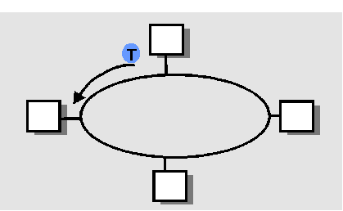
“Taking Turns” MAC protocols
Polling:
master node “invites” slave nodes to transmit in turn
concerns:
  polling delay
  single point of failure (master)
Token passing:
control token passed from one node to next sequentially.
When a node receives a token, it can transmits up to a maximum number of frames
concerns:
  token overhead
  latency
  single point of failure (token)

Slide 37
Summary of MAC protocols
What do you do with a shared media?
  Channel Partitioning, by time, frequency or code
    Time Division, Code Division, Frequency Division
  Random partitioning (dynamic),
    ALOHA, S-ALOHA, CSMA, CSMA/CD
    carrier sensing: easy in some technologies (wire), hard in others (wireless)
    CSMA/CD used in Ethernet
  Taking Turns
    polling from a central site, token passing

Slide 38
LAN technologies
Data link layer so far:
  services, error detection/correction, multiple access
Next: LAN technologies
  addressing
  Ethernet
  hubs, switches
  PPP

Slide 39
Link Layer
5.1 Introduction and services
5.2 Error detection and correction
5.3Multiple access protocols
5.4 Link-Layer Addressing
5.5 Ethernet
5.6 Hubs and switches
5.7 PPP
5.8 Link Virtualization: ATM

Slide 40
LAN Addresses and ARP
32-bit IP address:
network-layer address
used to get datagram to destination IP network (recall IP network definition)
LAN (or MAC or physical or Ethernet) address:
used to get datagram from one interface to another physically-connected interface (same network)
48 bit MAC address (for most LANs)
burned in the adapter ROM

Slide 41
LAN Addresses and ARP
Each adapter on LAN has unique LAN address
Six bytes
Expressed in hexadecimal notation
Broadcast address =
FF-FF-FF-FF-FF-FF
1A-2F-BB-76-09-AD
LAN
(wired or
wireless)
= adapter
71-65-F7-2B-08-53
58-23-D7-FA-20-B0
0C-C4-11-6F-E3-98

Slide 42
LAN Address (more)
MAC address allocation administered by IEEE
manufacturer buys portion of MAC address space (to assure uniqueness)
Analogy:
(a) MAC address: like Social Security Number
(b) IP address: like postal address
MAC flat address => portability
  MAC address of an adapter card does not change when it is moved from one LAN to another
IP hierarchical address NOT portable
  depends on IP network to which node is attached

Slide 43
Recall earlier routing discussion
Starting at A, given IP datagram addressed to B:
look up network address of B, find B on same network as A
link layer send datagram to B inside link-layer frame
A
223.1.1.1
223.1.2.1
223.1.1.2
223.1.1.4
223.1.2.9
B
223.1.2.2
E
223.1.1.3
223.1.3.27
223.1.3.1
223.1.3.2
frame dest
address
frame source
address
datagram source,
dest address
B’s MAC
addr
A’s MAC
addr
A’s IP
addr
B’s IP
addr
IP payload
datagram
frame

Slide 44
ARP: Address Resolution Protocol
Question: how to determine
MAC address of B
knowing B’s IP address?
Each IP node (Host, Router) on LAN has an ARP table
ARP Table: IP/MAC address mappings for some LAN nodes
< IP address; MAC address; TTL>
  TTL (Time To Live): time after which address mapping will be forgotten (typically 20 min)
237.196.7.78
1A-2F-BB-76-09-AD
237.196.7.23
237.196.7.14
LAN
71-65-F7-2B-08-53
58-23-D7-FA-20-B0
0C-C4-11-6F-E3-98
237.196.7.88

Slide 45
ARP protocol: Same LAN (network)
A wants to send datagram to B, and B’s MAC address not in A’s ARP table.
A broadcasts ARP query packet, containing B's IP address
  Dest MAC address = FF-FF-FF-FF-FF-FF
  all machines on LAN receive ARP query
B receives ARP packet, replies to A with its (B's) MAC address
  frame sent to A’s MAC address (unicast)
A caches (saves) IP-to-MAC address pair in its ARP table until information becomes old (times out)
  soft state: information that times out (goes away) unless refreshed
ARP is “plug-and-play”:
  nodes create their ARP tables without intervention from net administrator

Slide 46
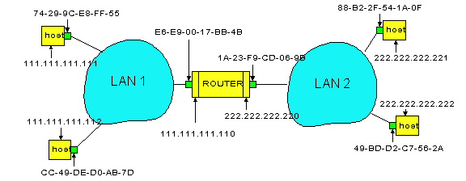
Routing to another LAN
walkthrough: send datagram from A to B via R
assume A know’s B IP address
Two ARP tables in router R, one for each IP network (LAN)
In routing table at source Host, find router 111.111.111.110
In ARP table at source, find MAC address E6-E9-00-17-BB-4B, etc
A
R
B

Slide 47
A creates datagram with source A, destination B
A uses ARP to get R’s MAC address for 111.111.111.110
A creates link-layer frame with R's MAC address as destination, frame contains A-to-B IP datagram
A’s data link layer sends frame
R’s data link layer receives frame
R removes IP datagram from Ethernet frame, sees its destined to B
R uses ARP to get B’s physical layer address
R creates frame containing A-to-B IP datagram sends to B
A
R
B

Slide 48
Link Layer
5.1 Introduction and services
5.2 Error detection and correction
5.3Multiple access protocols
5.4 Link-Layer Addressing
5.5 Ethernet
5.6 Hubs and switches
5.7 PPP
5.8 Link Virtualization: ATM

Slide 49

Ethernet
“dominant” wired LAN technology:
cheap $20 for 100Mbs!
first widely used LAN technology
Simpler, cheaper than token LANs and ATM
Kept up with speed race: 10, 100, 1000 Mbps
Metcalfe’s Ethernet
sketch

Slide 50
Star topology
Bus topology popular through mid 90s
Now star topology prevails
Connection choices: hub or switch (more later)
hub or
switch

Slide 51

Ethernet Frame Structure
Sending adapter encapsulates IP datagram (or other network layer protocol packet) in Ethernet frame
Preamble:
7 bytes with pattern 10101010 followed by one byte with pattern 10101011
used to synchronize receiver, sender clock rates

Slide 52
Ethernet Frame Structure (more)
Data: 46 to 1500 bytes
Addresses: 6 bytes
  if adapter receives frame with matching destination address, or with broadcast address (eg ARP packet), it passes data in frame to net-layer protocol
  otherwise, adapter discards frame
Type: indicates the higher layer protocol (mostly IP but others may be supported such as Novell IPX and AppleTalk)
CRC: checked at receiver, if error is detected, the frame is simply dropped

Slide 53
Unreliable, connectionless service
Connectionless: No handshaking between sending and receiving adapter.
Unreliable: receiving adapter doesn’t send acks or nacks to sending adapter
  stream of datagrams passed to network layer can have data gaps due to discarded fames if the application is using UDP
  data gaps will be filled by retransmissions if application is using TCP
  otherwise, application will see the gaps

Slide 54
Ethernet uses CSMA/CD
adapter may begin to transmit at anytime, i.e., no slots are used
adapter doesn’t transmit if it senses that some other adapter is transmitting, that is, carrier sense
transmitting adapter aborts when it senses that another adapter is also transmitting, that is, collision detection
Before attempting a retransmission, adapter waits a random time, that is, random access

Slide 55
Ethernet CSMA/CD algorithm
1. Adaptor receives datagram from network layer and creates frame
2. If adapter senses channel idle, it starts to transmit frame.
If it senses channel busy, waits until channel idle and then transmits
3. If adapter transmits entire frame without detecting another transmission, the adapter is done with frame !
4. If adapter detects another transmission while transmitting, aborts and sends jam signal
5. After aborting, adapter enters exponential backoff: after the nth collision, adapter chooses a K at random from
{0,1,2,…,2^{m}-1} where m = min(n, 10). Adapter waits K*512 bit times and returns to Step 2

Slide 56
Ethernet’s CSMA/CD (more)
Jam Signal: make sure all other transmitters are aware of collision; 48 bits;
Bit time: 0.1 microsec for 10 Mbps Ethernet ;
for K=1023, wait time is about 50 msec
Exponential Backoff:
Goal: adapt retransmission attempts to estimated current load
  heavy load: random wait will be longer
first collision: choose K from {0,1}; delay is K x 512 bit transmission times
after second collision: choose K from {0,1,2,3}…
after ten collisions, choose K from {0,1,2,3,4,…,1023}
See/interact with Java
applet on AWL Web site:
highly recommended !

Slide 57
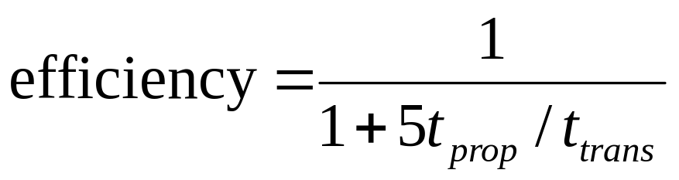
CSMA/CD efficiency
T_{prop} = max propagation delay between 2 nodes in LAN
t_{trans} = time to transmit max-size frame
Efficiency: the long-run fraction of time during which frames are being transmitted on the channel without collisions when there are a large number of active nodes
Efficiency goes to 1 as t_{prop} goes to 0
Goes to 1 as t_{trans} goes to infinity
Much better than ALOHA, but still decentralized, simple, and cheap
[Lam 1980, Bertsekas 1991]

Slide 58
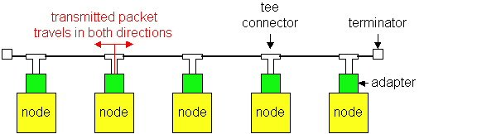
Ethernet Technologies: 10Base2
10: 10Mbps;
2: under 200 meters max cable length
thin coaxial cable in a bus topology
repeaters used to connect up to multiple segments
repeater repeats bits it hears on one interface to its other interfaces: physical layer device only!
has become a legacy technology

Slide 59
10BaseT and 100BaseT
10/100 Mbps rate; latter called “fast ethernet”
T stands for Twisted Pair
Nodes connect to a hub: “star topology”; 100 m max distance between nodes and hub
twisted pair
hub

Slide 60
Hubs
Hubs are essentially physical-layer repeaters:
  bits coming from one link go out all other links
  at the same rate
  no frame buffering
  no CSMA/CD at hub: adapters detect collisions
  provides net management functionality
twisted pair
hub

Slide 61

Manchester encoding
Used in 10BaseT, 10Base2
Each bit has a transition – 1: up to down, 0: down to up
Allows clocks in sending and receiving nodes to synchronize to each other
  no need for a centralized, global clock among nodes!
Hey, this is physical-layer stuff!

Slide 62
Gbit Ethernet
use standard Ethernet frame format
allows for point-to-point links as well as shared broadcast channels
Point-to-point links use switches
Shared broadcast channels use hubs called “Buffered Distributors”
in shared broadcast channels, CSMA/CD is used; short distances between nodes to be efficient
10 Gbps now !

Slide 63
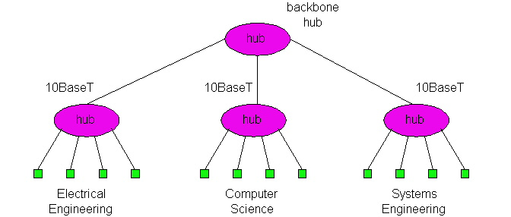
Interconnecting with hubs
Backbone hub interconnects LAN segments
Extends max distance between nodes
Limitations:
  But individual segment collision domains become one large collision domain – all hosts share 10Mbps
    if a node in CS and a node EE transmit at same time: collision
  Can’t interconnect 10BaseT & 100BaseT
  A collision domain has restrictions on the maximum allowable number of nodes, the maximum distance between two hosts, the maximum number of tiers in a multi-tier design

Slide 64
Switch
Link layer device
  stores and forwards Ethernet frames
  examines frame header and selectively forwards frame based on MAC dest address
  when frame is to be forwarded on segment, uses CSMA/CD to access segment
transparent
  hosts are unaware of presence of switches
plug-and-play, self-learning
  switches do not need to be configured

Slide 65
Forwarding
switch
hub
hub
hub
How do switches determine to which LAN segment to forward frame?
Looks like a routing problem...

Slide 66
Self learning
A switch has a switch table
entry in switch table:
  (MAC Address of a node, Switch Interface, Time Stamp)
  stale entries in table dropped (TTL can be 60 min)
Switch learns which hosts can be reached through which interfaces
  when frame received, switch “learns” location of sender: incoming interface
  records sender/interface pair in switch table

Slide 67
Filtering/Forwarding
When switch receives a frame:
index switch table using MAC destination address
if entry found for destination
then {
if destination on interface from which frame arrived
then drop the frame
else forward the frame on interface indicated
}
else flood
forward on all but the interface
on which the frame arrived

Slide 68
Switch example
Suppose C sends frame to D and D replies back with frame to C.
switch
address
interface
1
A
B
E
G
1
1
2
3
2
3
hub
hub
hub
A
I
D
F
B
C
G
H
E
Switch receives frame from C
  records in switch table that C is on interface 1
  because D is not in table, switch forwards frame into interfaces 2 and 3
frame received by D

Slide 69
Switch example
Suppose D replies back with frame to C.
address
interface
switch
A
B
E
G
C
1
1
2
3
1
hub
hub
hub
A
I
D
F
B
C
G
H
E
Switch receives frame from from D
  records in switch table that D is on interface 2
  because C is in table, switch forwards frame only to interface 1
frame received by C

Slide 70
Switch: traffic isolation
switch installation breaks subnet into LAN segments
switch filters packets:
  same-LAN-segment frames not usually forwarded onto other LAN segments
  segments become separate collision domains
switch
collision
domain
hub
hub
hub
collision domain
collision domain

Slide 71
Switches: dedicated access
Switch with many interfaces
Hosts have direct connection to switch
No collisions; full duplex
Switching: A-to-A’ and B-to-B’ simultaneously, no collisions
A
C’
B
switch
C
B’
A’

Slide 72
More on Switches
cut-through switching: when the output buffer is empty, a frame forwarded from input to output port without first collecting entire frame
  slight reduction in latency
combinations of shared/dedicated, 10/100/1000 Mbps interfaces

Slide 73
Institutional network
mail server
to external
network
router
web server
switch
IP subnet
hub
hub
hub

Slide 74

Switches vs. Routers
both store-and-forward devices
  routers: network layer devices (examine network layer headers)
  switches are link layer devices
routers maintain routing tables, implement routing algorithms
switches maintain switch tables, implement filtering, learning algorithms
Switch

Slide 75
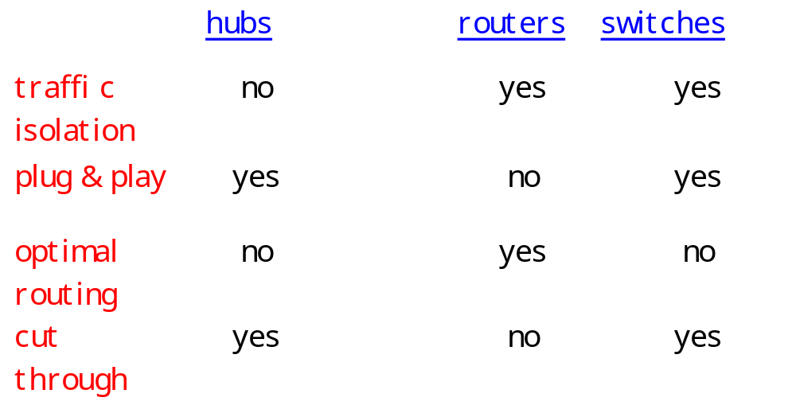
Summary comparison

Slide 76
Link Layer
5.1 Introduction and services
5.2 Error detection and correction
5.3Multiple access protocols
5.4 Link-Layer Addressing
5.5 Ethernet
5.6 Hubs and switches
5.7 PPP
5.8 Link Virtualization: ATM

Slide 77
Point to Point Data Link Control
one sender, one receiver, one link: easier than broadcast link:
  no Media Access Control
  no need for explicit MAC addressing
  e.g., dialup link, ISDN line
popular point-to-point Data Link Control (DLC) protocols:
  PPP (point-to-point protocol)
  HDLC: High level data link control (Data link used to be considered “high layer” in protocol stack!)

Slide 78
PPP Design Requirements [RFC 1557]
packet framing: encapsulation of network-layer datagram in data link frame
  carry network layer data of any network layer protocol (not just IP) at same time
  ability to demultiplex upwards
bit transparency: must carry any bit pattern in the data field
error detection (no correction)
connection liveness: detect a link failure, signal link failure to network layer
network layer address negotiation: endpoint can learn/configure each other’s network address

Slide 79
PPP non-requirements
no error correction/recovery
no flow control
out of order delivery OK
no need to support multipoint links (e.g., polling)
Error recovery, flow control, data re-ordering
all relegated to higher layers!

Slide 80

PPP Data Frame
Flag: delimiter (framing)
Address: does nothing (only one option)
Control: does nothing; in the future possible multiple control fields
Protocol: upper layer protocol to which frame delivered (eg, PPP-LCP, IP, IPCP, etc)

Slide 81
PPP Data Frame
info: upper layer data being carried, default maximum length = 1500 bytes
check: cyclic redundancy check for error detection

Slide 82
Byte Stuffing
“data transparency” requirement: data field must be allowed to include flag pattern <01111110>
  Q: is received <01111110> data or flag?
Sender:
  adds (“stuffs”) extra < 01111101> byte before each < 01111110> data byte
  adds (“stuffs”) extra < 01111101> byte before each < 01111101> data byte
Receiver:
  single 01111101 byte: discard 01111101
  two 01111101 bytes in a row: discard first byte, continue data reception
  single 01111110: flag byte

Slide 83

Byte Stuffing
flag byte
pattern
in data
to send
flag byte pattern plus
stuffed byte in transmitted data

Slide 84

PPP Control Protocol
Begins and ends in the dead state
Enters link establishment state when the physical layer is present and ready to be used
In the link establishment state, PPP link-control protocol (LCP) is used to negotiate link configuration options such as maximum frame size, authentication protocol (if any) to be used, etc.

Slide 85
PPP Control Protocol (Cont.)
Then, the end points enter the network layer configuration state to learn/configure network layer information using a network-control protocol
The network-control protocol to be used depends on the specific network layer protocol
  for IP: IP Control Protocol (IPCP) (protocol field: 8021) is used to configure/learn IP address
Once the network layer has been configured, PPP enters the open state and may begin sending network layer datagrams

Slide 86
PPP Control Protocol (Cont.)
The LCP echo-request frame and echo reply frame can be exchanged between Two PPP endpoints in order to check the status of the link
To terminate the link, one end of the PPP link sends a terminate-request LCP frame and the other end replies with a terminate-ack LCP frame
The link enter the dead state

Slide 87
Link Layer
5.1 Introduction and services
5.2 Error detection and correction
5.3Multiple access protocols
5.4 Link-Layer Addressing
5.5 Ethernet
5.6 Hubs and switches
5.7 PPP
5.8 Link Virtualization: ATM and MPLS

Slide 88
Virtualization of networks
Virtualization of resources: a powerful abstraction in systems engineering:
computing examples: virtual memory, virtual devices
  Virtual machines: e.g., java
  IBM VM os from 1960’s/70’s
layering of abstractions: don’t sweat the details of the lower layer, only deal with lower layers abstractly

Slide 89
The Internet: virtualizing networks
1974: multiple unconnected nets
  ARPAnet
  data-over-cable networks
  packet satellite network (Aloha)
  packet radio network
… differing in:
  addressing conventions
  packet formats
  error recovery
  routing
ARPAnet
satellite net
"A Protocol for Packet Network Intercommunication",
V. Cerf, R. Kahn, IEEE Transactions on Communications,
May, 1974, pp. 637-648.

Slide 90
The Internet: virtualizing networks
Internetwork layer (IP):
addressing: internetwork appears as a single, uniform entity, despite underlying local network heterogeneity
network of networks
Gateway:
“embed internetwork packets in local packet format or extract them”
route (at internetwork level) to next gateway
gateway
ARPAnet
satellite net

Slide 91
Cerf & Kahn’s Internetwork Architecture
What is virtualized?
two layers of addressing: internetwork and local network
new layer (IP) makes everything homogeneous at internetwork layer
underlying local network technology
  cable
  satellite
  56K telephone modem
  today: ATM, MPLS
… “invisible” at internetwork layer. Looks like a link layer technology to IP!

Slide 92
ATM and MPLS
ATM, MPLS separate networks in their own right
  different service models, addressing, routing from Internet
viewed by Internet as logical link connecting IP routers
  just like dialup link is really part of separate network (telephone network)
ATM, MPSL: of technical interest in their own right

Slide 93
Asynchronous Transfer Mode: ATM
1990’s/00 standard for high-speed (155Mbps to 622 Mbps and higher) Broadband Integrated Service Digital Network architecture
Goal: integrated, end-to-end transport for carrying voice, video, data
  meeting timing/QoS requirements of voice, video (versus Internet best-effort model)
  “next generation” telephony: technical roots in telephone world
  packet-switching (fixed length packets, called “cells”) using virtual circuits

Slide 94
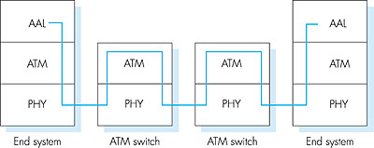
ATM architecture
The ATM protocol stack consists of three layers:
adaptation layer: only at edge of ATM network
  data segmentation/reassembly
  roughly analagous to Internet transport layer
  Several different types of AALs to support different types of services
ATM layer: the core of the ATM standard
  cell switching, routing
physical layer

Slide 95
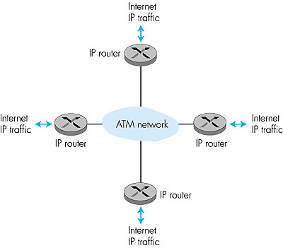
ATM: network or link layer?
Vision: end-to-end transport: “ATM from desktop to desktop”
  ATM is a network technology
Reality: used to connect IP backbone routers
  “IP over ATM”
  ATM as switched link layer, connecting IP routers

Slide 96
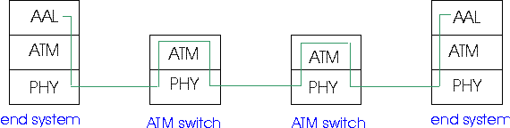
ATM Adaptation Layer (AAL)
ATM Adaptation Layer (AAL): “adapts” upper layers (IP or native ATM applications) to ATM layer below
AAL present only in end systems, not in switches
AAL layer segment (header/trailer fields, data) is fragmented across multiple ATM cells
  analogy: TCP segment is fragmented in many IP packets

Slide 97
ATM Adaptation Layer (AAL) [more]
Different versions of AAL layers, depending on ATM service class:
AAL1: for CBR (Constant Bit Rate) services, e.g. circuit emulation
AAL2: for VBR (Variable Bit Rate) services, e.g., MPEG video
AAL5: for data (eg, IP datagrams)

Slide 98
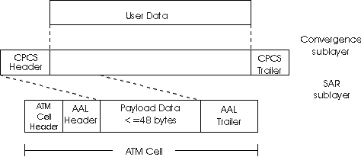
ATM Adaptation Layer (AAL) [more]
AAL has two sublayers:
Convergence sublayer: higher-layer data are encapsulated in a common part convergence sublayer (CPCS)
Segmentation and reassembly (SAR) sublayer: segments the CPCS-PDU and adds AAL header and trailer bits to form the payloads of the ATM
User data
AAL PDU
ATM cell

Slide 99
ATM Layer
Service: transport cells across ATM network
analogous to IP network layer
very different services than IP network layer
Network
Architecture
Internet
ATM
ATM
ATM
ATM
Service
Model
best effort
CBR
VBR
ABR
UBR
Guarantees ?
Congestion
feedback
no (inferred
via loss)
no
congestion
no
congestion
yes
no
Bandwidth
none
constant
rate
guaranteed
rate
guaranteed
minimum
none
Loss
no
yes
yes
no
no
Order
no
yes
yes
yes
yes
Timing
no
yes
yes
no
no

Slide 100
ATM Layer: Virtual Channels
VC transport: cells carried on VC from source to dest
  call setup for each call before data can flow
  each packet carries a virtual channel identifier (VCI)
  every switch on source-dest path maintain “state” for each passing connection
  link, switch resources (bandwidth, buffers) may be allocated to VC: to get circuit-like performance
Two types of VCs
  Permanent VCs (PVCs)
    long lasting connections
    typically: “permanent” route between IP routers
  Switched VCs (SVC):
    dynamically set up on per-call basis

Slide 101
ATM VCs
Advantages of ATM VC approach:
  QoS performance guarantee for connection mapped to VC (bandwidth, delay, delay jitter)
Drawbacks of ATM VC approach:
  Inefficient support of datagram traffic
  one PVC between each source/destination pair does not scale (N*2 connections needed)
  SVC introduces call setup latency, processing overhead for short lived connections

Slide 102

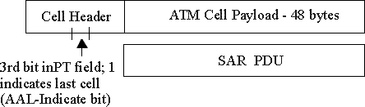
ATM Layer: ATM cell
5-byte ATM cell header
48-byte payload
  Why?: small payload -> short cell-creation delay for digitized voice
  halfway between 32 and 64 (compromise!)
Cell header
Cell format

Slide 103
ATM cell header
VCI: virtual channel ID
  will change from link to link through net
PT: Payload type (e.g. RM cell versus data cell)
CLP: Cell Loss Priority bit
  CLP = 1 implies low priority cell, can be discarded if congestion
HEC: Header Error Checksum
  cyclic redundancy check

Slide 104
ATM Physical Layer
Two classes of physical layer:
Structured: have a transmission frame structure (TDM like frame)
Unstructured: do not have frame structure
Two sublayers of physical layer:
Transmission Convergence Sublayer (TCS):
  Accept ATM cells from the ATM layer and prepare them for transmission
  Group bits arriving from the physical medium into cells and pass the cells to the ATM layer
Physical Medium Dependent (PMD) Sublayer:
  depends on physical medium being used
  Generates and delineating bits

Slide 105
ATM Physical Layer (more)
Transmission Convergence Sublayer (TCS)
At the transmit side: generates header checksum (HEC) byte -- 8 bits CRC
If the Physical Medium Dependent (PMD) sublayer is cell-based with no frames, TCS sends idle cells when ATM layer has not provided data cells to send
At the receive side, uses the HEC byte to correct all one-bit errors and some multiple-bit errors in the header
At the receive side, delineates cells by running the HEC on all contiguous sets of 40 bits (When a match occurs, a cell is delineated)

Slide 106
ATM Physical Layer (more)
Physical Medium Dependent (PMD) sublayer
Some possible PMD sublayers:
SONET/SDH (synchronous optical network/synchronous digital hierarchy) : have transmission frame structure (like a container carrying bits);
  bit synchronization;
  Generates and delineates frames
  bandwidth partitions (TDM);
  several speeds: OC3 = 155.52 Mbps; OC12 = 622.08 Mbps; OC48 = 2.45 Gbps, OC192 = 9.6 Gbps
T1/T3: have transmission frame structure (old telephone hierarchy): T1 = 1.5Mbps/ T3 = 45Mbps
Cell-based with no frames: just cells (busy/idle cells)

Slide 107
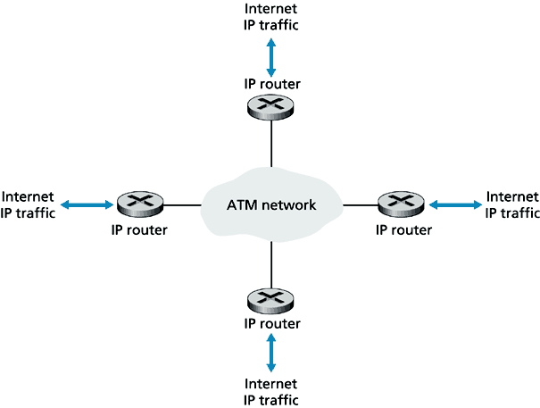
IP-Over-ATM
replace “network” with ATM network
ATM addresses, IP addresses

Slide 108
IP-Over-ATM
IP
IP
AAL
ATM
phy
AAL
ATM
phy
Eth
Eth
phy
phy

Slide 109
Datagram Journey in IP-over-ATM Network
at entry router:
  maps between IP destination address and ATM destination address (using ARP)
  passes datagram to AAL5
  AAL5 encapsulates data, segments cells, passes to ATM layer
ATM network: moves cell along VC to destination
at exit router:
  AAL5 reassembles cells into original datagram
  if CRC OK, datagram is passed to IP

Slide 110
Multiprotocol label switching (MPLS)
initial goal: speed up IP forwarding by using fixed length label (instead of IP address) to do forwarding
  borrowing ideas from Virtual Circuit (VC) approach
  but IP datagram still keeps IP address!
PPP or Ethernet
header
IP header
remainder of link-layer frame
MPLS header
label
Exp
S
TTL
20
3
1
5

Slide 111
MPLS capable routers
a.k.a. label-switched router
forwards packets to outgoing interface based only on label value (don’t inspect IP address)
  MPLS forwarding table distinct from IP forwarding tables
signaling protocol needed to set up forwarding table
  RSVP-TE (RFC 3209)
  forwarding possible along paths that IP alone would not allow (e.g., source-specific routing) !!
  use MPLS for traffic engineering
must co-exist with IP-only routers

Slide 112
MPLS forwarding tables
in out out
label label dest interface
10 A 0
in out out
label label dest interface
12 D 0
8 A 1
10 6 A 1
12 9 D 0
R6
0
0
D
1
1
R4
R3
R5
0
0
A
R2
R1
in out out
label label dest interface
in out out
label label dest interface
R1
8 6 A 0
6 - A 0

Slide 113
Chapter 5: Summary
principles behind data link layer services:
  error detection, correction
  sharing a broadcast channel: multiple access
  link layer addressing
instantiation and implementation of various link layer technologies
  Ethernet
  switched LANS
  PPP
  virtualized networks as a link layer: ATM, MPLS

