Slide 1
15-213 Recitation: C Review
TA’s
20 Feb 2017

Slide 2
Agenda
Logistics
Attack Lab Conclusion
C Assessment
C Programming Style
C Exercise
Cache Lab Overview
Appendix:
Valgrind
Clang / LLVM
Cache Structure

Slide 3
Logistics
Attack Lab is due tomorrow at midnight!
Come to office hours for help
rtarget phase 3 is only worth 5 points
0.2% of your grade ≈ 0% of your grade
Cache Lab will be released tomorrow!

Slide 4
Attack Lab Conclusion
Don’t use functions vulnerable to buffer overflow (like gets)
Use functions that allow you to specify buffer lengths:
fgets instead of gets
strncpy instead of strcpy
strncat instead of strcat
snprintf instead of sprint
Use sscanf and fscanf with input lengths (%213s)
Stack protection makes buffer overflow very hard…
But very hard ≠ impossible!

Slide 5
C Assessment
3.5 Basic C Programming Questions
Take some time to write down your answer for each question
Don’t worry if you think these questions are hard…
Come to the C Bootcamp (Check Piazza for time and location)

Slide 6
C Assessment: Question 1
Which lines have a problem and how can you fix it?
1 int main(int argc, char** argv) {
2 int *a = (int*) malloc(213 * sizeof(int));
3 for (int i=0; i<213; i++) {
4 if (a[i] == 0) a[i]=i;
5 else a[i]=-i;
6 }
7 return 0;
8 }

Slide 7
C Assessment: Question 1
malloc can fail!
1 int main(int argc, char** argv) {
2 int *a = (int*) malloc(213 * sizeof(int));
if (a == NULL) return 0;
3 for (int i=0; i<213; i++) {
4 if (a[i] == 0) a[i]=i;
5 else a[i]=-i;
6 }
7 return 0;
8 }

Slide 8
C Assessment: Question 1
Allocated memory is not initialized!
1 int main(int argc, char** argv) {
2 int *a = (int*) calloc(213 * sizeof(int));
if (a == NULL) return 0;
3 for (int i=0; i<213; i++) {
4 if (a[i] == 0) a[i]=i;
5 else a[i]=-i;
6 }
7 return 0;
8 }

Slide 9
C Assessment: Question 1
Declaring variables inside a for loop requires -std=c99
1 int main(int argc, char** argv) {
2 int *a = (int*) calloc(213 * sizeof(int));
if (a == NULL) return 0;
3 for (int i=0; i<213; i++) {
4 if (a[i] == 0) a[i]=i;
5 else a[i]=-i;
6 }
7 return 0;
8 }

Slide 10
C Assessment: Question 1
All allocated memory must be freed!
1 int main(int argc, char** argv) {
2 int *a = (int*) calloc(213 * sizeof(int));
if (a == NULL) return 0;
3 for (int i=0; i<213; i++) {
4 if (a[i] == 0) a[i]=i;
5 else a[i]=-i;
6 }
free(a);
7 return 0;
8 }

Slide 11
C Assessment: Question 2
What are the values of A and B?
#define SUM(x, y) x + y
int sum(int x, int y) {
return x + y;
}
int A = SUM(2, 1) * 3;
int B = sum(2, 1) * 3;

Slide 12
C Assessment: Question 2
What is wrong with our macro SUM?
#define SUM(x, y) x + y
int sum(int x, int y) {
return x + y;
}
int A = SUM(2, 1) * 3; // A = 2 + 1 * 3 = 5!?
int B = sum(2, 1) * 3; // B = 6

Slide 13
C Assessment: Question 2
Use parenthesis around result!
#define SUM(x, y) (x + y)
int sum(int x, int y) {
return x + y;
}
int A = SUM(2, 1) * 3; // A = 6
int B = sum(2, 1) * 3; // B = 6

Slide 14
C Assessment: Question 2 Part B
What are the values of A and B?
#define MULT(x, y) (x * y)
int mult(int x, int y) {
return x * y;
}
int A = MULT(2, 0 + 1) * 3;
int B = mult(2, 0 + 1) * 3;

Slide 15
C Assessment: Question 2 Part B
What is wrong with our macro MULT?
#define MULT(x, y) (x * y)
int mult(int x, int y) {
return x * y;
}
int A = MULT(2, 0 + 1) * 3; // A = (2 * 0 + 1) * 3 = 3?!
int B = mult(2, 0 + 1) * 3; // B = 6

Slide 16
C Assessment: Question 2 Part B
Use parenthesis around macro arguments (and result)!
#define MULT(x, y) ((x) * (y))
int mult(int x, int y) {
return x * y;
}
int A = MULT(2, 0 + 1) * 3; // A = ((2) * (0 + 1)) * 3 = 6
int B = mult(2, 0 + 1) * 3; // B = 6

Slide 17
C Assessment: Question 3
What lines make safe_int_malloc not so safe?
1 int *safe_int_malloc(int *pointer) {
2 pointer = malloc(sizeof(int));
3 if (pointer == NULL) exit(-1);
4 return &pointer;
5 }

Slide 18
C Assessment: Question 3
pointer is a local copy of the pointer!
1 int *safe_int_malloc(int **pointer) {
2 *pointer = malloc(sizeof(int));
3 if (pointer == NULL) exit(-1);
4 return &pointer;
5 }

Slide 19
C Assessment: Question 3
&pointer is a location on the stack in safe_int_malloc’s frame!
1 int **safe_int_malloc(int **pointer) {
2 *pointer = malloc(sizeof(int));
3 if (pointer == NULL) exit(-1);
4 return pointer;
5 }

Slide 20
C Assessment Conclusion
Did you answer every question correctly? If not…
Come to the C Bootcamp (Check Piazza for time and location)
Was the test so easy you were bored? If not…
Come to the C Bootcamp (Check Piazza for time and location)
When in doubt…
Come to the C Bootcamp (Check Piazza for time and location)
This will be very important for the rest of this class, so make sure you are comfortable with the material covered or come to the C Bootcamp!

Slide 21
C Programming Style
Document your code with comments
Check error and failure conditions
Write modular code
Use consistent formatting
Avoid memory and file descriptor leaks
Warning: Dr. Evil has returned to grade style on Cache Lab! ☺
Refer to full 213 Style Guide: http://cs.cmu.edu/~213/codeStyle.html

Slide 22
C Exercise
Learn to use getopt
Extremely useful for Cache Lab
Processes command line arguments
Let’s write a Pythagorean Triples Solver!
Pair up!
Login to a shark machine
$ wget http://cs.cmu.edu/~213/recitations/rec6.tar
$ tar xvf rec6.tar
$ cd rec6
But first, a simple getopt example…
$ vim getopt-example.c

Slide 23
C Exercise: $ man 3 getopt
int getopt(int argc, char * const argv[], const char *optstring);
getopt returns -1 when done parsing
optstring is string with command line arguments
Characters followed by colon require arguments
Find argument text in char *optarg
getopt can’t find argument or finds illegal argument sets optarg to “?”
Example: “abc:d:”
a and b are boolean arguments (not followed by text)
c and d are followed by text (found in char *optarg)

Slide 24

C Exercise: C Hints and Math Reminders
$a^{2}+b^{2}=c^{2}$
$⇒a=\sqrt{c^{2}−b^{2}}$
$⇒b=\sqrt{c^{2}−a^{2}}$
$⇒c=\sqrt{a^{2}+b^{2}}$
$⇒3^{2}+4^{2}=5^{2}$
String to float in C:
#include <stdlib.h>
float atof(const char *str);
Square root in C:
#include <math.h>
float sqrt(float x);

Slide 25
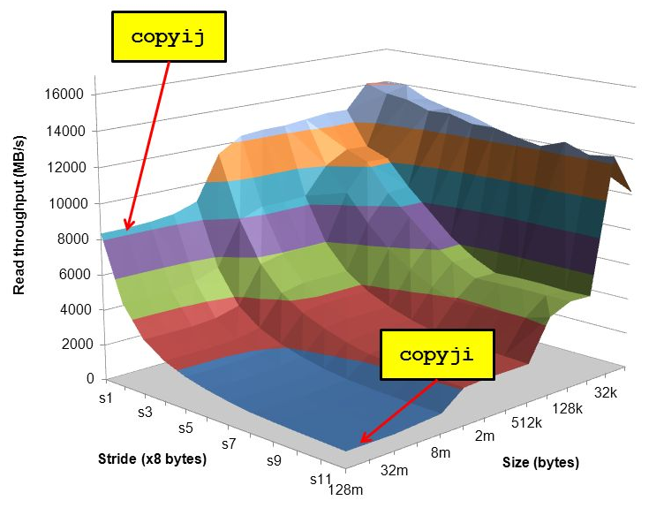
Cache Lab Overview
Programs exhibiting locality run a lot faster!
Temporal Locality – same item referenced again
Spatial Locality – nearby items referenced again
Cache Lab’s Goal:
Understand how L1, L2, … etc. caches work
Optimize memory dependent code to minimize cache misses and evictions
Noticeable increase in speed

Slide 26
If you get stuck…
Reread the writeup
Look at CS:APP Chapter 6
Review lecture notes (http://cs.cmu.edu/~213)
Come to Office Hours (Sunday to Thursday, 5-9pm WH-5207)
Post private question on Piazza
man malloc, man valgrind, man gdb

Slide 27
Cache Lab Tips!
Review cache and memory lectures
Ask if you don’t understand something
Start early, this can be a challenging lab!
Don’t get discouraged!
If you try something that doesn't work, take a well deserved break, and then try again
Finally, Good luck on Cache Lab!

Slide 28
Appendix
Valgrind
Clang / LLVM
Cache Structure

Slide 29
Appendix: Valgrind
Tool used for debugging memory use
Finds many potential memory leaks and double frees
Shows heap usage over time
Detects invalid memory reads and writes
To learn more… man valgrind
Finding memory leaks
$ valgrind –leak-resolution=high –leak-check=full –show-reachable=yes –track-fds=yes ./myProgram arg1 arg2

Slide 30
Appendix: Clang / LLVM
Clang is a (gcc equivalent) C compiler
Support for code analyses and transformation
Compiler will check you variable usage and declarations
Compiler will create code recording all memory accesses to a file
Useful for Cache Lab Part B (Matrix Transpose)

Slide 31
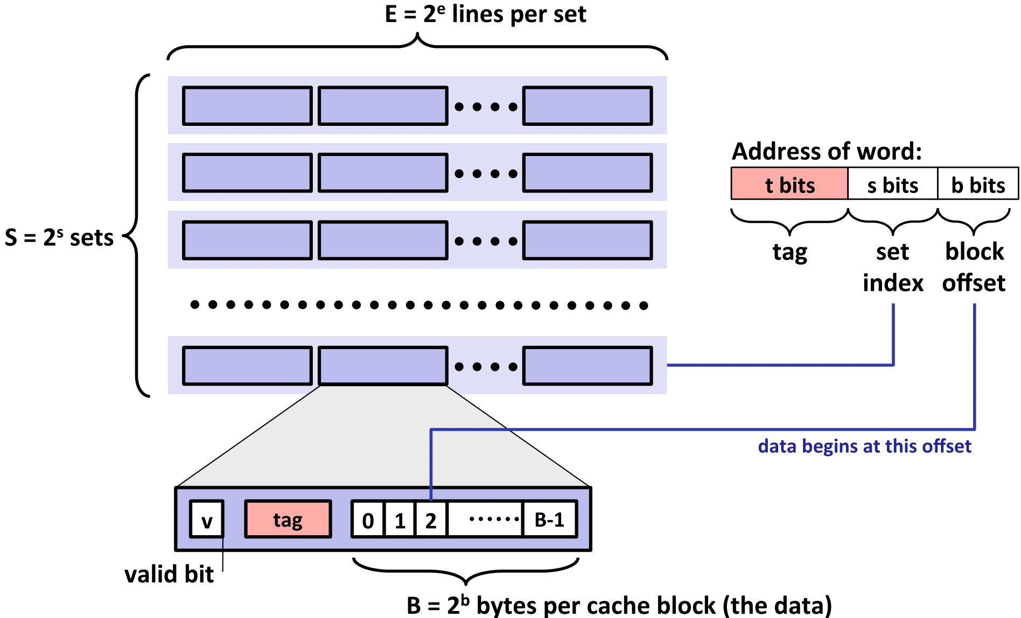
Appendix: Cache Structure

