Slide 1
GDB的常见指令介绍
黄郭斌制作

Slide 2
Contents
Compiling to use a debugger
More Information
License
Starting gdb and getting to main()
Breakpoints
Stepping Around
Examining Variables
Display Registers and Assembly

Slide 3
Compiling
You have to tell your compiler to compile your code with symbolic debugging information included. Here's how to do it with gcc, with the -g switch:
$ gcc -g hello.c -o hello
$ g++ -g hello.cpp -o hello
Once you've done that, you should be able to view program listings in the debugger.

Slide 4
Starting The Debugger
you can enter help at any gdb prompt and get more information. Also, you can enter quit to quit the debugger. Finally, just hitting RETURN will repeat the last command entered.
To start in neato and highly-recommended GUI mode, start the debugger with gdb -tui. (For many of the examples, below, I show the output of gdb's dumb terminal mode, but in real life I use TUI mode exclusively.)

Slide 5
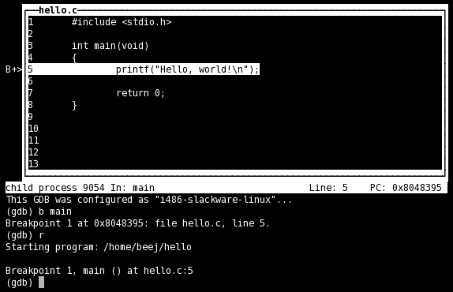
Starting The Debugger..
And here is a screenshot of what you'll see, approximately:

Slide 6
Breakpoints
First, before you issue the run command, you need to set a breakpoint someplace you'd like to stop. You use the break or b command, and specify a location, which can be a function name, a line number, or a source file and line number. These are examples of locations, which are used by various other commands as well as break:
break main Break at the beginning of the main() function
break 5 Break at line 5 of the current file
break hello.c:5 Break at line 5 of hello.c

Slide 7
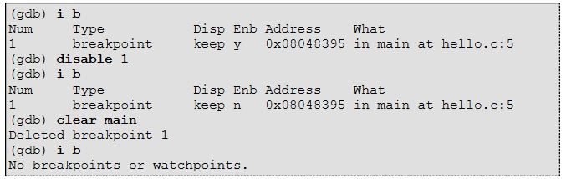
Breakpoints..
To list the current breakpoints, use the info command, like so: "info breakpoints" (or the shorter "i b"):

Slide 8
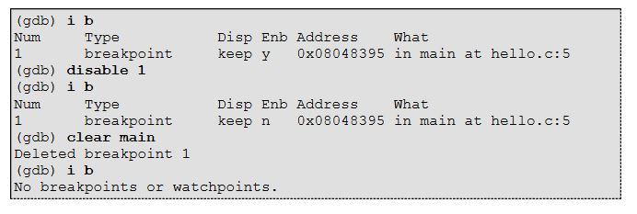
Breakpoints..
To clear a breakpoint, use the clear command with the breakpoint location. You can also clear a breakpoint by number with the delete command.
Additionally, you can enable or disable breakpoints, though these two commands take a breakpoint number as an argument, not a location! The enabled/disabled status of a breakpoint is visible under the "Enb" column in the breakpoint listing.

Slide 9
Stepping Around
Once execution stops at a breakpoint, you can tell the debugger to do a few things. Let's start with the next command (or n). This command moves you to the next statement in the current function (or returns to the function's caller if you've stepped off the end of the function.) Here's a sample run; remember that gdb is printing the line it will execute next just before the "(gdb)" prompt. Also notice that when we run next on the printf() line, we see the output appear.

Slide 10
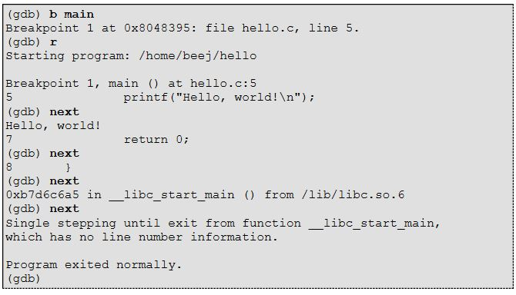
Stepping Around..
(That weird stuff at the end about __libc_start_main() shows you that there was another function that called your main() function! It wasn't compiled with debugging information so we can't see the source, but we can still step through it—which we do—and the program exits normally.)

Slide 11
Stepping Around..
Now, notice that next steps over function calls. This doesn't mean that function doesn't get called; it means that next will execute the function until it's done, and then return you to the next line in your current function.
What if you have a function you want to step into from your current function, and trace through that function line-by-line? Use the step (or s) command to do this. It works just like next, except it steps into functions.
Let's say you're tired of single stepping, and just want the program to run again. Use the continue (or c) command to continue execution.
What if the program is running but you forgot to set breakpoints? You can hit CTRL-C and that'll stop the program wherever it happens to be and return you to a "(gdb)" prompt. At that point, you could set up a proper breakpoint somewhere and continue to that breakpoint.
One final shortcut is that just hitting RETURN will repeat the last command entered; this will save you typing next over and over again.

Slide 12
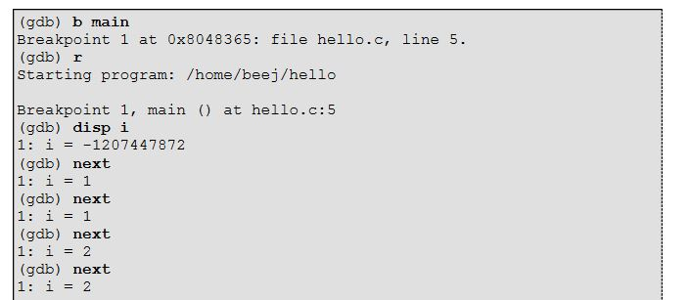
Examining Variables
If you have some variables you wish to inspect over the course of the run, you can display them, but only if the variable is currently in scope. Each time you step the code, the value of the variable will be displayed (if it's in scope).
(The following output is missing source code output between lines for clarity—it's what you'd see in GUI mode. Imagine you're seeing the highlight bar bouncing around the source code while you're running this:)

Slide 13
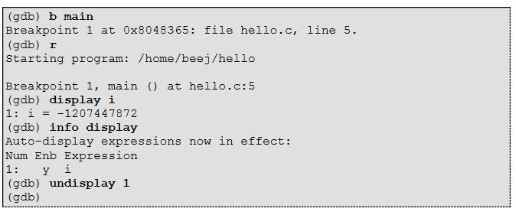
Examining Variables..
The number to the left of "i", above, is the display number of the variable. Use this number to undisplay the variable. If you forget the display numbers, you can type info display to get them:

Slide 14

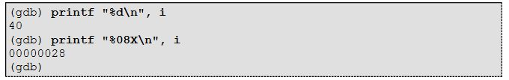
Examining Variables..
If you just want to one-off know the value of a variable, you can print it. Here we see the value of "i" is 40:
(The "$" with the number after it means something, but it's not important for beginners.)
There's also a handy printf command that you can use to better format your output if you want to:

Slide 15
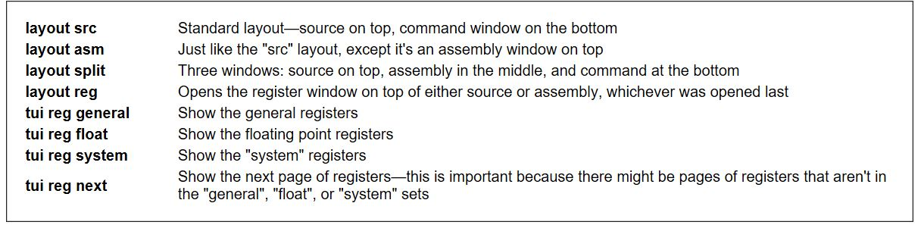
Display Registers and Assembly
In TUI mode, the layout command controls which windows you see. Additionally, the tui reg allows control of the register window, and will open it if it's not already open.
The commands are:

Slide 16
Reference
以上是我根据CS:APP的官方网站提供的推荐文档Beej‘s Quick Guide to GDB中节选出一些常用指令制作而成，具有一定的权威性，如需进一步更系统的阅读，请见：
http://beej.us/guide/bggdb

