Slide 1
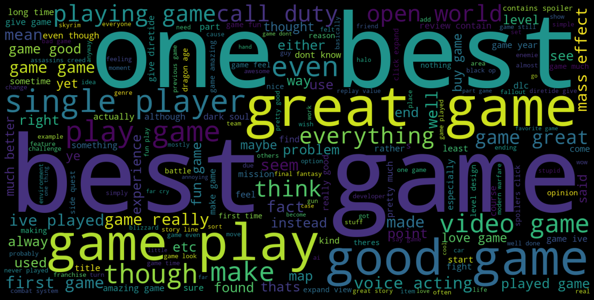
Video Game Sentiment Analysis

Slide 2
Intro
Sentiment analysis can play a huge part in connecting a company to their audience
By extracting sentiment from sources such as texts, posts, comments, etc huge amounts of valuable feedback can be attained without relying traditional numerically scored reviews

Slide 3
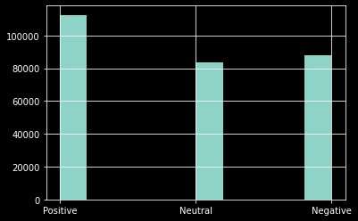
The Dataset
The data set was a (283983, 6) data set taken from Kaggle and the columns of interest were:
  ‘Userscore’ which contains numeric review scores
  ‘Comment’ which contains the text for each review
The response variable, ‘Userscore’, was converted to the classes [‘Negative’, ‘Neutral’, ‘Positive’]

Slide 4
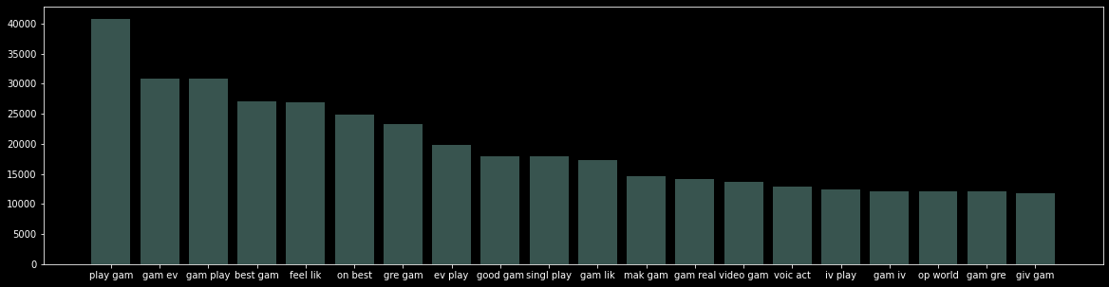
The Dataset
Exploring the frequency of the top 20 bigrams suggest that the topic of these comments commonly involve:
  Single player and open world game types
  Gameplay and voice acting in games

Slide 5
Data Cleaning
The text was processed by:
  removing punctuation and stopwords
  stemming words to their root words
  vectorizing each word into frequency columns
The resulting dataframe contained 400000+ columns

Slide 6
Data Cleaning
There were 3 methods used for dimension reduction:
  Filtering the columns by frequency: results in a dataframe with 283983 rows and 1460 columns
  Singular value decomposition: results in a dataframe with 283983 rows and 6 columns
  Clustering: results in a dataframe with 283983 rows and 42 columns

Slide 7
Models Applied
4 types of predictive models were tested:
  KNN Classification
  Gaussian Naive Bayes’
  Support Vector Classification
  Neural Network
Each model was run with up to 3 dataframes; one for each dimension reduction method
All models were tested with a 80/20 test-train split

Slide 8
KNN Classifier Metrics
KNN with Frequency Filtered Dataframe
 | precision | recall | f1-score | support
Negative | 0.614665 | 0.022265 | 0.042973 | 17696
Neutral | 0.441989 | 0.019141 | 0.036693 | 16718
Positive | 0.397803 | 0.985298 | 0.566776 | 22378
accuracy | 0.400813 | 0.400813 | 0.400813 | 0.400813
macro_avg | 0.484819 | 0.342235 | 0.215481 | 56792
weighted_avg | 0.478383 | 0.400813 | 0.247521 | 56792
KNN with SVD Dataframe
 | precision | recall | f1-score | support
Negative | 0.604553 | 0.681284 | 0.640629 | 17696
Neutral | 0.468793 | 0.329764 | 0.387176 | 16718
Positive | 0.616142 | 0.690812 | 0.651344 | 22378
accuracy | 0.581561 | 0.581561 | 0.581561 | 0.581561
macro_avg | 0.563163 | 0.567287 | 0.559716 | 56792
weighted_avg | 0.569155 | 0.581561 | 0.570242 | 56792
KNN with Clustered Dataframe
 | precision | recall | f1-score | support
Negative | 0.498493 | 0.738189 | 0.595112 | 17696
Neutral | 0.445102 | 0.197871 | 0.273954 | 16718
Positive | 0.593392 | 0.613996 | 0.603518 | 22378
accuracy | 0.530198 | 0.530198 | 0.530198 | 0.530198
macro_avg | 0.512329 | 0.516685 | 0.490862 | 56792
weighted_avg | 0.52017 | 0.530198 | 0.503884 | 56792

Slide 9
Gaussian Naive Bayes’ Metrics
GNB with SVD Dataframe
 | precision | recall | f1-score | support
Negative | 0.462539 | 0.862059 | 0.602048 | 17696
Neutral | 0.418567 | 0.247039 | 0.310702 | 16718
Positive | 0.698795 | 0.435428 | 0.536534 | 22378
accuracy | 0.512907 | 0.512907 | 0.512907 | 0.512907
macro_avg | 0.526634 | 0.514842 | 0.483095 | 56792
weighted_avg | 0.542688 | 0.512907 | 0.490469 | 56792
GNB with Clustered Dataframe
 | precision | recall | f1-score | support
Negative | 0.444407 | 0.82691 | 0.578117 | 17696
Neutral | 0.387075 | 0.243989 | 0.29931 | 16718
Positive | 0.667817 | 0.397712 | 0.49853 | 22378
accuracy | 0.486195 | 0.486195 | 0.486195 | 0.486195
macro_avg | 0.499767 | 0.489537 | 0.458652 | 56792
weighted_avg | 0.515562 | 0.486195 | 0.464684 | 56792

Slide 10
Support Vector Classifier Metrics
SVC with SVD Dataframe
 | precision | recall | f1-score | support
Negative | 0.562066 | 0.731295 | 0.635609 | 17696
Neutral | 0.483527 | 0.186984 | 0.26968 | 16718
Positive | 0.594074 | 0.724819 | 0.652966 | 22378
accuracy | 0.568513 | 0.568513 | 0.568513 | 0.568513
macro_avg | 0.546555 | 0.547699 | 0.519418 | 56792
weighted_avg | 0.551558 | 0.568513 | 0.534729 | 56792
SVC with Clustered Dataframe
 | precision | recall | f1-score | support
Negative | 0.519477 | 0.746044 | 0.61248 | 17696
Neutral | 0.479084 | 0.180165 | 0.261856 | 16718
Positive | 0.60165 | 0.674591 | 0.636036 | 22378
accuracy | 0.55131 | 0.55131 | 0.55131 | 0.55131
macro_avg | 0.533404 | 0.5336 | 0.503457 | 56792
weighted_avg | 0.539965 | 0.55131 | 0.518548 | 56792

Slide 11
Neural Network Metrics
NN with Filtered Frequency DF
 | Loss | Accuracy
Epoch 1 | 0.8 | 0.64
Epoch 2 | 0.68 | 0.7
Epoch 3 | 0.6 | 0.74
Epoch 4 | 0.52 | 0.78
Validation | 0.74 | 0.68
NN with SVD DF
 | Loss | Accuracy
Epoch 1 | 1.04 | 0.48
Epoch 2 | 0.91 | 0.56
Epoch 3 | 0.91 | 0.57
Epoch 4 | 0.91 | 0.57
Validation | 0.9 | 0.58
NN with Clustered DF
 | Loss | Accuracy
Epoch 1 | 0.99 | 0.52
Epoch 2 | 0.93 | 0.55
Epoch 3 | 0.56 | 0.56
Epoch 4 | 0.92 | 0.56
Validation | 0.92 | 0.56

Slide 12
Conclusion
The accuracy of most of the models tested seemed relatively similar ranging from around .48 to .57
The best model was a neural network trained on a frequency filtered DF scoring an accuracy of .68
Overall, the best model tested during this project performs significantly better than randomly guessing but is still far from reliable

