Slide 1
Big Mountain

Slide 2
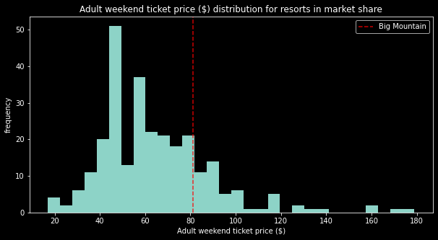
Current Market Strategy
Currently Big Mountain bases its prices off of the average of other resorts, but can we find a better way?
Also, what should we do to justify increasing ticket prices to increase revenue? And where can we cut costs without cutting prices?

Slide 3
Yes! We Can Do Better!
We found that Big Mountain has bigger, better facilities than its competitors and is justified in increasing its ticket prices
Based on the data, resorts with more runs and fast quads, higher vertical drops, and greater area of snow making have higher prices, and Big Mountain excels in all of those facilities!
Big Mountain currently charges $81/ticket but our models show that we could justifiably charge around $94/ticket!

Slide 4
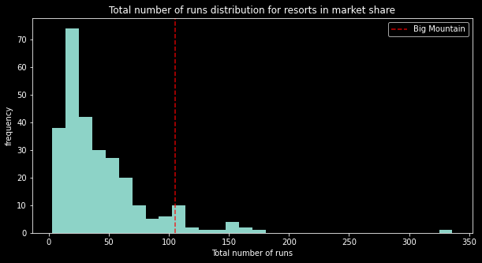
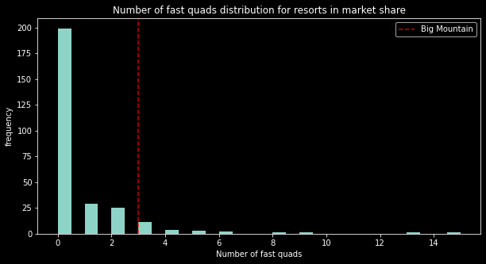
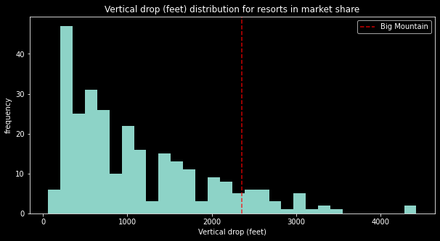
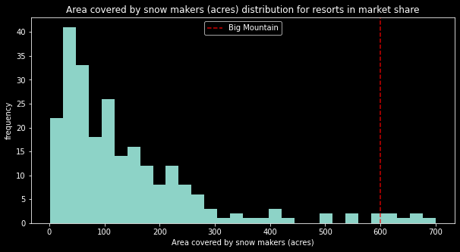
How Big Mountain Stacks Up

Slide 5
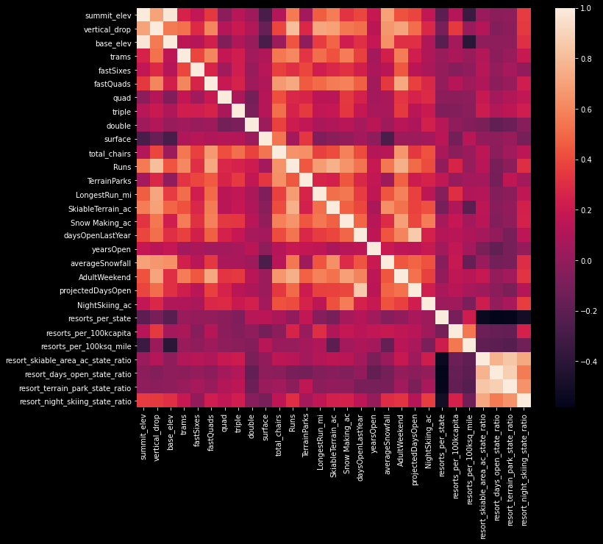
How Did We Find This?
After removing and correcting missing and erroneous values in a dataset containing the sum entirety of ski resorts in the US, we performed an analysis using the ticket prices of each resort as the variable of interest.
In the initial analysis a feature heatmap showed some potential variables of interest (runs, fast quads, and snow making) due to their high degree of correlation with ticket prices.

Slide 6
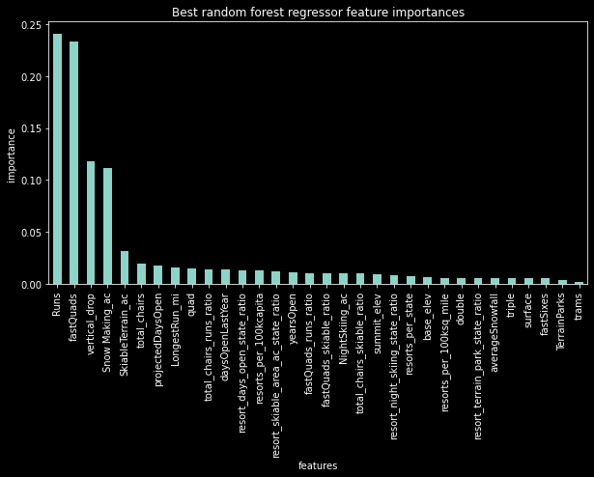
How Did We Find This?
Following the exploratory data analysis a linear regression model as well as a random forest model (both excluding Big Mountain) were trained.
8-fold cross validation yielded a mean accuracy of .633 and StD of .095 for the linear regression model and a mean accuracy of .698 and StD of .071 for the random forest model.
Thusly the random forest model was used to calculate Big Mountain’s predicted price of $94 (StD $10) as well as create a plot (shown on the right) showing variable of interest to consider for further investigation

Slide 7
Conclusion
In conclusion, based on a random forest model trained on a dataset including the features and prices of resort across the US, Big Mountain should consider increasing its prices knowing that it offers relatively high-end facilities compared to its competitors.
Additionally, based on the variable importance plot extracted from the aforementioned random forest model, the resort features to consider for further investigation are its number of runs and fast quads, the height of its vertical drop, and it area of snow making.

