Slide 1

Capstone 2: UFC Fight Analysis

Slide 2
What does it take to win a fight?
To find out, we will analyze data collected on these factors:
  Physical traits (e.g. age, height, and weight)
  Behaviors (e.g. take downs, submissions, footwork, clinches, and strikes)

Slide 3
Dataset Description
The data set has 5144 rows/151 columns with data on each fighter in a ‘red vs blue’ format
Each row describes a record of a fight in the UFC
Each column describes variables including:
  Physical traits of each fighter
  Behaviors of fighters in the fight
  The outcome of the fight (red win/blue win/draw)

Slide 4
Data Cleaning
To prepare the data for analysis, the following steps were taken:
  Fights with missing data and draws as outcomes were removed reducing the number of rows to 3648
  Differences between the quantified behavior of each fighter were taken to be used for analysis
  The outcome of the fight was one-hot-encoded to describe whether the red fighter wins or loses
  Applied SMOTE to balance data so red wins equal red losses

Slide 5
The Resulting Dataframe
The resulting dataframe contains the following variables:
diff_age: the difference in age between the 2 fighters
diff_height: the difference in height between the 2 fighters
diff_reach: the difference in reach between the 2 fighters
diff_avg_body_att: the difference in the average number of body strikes attempted per round between the 2 fighters
diff_avg_body_landed: the difference in the average number of body strikes landed per round between the 2 fighters

Slide 6
The Resulting Dataframe
diff_avg_clinch_att: the difference in the average number of clinches attempted per round between the 2 fighters
diff_avg_clinch_landed: the difference in the average number of clinches landed per round between the 2 fighters
diff_avg_distance_att: the difference in the average number of attempts to close distance per round between the 2 fighters
diff_avg_distance_att: the difference in the average number of successful attempts to close distance per round between the 2 fighters
diff_avg_ground_att: the difference in the average number of ground strikes attempted per round between the 2 fighters

Slide 7
The Resulting Dataframe
diff_avg_ground_landed: the difference in the average number of ground strikes landed per round between the 2 fighters
diff_avg_head_att: the difference in the average number of head strikes attempted per round between the 2 fighters
diff_avg_head_landed: the difference in the average number of head strikes landed per round between the 2 fighters
diff_avg_kd: the difference in the average number of knockdowns per round between the 2 fighters
diff_avg_leg_att: the difference in the average number of leg strikes attempted per round between the 2 fighters

Slide 8
The Resulting Dataframe
diff_avg_leg_landed: the difference in the average number of leg strikes landed per round between the 2 fighters
diff_avg_pass: the difference in the average number of guard passes per round between the 2 fighters
diff_avg_rev: the difference in the average number of reversals per round between the 2 fighters
diff_avg_sig_str_att: the difference in the average number of significant strikes attempted per round between the 2 fighters
diff_avg_sig_str_landed: the difference in the average number of significant strikes landed per round between the 2 fighters

Slide 9
The Resulting Dataframe
diff_avg_sig_str_pct: the difference in the average number of significant strikes protected against per round between the 2 fighters
diff_avg_sub_att: the difference in the average number of submissions attempted per round between the 2 fighters
diff_avg_td_att: the difference in the average number of takedowns attempted per round between the 2 fighters
diff_avg_td_landed: the difference in the average number of takedowns landed per round between the 2 fighters
diff_avg_td_pct: the difference in the average number of takedowns protected against per round between the 2 fighters

Slide 10
The Resulting Dataframe
diff_avg_total_str_att: the difference in the average number of total strikes attempted per round between the 2 fighters
diff_avg_total_str_landed: the difference in the average number of total strikes landed per round between the 2 fighters

Slide 11
Exploring the Data
Four models were tested during exploration, all of which were tuned with grid search:
KNN
Logistic Regression
Decision Tree
Random Forest

Slide 12
Exploring the Data
KNN Results
Best Score: 0.7039
 | Precision | Recall | F1-Score | Support
Red Wins | 1.0 | 1.0 | 1.0 | 415
Red Loss | 1.0 | 1.0 | 1.0 | 395
KNN Cf Matrix | Predicted Red Win | Predicted Red Loss
Actual Red Win | 415 | 0
Actual Red Loss | 0 | 395

Slide 13
Exploring the Data
Logistic Regression Results
Best Score: 0.5991
 | Precision | Recall | F1-Score | Support
Red Wins | .63 | .64 | .63 | 415
Red Loss | .62 | .61 | .61 | 395
KNN Cf Matrix | Predicted Red Win | Predicted Red Loss
Actual Red Win | 265 | 150
Actual Red Loss | 155 | 240

Slide 14
Exploring the Data
Decision Tree Results
Best Score: 0.6130
 | Precision | Recall | F1-Score | Support
Red Wins | .75 | .76 | .76 | 415
Red Loss | .74 | .74 | .74 | 395
KNN Cf Matrix | Predicted Red Win | Predicted Red Loss
Actual Red Win | 315 | 100
Actual Red Loss | 104 | 291

Slide 15
Exploring the Data
Random Forest Results
Best Score: 0.6698
 | Precision | Recall | F1-Score | Support
Red Wins | .95 | 1.0 | .98 | 415
Red Loss | 1.0 | .95 | .97 | 395
KNN Cf Matrix | Predicted Red Win | Predicted Red Loss
Actual Red Win | 415 | 0
Actual Red Loss | 21 | 374

Slide 16
Which models should we look at?
The Bad
  KNN: performed the best, but the validity of the results might be affected by the SMOTE technique used to balance the data, so kNN won’t be analyzed further
  Logistic regression: performed bad and won’t be analyzed further

Slide 17
Which models should we look at?
The Good
  Decision tree: performed decently and will be analyzed further
    gridsearch tuning suggested an entropy based decision tree with a max depth of 6 and a minimum leaf size of 17
  Random forest: had the best performance and will be analyzed further
    gridsearch tuning suggested a random forest with 100 non-bootstrapped sampled entropy based trees of max depth 6, minimum leaf size of 3, and splits with minimum samples of 3

Slide 18
Model Selection
How reliable is a Decision Tree model?
  When the model predicts red wins, it’s right 75% of the time
  When the model predicts red loses, it’s right 74% of the time
  When red actually wins, the model is right 76% of the time
  When red actually loses, the model is right 74% of the time
  Overall, the model is right 75% of the time

Slide 19
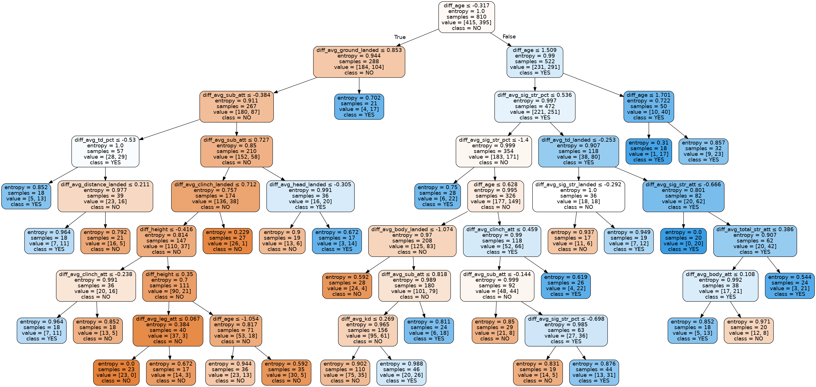
Model Selection
Decision tree plot

Slide 20
Model Selection
Decision tree notable outcomes
There seem to be few pathways that lead to relatively low entropy indicating situations where the model is accurate including examples such as:
  Red fighter is younger → has not too many more ground strikes landed → has less submissions attempted →has not many less clinches landed → is shorter → red loses
  Red is the same age as blue → has protected against less significant strikes →has attempted more takedowns → has attempted more significant strikes → red wins

Slide 21
Model Selection
How reliable is a Random Forest model?
  When the model predicts red wins, it’s right 95% of the time
  When the model predicts red loses, it’s right 100% of the time
  When red actually wins, the model is right 100% of the time
  When red actually loses, the model is right 95% of the time
  Overall, the model is right 97% of the time

Slide 22
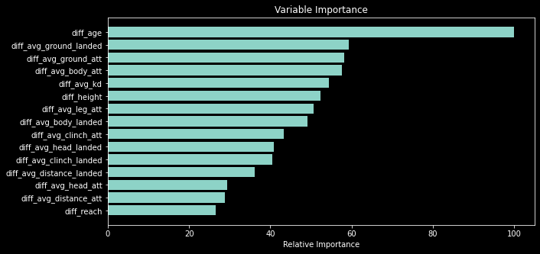
Model Selection
Variable importance plot

Slide 23
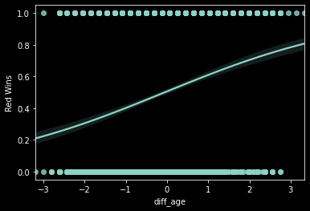
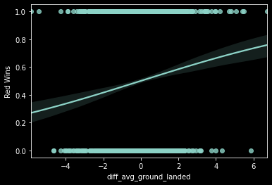
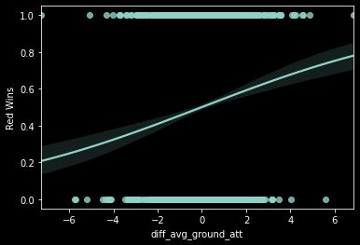
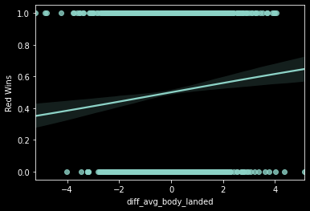
Model Selection
Log regression plots of top 4 important variables

Slide 24
What have we learned?
The results of our analyses show that:
  Fighters that are older than their opponents tend to be more likely to win suggesting that experience tends to triumph over youth
  Many fights are won on the ground as fighters who strike grounded opponents more often tend to have a greater chance of winning

Slide 25
What can we do better?
For future research we can try:
  Different techniques for balancing the data
  Feature selection algorithms for dimension reduction
  More classification models such as boosting, naive Bayes’, SVM, ect.

Slide 26

Remember to train hard and never stop testing yourselves!
Thanks for attending!

