Slide 1
Software Deployment in the Field
Technical Debt and Data-Ops
SEA Software Engineering Conference
April 14, 2015
Gary Granger
Earth Observing Laboratory
NCAR

Slide 2
Shipping first time code is like going into debt. A little debt speeds development so long as it is paid back promptly with a rewrite. ... The danger occurs when the debt is not repaid.
- Ward Cunningham

Slide 3
Every minute spent on not-quite-right code counts as interest on that debt. Entire engineering organizations can be brought to a stand-still under the debt load of an unconsolidated implementation, object- oriented or otherwise.
- Ward Cunningham

Slide 4
Integrated Sounding System
The ISS is a platform for hosting a collection of boundary-layer instruments which can be configured for each field project site while sharing a common deployment and data management infrastructure, comprised of networking, computer systems, and software.
Instruments, Network, Systems, Software, Data

Slide 5
Integrated Sounding System:
Instruments

Slide 6
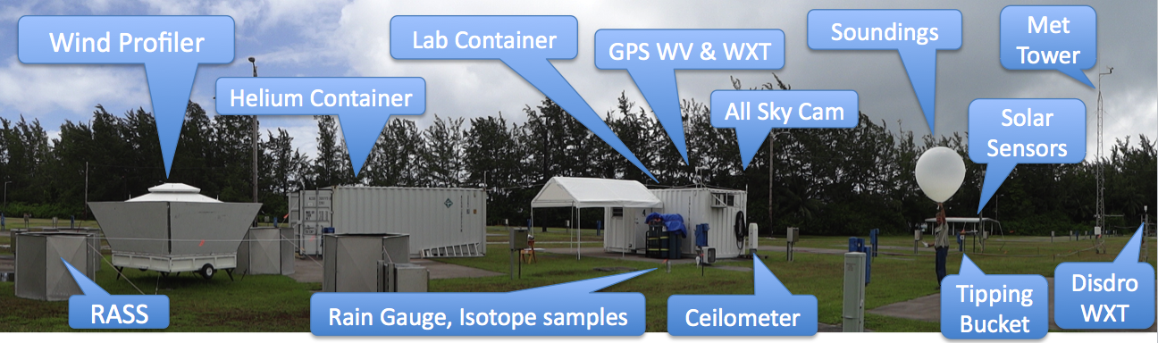
ISS at DYNAMO, Diego Garcia

Slide 7
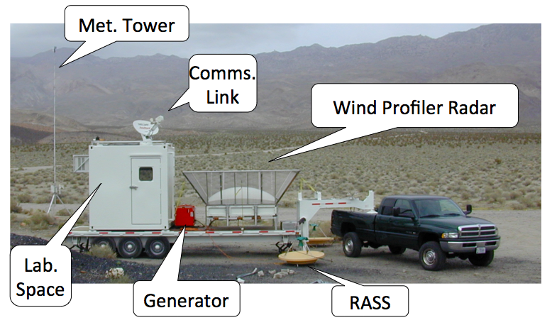
Mobile ISS at T-REX

Slide 8
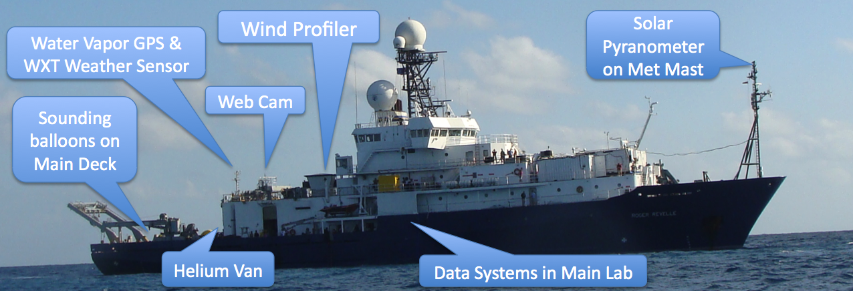
ISS at DYNAMO, R/V Revelle

Slide 9
Integrated Sounding System:
Network

Slide 10


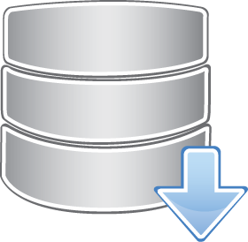
ISS Field Network
EOL
Profiler
RSYNC
GAUS
Laptop
Data
Manager
RSYNC
LIDAR PC
USB/DVD
Archives
DSM
Ceilometer PC
Web Cam
SODAR PC
GPS WV
Disdrometer

Slide 11
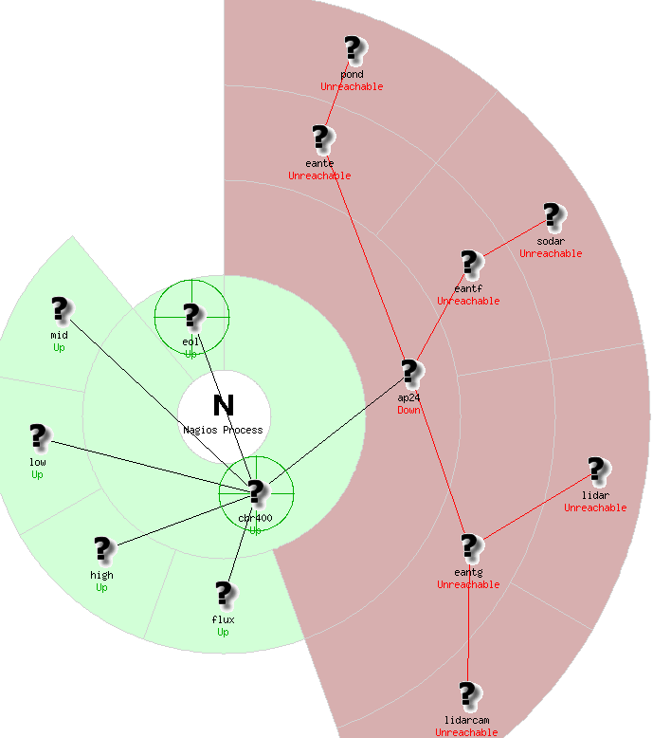
NAGIOS Monitoring for Network, Hosts, and Data
Nagios status map during SOAS wifi outage

Slide 12
Integrated Sounding System:
Systems

Slide 13
System Configuration
Bare metal installs and restores with kickstart files and bash scripts
Modular bash scripts for interactively configuring every instrument, scheduling their own “callbacks” with cron
JSON configuration database for each site kept in revision control
Scripts can be re-run at any time to update the system as the configuration changes

Slide 14
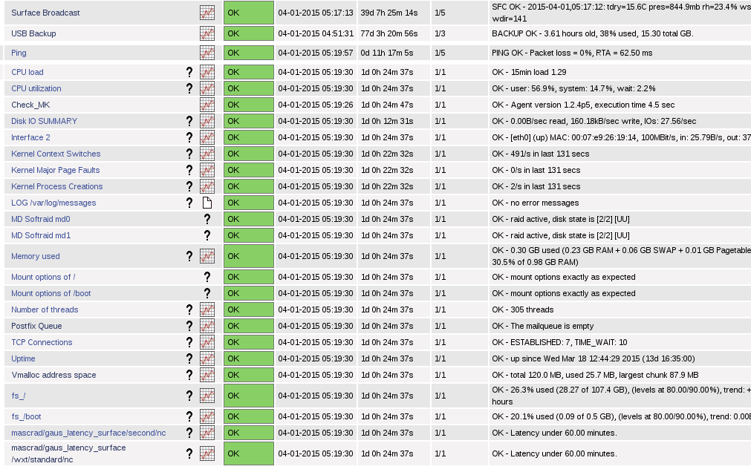
Data Manager Status at MASCRAD

Slide 15
Integrated Sounding System:
Software

Slide 16
ISS Python Catalog
Scan: filename patterns, simple format parsing including netcdf and SPC, read data samples
Catalog: query by name, time, category, size, checksums, and more complicated
Check: gaps, latency, sample density, custom, nagios reports, email alerts
Archive: ISO image with metadata from catalog query, integrity checks
Derive: Run processing when inputs have changed

Slide 17
Integrated Sounding System:
Data

Slide 18
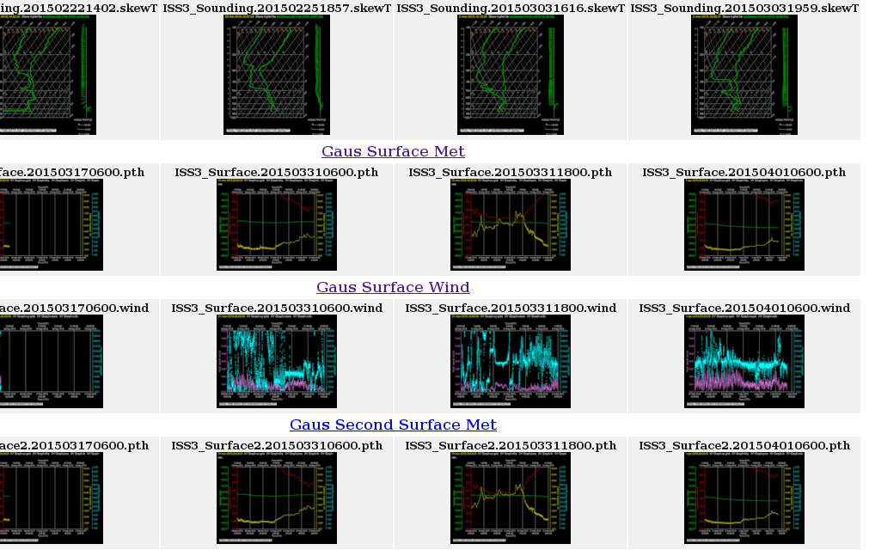
Web Plots for MASCRAD

Slide 19
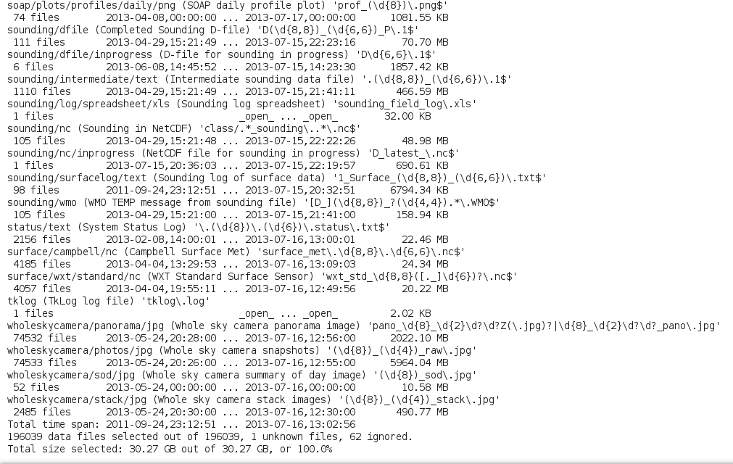
ISS
Python
Catalog,
ISS-3 SOAS inventory summary

Slide 20
Dev and Data Ops
Goals:
Configure an entire project deployment, all of its sites, instruments, data streams, derivations, and monitoring, with just the JSON parameter database and a python customization script.
Implement the real-time and post-project data processing like a continuously running build process, where all derived data products are regenerated and updated as the raw data files are filled in or as project parameters change.

