Slide 1
Cooperative Effects in the Optical Response of A Dense Gas
Ph.D. Dissertation Defense by
Yi Li
Major Advisor: Juha Javanainen
Mar 23, 2016

Slide 2
Overview
This dissertation

Slide 3
Outline
Introduction: light scattering and cooperative effects
Interaction between two-level atom and classical light
Cooperativity in a strongly interacting dipolar system
Optical response of gases of stationary atoms
Optical response of gases of moving atoms
Conclusion remarks

Slide 4




Classical models of light scattering
Rayleigh scattering
Mie scattering
Beer-Lambert law

Slide 5
Light scattering in quantum optics
Verify the existence of Bose-Einstein condensate;
Probe quantum statistics of atoms in an optical lattice;
Determine the relative phase of two Bose-Einstein condensates;
Monitor number of atoms in a BEC as they oscillate between two sides of a double-well trap.

Slide 6
Light-matter interaction in a broader context
Cavity QED:
Weak coupling: atomic state modified
Strong coupling: atoms and photons entangled
Interface between light and atomic ensembles
Cooperative effects involved !

Slide 7

Cooperative effects in the optical response of a dense gas
Challenge from the dipolar field:

Slide 8
Approach in this dissertation:
Photon recoil and saturation of the atoms may be neglected.

Slide 9
Semi-classical Theory of Interaction between Two-level Atom and Classical Light

Slide 10

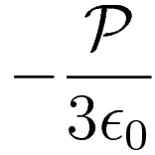

Local-field correction in a polarizable medium
=
+

Slide 11
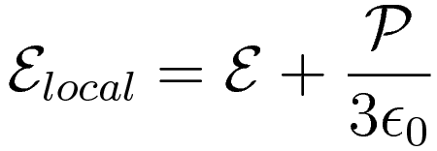

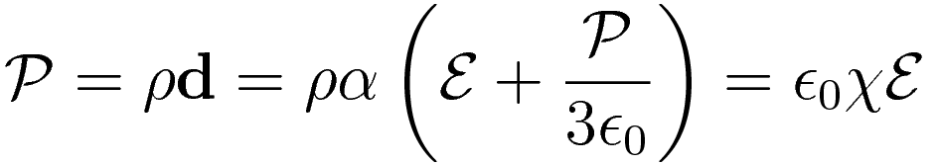
Local-field correction in a polarizable medium

Slide 12
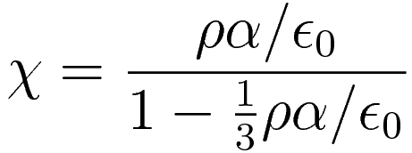
Local-field correction in a polarizable medium
Clausius-Mossotti relation
Lorentz-Lorenz formula

Slide 13
Interaction of a Two-level Atom with a Classical Field
Einstein A and B coefficients
Damped Two-level System
Polarizability of a Two-level Atom
Absorption of Two-level Medium and Lorentz-Lorenz shift

Slide 14







Einstein A and B coefficients
Spontaneous
Emission
Stimulated
Emission
Absorption

Slide 15
Einstein A and B coefficients
Spontaneous
Emission
Stimulated
Emission
Absorption
Detailed balance

Slide 16

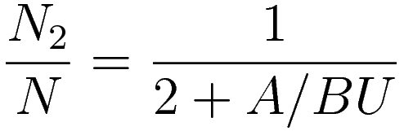
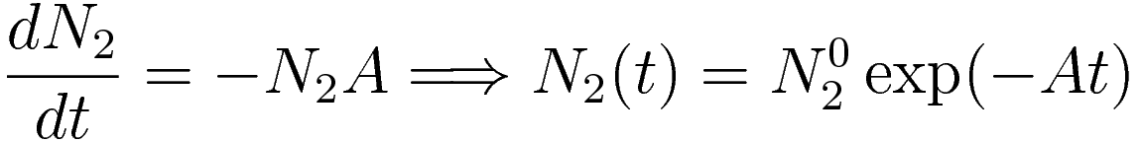
Einstein A and B coefficients

Slide 17


Einstein A and B coefficients
If the external field :
Spontaneous emission

Slide 18


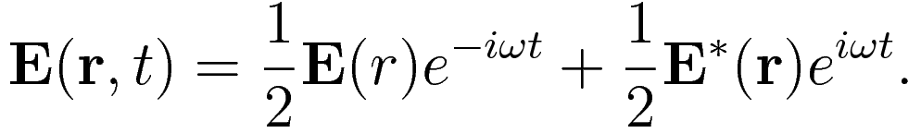
Damped Two-level System

Slide 19

Damped Two-level System
Hamiltonian in the dipole approximation:
Atomic Hamiltonian
Dipole-field interaction where

Slide 20

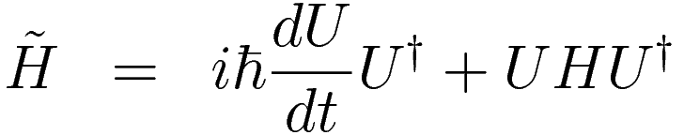
Damped Two-level System
Unitary transformation to a rotating frame by
so that:

Slide 21


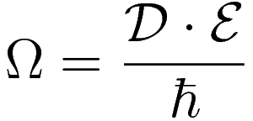
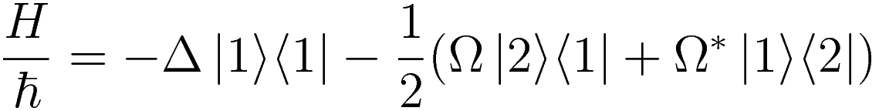
Damped Two-level System
Rotating-wave approximation (RWA):
drop the terms that contain
Detuning
Rabi frequency .
Transformed Hamiltonian:

Slide 22
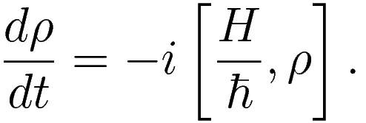
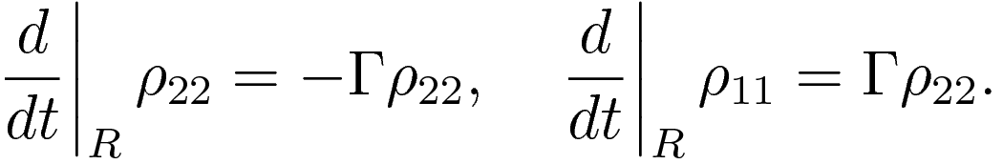
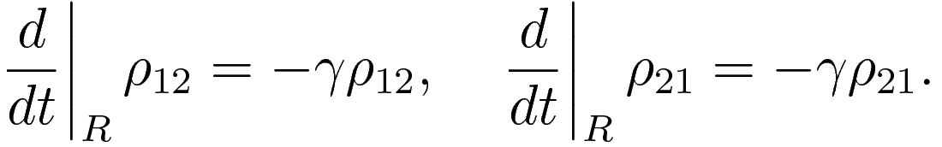
Damped Two-level System
Liouville-von Neumann equation:
Spontaneous emission:
Relaxation terms;

Slide 23
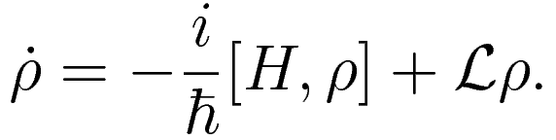
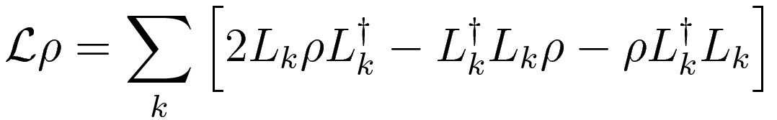
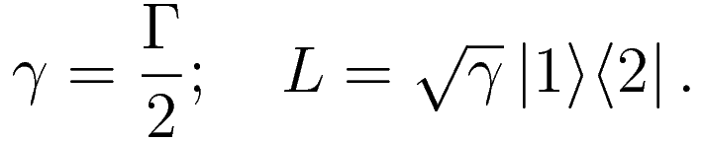
Damped Two-level System
Mater equation of a legitimate density operator:
Lindblad form:
Here:

Slide 24
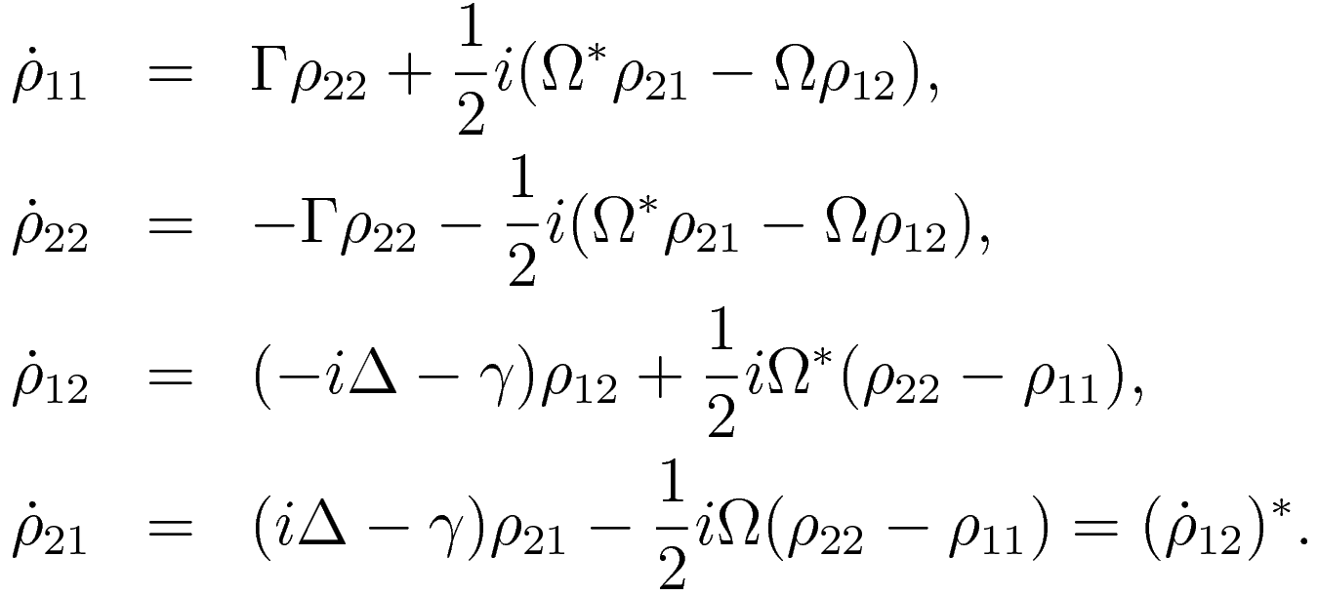
Damped Two-level System
Equations of the elements of the density operator:

Slide 25
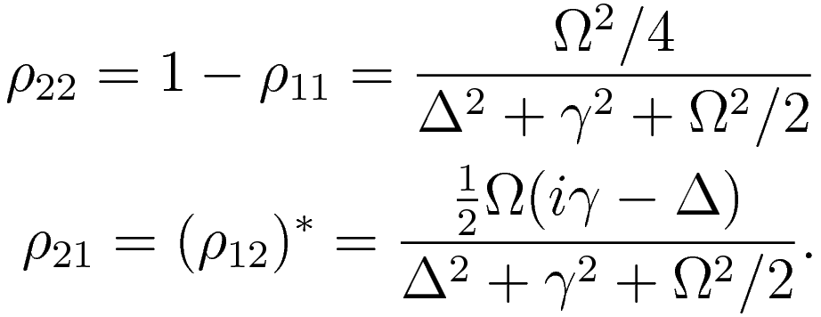
Damped Two-level System
Steady-state solution:

Slide 26
Damped Two-level System
Steady-state solution:

Slide 27
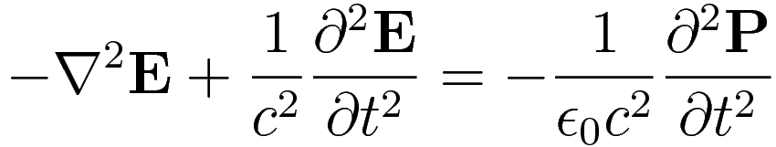
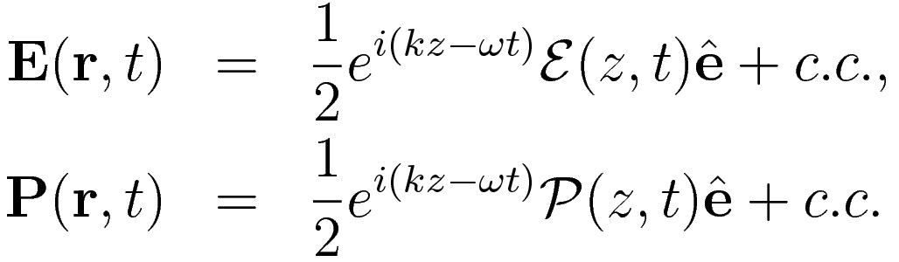
Polarizability of a Two-level Atom
Maxwell’s equation
Plane waves propagating in the +z direction:

Slide 28
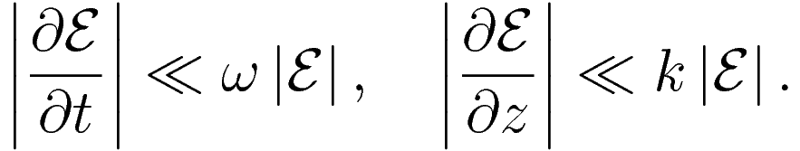
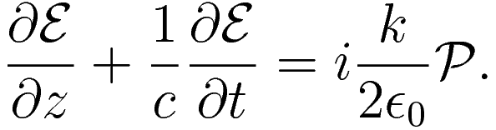
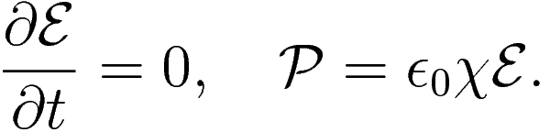
Polarizability of a Two-level Atom
Slowly-varying envelope approximation (SVEA):
Neglecting all but the lowest-order derivatives:
Stationary field amplitude and linear medium:

Slide 29

Polarizability of a Two-level Atom
Beer-Lambert law

Slide 30

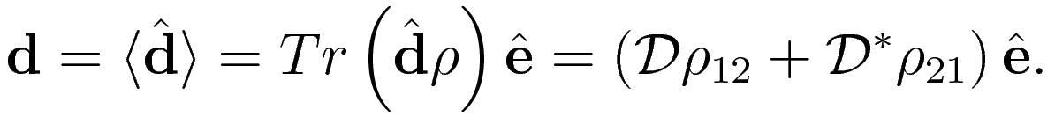
Polarizability of a Two-level Atom
Assume
On the other hand:

Slide 31

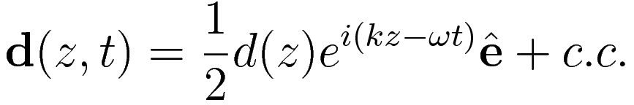
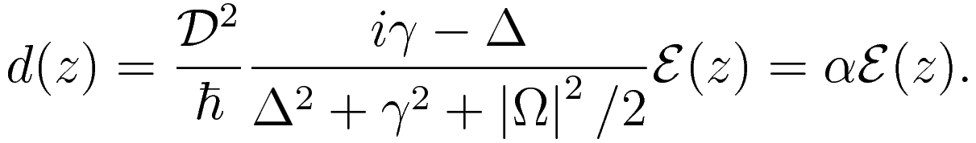
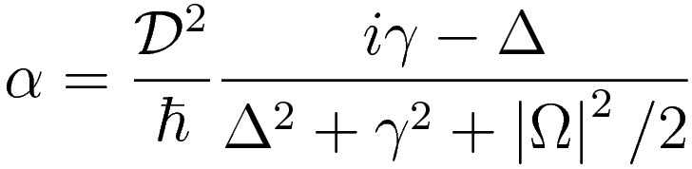
Polarizability of a Two-level Atom
Take the steady-state solution and restore the oscillations at the frequency :
with
Here
Polarizability of the two-level atom

Slide 32

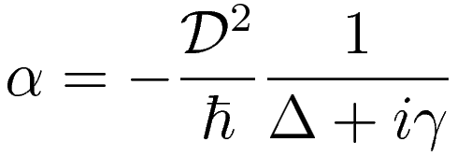
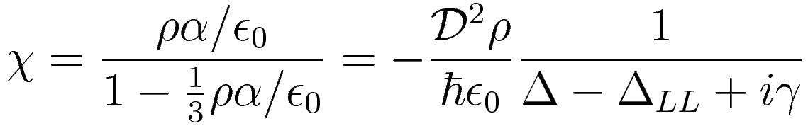
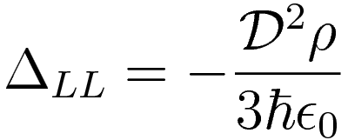
Absorption and Lorentz-Lorenz shift
In the weak-field approximation, :
Recall the Clausius-Mossotti equation:
where
Lorentz-Lorenz (LL) shift

Slide 33
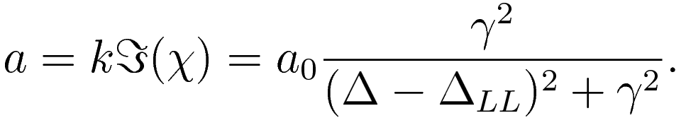
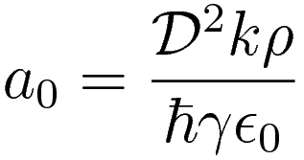
Absorption and Lorentz-Lorenz shift
The absorption coefficient of the medium is:
Here
is the resonance absorption coefficient.

Slide 34
Cooperativity in a Strongly Interaction Dipolar System

Slide 35
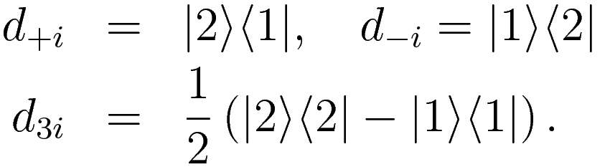

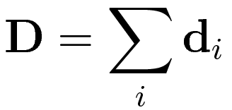
The Dicke model of superradiance
N two-level atoms
Define:
Atoms couple to the light in the same manner

Slide 36

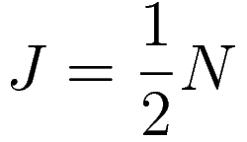




The Dicke model of superradiance
Assume that at t = 0, N atoms are all in the upper state:
Isomorphic with a spin-1/2 system:
and are analogous to Pauli spin matrices.
Dipole operator:

Slide 37
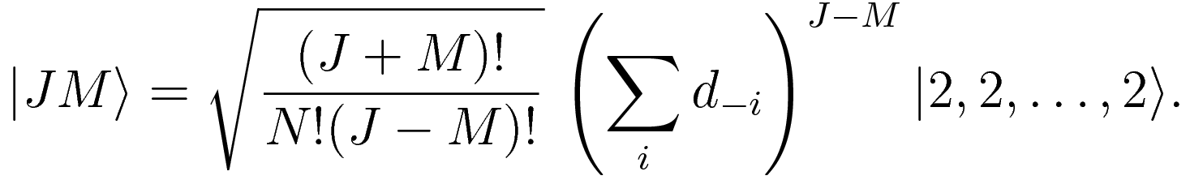



The Dicke model of superradiance
states are eigenstates of the collective operators:
Cooperative spontaneous emission rate:

Slide 38
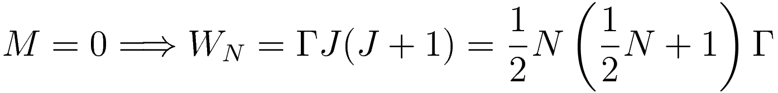

The Dicke model of superradiance
The maximum rate of spontaneous emission is proportional to .

Slide 39
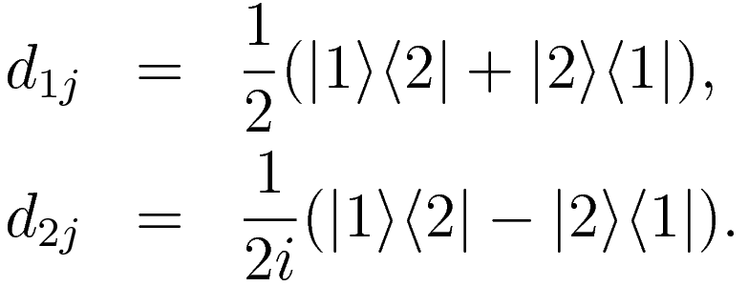
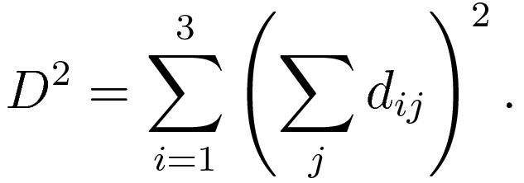
Collective Lamb shift
So far, nothing is different from the Dicke model.

Slide 40
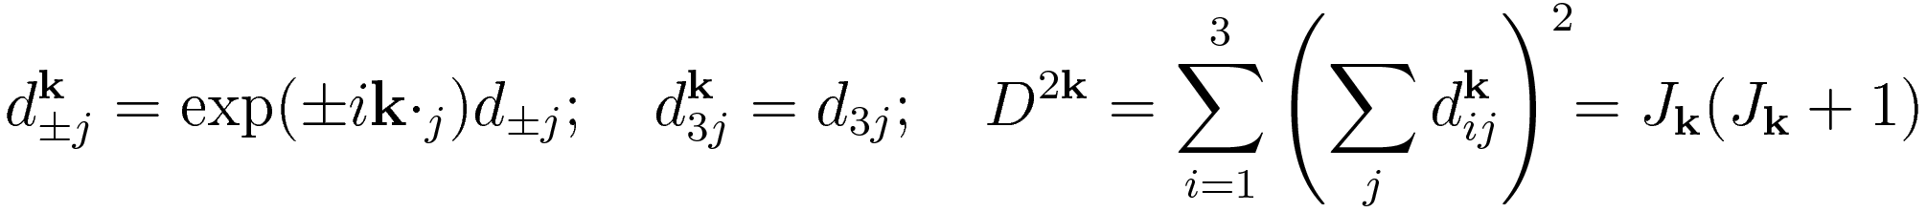
Collective Lamb shift
For a non-point-like geometry, position-dependent phase of light should be considered. Define:

Slide 41


Collective Lamb shift
The dipole moment of the j th atom:
To completely specify a state, we introduce a third quantum number
Dicke state provide a basis to calculate the frequency shift using the first-order perturbation.
Interaction Hamiltonian:

Slide 42


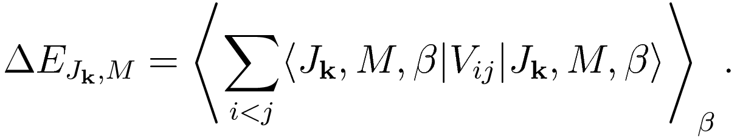
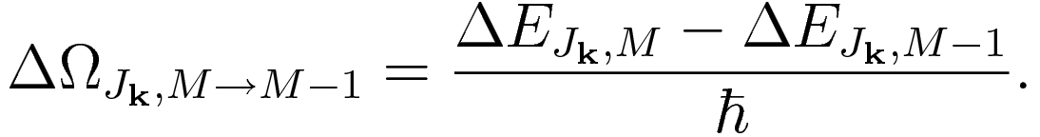
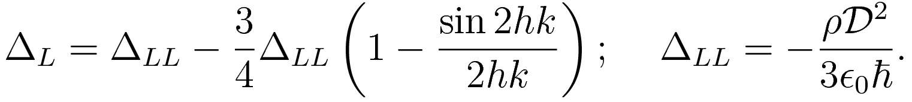
Collective Lamb shift
The energy shift for all states of and is:
The shift of a transition is:
In specific, for a slab geometry with thickness h:

Slide 43
Optical Response of Gases of Stationary Atoms

Slide 44

From Quantum Field Theory to Classical Simulations
QFT under the Markov and Born approximation
Ignore the motion of atoms, including photon recoil
Classical light of low intensity (coherent state)
atomic transition

Slide 45
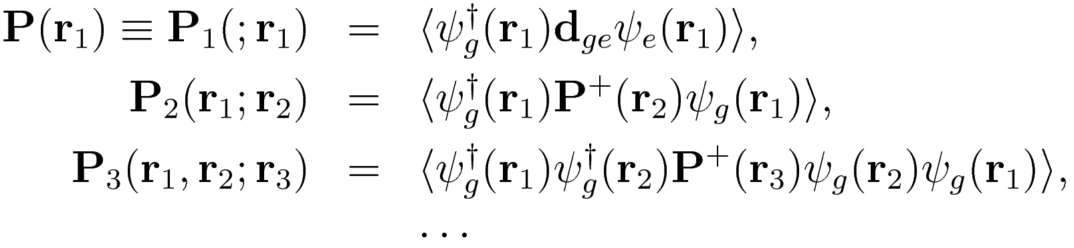
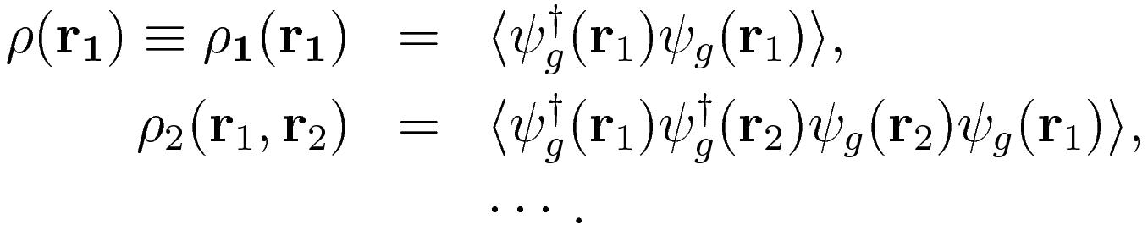
From Quantum Field Theory to Classical Simulations
Atomic correlation functions are defined as:
and also

Slide 46
From Quantum Field Theory to Classical Simulations
In classical physics, the correlation between atoms are induced by scattered light.
The lowest approximation is essentially dipole radiation due to atomic polarization.
The response of the medium is linear and isotropic.
The equation of motion for the polarization:

Slide 47
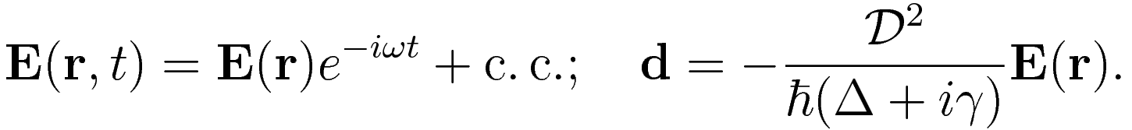
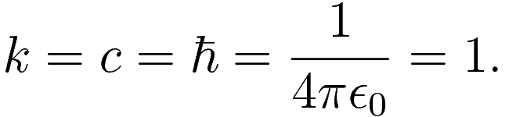
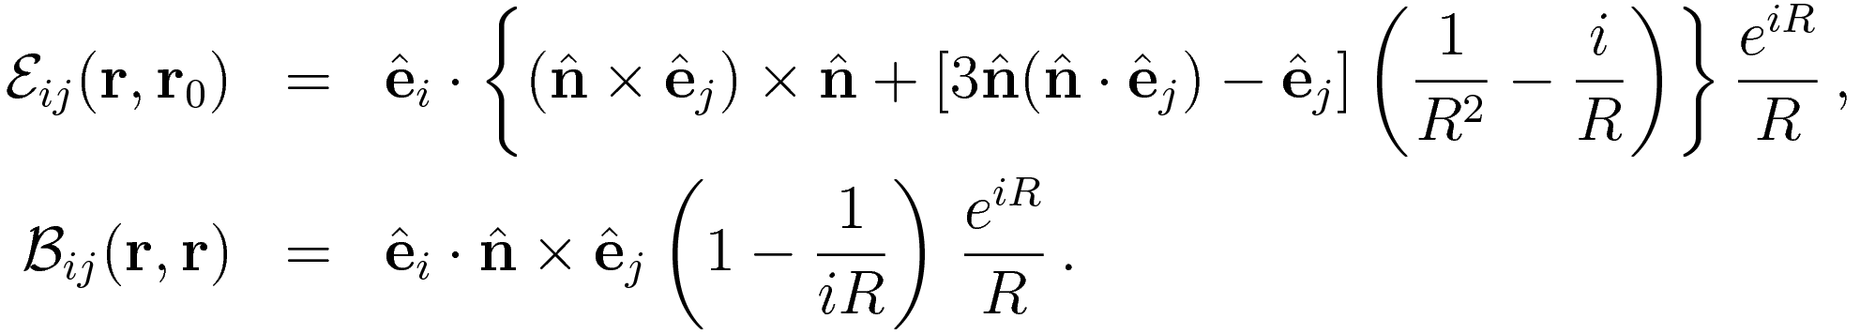
Preparation for Classical Simulations
Units convention:

Slide 48
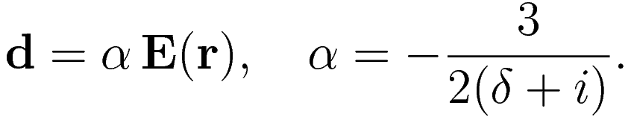

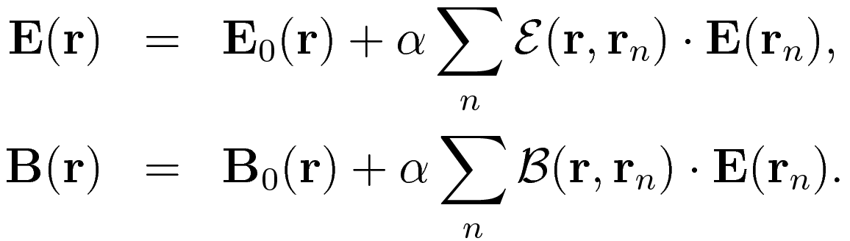
Preparation for Classical Simulations

Slide 49
Preparation for Classical Simulations
Factorization of the correlation functions:
We take the atoms in a gas to be distributed randomly and independently of one another in a volume defined by the geometry of the sample
Excellent approximation for scattering length and thermal de Broglie wavelength are ordinarily much smaller than the inter-atomic spacings.

Slide 50



Example: Radiation from a single atom
z
x
incoming
dipolar
interference

Slide 51











Example: Radiation from two atoms
z
Angular distribution of the radiation:
z

Slide 52




Radiation power from Gaussian clouds of atoms
Continuous medium
Example:

Slide 53


Radiation power from Gaussian clouds of atoms
The magnitude of the Poynting vector:
Superradiance?

Slide 54



Radiation power from Gaussian clouds of atoms
Discrete N atoms
Assume that each dipole radiates a field independently:
The average outward energy flux is given by:

Slide 55




Radiation power from Gaussian clouds of atoms
Discrete N atoms
The total radiated power:
In the limit , . However, not cooperative at all!

Slide 56


Radiation power from Gaussian clouds of atoms
Discrete N atoms
Normalized radiation patterns for two Gaussian samples with in (a) and in (b). For both cases, the number of atoms
and the detuning is

Slide 57


Radiation power from Gaussian clouds of atoms
Discrete N atoms
When the dipolar fields from all the other atoms are taken into account:
Negative detuning
Positive detuning
for different number of atoms, where

Slide 58

Shift of resonance line in a circular disk
z
h

Slide 59

Shift of resonance line in a circular disk
The absence of LL shift and CLS:

Slide 60



Shift of resonance line in a circular disk
We assume the resonance frequency of each atom is shifted by a Gaussian random with zero mean and rms

Slide 61
Gases of Moving Atoms

Slide 62



Analysis of a one-atom gas
R
v
-v
z
h

