Slide 1
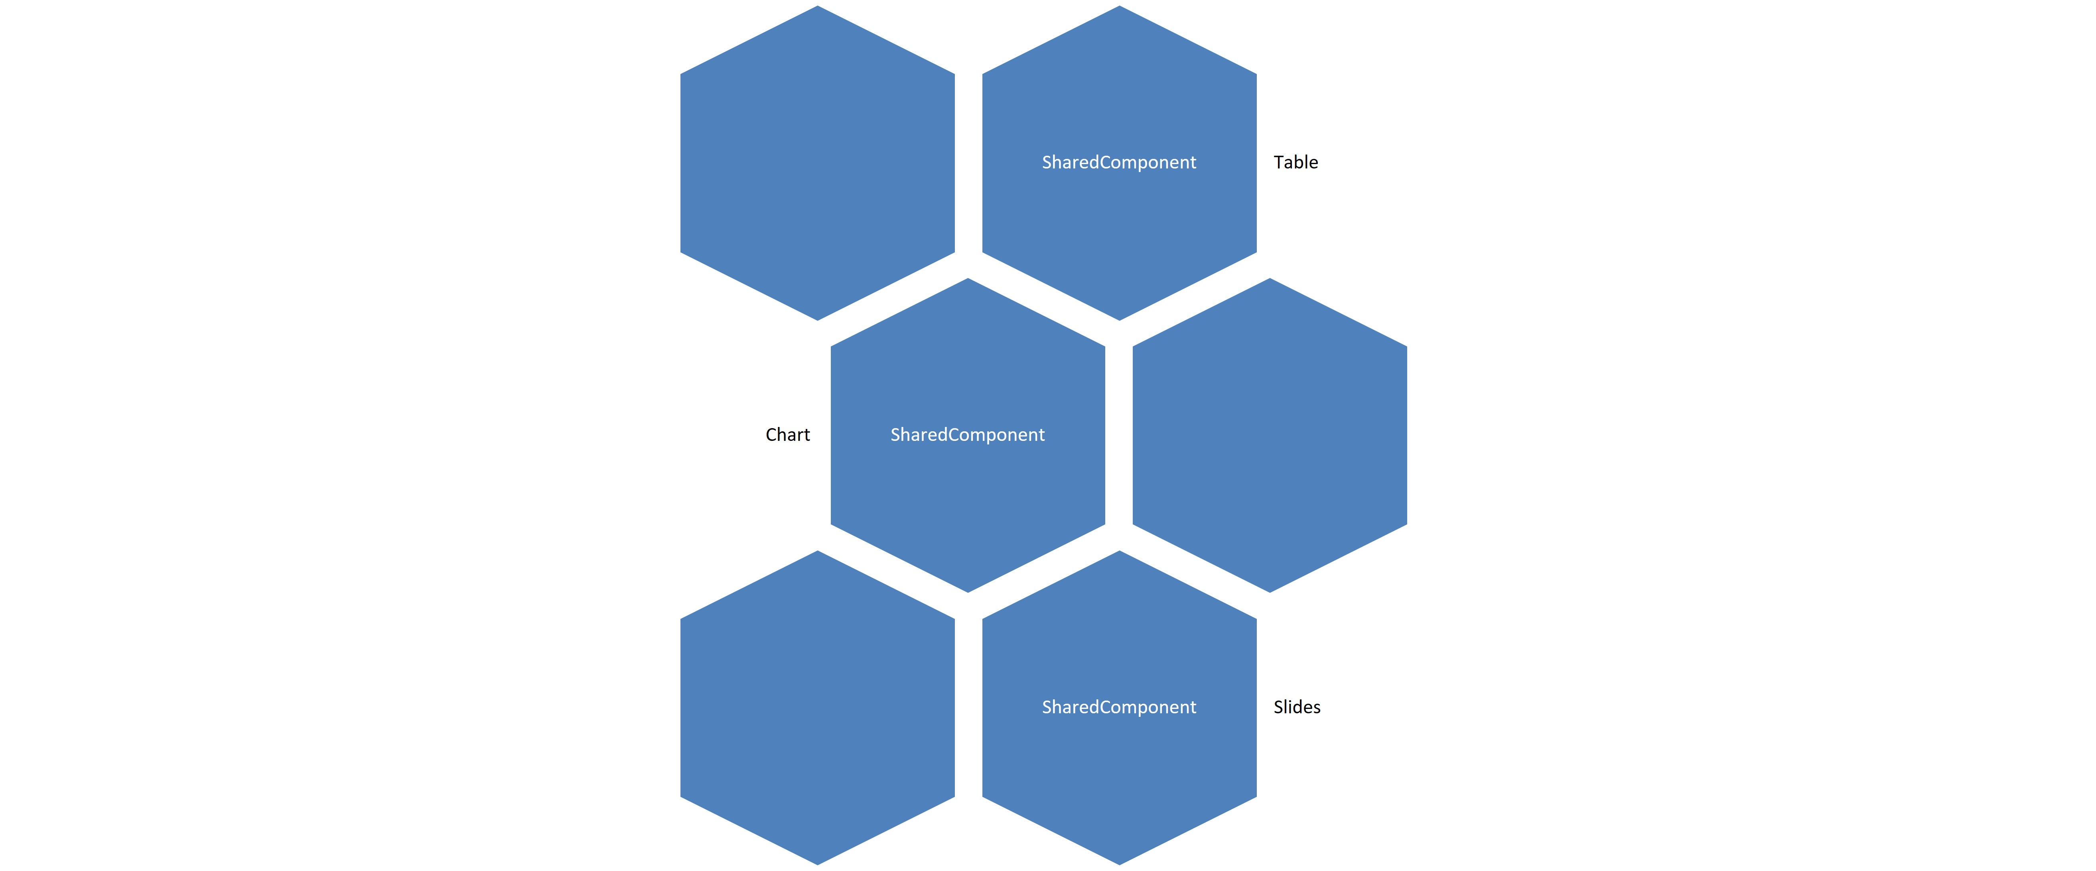
SmartArt
Table
SharedComponent
Chart
SharedComponent
Slides

