Slide 1

Check for updates

Slide 2
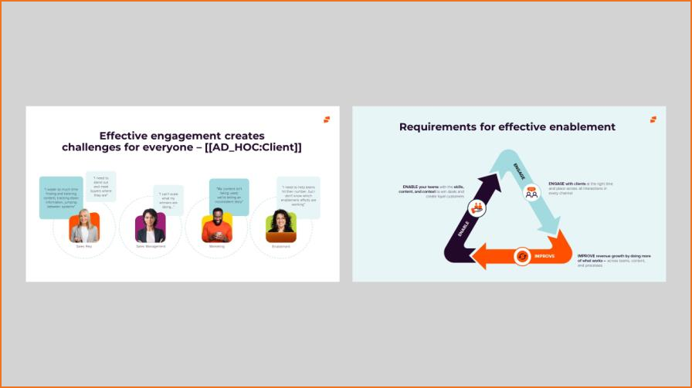

Slide 3


Slide 4


