Slide 1
Simulation of Mammalian Sperm in Viscous Media
Sunil Klein
Yuan-Hung Lo

Slide 2
Why Sperm?
279B – E. coli use in study of molecular biology
Interested in the difference in structure and function of Prokaryotic and Eukaryotic cells
Sperm cell is a widely-known and well-studied Eukaryote
Unique in its method propulsion:
Single flagellum that moves laterally in whip-like motion
Potential for this motion to be implemented in soft robots

Slide 3
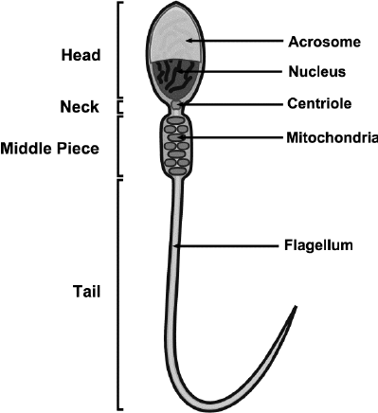
Structure
Highly evolved for efficient fertilization and movement through viscous fluid
Head
Nucleus – houses DNA
Acrosome – cap-like structure that contains enzymes which help sperm penetrate protective layers of egg
Centriole – flexible; facilitates sperm motility
Midpiece – houses mitochondria, which provide energy needed for sperm movement
Flagellum – whip-like tail; propulsion mechanism for sperm
Structure of a mammalian sperm
Notes:
Explain the basic structure of a mammalian sperm cell, highlighting key components like the head, midpiece, and tail.
Mention the importance of understanding sperm structure for simulations.

Slide 4
Dynamics
Move flagellum in a whip-like lateral motion to swim in viscous fluid
Propel toward an egg through coordinated beating of the flagellum
Progressive Motility vs Non-Progressive Motility
Calcium induced circular and hyperactive swimming
Low motility and uncoordinated movement can prohibit sperm’s ability to reach an egg and lead to infertility
Movement of E. coli
Movement of Sperm
Notes:
Discuss the movement and propulsion mechanisms of a sperm cell.
Explain how sperm cells use flagellar motion to swim through a fluid medium.
Mention that these dynamics are crucial for fertility and reproduction.

Slide 5
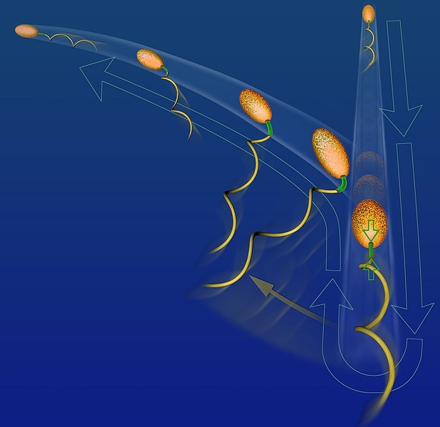
Nonlinearity and Buckling
Utilizing nonlinear motion and buckling of flagellum to drastically change swimming pace and trajectory
Varying flagellar patterns enable adaptive movement
Different head shape and size can also affect sperm motion
Buckling induced direction change
Notes:
Introduce the concept of nonlinearity in sperm motion and how it affects their behavior.
Explain what buckling is in the context of sperm movement.
Describe the challenges and complexities in modeling nonlinear sperm dynamics, emphasizing the need for advanced simulations.

Slide 6
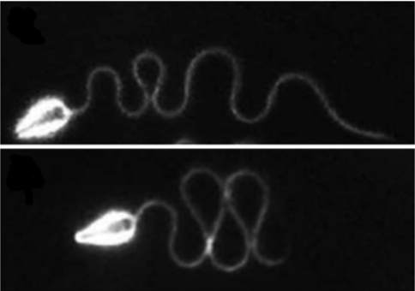
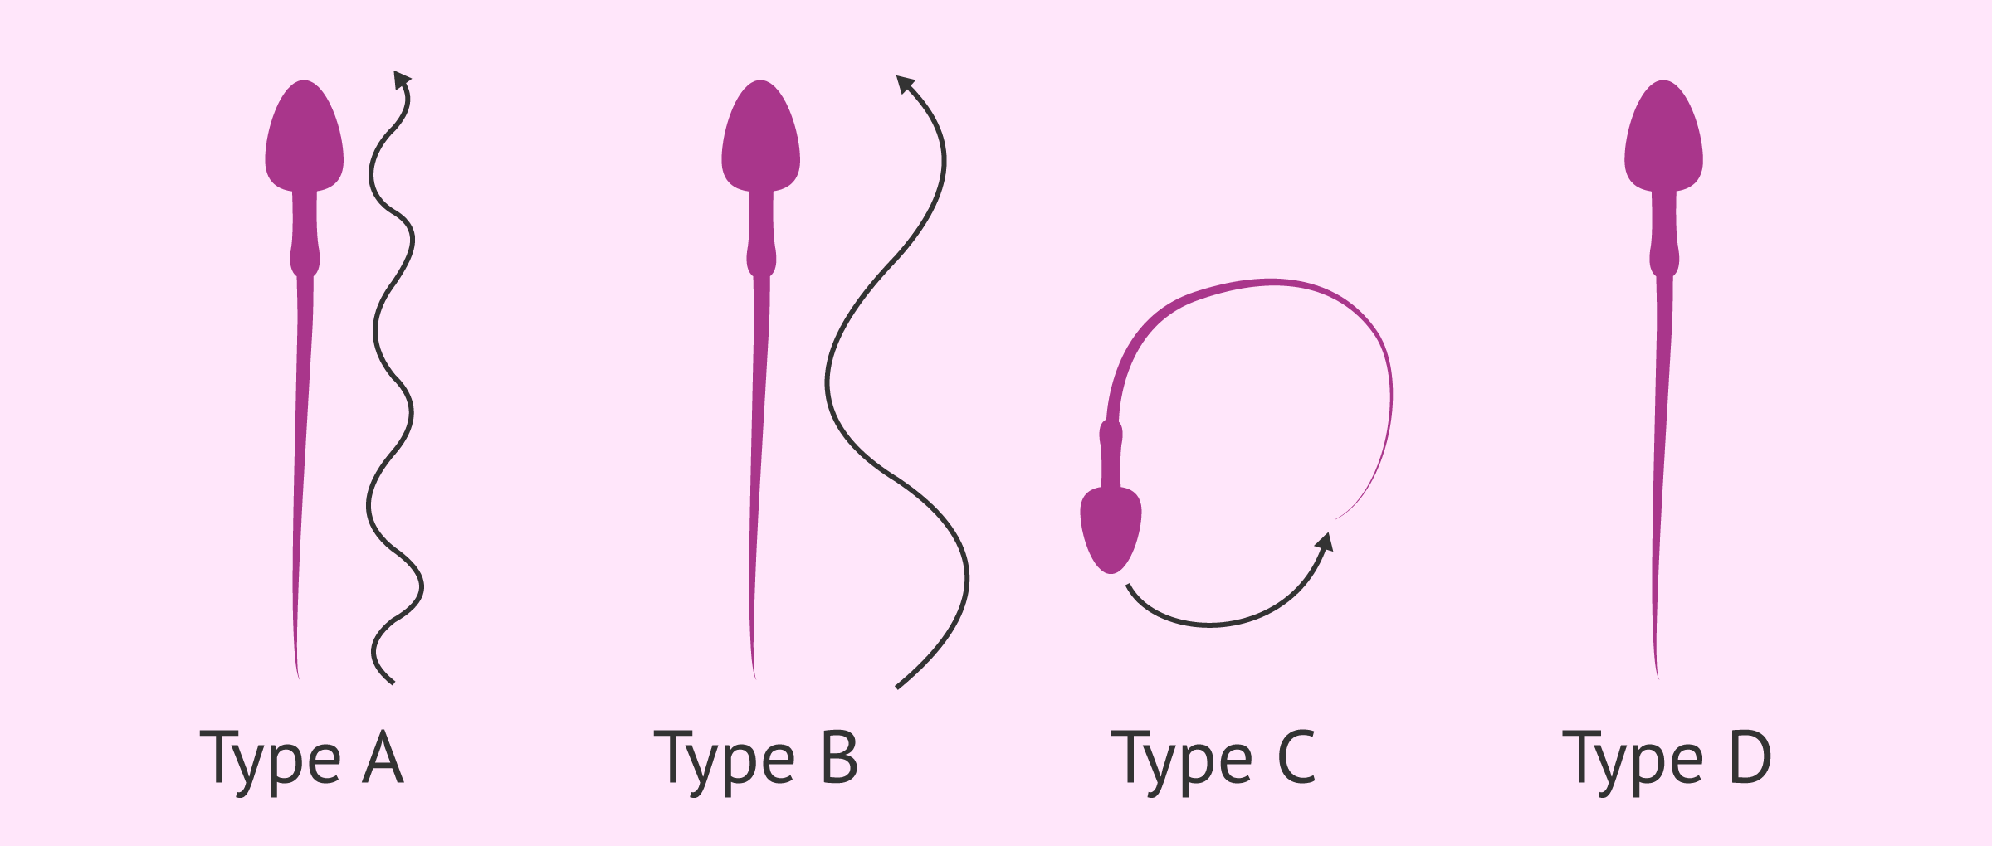
Modulation of Fluid Viscosity
Modeling sperm’s flagellar propulsion through physiological fluids
Often high viscosity and non-Newtonian fluid
As a sperm’s tail beats (oscillates), viscosity affects 3 flagellar parameters:
Frequency
Amplitude
Wavelength
Progressive motility – forward movement of sperm in a straight line
Sperm with different waveforms
Different types of sperm motility
Notes:
Discuss the impact of fluid viscosity on sperm motion.
Explain how different viscosities can affect sperm movement and why it's important to consider this in simulations.
Mention how research in this area has practical applications in fields like fertility treatment and contraception.

Slide 7
Questions

Slide 8
References
Gadelha, Hermes, and Eamonn Gaffney. Flagellar Ultrastructure Suppresses Buckling Instabilities and Enables Mammalian Sperm Navigation in High-Viscosity Media, Royal Society Publishing, 20 Mar. 2019, royalsocietypublishing.org/doi/10.1098/rsif.2018.0668.
Smith, D.J., et al. Bend Propagation in the Flagella of Migrating Human Sperm, and Its Modulation by Viscosity, Wiley Online Library, 25 Feb. 2009, onlinelibrary.wiley.com/doi/abs/10.1002/cm.20345. Accessed 29 October 2023.
Gadelha, H, et al. Nonlinear Instability in Flagellar Dynamics: A Novel Modulation Mechanism in Sperm Migration?, Royal Society Publishing, 12 May 2010, royalsocietypublishing.org/doi/10.1098/rsif.2010.0136. Accessed 29 October 2023.
Moreau, Clement, et al. The Asymptotic Coarse-Graining Formulation of Slender-Rods, Bio-Filaments and Flagella, Royal Society Publishing, 4 July 2018, royalsocietypublishing.org/doi/10.1098/rsif.2018.0235. Accessed 29 October 2023.
Leung, Miguel Ricardo, et al. The Multi-Scale Architecture of Mammalian Sperm Flagella and Implications for Ciliary Motility, Embo Press, 10 Mar. 2021, www.embopress.org/doi/full/10.15252/embj.2020107410. Accessed 29 October 2023.

Slide 9
Image Sources
Slide 4: https://www.researchgate.net/figure/Schematic-diagram-of-the-structure-of-mammalian-sperm_fig1_235926310
Slide 5:
https://www.quora.com/Why-is-E-coli-used-as-a-control-strain
Measurement uncertainty and sperm morphology (andrologyconsulting.com)
Side 6: https://news.mit.edu/2013/some-marine-microbes-use-controlled-failure-to-navigate-0707
Slide 7: https://royalsocietypublishing.org/doi/10.1098/rsif.2018.0668
https://www.invitra.com/en/analysis-of-sperm-motility/

Slide 10
