Slide 1
一堂課看懂 訓練類神經網路 的各種訣竅
李宏毅
Notes:
18
85
To do: 要不要講 Focal loss???
為什麼 Adam W 要這樣設計
Skip connection activation 的位置
====
To do: 要不要實作 gradient valinish
To do: 要不要說明為什麼要 activation
To do: 要不要說明 generalization vs optimization
不要講 SUTA 好了

Slide 2
步驟一：
我要什麼
步驟二：
我有哪些選擇
步驟三：
選一個最好的
+
深度學習 (類神經網路)
壞
測試 (Testing)
驗證
(Validation)
好
結果如何？
Notes:
機器學習三個步驟 (3+1)
我要甚麼 (甚麼是好!)
我有哪些選擇
從可能的選擇中選一個最好的
評估

Slide 3
介紹各種訓練類神經網路常用技巧
聽到一個跟訓練類神經網路有關的方法時，你要這樣問自己
方法名 | 改了那一個步驟 | 帶來什麼好處
…… | …… | ……
步驟一：
我要什麼
步驟二：
我有哪些選擇
步驟三：
選一個最好的
+

Slide 4
介紹各種訓練類神經網路常用技巧
聽到一個跟訓練類神經網路有關的方法時，你要這樣問自己
方法名 | 改了那一個步驟 | 帶來什麼好處
…… | …… | ……
Better Optimization：更低的 Training Loss
Better Generalization：更低的 Validation Loss
……

Slide 5
選擇合適的技巧
Overfitting
Training loss of deep learning
Validation loss
Training loss of linear model
Training loss
Better Optimization!
Better Generalization!

Slide 6
找函式步驟 3 + 1
步驟一：
我要找什麼
步驟二：
我有哪些選擇
步驟三：
選一個最好的
Optimization
Notes:
機器學習三個步驟 (3+1)
我要甚麼 (甚麼是好!)
我有哪些選擇
從可能的選擇中選一個最好的
評估

Slide 7

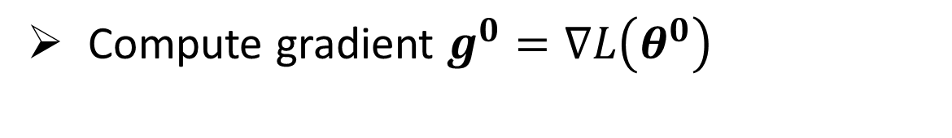
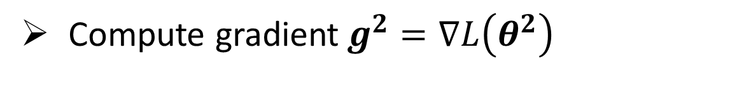
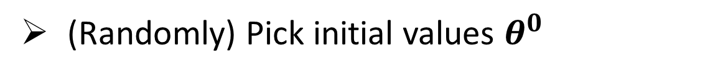

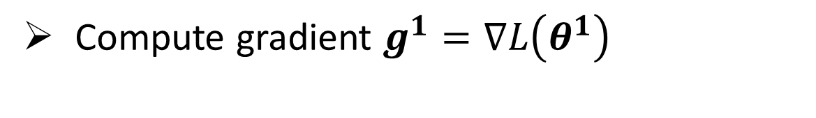

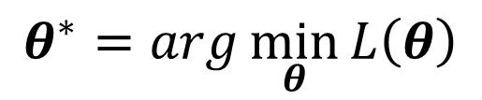
Vanilla Gradient Descent
$$θ^{∗}=arg\min_{θ}{L\left(θ\right)}$$
(Randomly) Pick initial values $θ^{0}$
Compute gradient $g^{0}=∇L\left(θ^{0}\right)$
$$θ^{1}←θ^{0}−ηg^{0}$$
Compute gradient $g^{1}=∇L\left(θ^{1}\right)$
$$θ^{2}←θ^{1}−ηg^{1}$$
Compute gradient$g^{2}=∇L\left(θ^{2}\right)$
$$θ^{3}←θ^{2}−ηg^{2}$$

Slide 8







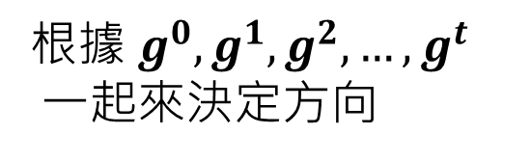
Optimizer
Vanilla Gradient Descent
根據當下算出來的 $g^{t}$ 來決定方向
$$g^{t}$$
Gradient Descent + Optimizer
……
根據 $g^{0},g^{1},g^{2},…,g^{t}$
一起來決定方向
$$g^{0}$$
$$g^{t−2}$$
$$g^{t−1}$$
$$g^{t}$$

Slide 9
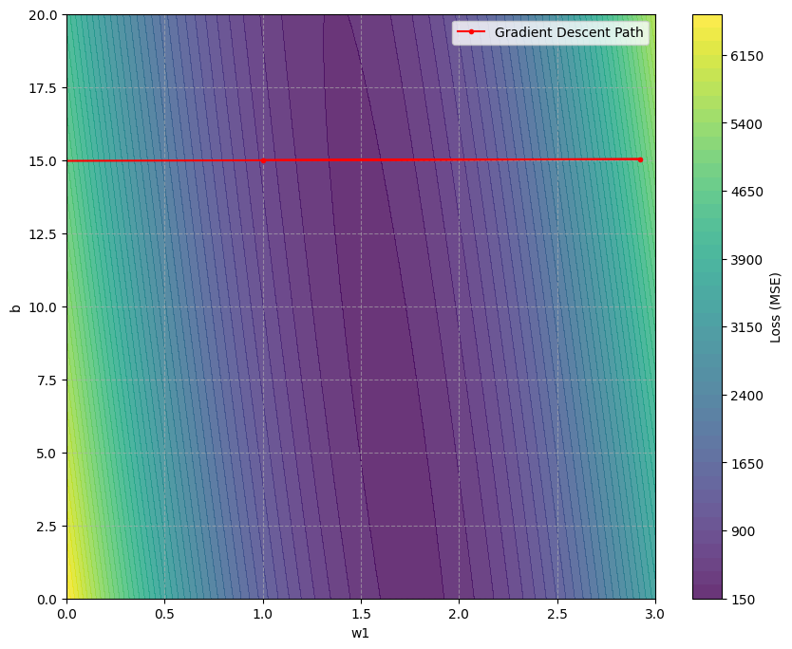



Learning Rate 實在是很難調 …
$$η=0.001$$
$$η=0.0001$$
Update 第二次就飛出了地圖之外
Update 一百次都還走不到谷底

Slide 10
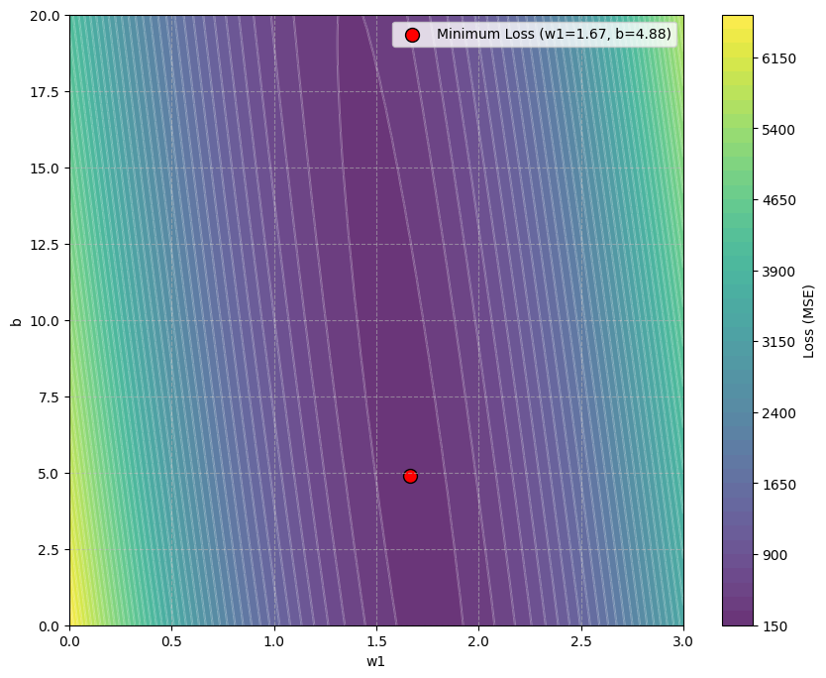
不同參數應該要有不同的 Learning Rate
Learning rate 小一點
Learning rate 大一點
怎麼知道那一個方向的 gradient 大、那一個小？

Slide 11
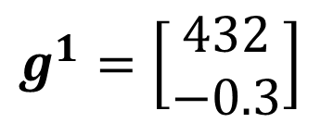
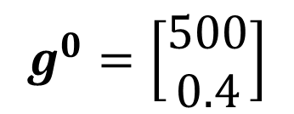
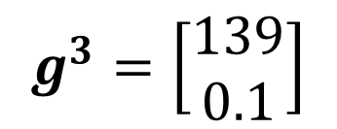
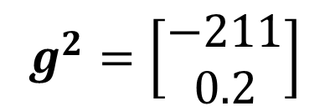
用過去的 Gradient 來決定 Learning Rate
Learning rate 小一點
$$g^{0}=\left[\begin{aligned}500 \\ 0.4\end{aligned}\right]$$
$$g^{1}=\left[\begin{aligned}432 \\ −0.3\end{aligned}\right]$$
$$g^{2}=\left[\begin{aligned}−211 \\ 0.2\end{aligned}\right]$$
$$g^{3}=\left[\begin{aligned}139 \\ 0.1\end{aligned}\right]$$
Learning rate 大一點

Slide 12
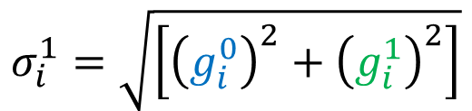


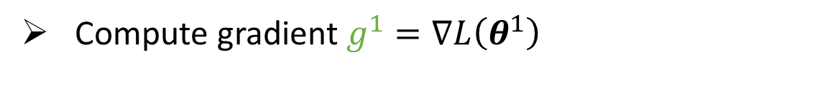
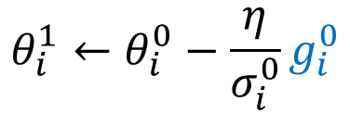
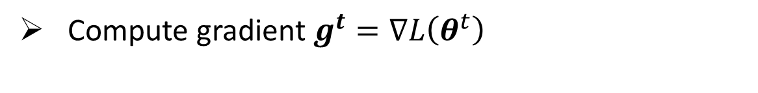

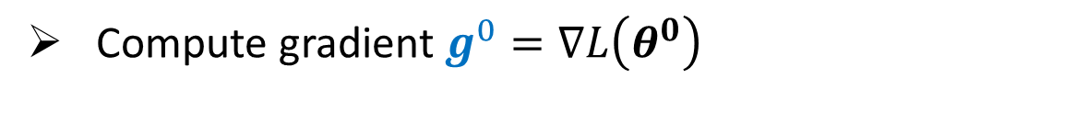


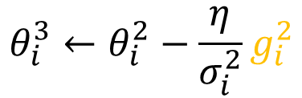

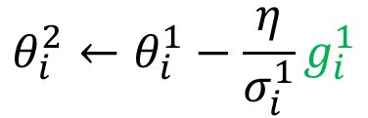
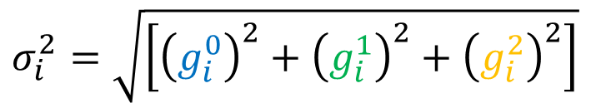
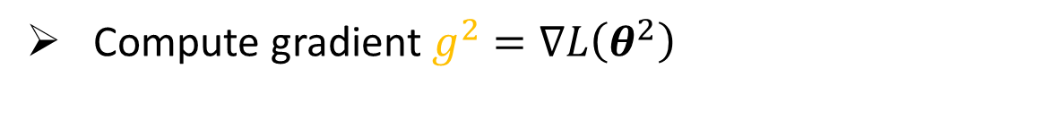

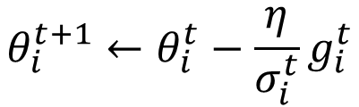
Adagrad
Compute gradient $g^{0}=∇L\left(θ^{0}\right)$
$$σ_{i}^{0}=\sqrt{{\left(g_{i}^{0}\right)}^{2}}$$
For each dimension $i$:
$$=\left|g_{i}^{0}\right|$$
$$θ_{i}^{1}←θ_{i}^{0}−\frac{\text{η}}{σ_{i}^{0}}g_{i}^{0}$$
Compute gradient $g^{1}=∇L\left(θ^{1}\right)$
Average?
For each dimension $i$:
$$σ_{i}^{1}=\sqrt{\left[{\left(g_{i}^{0}\right)}^{2}+{\left(g_{i}^{1}\right)}^{2}\right]}$$
$$θ_{i}^{2}←θ_{i}^{1}−\frac{\text{η}}{σ_{i}^{1}}g_{i}^{1}$$
Compute gradient$g^{2}=∇L\left(θ^{2}\right)$
$$σ_{i}^{2}=\sqrt{\left[{\left(g_{i}^{0}\right)}^{2}+{\left(g_{i}^{1}\right)}^{2}+{\left(g_{i}^{2}\right)}^{2}\right]}$$
For each dimension $i$:
$$θ_{i}^{3}←θ_{i}^{2}−\frac{\text{η}}{σ_{i}^{2}}g_{i}^{2}$$
……
Compute gradient$g^{t}=∇L\left(θ^{t}\right)$
$$σ_{i}^{t}=\sqrt{\sum_{i=0}^{t}{{\left(g_{i}^{t}\right)}^{2}}}$$
For each dimension $i$:
$$θ_{i}^{t+1}←θ_{i}^{t}−\frac{\text{η}}{σ_{i}^{t}}g_{i}^{t}$$

Slide 13

範例程式
連結： https://colab.research.google.com/drive/1XPIU-I77dXL9W74jnevmfb8K8XoEPRso?usp=sharing
Notes:
from mpl_toolkits.mplot3d import Axes3D
from matplotlib.animation import FuncAnimation
from IPython.display import HTML
import warnings
# 忽略 Matplotlib 可能產生的 UserWarning
warnings.filterwarnings("ignore", category=UserWarning)
# 設定 Matplotlib 在 Notebook 中顯示圖表
%matplotlib inline
=====
page_2025spring = np.array([93, 96, 98, 62, 62, 61, 61, 15, 18, 34, 25, 57])
x_count_2025spring = np.array([4334,3505,2627,2381,2574,2027,2088,174,467,1199,986,2139])
x_train_2025spring = np.array([ 2,0,2,6,28,36,11,0,1,3,7,29 ])
# 上課分鐘數 (y)
y_data_2025spring = np.array([84, 102, 111, 82, 80, 76, 79, 24, 24, 45, 34, 91])
x_page_2024 = np.array([27, 22, 27, 50, 49, 16, 24, 37, 33, 27, 36, 27, 36 ,30 ,16 ,41 ,62, 34 ])
x_word_2024 = np.array([ 2236, 1457,1309, 3404,2513,764,1448,2327,2006,1224,1121,1042,1040,1029, 1048,1946,2631,1846 ])
#x_matth_2024 = np.array([ 0,1,0,6,0,0,4,18, 5,0,1,0,0,0,2,0,0,8 ])
x_math_2024 = np.array([0, 0, 0, 0, 0, 0, 1, 1, 1, 0, 0, 0, 0, 0, 0, 0, 1, 1])
# 上課分鐘數 (y)
y_data_2024 = np.array([35, 30, 26, 35, 47 ,25, 35 ,38 ,37, 25, 38, 45, 46, 32, 15, 45 ,87, 38])
#NTU Machine Learning 2021 Spring
x_page_2021 = np.array([61, 29, 16, 21, 19, 9, 35, 43, 14, 60, 95 ,67, 38 ,39 ,42, 16, 64, 34, 37, 57])
#x_train_2021 = np.array([15,61, 3, 11, 7, 0, 0, 0, 1, 5, 23, 18, 19, 15, 4, 13, 23, 17, 9, 76])
y_data_2021 = np.array([109, 51, 34, 31, 38,19 ,56, 74, 31, 93, 160, 99, 49, 76, 72, 35, 165, 68, 86, 78])
x_page_2025fall = np.array([27,35,77,69,97])
x_word_2025fall = np.array([2616,2042,2665,2317,3923])
x_math_2025fall = np.array([0,0,0,0,0])
y_data_2025fall = np.array([31,48,95,82,120])

Slide 14
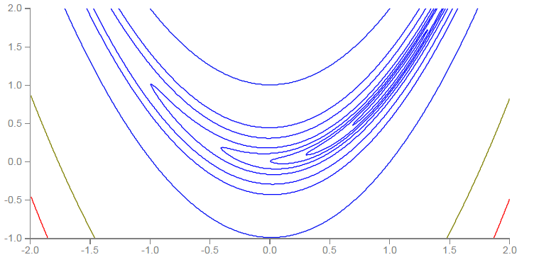
同一個參數的Gradient 大小不會一成不變
Smaller Learning Rate
Larger Learning Rate

Slide 15
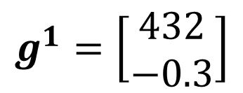
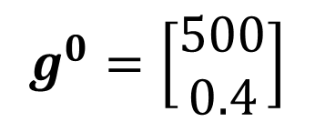
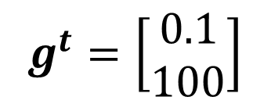
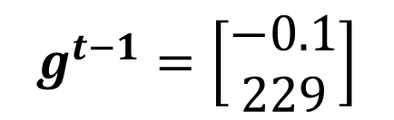
同一個參數的Gradient 大小不會一成不變
$$g^{0}=\left[\begin{aligned}500 \\ 0.4\end{aligned}\right]$$
$$g^{1}=\left[\begin{aligned}432 \\ −0.3\end{aligned}\right]$$
……
$$g^{t−1}=\left[\begin{aligned}−0.1 \\ 229\end{aligned}\right]$$
$$g^{t}=\left[\begin{aligned}0.1 \\ 100\end{aligned}\right]$$
變大
變大
Adagrad: 全部平方加起來
RMSProp: 最近算出來的 gradient 給比較大的影響

Slide 16
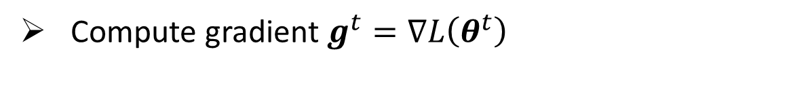

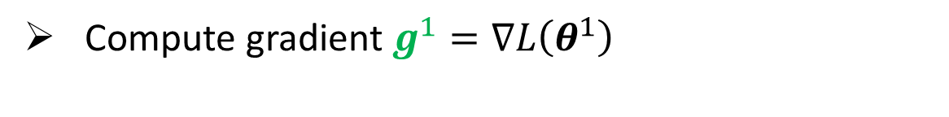
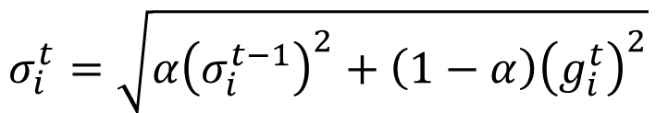

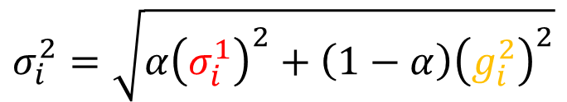
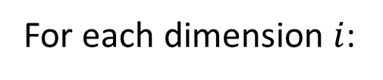
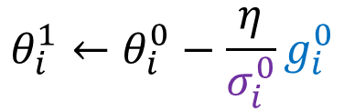
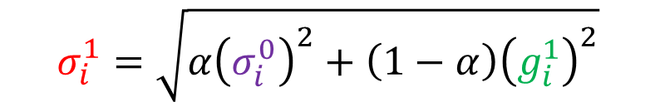
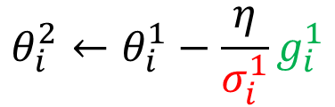


RMSProp
Compute gradient $g^{0}=∇L\left(θ^{0}\right)$
$$σ_{i}^{0}=\sqrt{{\left(g_{i}^{0}\right)}^{2}}$$
For each dimension $i$:
$$θ_{i}^{1}←θ_{i}^{0}−\frac{\text{η}}{σ_{i}^{0}}g_{i}^{0}$$
Compute gradient $g^{1}=∇L\left(θ^{1}\right)$
$$0<α<1$$
$$σ_{i}^{1}=\sqrt{{α\left(σ_{i}^{0}\right)}^{2}+\left(1−α\right){\left(g_{i}^{1}\right)}^{2}}$$
For each dimension $i$:
$$θ_{i}^{2}←θ_{i}^{1}−\frac{\text{η}}{σ_{i}^{1}}g_{i}^{1}$$
Compute gradient$g^{2}=∇L\left(θ^{2}\right)$
$$σ_{i}^{2}=\sqrt{{α\left(σ_{i}^{1}\right)}^{2}+\left(1−α\right){\left(g_{i}^{2}\right)}^{2}}$$
For each dimension $i$:
$$θ_{i}^{3}←θ_{i}^{2}−\frac{\text{η}}{σ_{i}^{2}}g_{i}^{2}$$
……
Compute gradient$g^{t}=∇L\left(θ^{t}\right)$
$$σ_{i}^{t}=\sqrt{{α\left(σ_{i}^{t−1}\right)}^{2}+\left(1−α\right){\left(g_{i}^{t}\right)}^{2}}$$
For each dimension $i$:
$$θ_{i}^{t+1}←θ_{i}^{t}−\frac{\text{η}}{σ_{i}^{t}}g_{i}^{t}$$

Slide 17
範例程式
連結： https://colab.research.google.com/drive/1XPIU-I77dXL9W74jnevmfb8K8XoEPRso?usp=sharing
Notes:
from mpl_toolkits.mplot3d import Axes3D
from matplotlib.animation import FuncAnimation
from IPython.display import HTML
import warnings
# 忽略 Matplotlib 可能產生的 UserWarning
warnings.filterwarnings("ignore", category=UserWarning)
# 設定 Matplotlib 在 Notebook 中顯示圖表
%matplotlib inline
=====
page_2025spring = np.array([93, 96, 98, 62, 62, 61, 61, 15, 18, 34, 25, 57])
x_count_2025spring = np.array([4334,3505,2627,2381,2574,2027,2088,174,467,1199,986,2139])
x_train_2025spring = np.array([ 2,0,2,6,28,36,11,0,1,3,7,29 ])
# 上課分鐘數 (y)
y_data_2025spring = np.array([84, 102, 111, 82, 80, 76, 79, 24, 24, 45, 34, 91])
x_page_2024 = np.array([27, 22, 27, 50, 49, 16, 24, 37, 33, 27, 36, 27, 36 ,30 ,16 ,41 ,62, 34 ])
x_word_2024 = np.array([ 2236, 1457,1309, 3404,2513,764,1448,2327,2006,1224,1121,1042,1040,1029, 1048,1946,2631,1846 ])
#x_matth_2024 = np.array([ 0,1,0,6,0,0,4,18, 5,0,1,0,0,0,2,0,0,8 ])
x_math_2024 = np.array([0, 0, 0, 0, 0, 0, 1, 1, 1, 0, 0, 0, 0, 0, 0, 0, 1, 1])
# 上課分鐘數 (y)
y_data_2024 = np.array([35, 30, 26, 35, 47 ,25, 35 ,38 ,37, 25, 38, 45, 46, 32, 15, 45 ,87, 38])
#NTU Machine Learning 2021 Spring
x_page_2021 = np.array([61, 29, 16, 21, 19, 9, 35, 43, 14, 60, 95 ,67, 38 ,39 ,42, 16, 64, 34, 37, 57])
#x_train_2021 = np.array([15,61, 3, 11, 7, 0, 0, 0, 1, 5, 23, 18, 19, 15, 4, 13, 23, 17, 9, 76])
y_data_2021 = np.array([109, 51, 34, 31, 38,19 ,56, 74, 31, 93, 160, 99, 49, 76, 72, 35, 165, 68, 86, 78])
x_page_2025fall = np.array([27,35,77,69,97])
x_word_2025fall = np.array([2616,2042,2665,2317,3923])
x_math_2025fall = np.array([0,0,0,0,0])
y_data_2025fall = np.array([31,48,95,82,120])

Slide 18

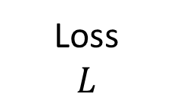
Optimization 會在 Gradient 很小時停止
Small Gradient
Loss
$$L$$
Saddle Point
Local
Minimum
Global Minimum

Slide 19
考慮動量 (Momentum)
因為有動量，所以移動中的物體不會輕易停下來。
Small Gradient
Loss
$$L$$
Saddle Point
Local
Minimum
Notes:
momentum

Slide 20








Compute gradient $g^{0}=∇L\left(θ^{0}\right)$
Momentum
For each dimension $i$:
$$m_{i}^{0}=g_{i}^{0}$$
$$θ_{i}^{1}←θ_{i}^{0}−\text{η}m_{i}^{0}$$
Compute gradient $g^{1}=∇L\left(θ^{1}\right)$
For each dimension $i$:
$$m_{i}^{1}=g_{i}^{0}+g_{i}^{1}$$
$$θ_{i}^{2}←θ_{i}^{1}−\text{η}m_{i}^{1}$$
Compute gradient$g^{2}=∇L\left(θ^{2}\right)$
For each dimension $i$:
$$m_{i}^{2}=g_{i}^{0}+g_{i}^{1}+g_{i}^{2}$$
$$θ_{i}^{3}←θ_{i}^{2}−\text{η}m_{i}^{2}$$
……
Compute gradient$g^{t}=∇L\left(θ^{t}\right)$
For each dimension $i$:
$$m_{i}^{t}=g_{i}^{0}+g_{i}^{1}+g_{i}^{2}+…+g_{i}^{t}$$
$$θ_{i}^{t+1}←θ_{i}^{t}−\text{η}m_{i}^{t}$$

Slide 21




Momentum
Compute gradient $g^{0}=∇L\left(θ^{0}\right)$
(這不是經典的 Momentum)
For each dimension $i$:
$$m_{i}^{0}=g_{i}^{0}$$
$$θ_{i}^{1}←θ_{i}^{0}−\text{η}m_{i}^{0}$$
$$0<β<1$$
Compute gradient $g^{1}=∇L\left(θ^{1}\right)$
For each dimension $i$:
$$m_{i}^{1}=βm_{i}^{0}+\left(1−β\right)g_{i}^{1}$$
$$θ_{i}^{2}←θ_{i}^{1}−\text{η}m_{i}^{1}$$
Compute gradient$g^{2}=∇L\left(θ^{2}\right)$
For each dimension $i$:
$$m_{i}^{2}=βm_{i}^{1}+\left(1−β\right)g_{i}^{2}$$
$$θ_{i}^{3}←θ_{i}^{2}−\text{η}m_{i}^{2}$$
……
Compute gradient$g^{t}=∇L\left(θ^{t}\right)$
For each dimension $i$:
$$m_{i}^{t}=βm_{i}^{t−1}+\left(1−β\right)g_{i}^{t}$$
$$θ_{i}^{t+1}←θ_{i}^{t}−\text{η}m_{i}^{t}$$

Slide 22
範例程式
連結： https://colab.research.google.com/drive/1XPIU-I77dXL9W74jnevmfb8K8XoEPRso?usp=sharing
Notes:
from mpl_toolkits.mplot3d import Axes3D
from matplotlib.animation import FuncAnimation
from IPython.display import HTML
import warnings
# 忽略 Matplotlib 可能產生的 UserWarning
warnings.filterwarnings("ignore", category=UserWarning)
# 設定 Matplotlib 在 Notebook 中顯示圖表
%matplotlib inline
=====
page_2025spring = np.array([93, 96, 98, 62, 62, 61, 61, 15, 18, 34, 25, 57])
x_count_2025spring = np.array([4334,3505,2627,2381,2574,2027,2088,174,467,1199,986,2139])
x_train_2025spring = np.array([ 2,0,2,6,28,36,11,0,1,3,7,29 ])
# 上課分鐘數 (y)
y_data_2025spring = np.array([84, 102, 111, 82, 80, 76, 79, 24, 24, 45, 34, 91])
x_page_2024 = np.array([27, 22, 27, 50, 49, 16, 24, 37, 33, 27, 36, 27, 36 ,30 ,16 ,41 ,62, 34 ])
x_word_2024 = np.array([ 2236, 1457,1309, 3404,2513,764,1448,2327,2006,1224,1121,1042,1040,1029, 1048,1946,2631,1846 ])
#x_matth_2024 = np.array([ 0,1,0,6,0,0,4,18, 5,0,1,0,0,0,2,0,0,8 ])
x_math_2024 = np.array([0, 0, 0, 0, 0, 0, 1, 1, 1, 0, 0, 0, 0, 0, 0, 0, 1, 1])
# 上課分鐘數 (y)
y_data_2024 = np.array([35, 30, 26, 35, 47 ,25, 35 ,38 ,37, 25, 38, 45, 46, 32, 15, 45 ,87, 38])
#NTU Machine Learning 2021 Spring
x_page_2021 = np.array([61, 29, 16, 21, 19, 9, 35, 43, 14, 60, 95 ,67, 38 ,39 ,42, 16, 64, 34, 37, 57])
#x_train_2021 = np.array([15,61, 3, 11, 7, 0, 0, 0, 1, 5, 23, 18, 19, 15, 4, 13, 23, 17, 9, 76])
y_data_2021 = np.array([109, 51, 34, 31, 38,19 ,56, 74, 31, 93, 160, 99, 49, 76, 72, 35, 165, 68, 86, 78])
x_page_2025fall = np.array([27,35,77,69,97])
x_word_2025fall = np.array([2616,2042,2665,2317,3923])
x_math_2025fall = np.array([0,0,0,0,0])
y_data_2025fall = np.array([31,48,95,82,120])

Slide 23

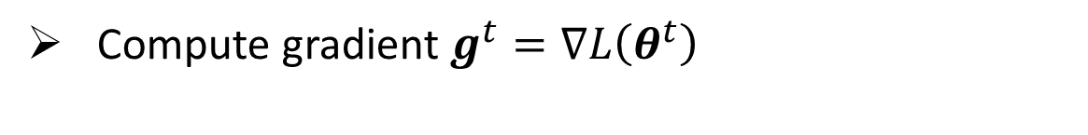
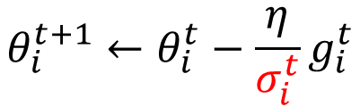


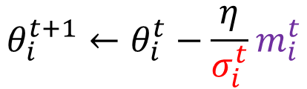

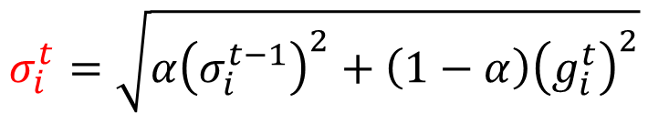
Adam: RMSProp + Momentum
Compute gradient$g^{t}=∇L\left(θ^{t}\right)$
Momentum
For each dimension $i$:
$$m_{i}^{t}=βm_{i}^{t−1}+\left(1−β\right)g_{i}^{t}$$
$$θ_{i}^{t+1}←θ_{i}^{t}−\text{η}m_{i}^{t}$$
RMSProp
$$σ_{i}^{t}=\sqrt{{α\left(σ_{i}^{t−1}\right)}^{2}+\left(1−α\right){\left(g_{i}^{t}\right)}^{2}}$$
$$θ_{i}^{t+1}←θ_{i}^{t}−\frac{\text{η}}{σ_{i}^{t}}g_{i}^{t}$$
For each dimension $i$:
Adam
$$θ_{i}^{t+1}←θ_{i}^{t}−\frac{\text{η}}{σ_{i}^{t}}m_{i}^{t}$$
Adam has bias-corrected terms, which are omitted here for simplicity.
Notes:
Original paper: https://arxiv.org/pdf/1412.6980.pdf

Slide 24
範例程式
連結： https://colab.research.google.com/drive/1XPIU-I77dXL9W74jnevmfb8K8XoEPRso?usp=sharing
Notes:
from mpl_toolkits.mplot3d import Axes3D
from matplotlib.animation import FuncAnimation
from IPython.display import HTML
import warnings
# 忽略 Matplotlib 可能產生的 UserWarning
warnings.filterwarnings("ignore", category=UserWarning)
# 設定 Matplotlib 在 Notebook 中顯示圖表
%matplotlib inline
=====
page_2025spring = np.array([93, 96, 98, 62, 62, 61, 61, 15, 18, 34, 25, 57])
x_count_2025spring = np.array([4334,3505,2627,2381,2574,2027,2088,174,467,1199,986,2139])
x_train_2025spring = np.array([ 2,0,2,6,28,36,11,0,1,3,7,29 ])
# 上課分鐘數 (y)
y_data_2025spring = np.array([84, 102, 111, 82, 80, 76, 79, 24, 24, 45, 34, 91])
x_page_2024 = np.array([27, 22, 27, 50, 49, 16, 24, 37, 33, 27, 36, 27, 36 ,30 ,16 ,41 ,62, 34 ])
x_word_2024 = np.array([ 2236, 1457,1309, 3404,2513,764,1448,2327,2006,1224,1121,1042,1040,1029, 1048,1946,2631,1846 ])
#x_matth_2024 = np.array([ 0,1,0,6,0,0,4,18, 5,0,1,0,0,0,2,0,0,8 ])
x_math_2024 = np.array([0, 0, 0, 0, 0, 0, 1, 1, 1, 0, 0, 0, 0, 0, 0, 0, 1, 1])
# 上課分鐘數 (y)
y_data_2024 = np.array([35, 30, 26, 35, 47 ,25, 35 ,38 ,37, 25, 38, 45, 46, 32, 15, 45 ,87, 38])
#NTU Machine Learning 2021 Spring
x_page_2021 = np.array([61, 29, 16, 21, 19, 9, 35, 43, 14, 60, 95 ,67, 38 ,39 ,42, 16, 64, 34, 37, 57])
#x_train_2021 = np.array([15,61, 3, 11, 7, 0, 0, 0, 1, 5, 23, 18, 19, 15, 4, 13, 23, 17, 9, 76])
y_data_2021 = np.array([109, 51, 34, 31, 38,19 ,56, 74, 31, 93, 160, 99, 49, 76, 72, 35, 165, 68, 86, 78])
x_page_2025fall = np.array([27,35,77,69,97])
x_word_2025fall = np.array([2616,2042,2665,2317,3923])
x_math_2025fall = np.array([0,0,0,0,0])
y_data_2025fall = np.array([31,48,95,82,120])

Slide 25





Learning Rate Scheduling
$${\text{η}}^{t}$$
$$θ_{i}^{t+1}←θ_{i}^{t}−\frac{\text{η}}{σ_{i}^{t}}m_{i}^{t}$$
$$θ_{i}^{t+1}←θ_{i}^{t}−\frac{\text{η}}{σ_{i}^{t}}m_{i}^{t}$$
$${\text{η}}^{t}$$
Warm Up
Learning Rate Decay
探索地形
準備停下來
$$t$$
Notes:
這跟人類也很像
Please refer to Radam
https://arxiv.org/abs/1908.03265

Slide 26
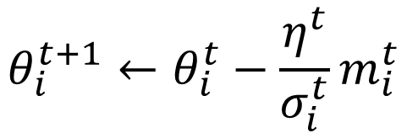
Summarization of Optimizer
Learning rate scheduling
$$θ_{i}^{t+1}←θ_{i}^{t}−\frac{η^{t}}{σ_{i}^{t}}m_{i}^{t}$$
Momentum: sum of the previous gradients
Consider direction
square of the gradients
only magnitude
方法名 | 改了那一個步驟 | 帶來什麼好處
Adagrad, RMSProp, Momentum, Adam, etc. | 找最好的函式 | Better Optimization (not for Generalization)
Notes:
Adam在testing時error較大的事實。
https://openreview.net/pdf?id=Bkg3g2R9FX
https://shaoanlu.wordpress.com/2017/05/29/sgd-all-which-one-is-the-best-optimizer-dogs-vs-cats-toy-experiment/

Slide 27
Dropout
訓練時隨機丟掉一些神經元
驗證和測試時
火力全開

Slide 28
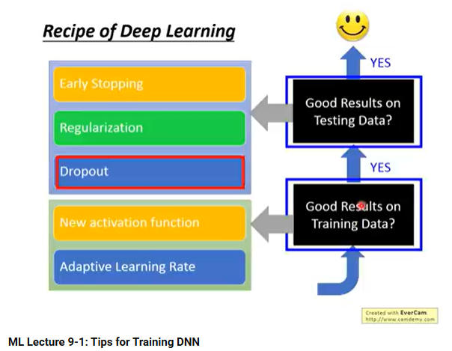
Dropout
方法名 | 改了那一個步驟 | 帶來什麼好處
Dropout | 找最好的函式 | Better Generalization (Worse Optimization)
注意 Dropout 的選擇時機!
https://youtu.be/xki61j7z-30?si=EoF1VjcP3_L5UWI3&t=4227

Slide 29
Initialization
不同的起始位置，可能會導致非常不同的訓練結果
(Optimizer 可以克服初始位置帶來的差異嗎？)

Slide 30
範例程式
連結： https://colab.research.google.com/drive/1XPIU-I77dXL9W74jnevmfb8K8XoEPRso?usp=sharing
Notes:
from mpl_toolkits.mplot3d import Axes3D
from matplotlib.animation import FuncAnimation
from IPython.display import HTML
import warnings
# 忽略 Matplotlib 可能產生的 UserWarning
warnings.filterwarnings("ignore", category=UserWarning)
# 設定 Matplotlib 在 Notebook 中顯示圖表
%matplotlib inline
=====
page_2025spring = np.array([93, 96, 98, 62, 62, 61, 61, 15, 18, 34, 25, 57])
x_count_2025spring = np.array([4334,3505,2627,2381,2574,2027,2088,174,467,1199,986,2139])
x_train_2025spring = np.array([ 2,0,2,6,28,36,11,0,1,3,7,29 ])
# 上課分鐘數 (y)
y_data_2025spring = np.array([84, 102, 111, 82, 80, 76, 79, 24, 24, 45, 34, 91])
x_page_2024 = np.array([27, 22, 27, 50, 49, 16, 24, 37, 33, 27, 36, 27, 36 ,30 ,16 ,41 ,62, 34 ])
x_word_2024 = np.array([ 2236, 1457,1309, 3404,2513,764,1448,2327,2006,1224,1121,1042,1040,1029, 1048,1946,2631,1846 ])
#x_matth_2024 = np.array([ 0,1,0,6,0,0,4,18, 5,0,1,0,0,0,2,0,0,8 ])
x_math_2024 = np.array([0, 0, 0, 0, 0, 0, 1, 1, 1, 0, 0, 0, 0, 0, 0, 0, 1, 1])
# 上課分鐘數 (y)
y_data_2024 = np.array([35, 30, 26, 35, 47 ,25, 35 ,38 ,37, 25, 38, 45, 46, 32, 15, 45 ,87, 38])
#NTU Machine Learning 2021 Spring
x_page_2021 = np.array([61, 29, 16, 21, 19, 9, 35, 43, 14, 60, 95 ,67, 38 ,39 ,42, 16, 64, 34, 37, 57])
#x_train_2021 = np.array([15,61, 3, 11, 7, 0, 0, 0, 1, 5, 23, 18, 19, 15, 4, 13, 23, 17, 9, 76])
y_data_2021 = np.array([109, 51, 34, 31, 38,19 ,56, 74, 31, 93, 160, 99, 49, 76, 72, 35, 165, 68, 86, 78])
x_page_2025fall = np.array([27,35,77,69,97])
x_word_2025fall = np.array([2616,2042,2665,2317,3923])
x_math_2025fall = np.array([0,0,0,0,0])
y_data_2025fall = np.array([31,48,95,82,120])

Slide 31
Initialization
當有多個 Training Loss 最低點的時候，
起始位置決定我們走到哪一個最低點
Notes:
Training Loss

Slide 32

Initialization
當有多個 Training Loss 最低點的時候，
起始位置決定我們走到哪一個最低點
Training
Loss
Validation
Loss
在平坦盆地中
在峽谷中

Slide 33



Initialization
可以輕易蒐集大量資料進行訓練
Pretext Task
180
Pre-train
Initialization
Bird
Downstream Task
Notes:
Transfer
Learning

Slide 34
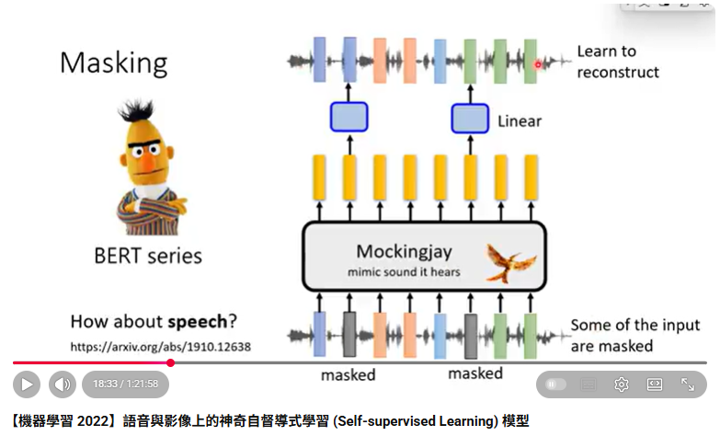

More about Pretext Task
https://youtu.be/lMIN1iKYNmA?si=M6hL7pKbOU_ufefo

Slide 35
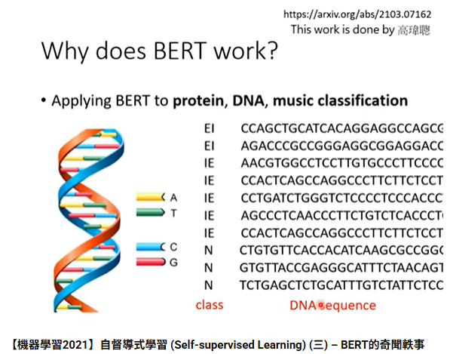
Initialization
Pre-train 對於 Optimization 和 Generalization 都有幫助
https://youtu.be/ExXA05i8DEQ?si=bpmI5yogGDiJ3FUf&t=508
方法名 | 改了那一個步驟 | 帶來什麼好處
Initialization (e.g., pre-train) | 找最好的函式 | Better Optimization, Better Generalization

Slide 36
找函式步驟 3 + 1
步驟一：
我要找什麼
步驟二：
我有哪些選擇
步驟三：
選一個最好的
Better Network Architecture
Notes:
機器學習三個步驟 (3+1)
我要甚麼 (甚麼是好!)
我有哪些選擇
從可能的選擇中選一個最好的
評估

Slide 37
劃定一個剛剛好的函式範圍
good function
good function
good function
函式集合太小，可能會沒有包含好的函式
函式集合大一點，比較可能包到好的函式
選一個小範圍但剛好包含好的函式
(容易 overfitting)
(根據 domain knowledge)
Notes:
不同方向不同 learning rate

Slide 38
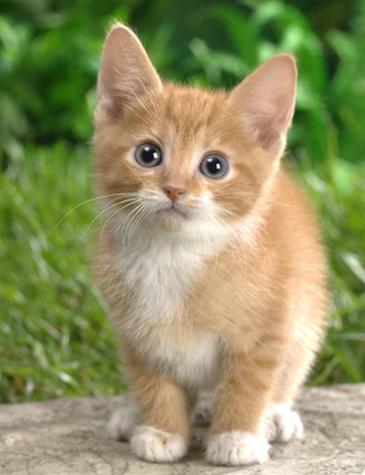
Convolutional Layer
3 channels
1000 x 1000
For image processing
…...
3-D
tensor
1000
…...
1000 x 1000
1000 x 1000
1000
…...
1000 x 1000
value represents intensity
Feature

Slide 39
……
1000 x 1000 x 3 parameters
1000 x 1000
…...
……
……
1000 x 1000
…...
1000 x 1000 x 3 x 1000 parameters
……
1000 neurons
Typical multi-layer perceptron (MLP) is “fully connected”.
1000 x 1000
…...
Do we really need “fully connected” in image processing?
Feature
Notes:
More parameters,
Not only computational intensive
But also easier to overfit

Slide 40
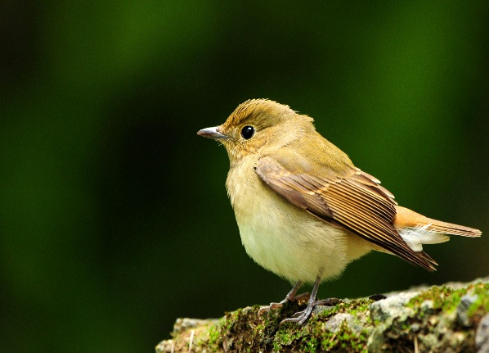

Observation 1
Input
Layer 1
Layer 2
……
……
……
……
……
Bird?
……
basic
detector
advanced
detector
Notes:
https://www.dcard.tw/f/funny/p/233833012

Slide 41
Observation 1
A neuron does not have to see the whole image.
Input
Layer 1
Layer 2
……
……
……
……
……
Bird?
……
basic
detector
advanced
detector
Some patterns are much smaller than the whole image.
Notes:
https://www.dcard.tw/f/funny/p/233833012

Slide 42
Simplification 1
the same receptive field
Receptive field
1 | 0 | 0 | 0 | 0 | 1
0 | 1 | 0 | 0 | 1 | 0
0 | 0 | 1 | 1 | 0 | 0
1 | 0 | 0 | 0 | 1 | 0
0 | 1 | 0 | 0 | 1 | 0
0 | 0 | 1 | 0 | 1 | 0
1 | 0 | 0 | 0 | 0 | 1
0 | 1 | 0 | 0 | 1 | 0
0 | 0 | 1 | 1 | 0 | 0
1 | 0 | 0 | 0 | 1 | 0
0 | 1 | 0 | 0 | 1 | 0
0 | 0 | 1 | 0 | 1 | 0
1 | 0 | 0 | 0 | 0 | 1
0 | 1 | 0 | 0 | 1 | 0
0 | 0 | 1 | 1 | 0 | 0
1 | 0 | 0 | 0 | 1 | 0
0 | 1 | 0 | 0 | 1 | 0
0 | 0 | 1 | 0 | 1 | 0
Can be overlapped
Can different neurons have different sizes of receptive field?
Not square receptive field?

Slide 43
Simplification 1 – Typical Setting
stride = 2
overlap
all channels
1 | 0 | 0 | 0 | 0 | 1
0 | 1 | 0 | 0 | 1 | 0
0 | 0 | 1 | 1 | 0 | 0
1 | 0 | 0 | 0 | 1 | 0
0 | 1 | 0 | 0 | 1 | 0
0 | 0 | 1 | 0 | 1 | 0
1 | 0 | 0 | 0 | 0 | 1
0 | 1 | 0 | 0 | 1 | 0
0 | 0 | 1 | 1 | 0 | 0
1 | 0 | 0 | 0 | 1 | 0
0 | 1 | 0 | 0 | 1 | 0
0 | 0 | 1 | 0 | 1 | 0
kernel size (e.g., 3 x 3)
1 | 0 | 0 | 0 | 0 | 1
0 | 1 | 0 | 0 | 1 | 0
0 | 0 | 1 | 1 | 0 | 0
1 | 0 | 0 | 0 | 1 | 0
0 | 1 | 0 | 0 | 1 | 0
0 | 0 | 1 | 0 | 1 | 0
padding
The receptive fields cover the whole image.
Each receptive field has a set of neurons (e.g., 64 neurons).
Notes:
守的滴水不漏無懈可擊

Slide 44
……
……
2 x 2
1000 x 1000
…...
……
2 x 2
……
……
1000 x 1000
…...
……
2 x 2
1000 x 1000
…...
1000 x 1000 x 3 x 1000 parameters
Receptive Field
1 / (500 × 500) times fewer parameters
Feature
Notes:
More parameters,
Not only computational intensive
But also easier to overfit

Slide 45
Benefit of Simplification 1
Fully Connected Layer
Each neuron processes the whole image.
Receptive Field
good function
Each neuron only processes a small region (receptive field).
Basic patterns are much smaller than the whole image. Each neuron only has to process a receptive field.
Notes:
Need an metaphor?

Slide 46
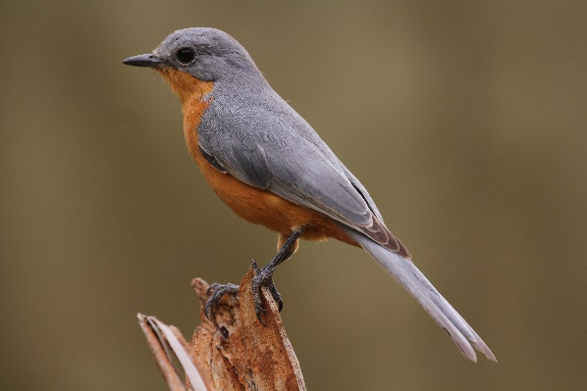


Observation 2
The same patterns appear in different regions.
I detect “beak” in my receptive field.
They do the same thing. How about using the same parameters?
I detect “beak” in my receptive field.

Slide 47
Simplification 2 – Sharing parameters
Each receptive field has a set of neurons (e.g., 64 neurons).
1 | 0 | 0 | 0 | 0 | 1
0 | 1 | 0 | 0 | 1 | 0
0 | 0 | 1 | 1 | 0 | 0
1 | 0 | 0 | 0 | 1 | 0
0 | 1 | 0 | 0 | 1 | 0
0 | 0 | 1 | 0 | 1 | 0
1 | 0 | 0 | 0 | 0 | 1
0 | 1 | 0 | 0 | 1 | 0
0 | 0 | 1 | 1 | 0 | 0
1 | 0 | 0 | 0 | 1 | 0
0 | 1 | 0 | 0 | 1 | 0
0 | 0 | 1 | 0 | 1 | 0
1 | 0 | 0 | 0 | 0 | 1
0 | 1 | 0 | 0 | 1 | 0
0 | 0 | 1 | 1 | 0 | 0
1 | 0 | 0 | 0 | 1 | 0
0 | 1 | 0 | 0 | 1 | 0
0 | 0 | 1 | 0 | 1 | 0
……
……

Slide 48
Simplification 2 – Sharing parameters
Each receptive field has a set of neurons (e.g., 64 neurons).
Each receptive field has the neurons with the same set of parameters.
filter 1
1 | 0 | 0 | 0 | 0 | 1
0 | 1 | 0 | 0 | 1 | 0
0 | 0 | 1 | 1 | 0 | 0
1 | 0 | 0 | 0 | 1 | 0
0 | 1 | 0 | 0 | 1 | 0
0 | 0 | 1 | 0 | 1 | 0
filter 1
1 | 0 | 0 | 0 | 0 | 1
0 | 1 | 0 | 0 | 1 | 0
0 | 0 | 1 | 1 | 0 | 0
1 | 0 | 0 | 0 | 1 | 0
0 | 1 | 0 | 0 | 1 | 0
0 | 0 | 1 | 0 | 1 | 0
1 | 0 | 0 | 0 | 0 | 1
0 | 1 | 0 | 0 | 1 | 0
0 | 0 | 1 | 1 | 0 | 0
1 | 0 | 0 | 0 | 1 | 0
0 | 1 | 0 | 0 | 1 | 0
0 | 0 | 1 | 0 | 1 | 0
filter 2
filter 2
filter 3
filter 3
filter 4
filter 4
……
……

Slide 49
Benefit of Simplication 1 + 2
Fully Connected Layer
Each neuron processes the whole image.
Receptive Field
Each neuron only processes a small region (receptive field).
Parameter Sharing
Convolutional Layer
Some neurons share parameters.
Basic patterns are much smaller than the whole image. Each neuron only has to process a receptive field.
Different receptive fields need the same detectors, so neurons for different receptive fields share parameters.
Notes:
Need an metaphor?

Slide 50

方法名 | 改了那一個步驟 | 帶來什麼好處
CNN (e.g., for image) | 改變函式搜尋範圍 | Better Generalization
To learn more about CNN …
https://youtu.be/OP5HcXJg2Aw?si=cNhXe9W-PgP45jN1&t=1686

Slide 51




Skip Connection (Residual Connection)
(為了簡化，此處沒有畫出 activation 和 bias)
https://arxiv.org/abs/1512.03385
……
$$L$$
$$ΔL$$
$$Δw$$
$$\frac{∂L}{∂w}≈\frac{ΔL}{Δw}$$

Slide 52



Skip Connection (Residual Connection)
(為了簡化，此處沒有畫出 activation 和 bias)
https://arxiv.org/abs/1512.03385
……
$$L$$
$$ΔL$$
往往很小 (gradient vanishing)
$$Δw$$
$$\frac{∂L}{∂w}≈\frac{ΔL}{Δw}$$
有時候又會突然變很大 (gradient exploding)
Notes:
Identity Mappings in Deep Residual Networks

Slide 53









Skip Connection (Residual Connection)
(為了簡化，此處沒有畫出 activation 和 bias)
……
$$W$$
$$L$$
$$a^{′}$$
$$=Wa$$
$$a$$
……
$$W$$
$$L$$
$$a^{′}$$
$$a$$
$$a^{′}=Wa+a$$

Slide 54


Source of image: https://arxiv.org/abs/1712.09913
Without skip connection
With skip connection
方法名 | 改了那一個步驟 | 帶來什麼好處
Skip Connection | 改變函式搜尋範圍 | Better Optimization

Slide 55
各種 Normalization
mean = 0
mean = 0
mean = 0
Norm
Norm
Norm
限制範圍

Slide 56

Normalization
Batch Renormalization
https://arxiv.org/abs/1702.03275
Layer Normalization
https://arxiv.org/abs/1607.06450
https://youtu.be/BABPWOkSbLE?si=gzwtWMEBzbgf7slI
方法名 | 改了那一個步驟 | 帶來什麼好處
Normalization | 改變函式搜尋範圍 | Better Optimization (Sometimes Better Generalization)
Notes:
Batch Renormalization
https://arxiv.org/abs/1702.03275
Layer Normalization
https://arxiv.org/abs/1607.06450
Instance Normalization
https://arxiv.org/abs/1607.08022
Weight Normalization
https://arxiv.org/abs/1602.07868
Spectrum Normalization
https://arxiv.org/abs/1705.10941

Slide 57
找函式步驟 3 + 1
步驟一：
我要找什麼
步驟二：
我有哪些選擇
步驟三：
選一個最好的
Loss
Notes:
機器學習三個步驟 (3+1)
我要甚麼 (甚麼是好!)
我有哪些選擇
從可能的選擇中選一個最好的
評估

Slide 58






















Classification
dog
bird
cat
…
$$f$$
Regression
$$a_{1}$$
+
$$w_{1,1}$$
$$c_{1}$$
$$b_{1}$$
$$w_{2,1}$$
$$x_{1}$$
$$c_{2}$$
$$w_{3,1}$$
$$y$$
+
$$a_{2}$$
+
$$w_{1,2}$$
$$b^{′}$$
$$b_{2}$$
$$w_{2,2}$$
$$x_{2}$$
$$c_{3}$$
$$w_{3,2}$$
$$a_{3}$$
+
$$b_{3}$$
Notes:
分類問題

Slide 59










Classification
dog
bird
cat
…
$$f$$
Classification
$$c_{1,1}$$
$$a_{1}$$
+
$$w_{1,1}$$
10
$$y_{1}$$
$$c_{2,1}$$
$$b_{1}$$
$$w_{2,1}$$
$$x_{1}$$
+
Class 1
$$c_{1,2}$$
$$w_{3,1}$$
$$b_{1}^{′}$$
$$a_{2}$$
+
$$w_{1,2}$$
$$c_{2,2}$$
$$b_{2}$$
3
$$y_{2}$$
+
$$c_{1,3}$$
$$w_{2,2}$$
$$x_{2}$$
Class 2
$$b_{2}^{′}$$
$$c_{2,3}$$
$$w_{3,2}$$
$$a_{3}$$
+
$$b_{3}$$
Notes:
分類問題

Slide 60






Loss = Evaluation Metrics?
Classification
dog
bird
cat
…
$$f$$
Ground truth: bird
1
dog
bird
cat
…
$$f$$
Ground truth: cat
0
Accuray = 0.5
Use as loss $L$?

Slide 61














Loss = Evaluation Metrics?
Classification
$$g=∇L\left(θ\right)$$
……
$$c_{1,1}$$
$$a_{1}$$
2
$$y_{1}$$
$$c_{2,1}$$
+
Class 1
$$c_{1,2}$$
Ground truth:
Class 2
$$b_{1}^{′}$$
……
$$a_{2}$$
0
$$c_{2,2}$$
Nothing is happening.
1
$$y_{2}$$
+
$$c_{1,3}$$
Class 2
+0.01
$$b_{2}^{′}$$
$$c_{2,3}$$
$$a_{3}$$
……
Gradient is 0 ……
+0.01
Change a little bit

Slide 62

Loss = Evaluation Metrics?
For classification, if we use accuracy as the loss function …
無法下坡
Loss
$$L$$

Slide 63













Cross-entropy as the loss in classification
……
$$c_{1,1}$$
$$a_{1}$$
2
$$y_{1}$$
$$c_{2,1}$$
+
Ground
truth:
Class 2
0.73
Class 1
$$c_{1,2}$$
0.27
$$b_{1}^{′}$$
$$a_{2}$$
……
$$c_{2,2}$$
1
$$y_{2}$$
+
$$c_{1,3}$$
Class 1
Class 2
Class 2
softmax
$$b_{2}^{′}$$
$$c_{2,3}$$
$$a_{3}$$
……

Slide 64

什麼是 Softmax?
請見本課程第三講
https://youtu.be/8iFvM7WUUs8?si=VdfmHEdUEm1TJOlR

Slide 65





$$l=−\sum_{i}{{\hat{y}}_{i}log\left(y_{i}^{′}\right) }$$
兩個分布越接近越小
……
$$c_{1,1}$$
$$a_{1}$$
$${\hat{y}}_{1}$$
$${\hat{y}}_{2}$$
$$y_{1}^{′}$$
$$y_{2}^{′}$$
2
$$y_{1}$$
$$c_{2,1}$$
1.0
Cross-entropy
+
Ground
truth:
Class 2
0.73
Class 1
$$c_{1,2}$$
0.27
$$b_{1}^{′}$$
$$a_{2}$$
……
0.0
$$c_{2,2}$$
1
$$y_{2}$$
+
$$c_{1,3}$$
Class 1
Class 2
Class 1
Class 2
Class 2
$$b_{2}^{′}$$
$$c_{2,3}$$
$$a_{3}$$
……
+0.01
+0.01

Slide 66


Why Cross-entropy?
https://youtu.be/fZAZUYEeIMg
https://youtu.be/hSXFuypLukA

Slide 67

Loss = Evaluation Metrics?
For classification, if we use cross-entropy as the loss function …
Loss
$$L$$

Slide 68
步驟一：
我要什麼
步驟二：
我有哪些選擇
步驟三：
選一個最好的
+
cross-entropy
accuracy
壞
accuracy
測試 (Testing)
驗證
(Validation)
好
結果如何？
方法名 | 改了那一個步驟 | 帶來什麼好處
Do not use accuracy as loss | 我要找甚麼 | Better Optimization (Not for Generalization)

Slide 69

有沒有其他可能性？
https://youtu.be/QSEPStBgwRQ?si=5oBXckoLuqbaroKY

Slide 70


Need More Training Data …
Overfitting
$$L=\sum_{x\sim Train}{l\left(f\left(x\right),\hat{y} \right)}$$
$$L=\sum_{x\sim Test}{l\left(f\left(x\right),\hat{y} \right)}$$
Collecting more training data
(be careful about the representative)
方法名 | 改了那一個步驟 | 帶來什麼好處
More training data | 我要找甚麼 | Better Generalization Not for Optimization

Slide 71


Data Augmentation
Overfitting
$$L=\sum_{x\sim Train}{l\left(f\left(x\right),\hat{y} \right)}$$
$$L=\sum_{x\sim Test}{l\left(f\left(x\right),\hat{y} \right)}$$
Collecting more training data
voice
conversion
change volume
flip
blurry
bird
bird
bird
Hello~
Hello~
Hello~

Slide 72
Be careful about what you augment
Overfitting
$$L=\sum_{x\sim Train}{l\left(f\left(x\right),\hat{y} \right)}$$
$$L=\sum_{x\sim Test}{l\left(f\left(x\right),\hat{y} \right)}$$
Collecting more training data
voice
conversion
change volume
flip
blurry
right
right
right
Speaker X
Speaker X
Speaker X

Slide 73



Mixup
https://arxiv.org/abs/1710.09412
1.0
$$f$$
???
0.5 x
0.0
x 0.5
dog
cat
+
1.0
+
$$f$$
???
0.5 x
0.0
x 0.5
dog
cat
=
=
$$f$$
0.5
0.5
???
dog
cat
Notes:
資料增強 (Mixup / CutMix / CutOut / AugMix / RandAugment / AutoAugment ), 標準化與縮放

Slide 74
Data Augmentation
Overfitting
$$L=\sum_{x\sim Train}{l\left(f\left(x\right),\hat{y} \right)}$$
$$L=\sum_{x\sim Test}{l\left(f\left(x\right),\hat{y} \right)}$$
Collecting more training data
(be careful about the representative)
方法名 | 改了那一個步驟 | 帶來什麼好處
Data Augmentation (e.g. Mixup) | 我要找甚麼 | Better Generalization Not for Optimization

Slide 75



Semi-supervised Learning
bird
Unlimited unlabeled data
cat
dog
$$L=\sum_{x\sim Train}{l\left(f\left(x\right),\hat{y} \right)}$$
$$+λ\sum_{x\sim Unlabel}{?????}$$

Slide 76




$$L=\sum_{x\sim Train}{l\left(f\left(x\right),\hat{y} \right)}$$
$$+λ\sum_{x\sim Unlabel}{l′\left(f\left(x\right) \right)}$$
larger entropy
entropy
distribution
$$f\left(x\right)$$
smaller entropy
非黑即白的世界
$$f\left(x\right)$$

Slide 77





$$L=\sum_{x\sim Train}{l\left(f\left(x\right),\hat{y} \right)}$$
$$+λ\sum_{x,x^{′}\sim Unlabel}{g\left(x,x^{′}\right)l′\left(f\left(x\right)\text{,}f\left(x′\right)\right)}$$
$$g\left(x,x^{′}\right)=\left\{\begin{aligned}1 connect \\ 0 otherwise\end{aligned}\right.$$
“相近”
$$l′\left(f\left(x\right)\text{,}f\left(x′\right)\right)$$
物以類聚的世界
$f\left(x\right),f\left(x′\right)$ 的 “距離”

Slide 78




Semi-supervised Learning
$$L=\sum_{x\sim Train}{l\left(f\left(x\right),\hat{y} \right)}$$
$$+λ\sum_{x\sim Unlabel}{l′\left(f\left(x\right) \right)}$$
$$L=\sum_{x\sim Train}{l\left(f\left(x\right),\hat{y} \right)}$$
$$+λ\sum_{x,x^{′}\sim Unlabel}{g\left(x,x^{′}\right)l′\left(f\left(x\right)\text{,}f\left(x′\right)\right)}$$
方法名 | 改了那一個步驟 | 帶來什麼好處
Semi-supervised (e.g., Entropy, Graph) | 我要找甚麼 | Better Generalization Not for Optimization

Slide 79





Parameter Regularization
希望 Parameter 越接近 0 越好
$$R\left(θ\right)=\sum_{i}{{\left(θ_{i}\right)}^{2}}$$
$$L′\left(θ\right)=L\left(θ\right)$$
$$+λR\left(θ\right)$$
跟資料有關
對於 Parameter 的偏好 (與資料無關)
Not Preferred
Preferred
$$x$$
$$x$$
Notes:
一個權重較小的模型通常對應一個「更平滑」的函數，這意味著當輸入發生微小變化時，模型的輸出變化也相對較小 ⁶。這種平滑性是良好泛化能力的標誌，因為它表明模型對輸入數據中的噪聲和微小擾動不那麼敏感。例如，假設有兩個高度相關的輸入特徵，一個未經正規化的模型可能會將一個很大的權重賦予其中一個特徵（例如，權重為 $w$），而另一個特徵的權重則為 0。這種模型是不穩健的。而 L2 正規化會傾向於將權重均勻地分配給這兩個相關特徵（例如，每個特徵的權重都是 $w/2$），因為 $(w/2)^2 + (w/2)^2 < w^2 + 0^2$。這種權重分配方式使模型對單一特徵的測量誤差更具魯棒性，從而提升了泛化能力 ⁶。
AdamW 的優勢在於訓練像 Transformer 這樣的大型、高度參數化的模型時表現得尤為突出，例如 BERT、GPT 和 LLaMA 等模型 。
一個權重較小的模型通常對應一個「更平滑」的函數

Slide 80












Parameter Regularization
希望 Parameter 越接近 0 越好
$$R\left(θ\right)=\sum_{i}{{\left(θ_{i}\right)}^{2}}$$
$$L′\left(θ\right)=L\left(θ\right)$$
$$+λR\left(θ\right)$$
跟資料有關
對於 Parameter 的偏好 (與資料無關)
$$g=∇L\left(θ\right)$$
$$θ←θ−ηg$$
$$g′=∇L′\left(θ\right)$$
$$θ←θ−ηg′$$
$$=θ−η\left(g+2λθ\right)$$
$$=θ−ηg−2ηλθ$$
$$=\left(1−2ηλ\right)θ−ηg$$
$$=∇L\left(θ\right)$$
$$+λ∇R\left(θ\right)$$
$$=∇L\left(θ\right)$$
$$+2λθ$$
$$g$$
weight decay
Notes:
一個權重較小的模型通常對應一個「更平滑」的函數，這意味著當輸入發生微小變化時，模型的輸出變化也相對較小 ⁶。這種平滑性是良好泛化能力的標誌，因為它表明模型對輸入數據中的噪聲和微小擾動不那麼敏感。例如，假設有兩個高度相關的輸入特徵，一個未經正規化的模型可能會將一個很大的權重賦予其中一個特徵（例如，權重為 $w$），而另一個特徵的權重則為 0。這種模型是不穩健的。而 L2 正規化會傾向於將權重均勻地分配給這兩個相關特徵（例如，每個特徵的權重都是 $w/2$），因為 $(w/2)^2 + (w/2)^2 < w^2 + 0^2$。這種權重分配方式使模型對單一特徵的測量誤差更具魯棒性，從而提升了泛化能力 ⁶。
AdamW 的優勢在於訓練像 Transformer 這樣的大型、高度參數化的模型時表現得尤為突出，例如 BERT、GPT 和 LLaMA 等模型 。
一個權重較小的模型通常對應一個「更平滑」的函數

Slide 81
Parameter Regularization
希望 Parameter 越接近 0 越好
$$R\left(θ\right)=\sum_{i}{{\left(θ_{i}\right)}^{2}}$$
$$L′\left(θ\right)=L\left(θ\right)$$
$$+λR\left(θ\right)$$
跟資料有關
對於 Parameter 的偏好 (與資料無關)
方法名 | 改了那一個步驟 | 帶來什麼好處
Parameter Regularization | 我要找甚麼 | Better Generalization Not for Optimization
Weight Decay | 找最好的函式 | Better Generalization Not for Optimization
Notes:
一個權重較小的模型通常對應一個「更平滑」的函數，這意味著當輸入發生微小變化時，模型的輸出變化也相對較小 ⁶。這種平滑性是良好泛化能力的標誌，因為它表明模型對輸入數據中的噪聲和微小擾動不那麼敏感。例如，假設有兩個高度相關的輸入特徵，一個未經正規化的模型可能會將一個很大的權重賦予其中一個特徵（例如，權重為 $w$），而另一個特徵的權重則為 0。這種模型是不穩健的。而 L2 正規化會傾向於將權重均勻地分配給這兩個相關特徵（例如，每個特徵的權重都是 $w/2$），因為 $(w/2)^2 + (w/2)^2 < w^2 + 0^2$。這種權重分配方式使模型對單一特徵的測量誤差更具魯棒性，從而提升了泛化能力 ⁶。
AdamW 的優勢在於訓練像 Transformer 這樣的大型、高度參數化的模型時表現得尤為突出，例如 BERT、GPT 和 LLaMA 等模型 。
一個權重較小的模型通常對應一個「更平滑」的函數

Slide 82






AdamW
Momentum
For each dimension $i$:
$$m_{i}^{t}=βm_{i}^{t−1}+\left(1−β\right)g_{i}^{t}$$
https://arxiv.org/abs/1711.05101
RMSProp
$$σ_{i}^{t}=\sqrt{{α\left(σ_{i}^{t−1}\right)}^{2}+\left(1−α\right){\left(g_{i}^{t}\right)}^{2}}$$
For each dimension $i$:
Adam
AdamW
$$θ_{i}^{t+1}←θ_{i}^{t}−\frac{{\text{η}}^{t} }{σ_{i}^{t}}m_{i}^{t}$$
$$θ_{i}^{t+1}←\left(1−2{\text{η}}^{t}λ\right)θ_{i}^{t}−\frac{{\text{η}}^{t} }{σ_{i}^{t}}m_{i}^{t}$$
方法名 | 改了那一個步驟 | 帶來什麼好處
AdamW | 找最好的函式 | Better Generalization (cf. Adam) Better Optimization (cf. Vanilla)
Notes:
Adam has bias-corrected terms, which are omitted here for simplicity.

Slide 83
Concluding Remarks
方法名 | 改了那一個步驟 | 帶來什麼好處
Adagrad, RMSProp, Momentum, Adam, etc. | 找最好的函式 | Better Optimization
AdamW | 找最好的函式 | Better Generalization (cf. Adam) Better Optimization (cf. Vanilla)
Dropout | 找最好的函式 | Better Generalization
Weight Decay | 找最好的函式 | Better Generalization
Initialization (e.g., pre-train) | 找最好的函式 | Better Optimization, Better Generalization
CNN (e.g., for image) | 改變函式搜尋範圍 | Better Generalization
Skip Connection | 改變函式搜尋範圍 | Better Optimization
Normalization | 改變函式搜尋範圍 | Better Optimization (Sometimes Better Generalization)
Do not use accuracy as loss | 我要找什麼 | Better Optimization
More training data | 我要找什麼 | Better Generalization
Data Augmentation (e.g. Mixup) | 我要找什麼 | Better Generalization
Semi-supervised (e.g., Entropy, Graph) | 我要找什麼 | Better Generalization
Parameter Regularization | 我要找甚麼 | Better Generalization

