Slide 1
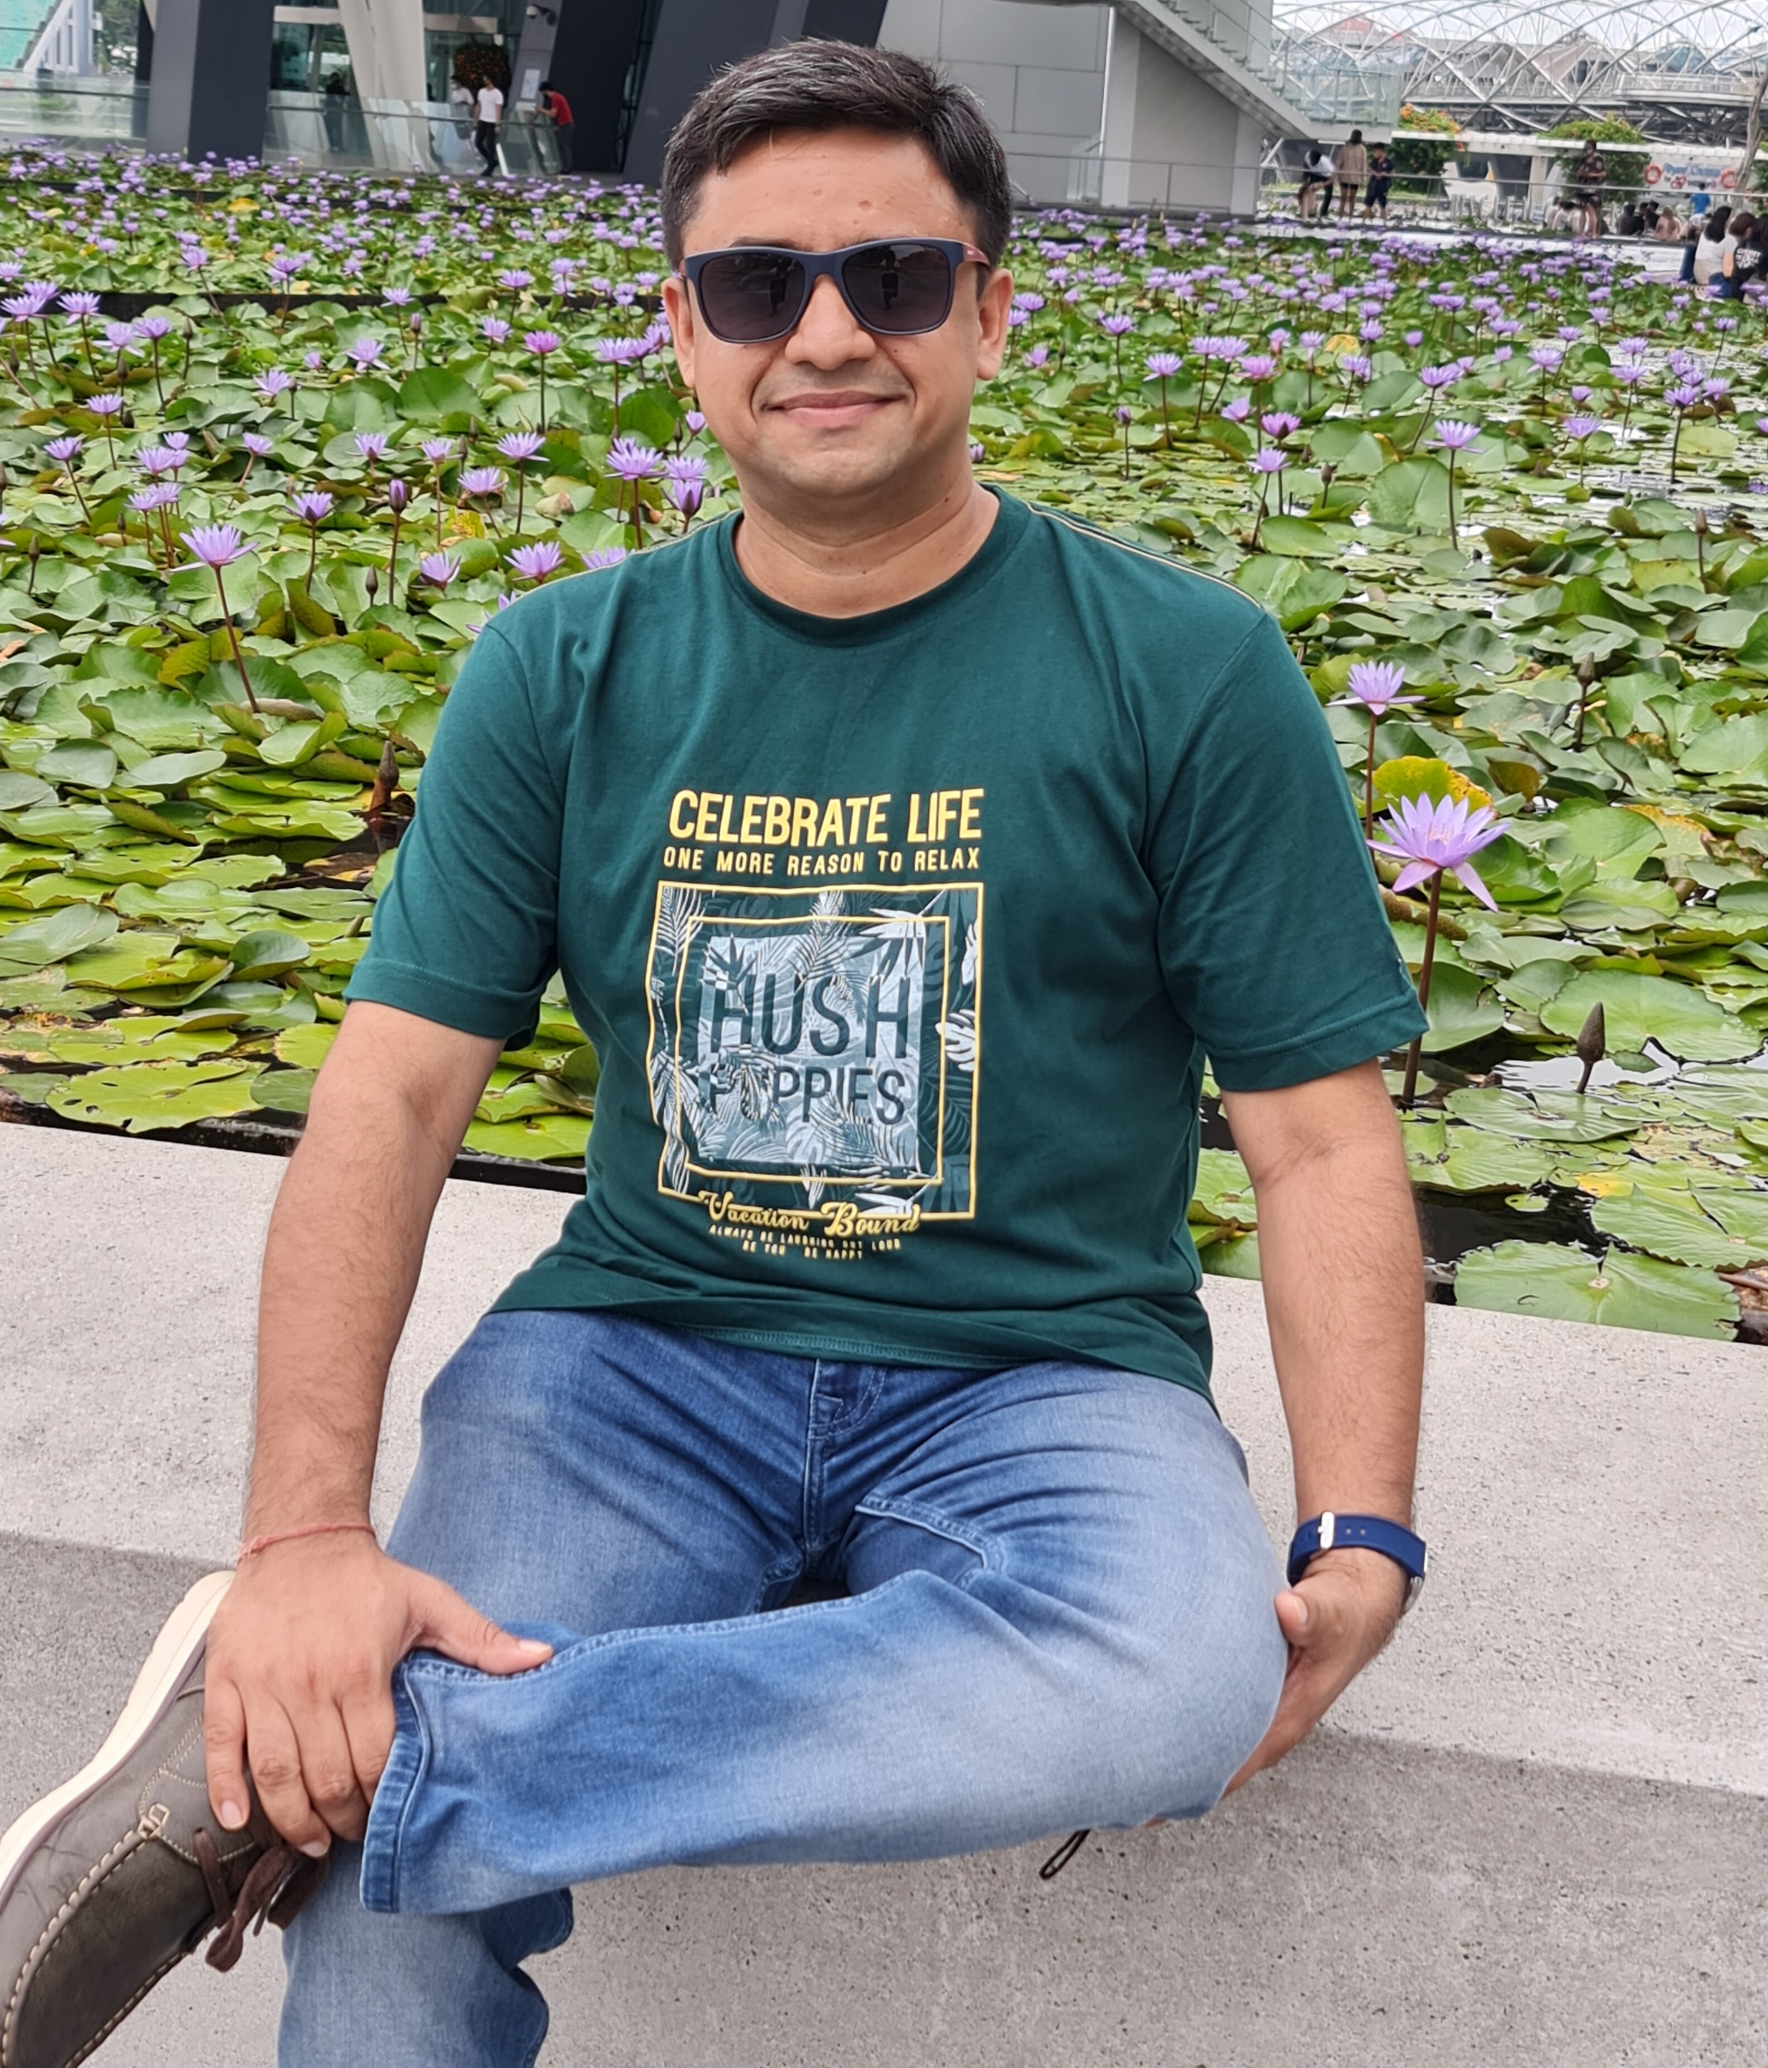
About Me
Hi, my name is Gaurav Bansal. I am an INDIAN national and currently staying & working in Singapore since 2018.
I’ve been a developer for more than 12 years & following the blockchain space since last 4 years and have worked on some projects in multiparty systems & design some solutions using the frameworks like Hyperledger Fabric, Enterprise Ethereum, etc.
I have strong foundations in Supply Chain, Manufacturing & Traceability domains and currently working on a project which is based on blockchain powered Supply Chain Financing & Traceability solution to cater the needs of Suppliers, BUs & End-users with a sustainable model.

Slide 2
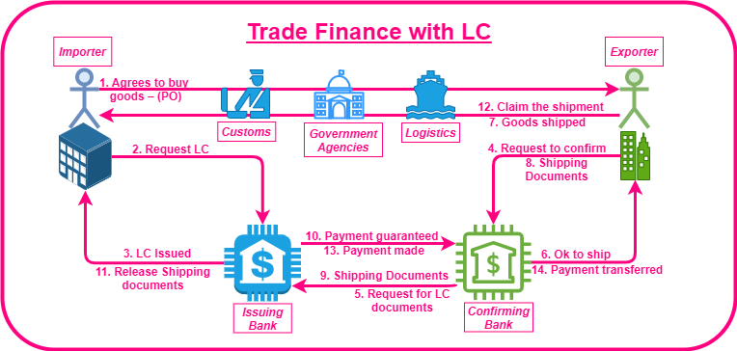
Problem Statement

Slide 3
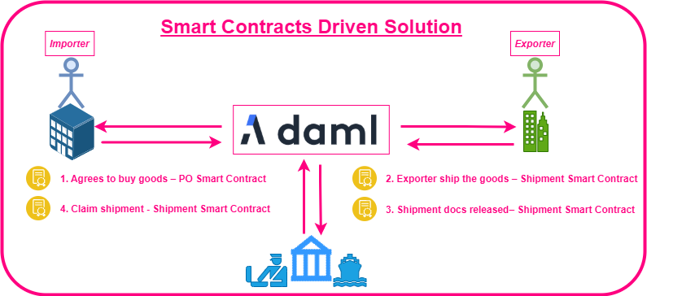
Proposed Solution

Slide 4
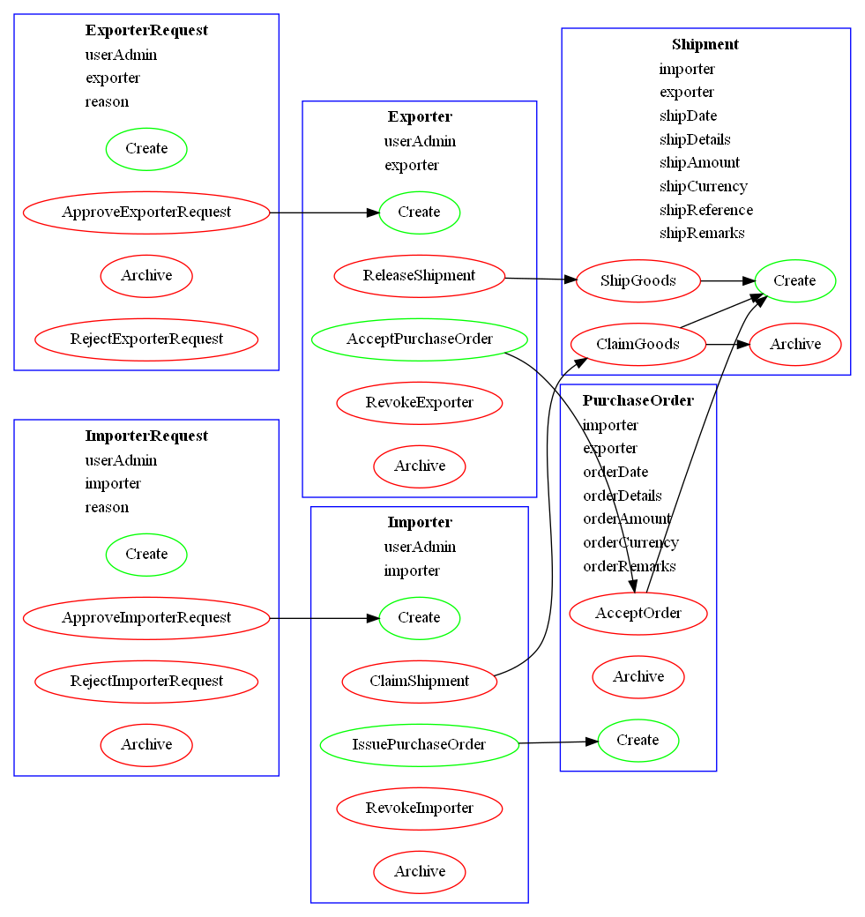
DAML Design

Slide 5
Links
Code on Github
DAML Hub Ledger ID: rwhqawm98vuyuqua
Video Link

