Slide 1

New Generation in WSCC
Presentation
January 31, 2000
Proprietary and Confidential 5/02

Slide 2
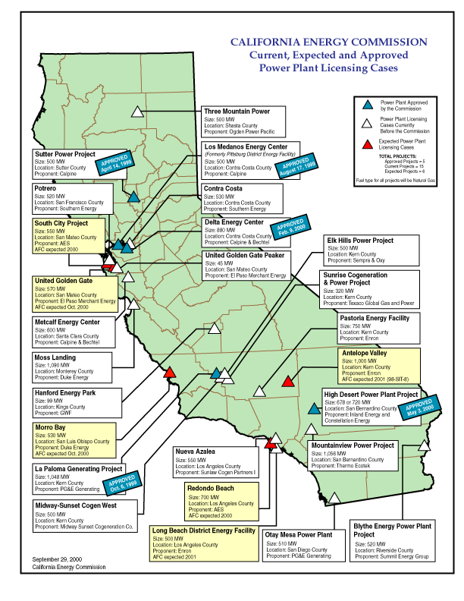
California
High Probability Plants: (UC) Under Construction (AP) Approved by CEC
  Seawest, 16 MW, Mar 2001(UC)
  Sutter, 500MW, Jun 2001(UC)
  Los Medanos, 500 MW, Jul 2001 (UC)
  La Paloma, 1,043 MW, Nov 2001(UC)
  Delta, 880 MW, Jul 2002 (UC)
  Moss Landing, 1,090 MW, Sep 2002(UC)
  Elk Hills, 500 MW, Jul 2002
  High Desert, 720 MW, Jan 2003 (AP)
  Sunrise, 320 MW, Jan 2003
  Otay Mesa, 510 MW, Jun 2003
  Pastoria, 750 MW, Jun 2003
Medium Probability Plants
  Metcalf, 600 MW, Feb 2003
  Blythe, 520 MW, Mar 2003
  Midway-Sunset, 500 MW, Mar 2003
  Contra Costa, 530 MW, Apr 2003
  Mountainview, 1,056 MW, Apr 2003
  Rosarito (Tijuana, MX), 255 MW, Apr 2003
California

Slide 3
California Electricity Updates
Lodi Gas Storage has signed a 10-year firm agreement with Calpine to provide the independent power generator with up to 4 billion cf of gas from its proposed Northern California storage facility. Financial terms of the deal were not disclosed. The capacity equals 20% of the San Jose, Calif.-based power generation company’s projected western region peak-day gas requirements for 2002. Lodi is scheduled to begin construction of the storage facility in mid-March, with service expected to launch in October.
LA Mayor Richard Riordan is offering to build a 400-MW power plant at the 1,660-MW coal-fired Intermountain Power Project in Utah and supply its power to the state. Construction estimated at $300-million, taking two years to complete.
AES Corp. asked California regulators to quickly approve a proposal to put two of the company's mothballed generating units back online after substantial refurbishment. If approved, it would add 450 MW to the grid.
Leader of the California Senate and Assembly have asked the CEC to override a recent decision of the San Jose City Court and approve the construction of Calpine Corp.'s 600-MW Metcalf power plant.
California
Notes:
CISO has reset target pricing mechanism for the real time energy imbalance market. The price of the highest decremental bids is greater than the price for the lowest incremental bid. The new price is to be greater of zero or the lowest incremental bid.

Slide 4
PNW Updates
Washington
  FPL Energy will build, own and operate a 300-MW Stateline wind project. PPM has agreed to purchase and market the entire output of the project over a 25-year period. Once the project is fully operational, more than 450 wind turbines will produce enough electricity to serve the energy needs of some 70,000 homes.
  Duke Energy North America intends to build a 630-MW, gas-fired station. Duke will spend more than $250 million to build the plant and offered $5 million purchase the 22-acre site from Energy Northwest will operate and maintain the plant once it is complete. Under the agreement, Energy Northwest will also buy up to 100 MW at production cost.
Oregon
  Klamath Falls, 500 MW, July 2000. Because tax-exempt financing was used for the project, 250 MW were set to be sold to tax exempt entities. There is still 100 MW left for sale. The plant developer is currently looking at the possibility of 250 MW expansion.
Idaho
  Rathdrum, 270 MW, 6,900 HR CC, Construction delays have pushed this online date from June 2001 to August 2001.
  Idaho Power Co has issued an RFP for 250 MW of peaking power installed by June 2004.
PNW
Notes:
Formerly (stalled) NWPE 220 MW project. FPL bought rights in 1/99. Construction to began 9/1/99 As of 4/25/00 Unit 1 not complete and gas line construction has been stalled.

Slide 5
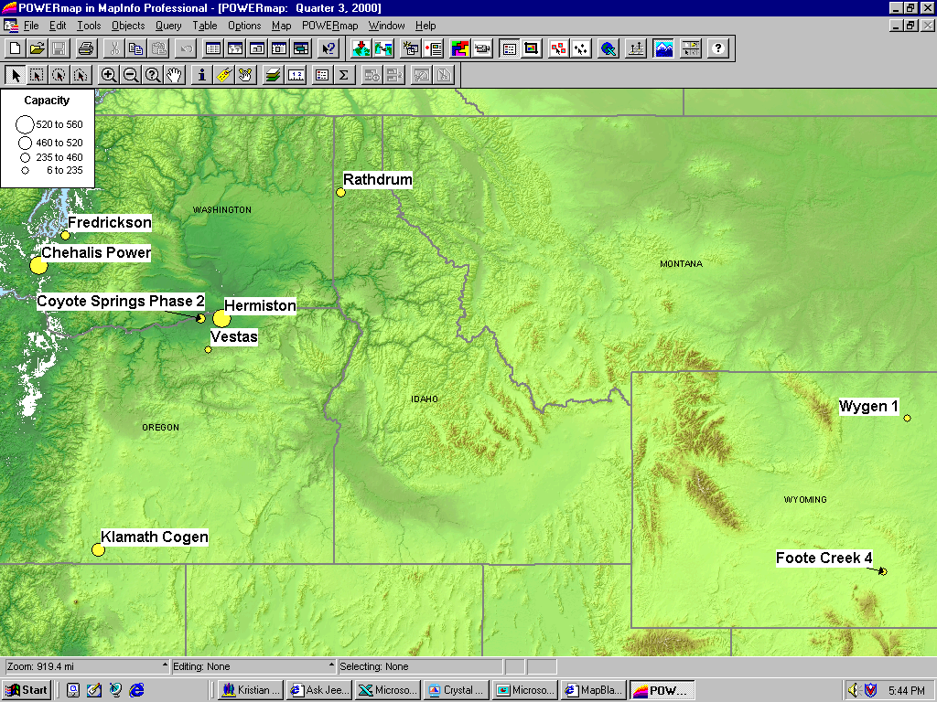
PNW New Generation Map

Slide 6
Rockies Updates
Colorado Office of Consumer Counsel claims that PSCO wasted $567 million by not building generation.(MWD 11/14/00) This did not stop the PUC from approving these purchases on Dec 14th.
North American Power Group has announced plans to invest $175 million in a new power line that would connect Colorado's Front Range with coal-fired generation resources in Wyoming and northern Colorado. If approved, the plans call for the project to be completed in 2004 and predict that 30% more power could be delivered to electricity markets in Colorado. The lines would run from northeast of Douglas, Wyoming into Colorado near Ault and south into metro Denver, according to WAPA.
Ft. St. Vrain, 235 MW (UC), June 2001. Construction has begun on this 3rd unit of existing 2 7FA converted nuke site.
Ray Nixon (Phase 2), 460 MW, May 2003. Not short listed, but will probably be built(80%).
PSCo has issued its “Recommended Plan” which shows 739 MW for 2002, 334 MW for 2003 and 516 MW 2004 for a total of 1,589MW.
PSCo has a $4.5 million DSM Request for Proposal for Bid 2001 which is roughly 362 MW.
Midway, 225 MW, Jul 2001. 6 x LM6000 Peaker. PPA signed for 11 year toll on Oct 15th. Air Permits received Oct 31st. County commission approval received Dec 14th.
Rockies

Slide 7
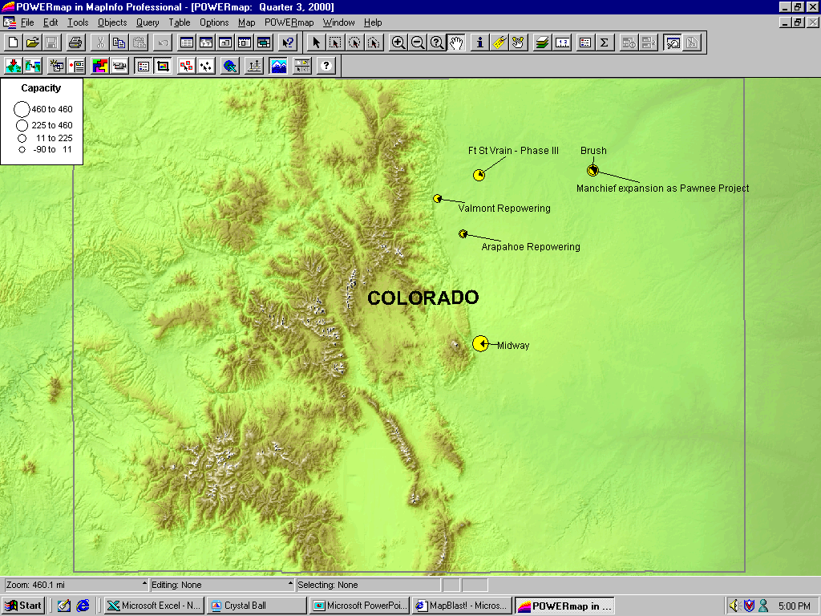
Rockies New Generation Map

Slide 8
DSW Updates
Arizona
  Red Hawk, 1,060 MW, Pinnacle West(APS), June 2002. Broke ground on Dec 19th.
  Panda Gila, 1,000 MW, Oct 2002. Project entered public notice phase on Dec 15th. Project has become a joint venture with Teco.
  Mesquite, 1,250 MW, Sempra, Jan 2003. Approval received on Dec 7th. Construction commencement is scheduled for Q2 2001.
  West Phoenix 4, 120 MW, Aug 2001. Major equipment delivery expected Dec 2000.
  Kyrene Expansion, 250 MW, Jan 2002. Expansion capacity was revised from 825 MW to 250 MW to meet community pollution concerns. Plan has expanded to a retrofit for emissions of existing units and the acquisition of local emission offsets.
Nevada
  M&N Windpower and Siemens Automation & Technology are forming a join venture to develop a wind farm in Nevada that could generate up to 260 MW. 85 MW on-line as early as 2002. Balance of generation would go into service in 2004. The project would use 325 turbines.
DSW

Slide 9
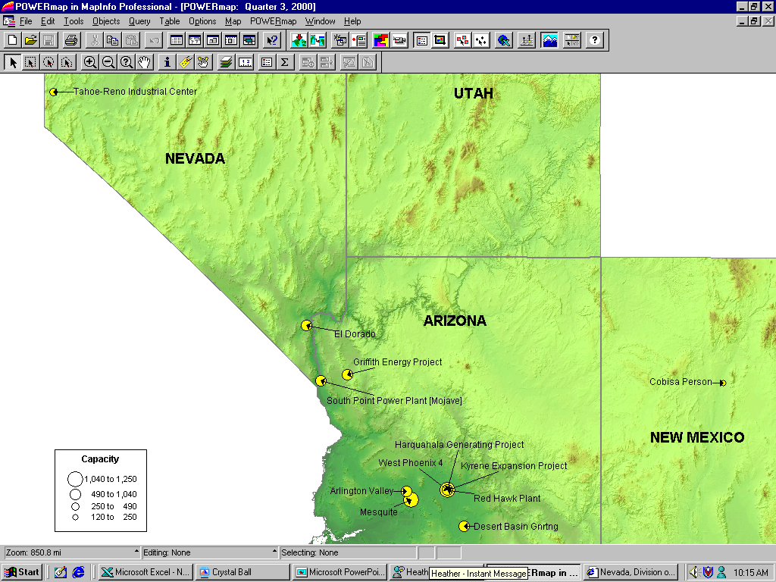
DSW New Generation Map

Slide 10
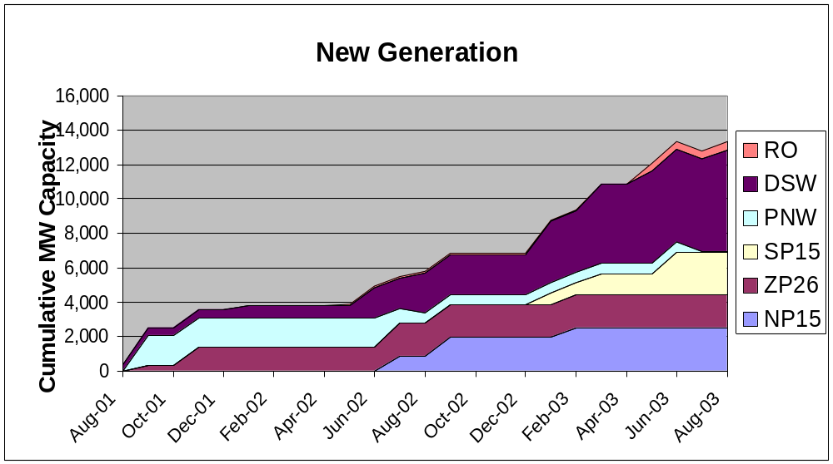
Summary
RO: Rockies DSW: Desert Southwest
PNW: Pacific Northwest
Summary

Slide 11
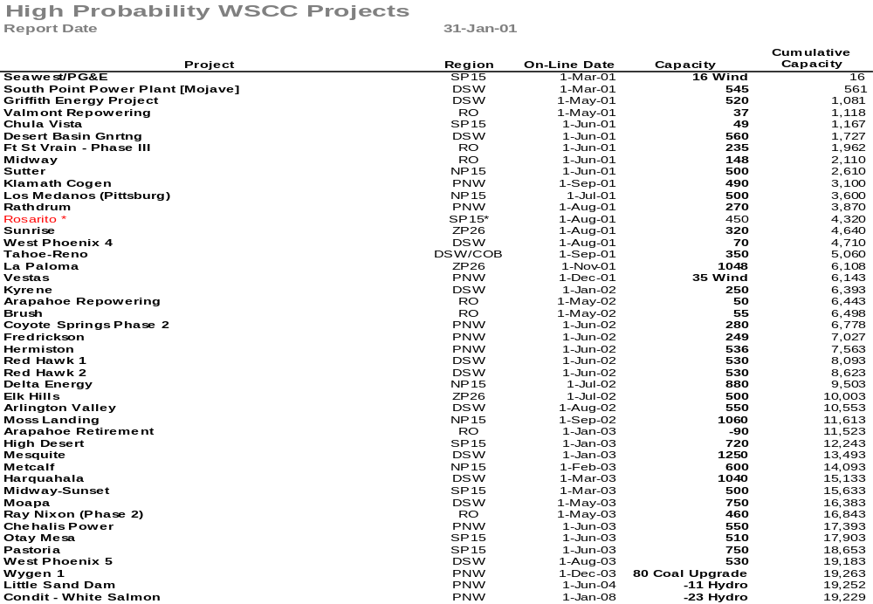
Sorted List By Date
Bold items are shown on the preceding graph

Slide 12
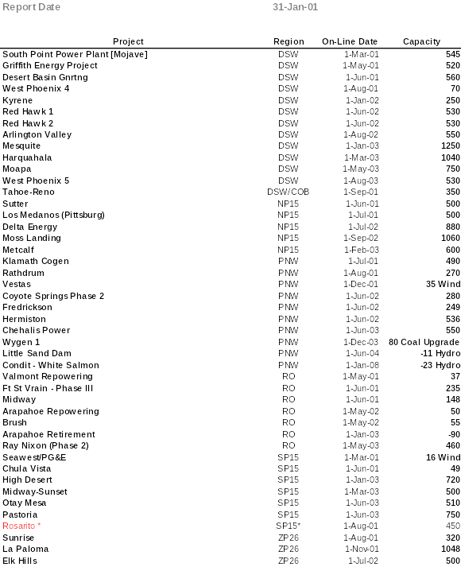
Sorted List By Region

Slide 13
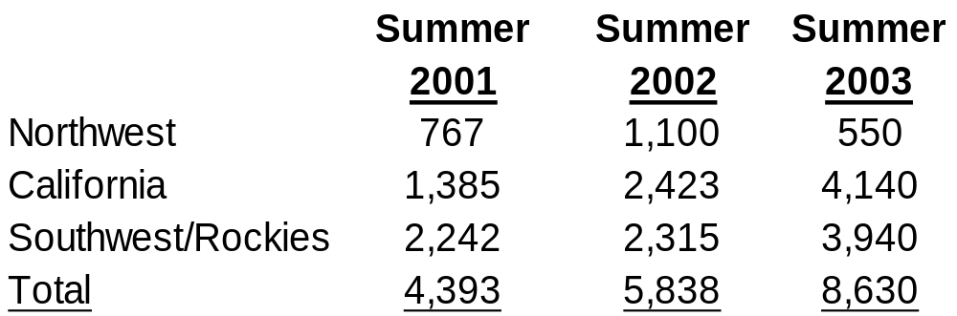
WSCC Capacity Additions
I
II
III
IV
V
VI
I. Sunrise Peaker, ZP26, 320 MW, Aug 01. Note: Rosarito(Not included), 450 MW, CFE, Aug 01. Rosarito is not connected to the CFE main grid, but it can export to SP15 during an emergency.
II. Elk Hills, ZP26, 500 MW, Jul 02.
III. Pastoria, SP15, 750 MW, Jul 03. Midway-Sunset, SP15, 500 MW, Mar 03.
IV. Valmont Repower , 37 MW, May 01. Midway changed to 225 MW, Jun 01.
V. Kyrene Expansion , changed from 825 to 250 MW, Jan 02. Redhawk 1&2, 1,060 MW, Jun 02.
VI. Moapa, 750 MW, May 03. West Phoenix 5, 530 MW, Aug 03.
Summer Summary

