Slide 1
TRADE SUPPORT SERVER
PRESENTATION TO SAPIENT
February 8th, 2001

Slide 2



Agenda
Overview of EnronOnline
Trade Support Server
Proposed Structure
Upside for Sapient
Next Steps
Discussion and Q&A

Slide 3
Overview of EnronOnline

Slide 4
EnronOnline
EnronOnline is the world’s largest e-commerce website.
  Total Life to Date Transactions > 650,000
  Average Daily Transactions > 3,600
  Life to Date Notional Value of Transactions > $400 billion
  Daily Notional Value Approximately $2.6 billion
  Average number of Logged in Users 3,000

Slide 5
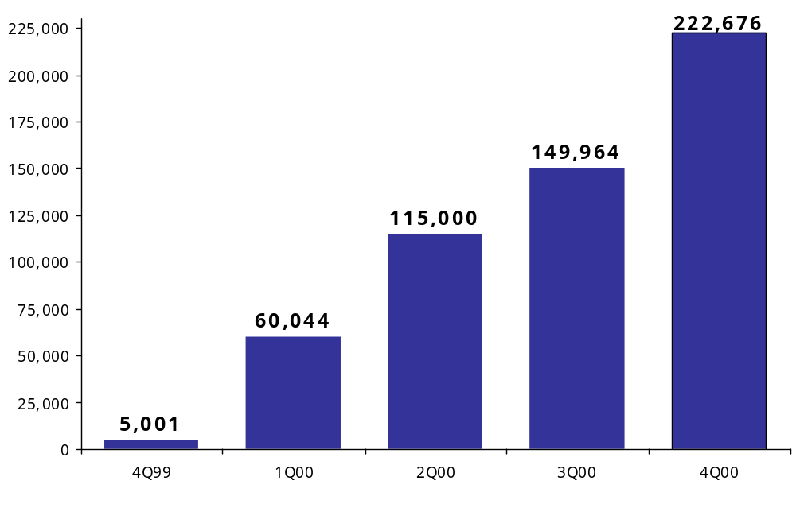
Transactions via EnronOnline
Quarterly

Slide 6
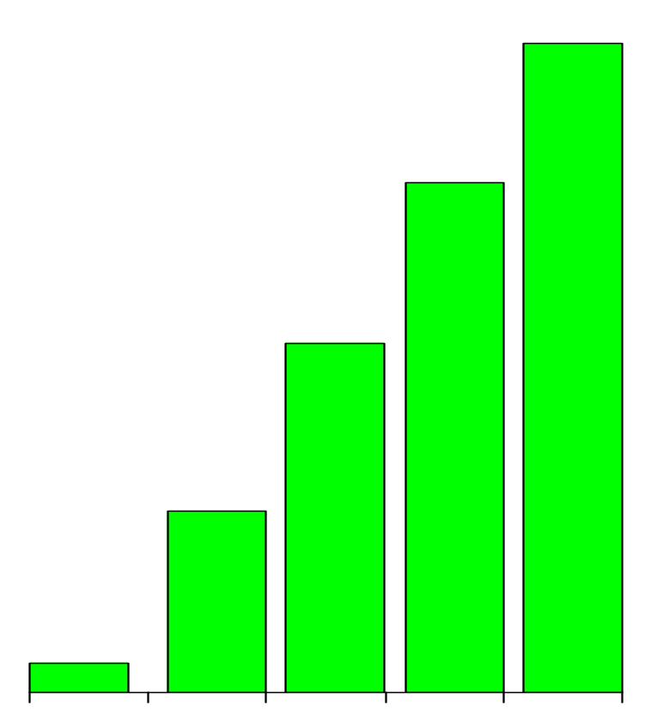
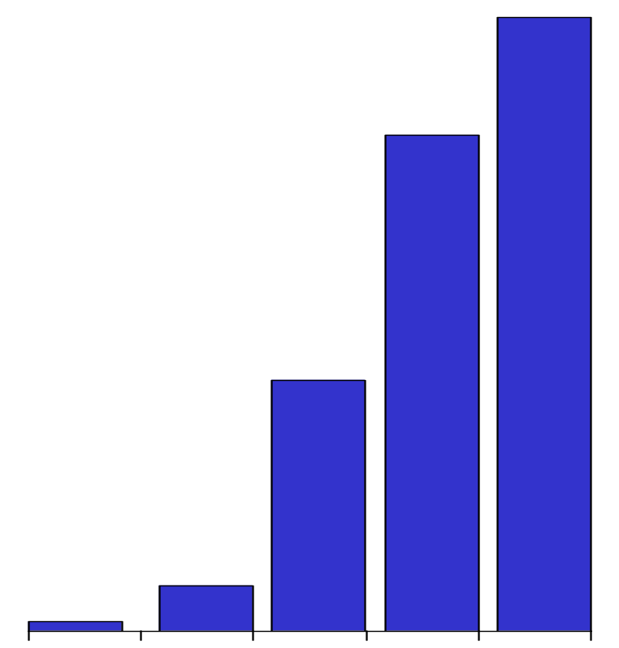
EnronOnline’s Growth
Daily Customers
(Average)
Daily Products Offered
(Average)
3,000
1,157
2,427
909
623
1,227
323
224
53
44
Q499 Q100 Q200 Q300 Q400
Q499 Q100 Q200 Q300 Q400

Slide 7
Markets Available on EnronOnline
Commodity Types
Argentine Natural Gas
Asian Crude & Products
Asian Metals
Australian & Japanese
Weather
Australian Power
Austrian Power
Bandwidth
Belgian Natural Gas
Canadian Natural Gas
Canadian Power
Credit Derivatives
Dutch Power
Dutch Aluminum
Emissions
European Coal
European Weather
German Power
International Coal
Japanese Aluminum
LME Metals Contracts
LPG
Nordic Power
Oil & Refined
Products
Petrochemicals
Plastics
Pulp & Paper
Sea Freight
Spanish Power
Swiss Power
UK Metals
UK Natural Gas
UK Power
US Gas Pipeline Capacity
US Lumber
US Metals
US Natural Gas
US Power
US Steel
US Weather

Slide 8
Trade Support Server

Slide 9
Trade Support Server
Long Term
Liquidity
EnronOnline’s Strategy
TSS
Spot
Basic
Value Added
Transactional Services
Notes:
Where we are, where we want to go:
Today: RFQ –current tech within i2/Aspect/Supplybase
Immediate future: Auctions – In development with RCP, Open1st, Aspect
Near term: Futures Exchange – Dynamic pricing marketplace which will also create sales opportunities for private marketplaces of design and source, SCM software

Slide 10


Trade Support Server
Provide EnronOnline customers with a cost effective solution to integrate their transaction data into their management, logistics, and back office systems.

Slide 11
Value Proposition
Reduce errors
  Elimination of key-strokes reduces the risk of expensive data input errors.
  Catching just one error pays for the entire project
  Must companies devote substantial contingencies in their budgets to account for errors
Efficiency (Time Saving)
  Customers have large staffs (mid-office, back-office, settlements) devoted to the input and checking of trade data.
Real time trade data enables better controls
  Price risk
  Credit risk
  Enables real time position management

Slide 12

Proposed Solution
Trade Support Server, along with Transaction Data Feeds will allow clients to:
  Upload transaction data information directly into existing back-office systems
  Electronically confirm trades
  Eliminate redundant data entry and data entry errors.

Slide 13
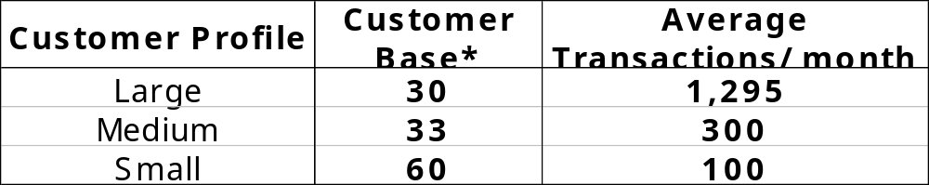
Target Market
EnronOnline has active traders in its Customer base in need of these type of services.
* This is not the total number of EnronOnline’s registered customers. It only represents approximate number of customers

Slide 14
Proposed Structure

Slide 15
Framework
The Trade Support Server will be licensed to one or more System Integrators.
System Integrators will implement the server for our clients and will be paid directly from the customer for implementation.
Once the client has ‘Trade Support Server’ linked to their risk management system, customer can buy EnronOnline’s transaction feeds on a per trade or a license basis.
Other value added services will be provided by EnronOnline

Slide 16
Schematic Overview
Client Firewall
Client Risk
Management System
TDF
EnronOnline
Trade Support Server (“TSS”)
EnronOnline
Transaction Database
Client Enterprise Resource Planning System

Slide 17
What would a System Integrator bring ?
A System Integrator would bring:
Experience and Infrastructure
Neutrality to customers interests
Strong relationships with the target customer group
  Sales process will be faster and more credible
  In many cases, you are already familiar with customer’s systems

Slide 18
Upside for Sapient

Slide 19
EnronOnline's Advantages
EnronOnline is uniquely positioned to offer this service:
  EnronOnline captures 40% of the daily transactions in the Wholesale Energy Market.
  EnronOnline has a large customer base.
  EnronOnline customers include all the major industry players.
  EnronOnline offers a large diversity of commodities.

Slide 20

Why Partner ?
Significant integration revenues
Increase your current customer base
Strengthen your relationship with many of your existing customers
Open the door for future business opportunities
Ongoing revenue channel via TDF

Slide 21
Business Potential
If we consider that:
  Potential Customers: 63
  Average consultancy fee/hour: $250
  Average number of consultants in shop: 6
  Project Duration (Integration Process): 60 days
Then:
Revenue from Integration > $ 56 Million

Slide 22
Next steps

Slide 23
Business Proposition
System Integrator pays up front fee to Enron for unlimited license for TSS technology
The license will be exclusive to a few System Integrators
Once the system has been implemented clients can subscribe to EnronOnline’s transaction data feeds and auto-confirm services
Pricing structures for these data feeds will be decided up front in discussions with System Integrator

Slide 24
Timeline
STAGES
1. Concept Introduction
2. Solicit License Fee Structure and Bids
3. Selection of System Integrators
4. Product Testing
5. Implementation
6. Commercial “Roll-Out”
DATES
February 5th to 16th
February 19th to 23th
February 28th
March 1st to 9th
March 12th to 30th
April 1st

Slide 25
Discussion and Q&A

