Slide 1
Sourcing and Auctioning Services
February 2001

Slide 2
Agenda.
Sourcing & auction services overview
Accenture sourcing scorecard
Our eSourcing solutions

Slide 3
Key Take-aways
Accenture brings you a unique blend of sourcing and auctioning experience, business relationships and technical infrastructure.
Our experience in applying strategic sourcing techniques within B2B exchange environments is unmatched.
We have the technical advantage by providing two leading web-based dynamic pricing solutions (commerce one and moai).
Accenture continues to push the envelope by developing emerging technical solutions to real-world business problems.

Slide 4
Accenture is the leader strategic sourcing and auction services provider globally.
Accenture Dynamic Pricing Services Fact Sheet
Over $1 Billion in auction volume in CY00 delivering over $200M in direct annual savings
Over 31 distinct commodity categories (both direct and indirect)
Over 80 experienced auction staff, with 400 experienced strategic sourcing consultants and 2,600 supply chain experts deployed globally
Four native languages spoken in DPS-deployed personnel (English, French, German and Spanish). Brazilian-Portuguese supported by our offices in Rio de Janero and São Paulo Brazil.
DPS Operational centers with dedicated staff in Palo Alto, Chicago and London; Accenture offices in 49 countries globally.

Slide 5
The Following Diagram Provides a Useful Framework for Understanding the Various Dynamic Pricing Applications.
Uses
Market Making
Sales
Procurement
eMarket Operators (Industry Consortia, Net Market Makers) – Auction product is the basis of the customer’s business model
eMarket Operators
Customers
Companies
Corporations – Auction product used primarily for the benefit of a single company
Market making – Many-to-many auction events
  Increased efficiency of fragmented markets
  Transaction volume or bid/ask-spread revenue model
Sales – Forward auctions
  Inventory liquidation
  Sale of excess capacity
  Commodity finished goods
Procurement – Reverse auctions
  Reduced cost of goods and services procured
  Total cost of ownership

Slide 6
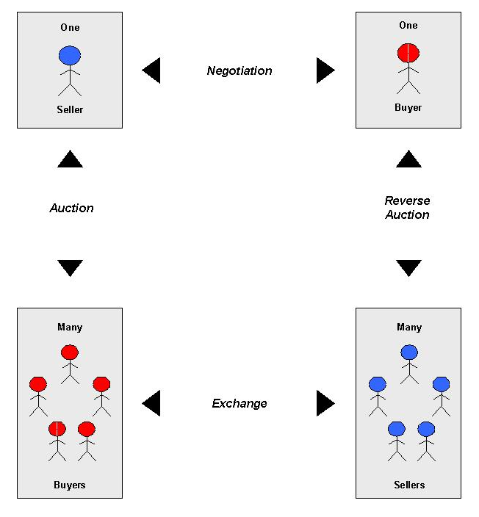
Dynamic pricing supports four different types of interactive between buyers and sellers.
Negotiation
Single entities engage in one type of interaction (e.g., negotiation of long-term contracts )
Forward auction
Buyer(s) bid on goods or services supplied by the auction host.
Prices typically rise until auction ends
Example products include surplus equipment, rare art, or airline seats
Reverse auction
Supplier(s) bid on the opportunity to sell goods or services to the auction host
Prices typically fall until auction ends
Example products include almost any direct or indirect materials used by the auction host
Exchange
Interactive networks allow buyers and sellers to exchange goods/services in a virtual marketplace
Prices fluctuate with supply/demand balance
Products are typically constrained to commodity goods

Slide 7
Up-front Sourcing Work Drives Sourcing Strategy Formulation– Although the Majority of Products and Services Are Appropriate for Eauction, Unique Supply Market Conditions May Require Alternative Strategies.
Spot Buy or Long-Term Contracts t
Illustrative Example
1) simple auction event
  Non-price parameters are static
  Discuss non-price cost drivers in advance and post on the site as conditions of the auction event
  Multi-lot auctions are included in this category
2) complex auction event
  Total-cost-of-ownership analysis drives weighted calculation of summary bid parameter
  Bidders maintain flexibility to “give”on the parameters that they have flexibility to control
  Multi-parameter, multi-lot, and multi-round auctions are included in this category
3) sealed bid / private offering
  Applies primarily when few suppliers or only one supplier is available
  Limited application
4) structured negotiation / erfq
  Modification of traditional multi-round supplier negotiation process
  Limited application
5) not appropriate for competitive supplier selection
L
Complex Auction Event
Simple Auction Event
1
Real-Time Dynamic Pricing
(eAuction)
2
Supply Market Complexity
Structured Negotiations
eRFQ
Sealed Bid /
Private Offering
4
3
5
H
H
L
Product/Service Complexity
Static Pricing

Slide 8
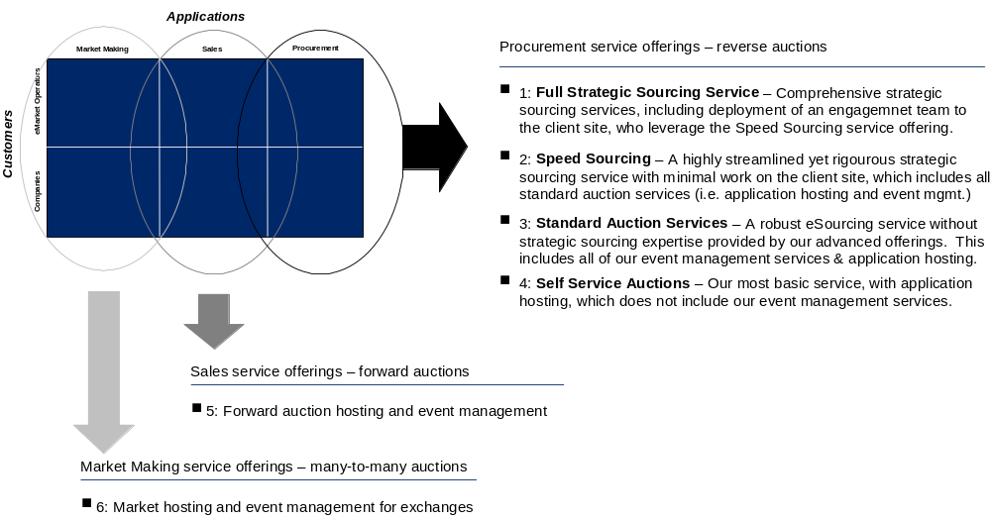
We have Six core service offerings which produce immediate bottom-line impact .

Slide 9
Conducting successful eSourcing events require seamless integration of four key capabilities
Procurement
Market Making
Applications
Procurement
Sales
eMarket Operators
Customers
Companies
End Customer
Supplier
$ Savings $
1
2
Auction Event Mgmt.
3
4
Strategic Sourcing
Software Hosting
Technology Application (Software Tool)
Spend analysis
Requirements definition
Baseline development
TCO model analysis
Supplier value proposition unbundling
Identification/ qualification of supplier participants
Auction variable choice
Auction event strategy development
  Timing/duration
  Transparency
  Lot division
  Variable sequencing
  Bidding format
  Min bid increment
Host/originator training
Event monitoring/ set-up
  Bidder training and set-up
  Real-time communication
Post-event reporting
Hosting facility
Hardware systems
Security
Failure management
Throughput management
Communications
Branded auction application
Implementation of auction software, alone, will not produce significant savings.

Slide 10
Each offering provides incremental services .
Full
Strategic Sourcing
Full Strategic Sourcing Service
Historical spend assessment and data collection
Product/service category prioritization and development of sourcing strategy
Detailed Total-Cost-Of-Ownership analysis and model development
Client eAuction process setup and organizational coordination
Client internal promotion of the eAuction program
Speed Sourcing
Conduct category kickoff meeting
Conduct commodity/industry analysis
Advise client on development of total-cost-of-ownership model
Develop auction strategy
Identify new suppliers, create RFI & help select final bidders
Tailor client RFQ for eAuction environment
Standard Auction Service
Auction event strategy assistance
Auction variable choice assistance
Hosted application
Host/bidder training
Bidder tech support
Event monitoring/setup
Post-event reporting
Self Service Auctions
Hosted Applications
Event set-up using parameters supplied by client
Emergency technical support during event only
Speed
Sourcing
Standard
Auction
Service

Slide 11
Our competitors focused on point solutions -
Accenture maximizes results cross ALL product category and supply market situations.
L
Complex Auction Event
Simple Auction Event
Many candidate suppliers
Accenture - DPS
Free Markets
Auction Technology
Providers
Supply Market Complexity
eFQ Technology
Providers
Few candidate suppliers or single supplier
H
Structured Negotiations
eRFQ
Sealed Bid /
Private Offering
H
L
Product/Service Complexity
Products with low-complexity specifications
Difficult to specify or designed-in products

Slide 12
We deliver Maximum Flexibility and Superior Value to our clients as business neds change ..
Relationship life cycle – Illustrative
Self service forward and reverse auction events
Pilot
Full-Service hosted auction events
In-house installation of eAuction tool
“Make-Buy” decision
Full-Service hosted auction events
Value proposition
Demonstrate service offering value
Deliver dramatic reduction in total cost of purchased goods and services
Enhance revenue and reduce trasaction costs associated with sale of excess inventory or commodity finished goods.
Implement auction tool in house
Capitalize on learning gained during full-service hosting period
Conduct majority of auction events in self-service mode without on-going hosting fees
Minimize long-run cost of sourcing/ eAuction events
Leverage Accenture category expertise, sourcing expertise, and auction expertise on as-needed basis

Slide 13
For our Exchange Partners, we offer a unique value proposition
Flexibility in our offering and teaming approach
Broad industry relationships and a sales channel that can be leveraged to drive rapid adoption of the exchange auction service offering
Service offerings that are tailored for the exchange environment
Extensive eauction experience
Industry-leading strategic sourcing expertise and knowledge base
Deep industry and commodity-specific expertise
Global size and scope
  Unique ability to scale rapidly
  Immediate international presence

Slide 14
Agenda.
Sourcing & auction services overview
Accenture sourcing scorecard
Our sourcing solutions

Slide 15
Accenture Is the Leader Strategic Sourcing and Auction Services Provider Globally.
Accenture Strategic Sourcing
and Auction Services Fact t Sheet
1996-2000
Over 200 global fortune 1000 clients, with over 50 clients in 2000
Conducted sourcing assessments on over $1 trillion in spend
Over 3000 experienced consulting personnel
Over $25 B in negotiated commodity spend and over $3 B in annual savings
Over 200 distinct commodities negotiated accenture across direct and indirect materials

Slide 16
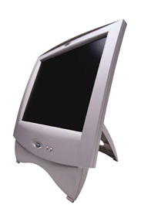
Our Unparalleled Assets — Knowledge Sharing Technology, Internal Networks, Practice Tools — Ensure That Sourcing Personnel Are Kept on the Leading Edge and Can Inject Creativity Into Their Work.
Sourcing and Auctioning Practice Assets
Procurement
Technology
Global
Sourcing Strategy
Accenture
Engagement Experience
Internet-based Solutions
eProcurement Strategy and Implementation
Alliances with eProcurement and ERP Software providers
Procurement Cards
Sourcing Strategy
Currency Exchange
Transportation
Alliance Development and Implementation
Proposals
Engagement Summaries
Workplans
Deliverables
Lessons Learned
Procurement
Best Practices
Methodologies
and Techniques
Supplier
Management
Purchasing Strategy
Supplier Selection
Purchasing Process
Accenture counts Payable Process
Materials Management
Procurement Diagnostic
Strategic Sourcing
Market Analysis
Fact t Based Negotiation
Supplier Performance Evaluation
Negotiation Strategy and Execution
Partnership Development and Implementation
Accenture
Knowledge Exchange
Databases

Slide 17
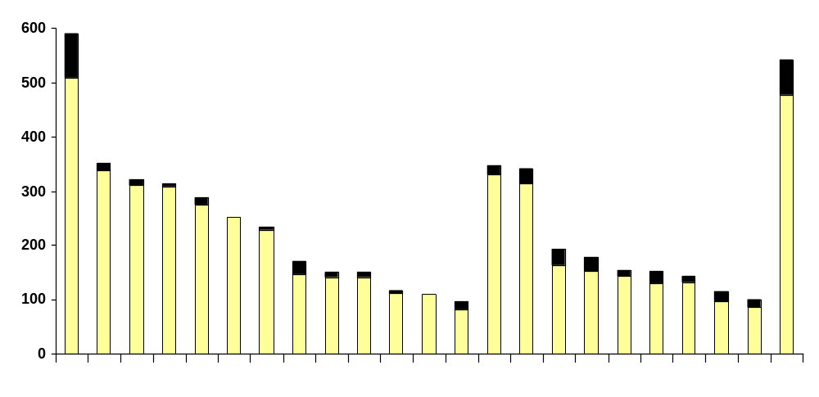
On a Project for Large Computer Manufacture, We Assisted in Reducing Cost of Direct and Indirect Materials by Almost $400 MM Annually, Covering Almost $4 B in Spending.
Direct Materials
Indirect Materials
Annual Savings
Annual Spend
Secondary
Storage
DRAMs
Semis
Mobiles
Displays
Software
Packaging
Networks
Alpha chips
Consulting
Hard Drives
Microprocessors
Interconnect
Power Supplies
Print Advertising
Repair Services
Remainder of
Indirect Mtls
(14 commodities)
Ad/Promo & Events
Factory Supplies
Contract t Labor
Other Advertising
Capital Expenditures
Remainder of Direct Mtls
(10 commodities)

Slide 18
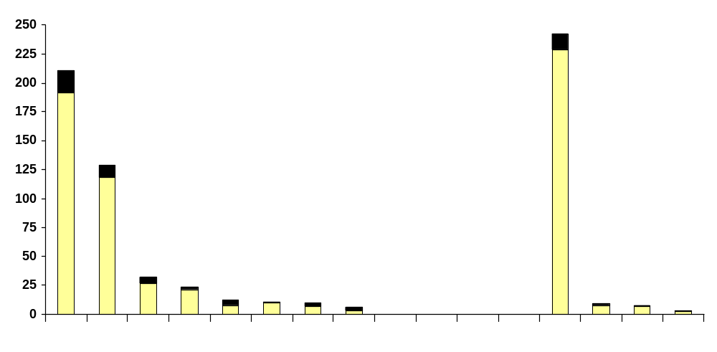
On a Current Project for a Manufacturer, Accenture to Date Has Assisted in Reducing Cost of Direct and Indirect Materials by $65 MM Annually Covering Almost $0.7 B in Spend.
Direct Materials
Indirect Materials
Annual Savings
Annual Spend
In process
In process
In process
In process
Igniters
Sensors
Capital
Expenditure/
Major MRO
PVF
Fasteners
Custom
Molded Parts
Chemicals
Plastic Resin
Various Parts
and Seals
Power Cords
Pipe Fittings
Carbon Steel
Wire Harness
Screw Machine
Parts
Stainless Steel
Small Package

Slide 19
The Strategies Used to Reduce the Cost of Materials and Services Are Complex As They Are Based on the Internal Approach H in Combination With the External Market Conditions .
Purchase Category Strategy Development Framework
Exploit / Create Market Leverage
Outsourcing
Local Purchase
Spot
Competitive Bid
Alliance
Supplier Programs
Supplier Base Rationalization
Changing the approach to an external supply market in order to reduce unit cost. A portfolio of approach are available to create this change
Bundling
Change Supply Characteristics
Portfolio Pricing
Standardization
Internal changes or accommodations allows the capture of lower total costs
Specification
Change
Logistical Improvements

Slide 20
Our deep eAuction experience base extends across industry segments and product/service categories.
Example commodity categories
Example industry verticals
  Industrial chemicals
  Refining process consumables
  Pipes, Valves & Fittings
  Gas cylinders
  Transportation services
  Seismic services
  Contract labor services
  Complex Machinery
  Casings
  Packaging
  Telecommunications
  Microprocessors
  Sub-assemblies for consumer durable goods (direct materials)
  PC consumables
  IT Hardware
  Stationery
  Water meters
  Numerous food commodities
  Automotive
  Airline
  Consumer goods
  Distribution/Logistics
  Food production/Hospitality
  Energy
  Mining
  Petrochemicals
  Utilities

Slide 21
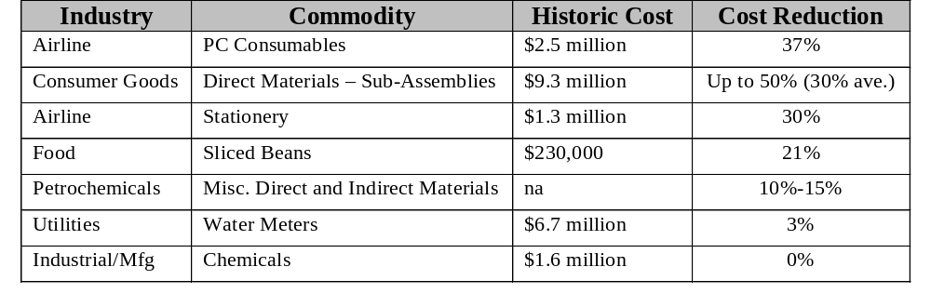
Our experience suggests that reverse auction savings results are heavily influenced by the level of strategic sourcing Accenture conducted in advance of the eAuction event.
Representative sample of savings achieved through reverse auctions
Full-Service Strategic Sourcing
Accenture Standard Auction Services (With Minimized Sourcing)
Client Self-Service (No Sourcing)
Results are highly correlated with the level of Strategic Sourcing effort invested to prepare for the auction event. Coordination of the souring effort with the auction strategy is another key success factors.

Slide 22
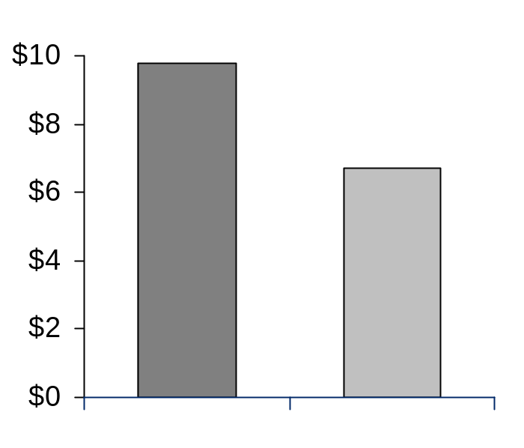
Case study #1 (direct materials): Global consumer products manufacturer.
Scenario: Two hour reverse auction for 2-year contract for manufacturing direct material purchase
Auction Details
Cost Savings
100+ SKUs divided into 8 lots
21 global suppliers (US, Canada, China, Taiwan, and Singapore represented)
267 total bids
2 hour auction timeframe with extensions if activity occurred in final 5 minutes
Millions
$9.8
31.1%
Savings
$6.7
Historic Cost
Winning Cost

Slide 23
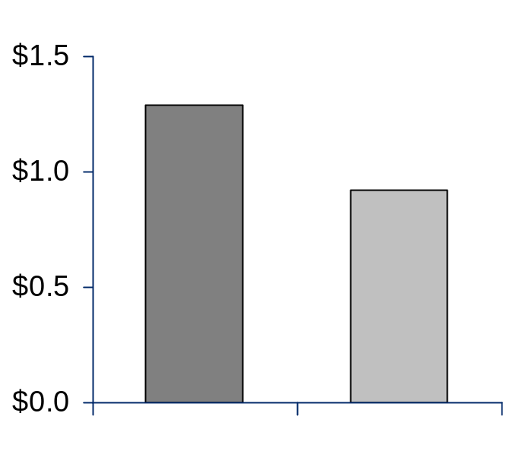
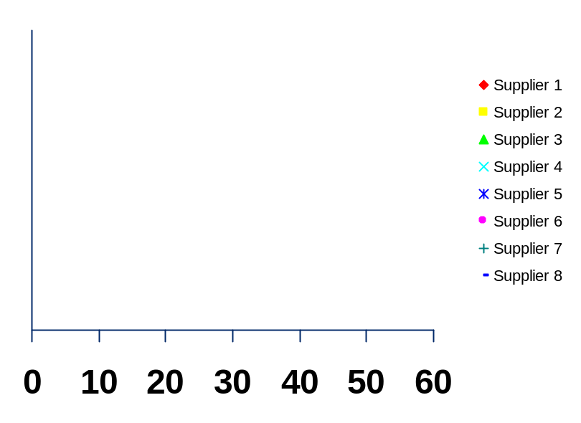
Case Study #2 (Indirect Materials): Global Airline.
Scenario: One hour reverse auction for stationery supplies
Competitive Reaction During Auction
Cost Savings
Millions
Millions
$1.4 -
$1.29
30%
Savings
$1.3 -
$0.92
$1.2 -
$1.1 -
$1 -
60
50
40
30
20
10
0
Historic Cost
Winning Cost
Bid Time Remaining (minutes)
8 suppliers, 49 total bids
The winner bid 10 times with an average price drop of $46k per bid

Slide 24
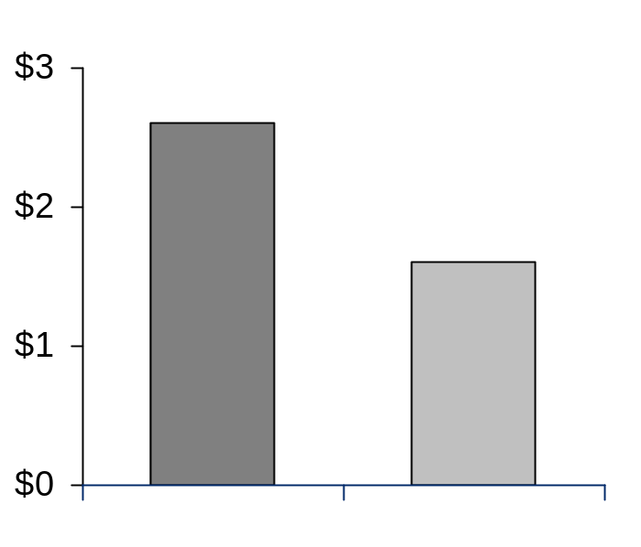
Case Study #2 (Indirect Materials): Global Airline (Cont’d).
Scenario: One hour reverse auction for PC Consumables
Competitive Reaction During Auction
Cost Savings
Millions
$3.0 -
Millions
Supplier 1
$2.6
37%
Savings
$2.5 -
Supplier 2
Supplier 3
Supplier 4
$2.0 -
Supplier 5
$1.6
Supplier 6
Supplier 7
Supplier 8
$1.5 -
Supplier 9
60
50
40
30
20
10
0
0
10
20
30
40
50
60
Bid Time Remaining (minutes)
Historic Cost
Winning Cost
9 suppliers, 46 total bids
Winner bid 10 times with an average price drop of $106k per bid

Slide 25
Agenda.
Sourcing & auction services overview
Accenture sourcing scorecard
Our sourcing solutions
  Business overview
  Solution demo
  Technology roadmap

Slide 26
As an Extension to Our Eprocurement Market Offering, Accenture Has Created a Dedicated Eauction Service Organization – Dynamic Pricing Solutions.
Our offerings are built upon accenture deep experience base, our extensive knowledge capital in procurement and sales functions and our cross-industry breadth
We are a first mover in real-time dynamic pricing solutions. Our solution has been “live” in our palo alto, CA and kensington, UK hosting facilitates since fall ‘99
Our sourcing and dynamic pricing solutions teams provide the complete solution
  Expert teams distributed globally
  Proven processes
  Hosted technology – no software installation or up-front technology investment required
Our substantial reference list includes leading-edge fortune 500 clients

Slide 27
We have Six core service offerings which produce immediate bottom-line impact .

Slide 28
Accenture‘s Six turn-key offerings have compelling value propositions
Procurement applications – reverse auctions
  Leverage the real-time dynamic pricing environment to dramatically reduce the cost of purchased goods and services
  Accelerate benefits and compress the time-line of strategic sourcing projects by 4-12 weeks
  Reduce administrative costs for bid/quote activities
Sales applications – forward auctions
  Leverage the real-time dynamic pricing environment to obtain higher selling price and increase channel control
  Improve process efficiencies and reduce transaction costs
  Establish auction events for market price discovery
Market making applications – many-to-many auctions
  Establish efficient markets for buyers and sellers of commodity goods
  Generate revenue stream through transaction fees, subscription fees, and/or advertising
5%-40%+ cost reduction
50%-60% reduction in bid-quote cycle
2%-5% lower admin costs
Sell excess/obsolete inventory at 65-80 cents on the dollar versus 20-30 cents typically paid by liquidators or resellers
Create an on-going revenue stream with low resource/maintenance requirements

Slide 29
Agenda.
Sourcing & auction services overview
Accenture sourcing scorecard
Our sourcing solutions
  Business overview
  Solution demo
  Technology roadmap
Key take-aways

Slide 30
Agenda.
Sourcing & auction services overview
Accenture sourcing scorecard
Our sourcing solutions
  Business overview
  Solution demo
  Technology roadmap

Slide 31
Accenture Is Helping Our Partners Develop Leading-edge Bidding Functionality That Mirrors Real-life Situations.
Multi-Parameter Bidding
Multi-Line Bidding
Description: Buyer and seller negotiate multiple parameters in addition to price to determine total delivered value
Description: Buyers can create complex eRFQs that contain multiple products and/or parameters
Possible Attributes:
Item
Description
Quantity
Bid
1
Price
Unit price
Shipping cost
Volume discounts
1.0
Desktop computer setup
$W/each
1.1
CPU, 700 MHz
1,000/year
$X/each
1.2
Monitor, 17 inch
1,000/year
$Y/each
2
Product
Rating
Grade/quality
Condition
1.3
Modem card
1,000/year
$Z/each
2.0
Laptop computer setup
$K/each
3
Date
Ship date
Delivery date
2.1
Laptop, 500 MHz, 13” LCD
500/year
$L/each
2.2
Modem card
500/year
$M/each
4
Financing
Terms
Leasing
2.3
Leather carrying case
500/year
$N/each

Slide 32
Moai Liveexchange Allows Buyers and Sellers to Do Online Negotiations.
Structured Negotiations
Multi-Stage Negotiations
Description: Buyer and seller negotiate in structured, threaded discussions that are tracked and recorded until a final agreement is reached
Description: Buyer negotiates with suppliers on first parameter(s) until agreed upon and then negotiates the next parameter(s). Contract awarded to “best” bid after all stages
Buyer Distributes RFQ
Supplier
Submits Bid
15 Suppliers
Documentation
Created
Buyer Negotiates Price
Stage 1: Price
Documentation
Created
Supplier Negotiates Delivery
10 Suppliers
Documentation
Created
Buyer Awards Contract t
Stage 2:
Shipping Terms
Documentation
Created
5 Suppliers
Stage 3:
Quality Level
Winning Supplier

